Slide 1
Lesson 8: line following
Seshan brothers

Slide 2
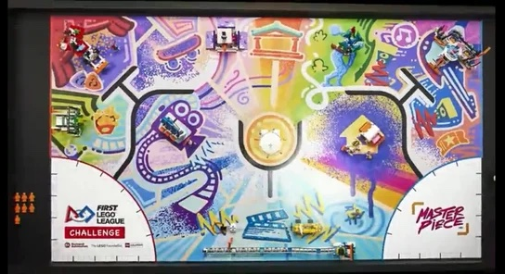
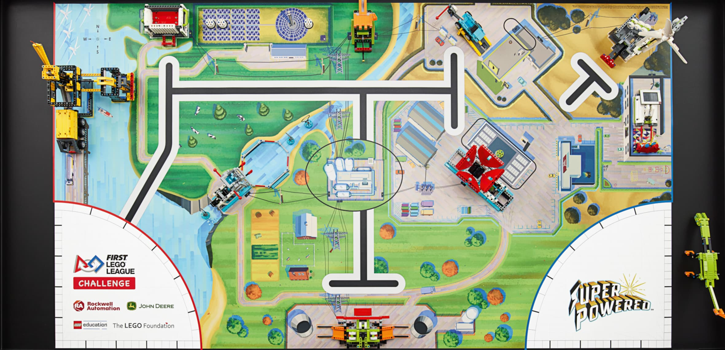
WHY is line following important?
No matter what season of FIRST LEGO League you are competing in, you will find that the challenge mat has lines
Lines can help you navigate to the far end of the board reliably
Lines can help you get to a mission model
Learning to line follow is crucial in FIRST LEGO League

Slide 3
HANDLING COLORED lines
In some seasons, FIRST LEGO League mats have had colored lines
Problem: Colored lines on the mat are sometimes not LEGO colors, meaning they are hard to detect in color mode. In addition, in reflected light mode, the red reads a very high value making it not distinguishable from white. This is because the color sensor shines a red light.
Solution: Color mode works reliably for detecting the red on the mat so color mode can be used. For the green, only reflected light will work on it because it reads a low value that is almost black.

Slide 4
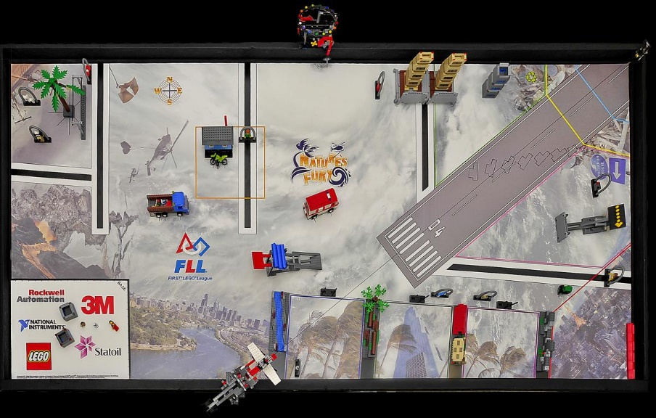
FINDING Useful lines
Lines often are designed to go to a mission model and help you navigate
If you line follow with your color sensors, you will be where you need to be
Look for useful lines to follow

Slide 5
NOT-so-Useful lines
Sometimes, lines are too close to a mission model to line follow
Therefore, you would have to apply other techniques
You don’t have to line follow on every line

Slide 6
TIPS FOR LINE FOLLOWING
Make sure you are actually on the line before you line follow
Move Until the Line
Turn a bit to become straight to the line

Slide 7
NEXT STEPS
Complete the line following lessons on EV3Lessons.com or PrimeLessons.org

Slide 8
Credits
This tutorial was created by Sanjay Seshan and Arvind Seshan
More lessons at www.ev3lessons.com, www.primelessons.org and www.flltutorials.com
This work is licensed under a Creative Commons Attribution-NonCommercial-ShareAlike 4.0 International License.

