Slide 1
Passive attachments
Seshan brothers

Slide 2
What is an attachment?
A mechanism you build that can assist your robot in accomplishing a task (e.g. pick up an object, drop off an object)
This mechanism is “attached” to the base robot
For a competition robot, the goal is to design attachments that work consistently every time and are easy to add/remove

Slide 3
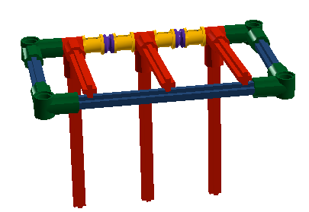
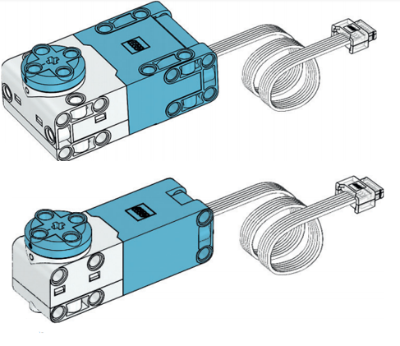
PASSIVE VS. Powered
Passive attachments do not require any external power. They typically work based on the movement of the robot or simple uses of gravity.
This lesson covers some simple types of passive attachments
Powered attachments need some type of power source. This includes power from motors, pneumatics and other sources.

Slide 4
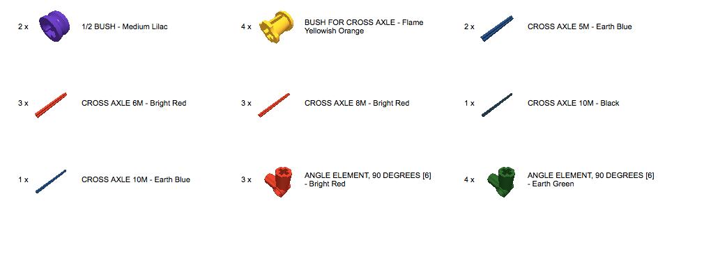
one-way Gate or curtain
Passive attachment that lets objects in but not out
Uses gravity
Can be modified to any size

Slide 5
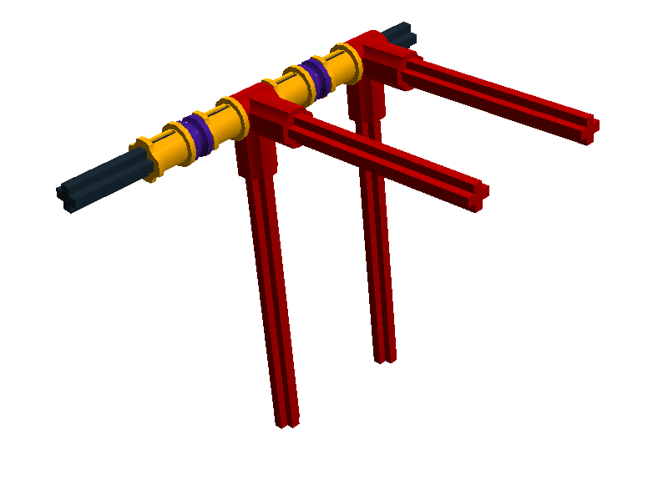
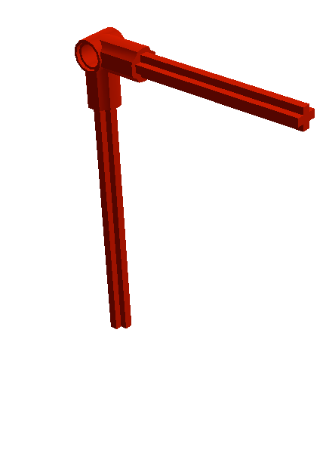
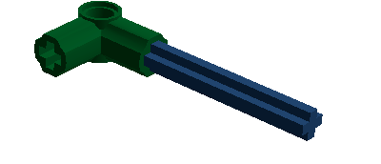
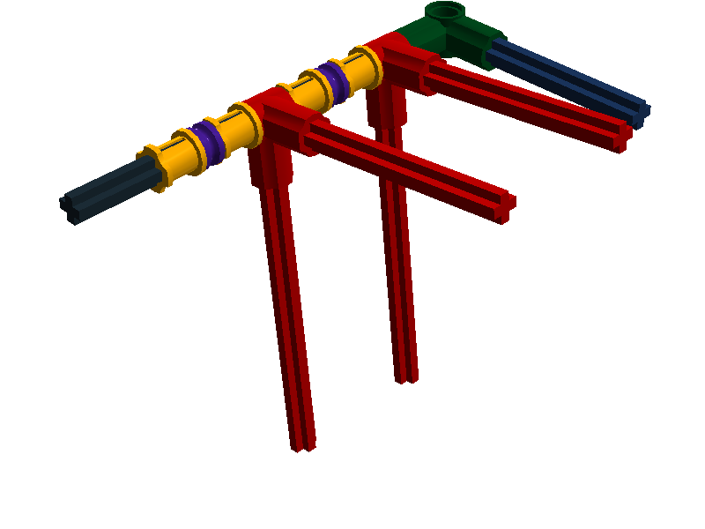
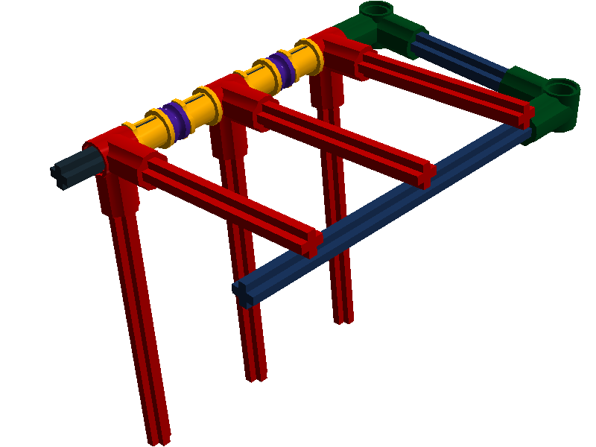
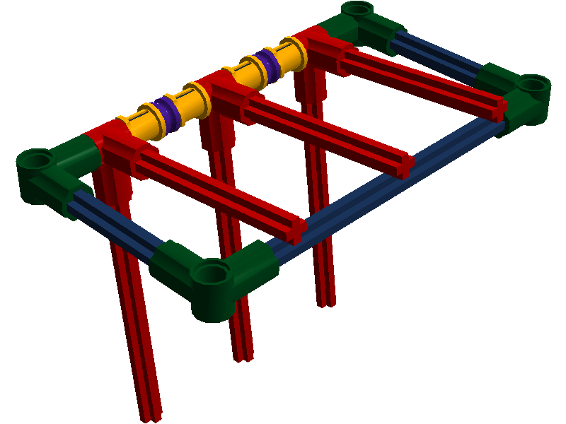
TRY Building one…

Slide 6
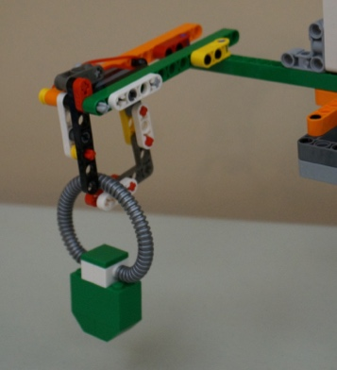
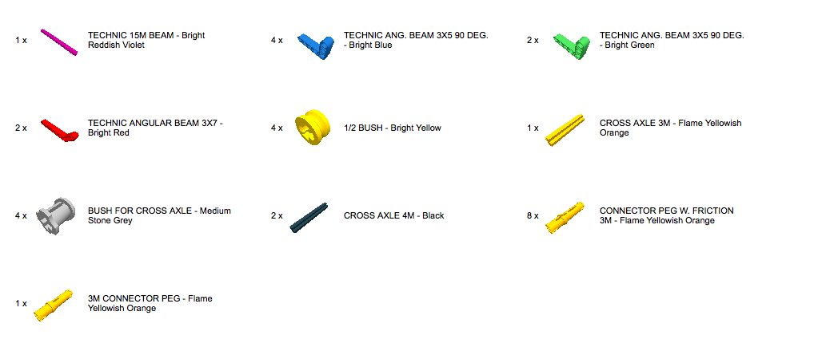
CARABiner
Passive attachment that lets objects in but not out
Can be made using gravity or using rubber bands
Can be modified to any size

Slide 7
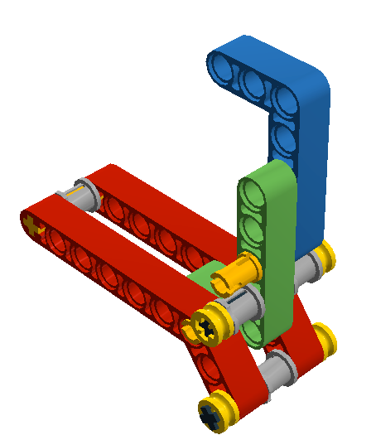
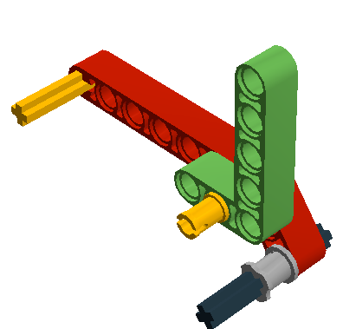
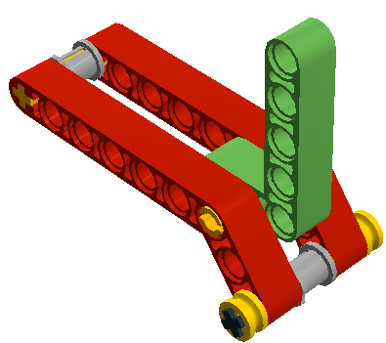
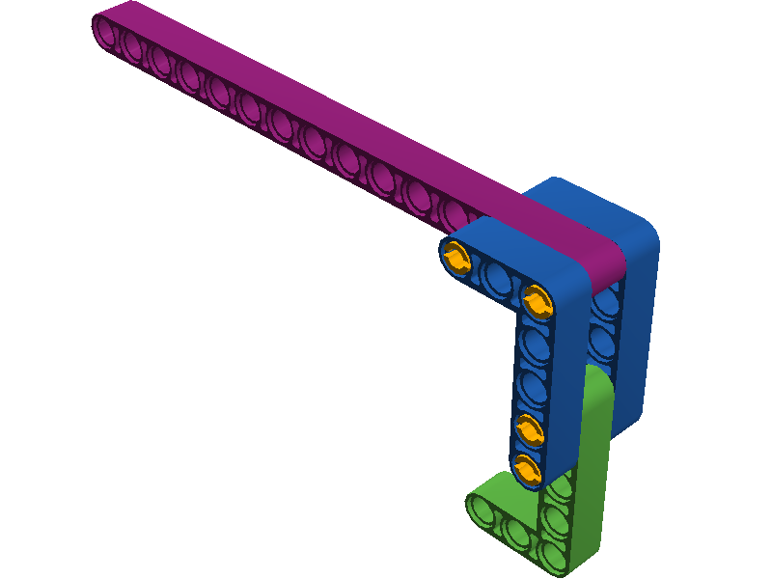
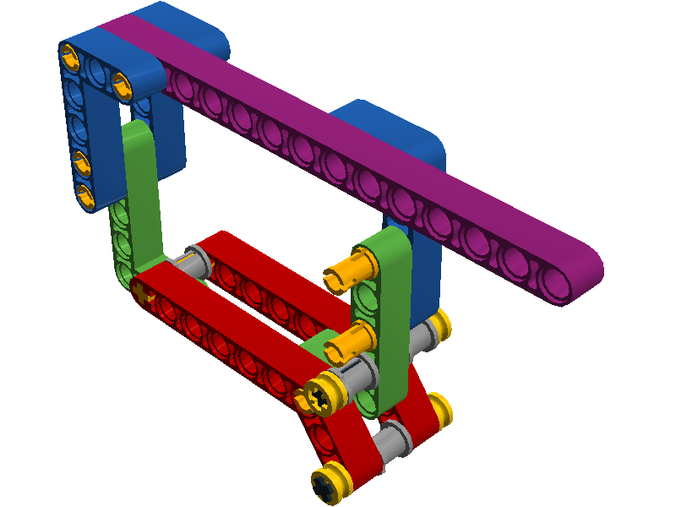
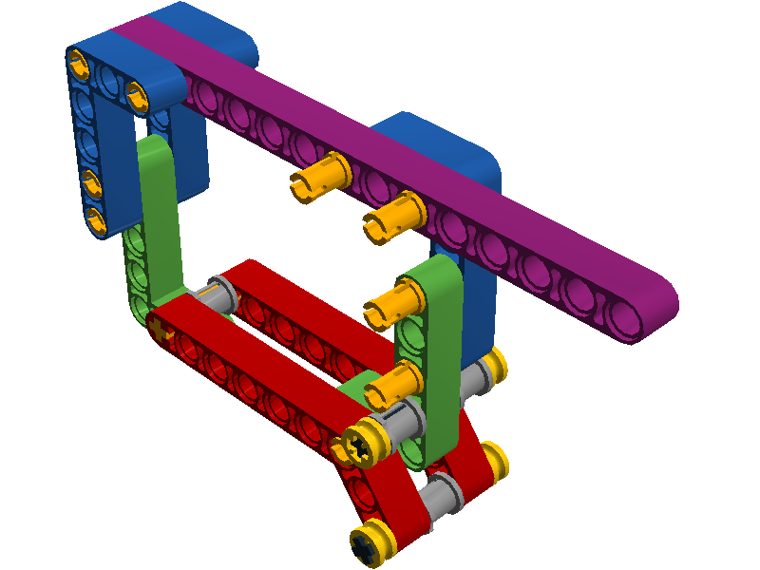
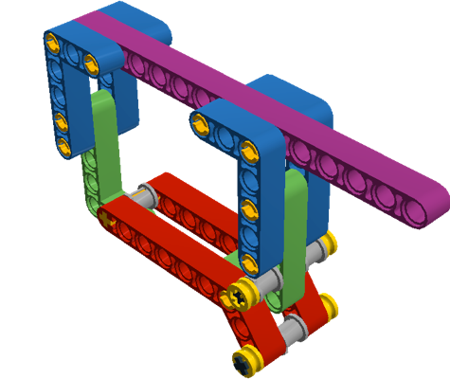
TRY BUILDING ONE…
Add rubber bands on bushings as needed

Slide 8
Credits
This tutorial was created by Sanjay Seshan and Arvind Seshan
More lessons at www.ev3lessons.com, www.primelessons.org, and www.flltutorials.com
This work is licensed under a Creative Commons Attribution-NonCommercial-ShareAlike 4.0 International License.

