Slide 1
WHEELS
SESHAN BROTHERS

Slide 2
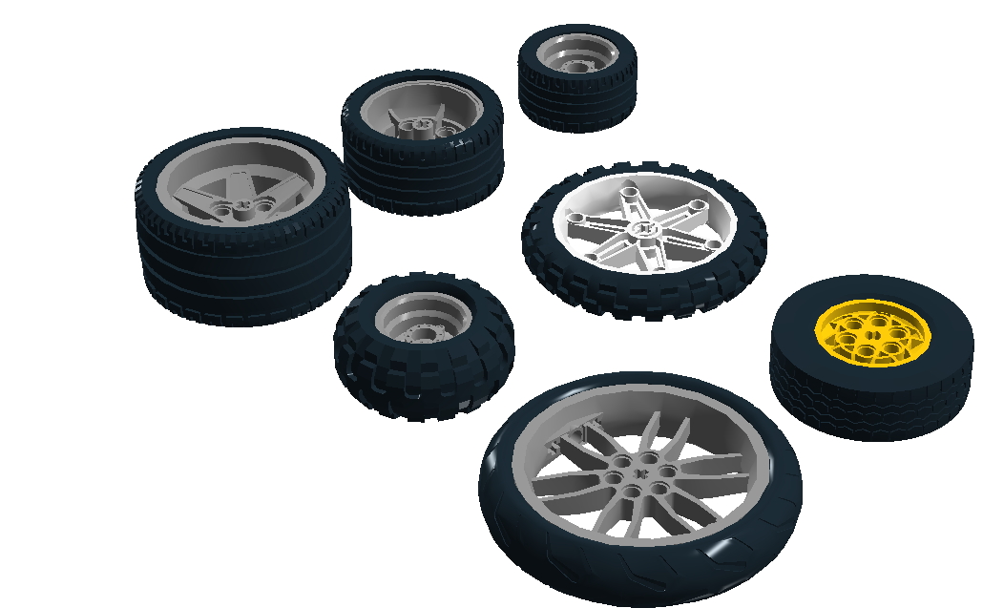
Lots to Choose FROM
LEGO is the largest tire manufacturer in the world!
LEGO has wheels of all sizes and also treads
43.2 X 22
56 X 28
68.8 X 36
81.6 X 15
56 X 26
62.4 X 20
94.2 X 22

Slide 3
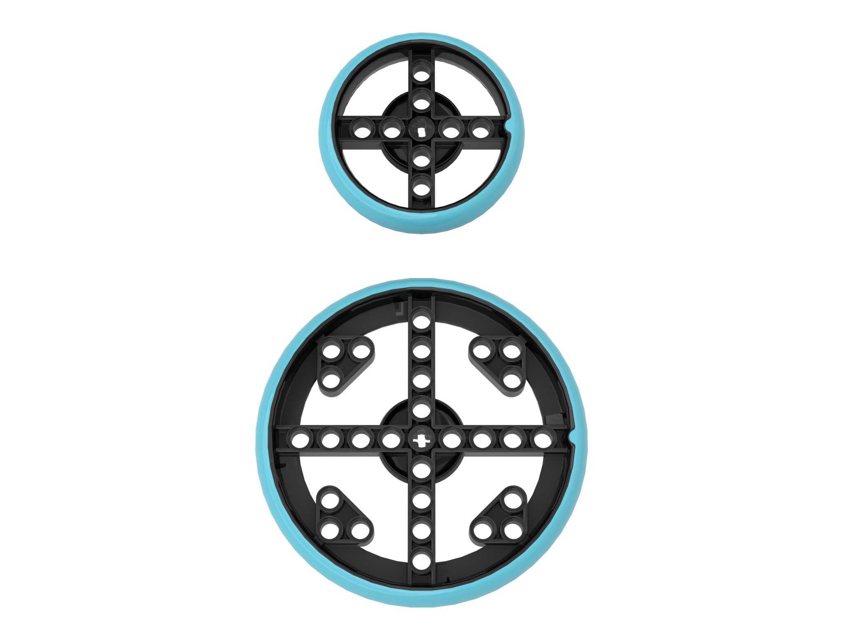
SPIKE PRIME WHEELS
The rubber tire is molded on to the rim. Therefore, they will not slip off the rim as many LEGO tires do.
The small tire is 56 X14 (same size as the wheel in the EV3 Core set) and the large tire is 88 X 14
In SPIKE Prime, you get four 56 X14 tires in the Core Set and an additional four 88 X 14 in the Expansion Set
While these tires are firm, teams often complain that that they get dirty very easily and lack enough friction. Because these tires tend to slip on the challenge mat, teams who use these wheels have to clean the tires often.

Slide 4
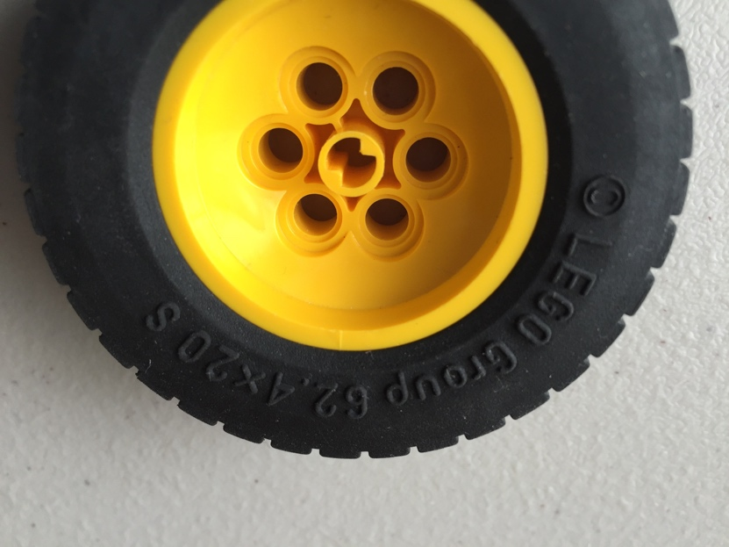
TIP: Measuring the size of A Tire
Look for the size of the tire on the tire itself
The first number is the diameter to of the tire in mm. The second is the width of the tire in mm.
Look up the tire on a LEGO catalogue (e.g. Brickowl.com and Bricklink.com), or using the LEGO wheels chart by Sariel (see page 12)

Slide 5
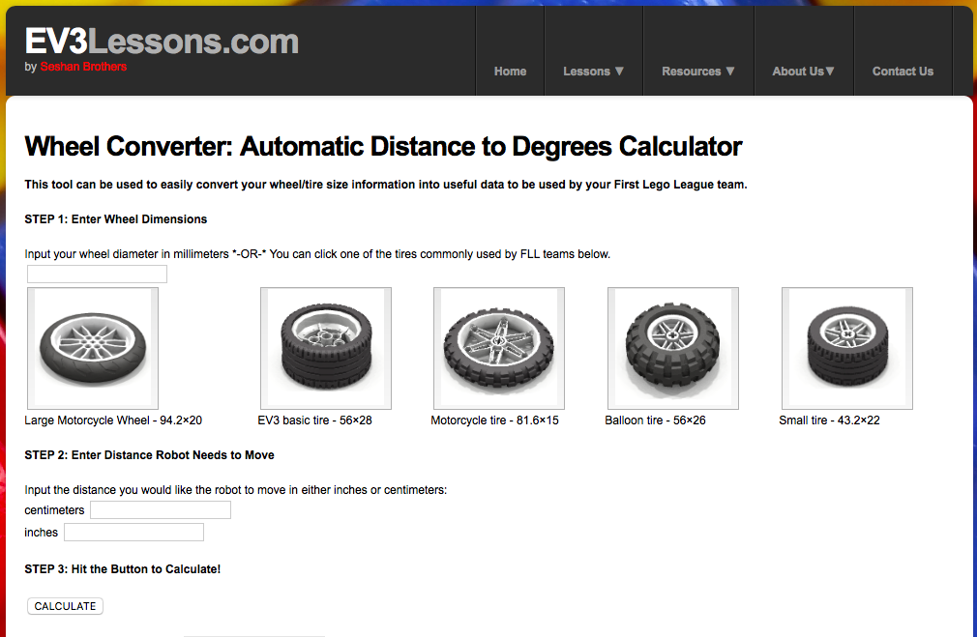
Knowing your wheel size helps Convert DISTANCE to DEGREES
https://ev3lessons.com/en/Resources/WheelConverter/

Slide 6
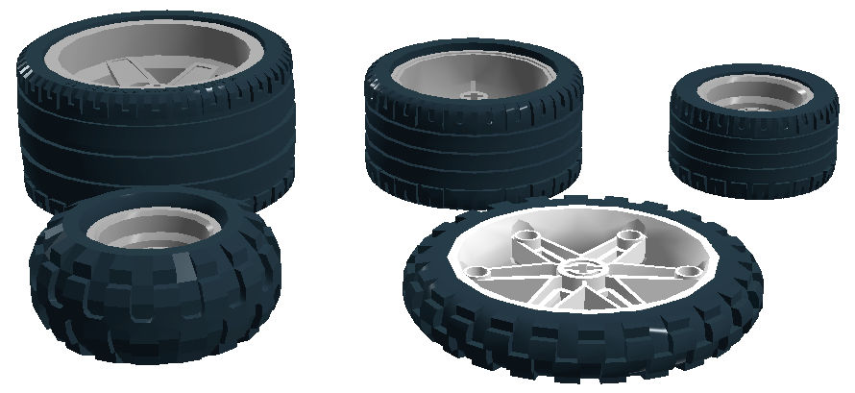
“Best” Wheels for FIRST LEGO LEAGUE
There are many options for wheels on your competition robot. There is no “best” wheel.
Some wheels are better than others, but there is no one wheel that is perfect for every task or every surface your robot will run on.
Every wheel has a pro and a con
Do not make decisions on what wheel to use based on someone else’s experience
Create a set of tests to see if the wheels can hold the weight of the robot, drive straight and are fast enough for your tasks (see next page)
45560 EV3 Expansion
45544 EV3 Core
31313 EV3
Common wheels found in MINDSTORMS sets
9797 NXT
9695 NXT Resource

Slide 7
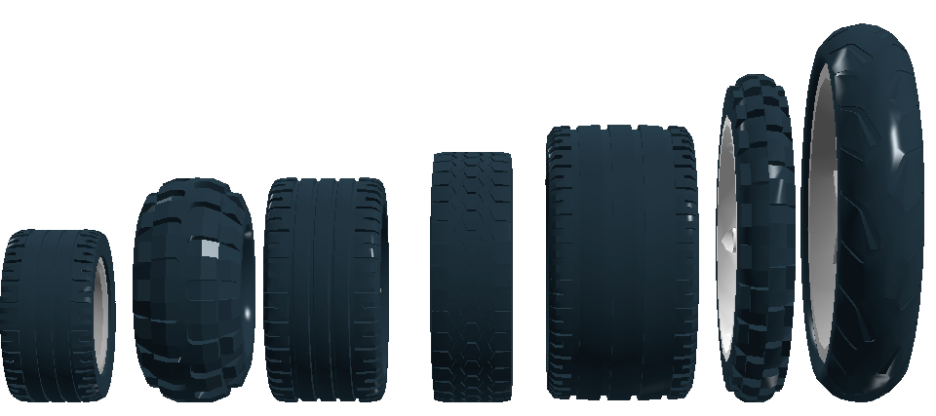
Things to Consider: size, Speed, accuracy, stability...
Large wheels make a robot taller and so might give you both greater ground clearance as well as a higher center of gravity
This might be positive as you might be able to to drive over obstacles, but might also make your robot unstable
Large wheels allow your robot to travel further for each rotation, therefore, making your robot faster.
Speed can be a positive thing in a timed robotics contest, but your robot may not travel as accurately
Smaller wheels are slower but can be more accurate than large wheels
Wider wheels allow for more contact with the ground which might increase stability, but can also cause more friction.
See next page for sample tests

Slide 8
Sample WORKSHEET
Tests | Results
Wheel used | (List the wheel type and size)
Accuracy Test: Move straight 20-30 inches | (Does the robot veer?)
Turn Test: Four 90 degree turns in a row | (Are the turns accurate?)
Traction Test: Push an object | (Does the robot skid?)
Speed Test: Time to go 70 inches, Turn 360 degrees | (Is your robot fast?)
Tire observations | (Does the tire stay on the rim or come off easily?)
Height and width of robot (when using these tires) | (Does the tire make the robot narrower, wider, taller, or shorter?)
You will have to weigh the plusses and minuses of each wheel for your robot.

Slide 9
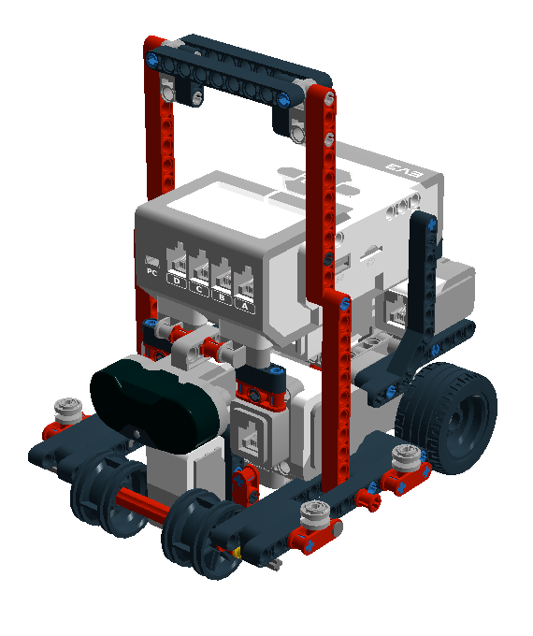

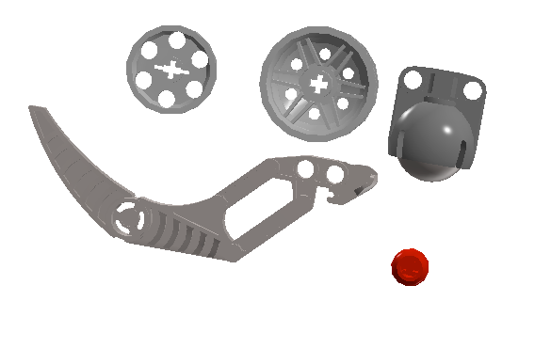
BACK Wheels: SKIDS, CASTER WHEELS….
Back wheels or skids need to allow the robot to turn smoothly. You can create them out of many different LEGO elements including wheels without the tire, LEGO balls, EV3 caster wheels, etc. Here too, there are pros and cons. You should test your back wheels or skids.

Slide 10
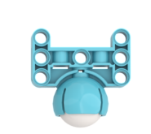
SPIKE PRIME CASTER
The ball in the caster wheel can be removed by using some floss

Slide 11
Wheels for other uses
Riding wheels can help your robot drive along walls.
FLL Tip: Make sure that they are installed at the correct height for your table (at home or at competition). You might have either 2X4 or 2X3 wood as walls.

Slide 12
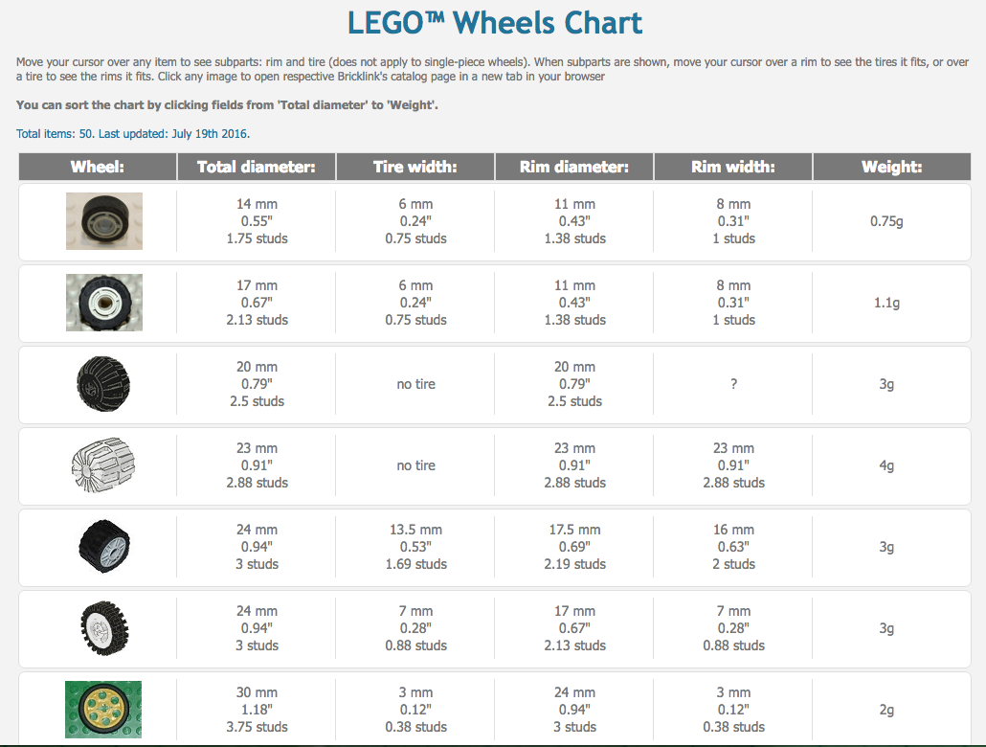
USEFUL TOOL: LEGO WHEELS CHART
http://wheels.sariel.pl/

Slide 13
Credits
This tutorial was created by Sanjay Seshan and Arvind Seshan
More lessons at www.ev3lessons.com, www.primelessons.org and www.flltutorials.com
LEGO Wheels Chart from http://wheels.sariel.pl/
This work is licensed under a Creative Commons Attribution-NonCommercial-ShareAlike 4.0 International License.

