Slide 1
CORE VALUES POSTER
BY PENNSYLVANIA’s FINEST ROBOTICS

Slide 2
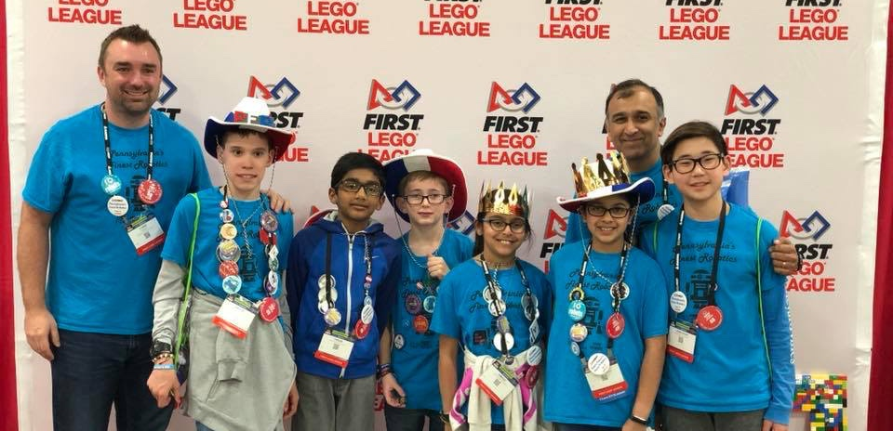
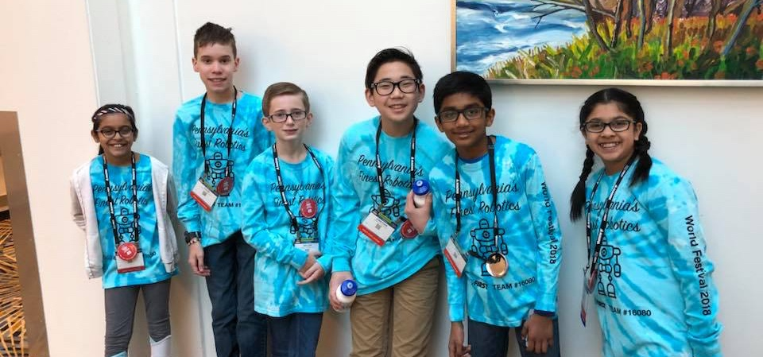
MEET THE TEAM
6 members, 5th grade – 8th grade
1st place Champion’s at 2016 Central PA
1st place Champion’s at 2017 Southeast PA
1st place Champion’s at 2018 East PA
3rd place trophy in Teamwork at World Festival 2017
Our favorite core values are ”We are a Team” and ”We have fun”!

Slide 3
WHY IS A CORE VALUES POSTER USED?
Core Values posters are not required, but can be used to share your team story!
It’s a long season, so show off what you accomplished at competitions and outreach events.
Every team’s journey is unique, and judges want to know what makes your journey special.
Time is limited
During judging sessions, you only have a few minutes to share your story. The poster displays the details that may get glossed over while talking with judges.
It can serve as a point of reference when talking to judges.

Slide 4

Key Sections of A CORE VALUES POSTER
We recommend that you base your poster on the new rubrics and Core Values.
Some teams make them by hand. Some teams print out text and glue them. Some are simple and some are colorful. They come in all sizes and shapes!
Notes:
Mostly the rubric items that are not part of the teamwork exercise

Slide 5
What can you put in a CORE VALUE POSTER
Anything that highlights the Core Values your team demonstrated throughout the season
Describe what the team did, but as they say, “a picture is worth 1,000 words”. So include photos as well
Team photos should reflect the key areas of the Rubric
Photos from an outreach event, team working together on something, team going on an outing

Slide 6
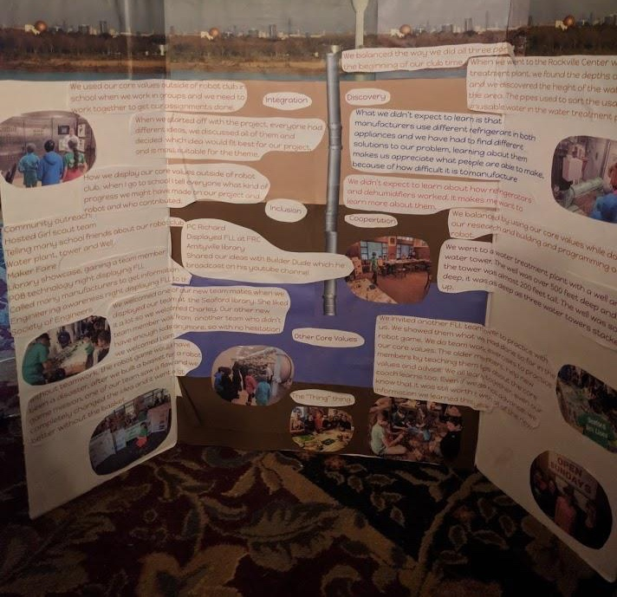
POSTER DESIGN CONNECTED TO TEAM PROJECT
The Seaford Sea Lions designed their poster to look like the layers of soil and aquafer under Long Island, NY
They connected their Core Values poster to the season’s theme/their project

Slide 7
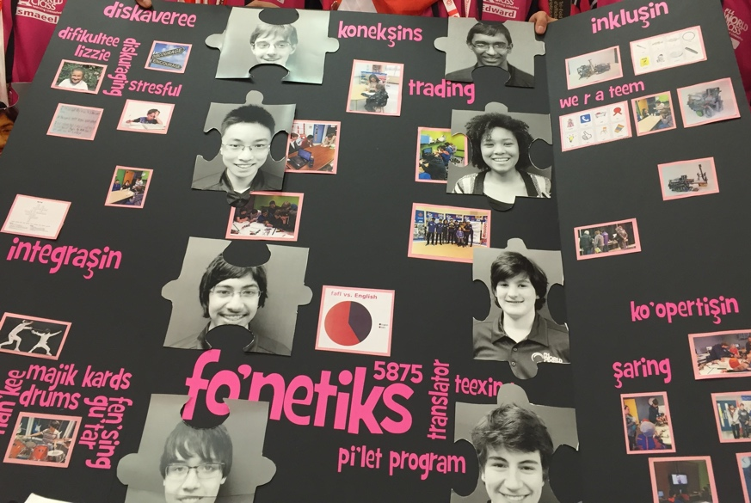
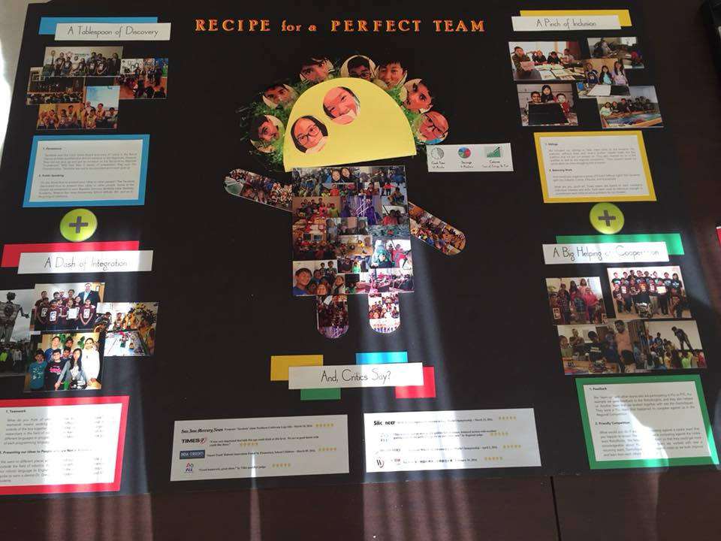
POSTER DESIGN CONNECTED TO TEAM NAME
Tacobots
fonetiks

Slide 8
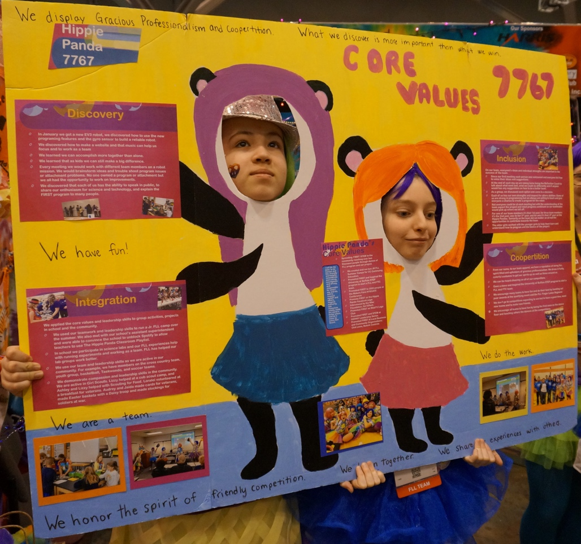
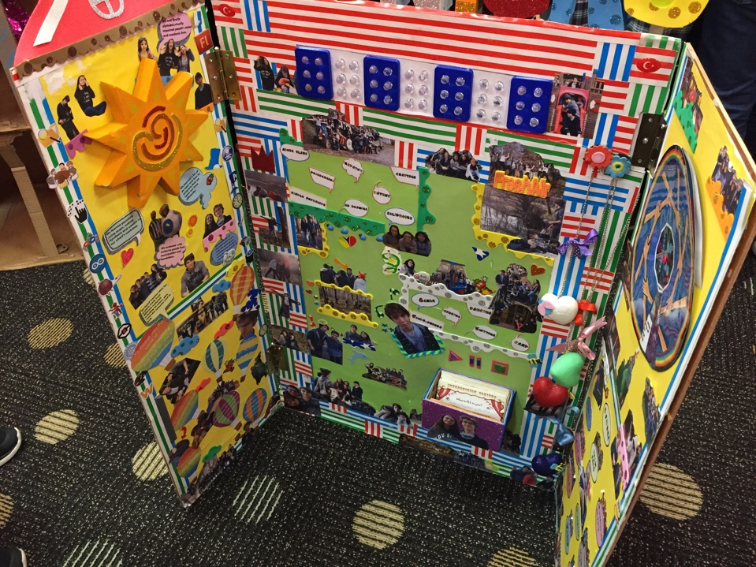
COLORFUL posters
Have fun with your posters!

Slide 9
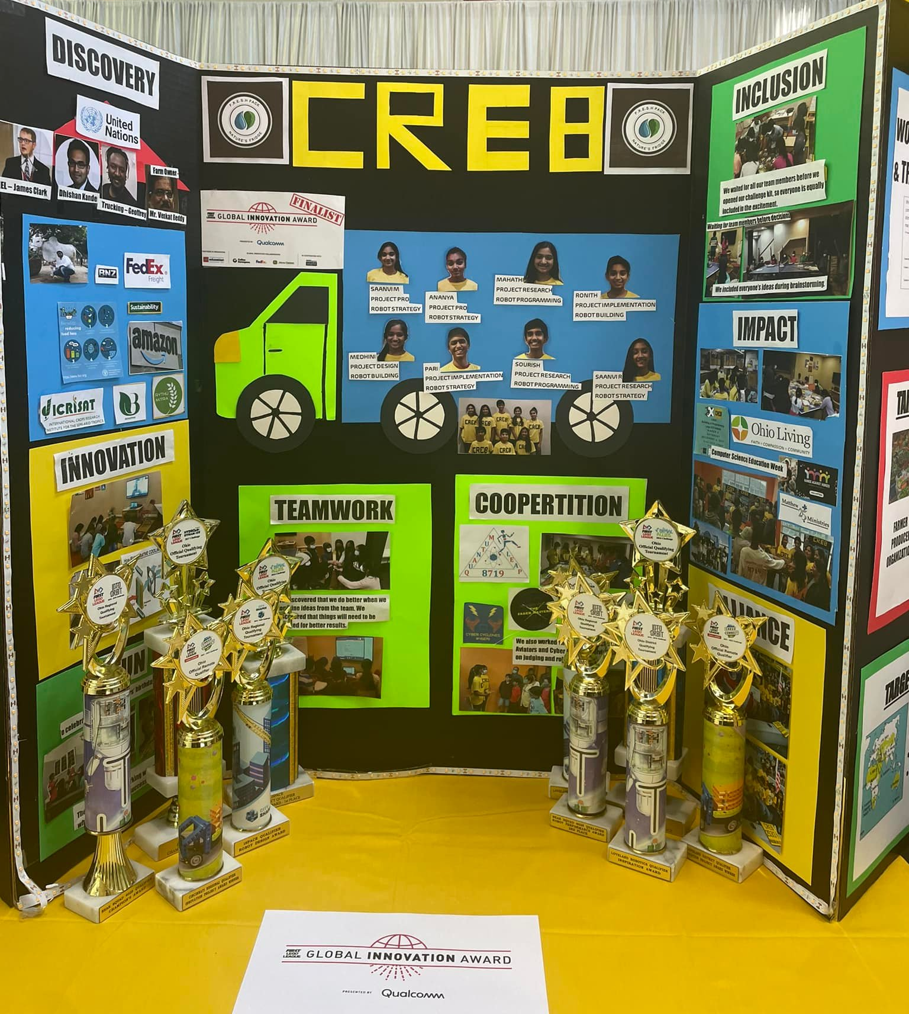
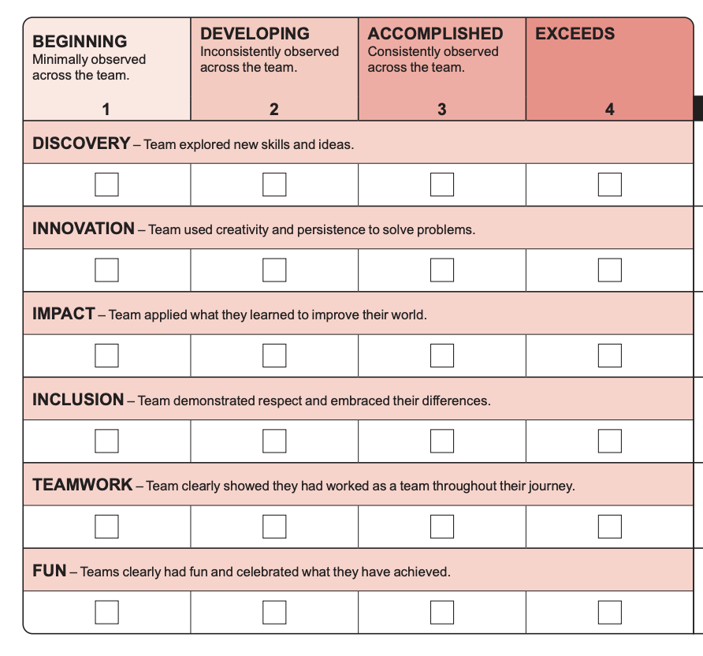
TIP: follow the Rubric
Source: Ohio FLL Facebook

Slide 10
CREDITS
This lesson was written by PA’s Finest Robotics Team
More lessons for FIRST LEGO League are available at www.flltutorials.com
Creative Commons Attribution-NonCommercial-ShareAlike 4.0 International License

