Slide 1
Introduction to Core Values
Vicky Zhai, FTC 9873

Slide 2
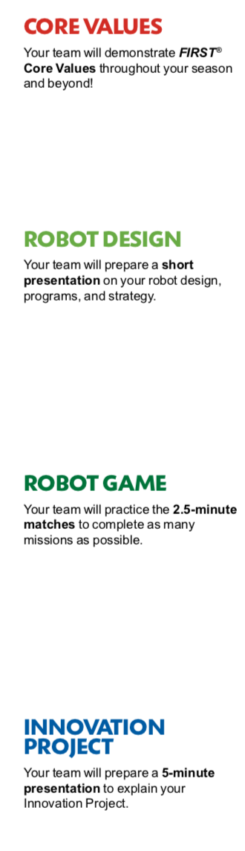
Core values: HoW IT FITS TOGETHER
The Robot Design, Innovation Project and Robot Game are what teams DO.
The Core Values are how they do it.

Slide 3
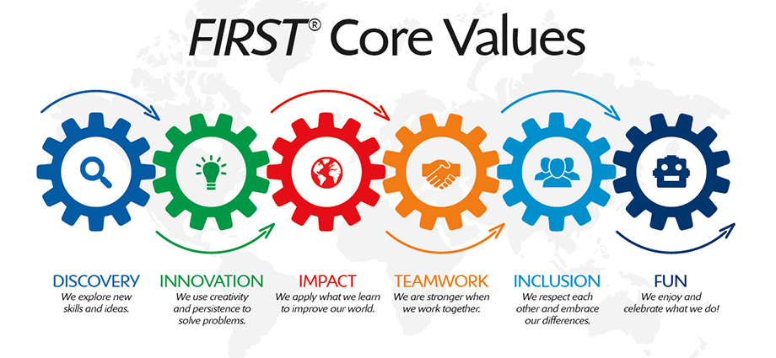
FIRST CORE VALUES

Slide 4
LEARN THE TERMS USED in the CORE VALUES
We express the FIRST philosophies of Gracious Professionalism and Coopertition through our Core Values:
Discovery: We explore new skills and ideas.
Innovation: We use creativity and persistence to solve problems.
Impact: We apply what we learn to improve our world.
Inclusion: We respect each other and embrace our differences.
Teamwork: We are stronger when we work together.
Fun: We enjoy and celebrate what we do!
Notes:
Have examples for each?
Animate that teamwork is judged by teamwork activity, other parts are judged using poster/presentation

Slide 5
Gracious professionalism
“Learn and compete like crazy, but treat one another with respect and kindness”
Dr. Woodie Flowers, FIRST Distinguished Advisor

Slide 6
Coopertition
“ Teams can and should help and cooperate with each other even as they compete”
Dr. Woodie Flowers, FIRST Distinguished Advisor

Slide 7
NOW THINK ABOUT…
How will your team demonstrate that you understand the Core Value and used them?
How will you make decisions and include everyone?
How will you share your knowledge and impact others?

Slide 8
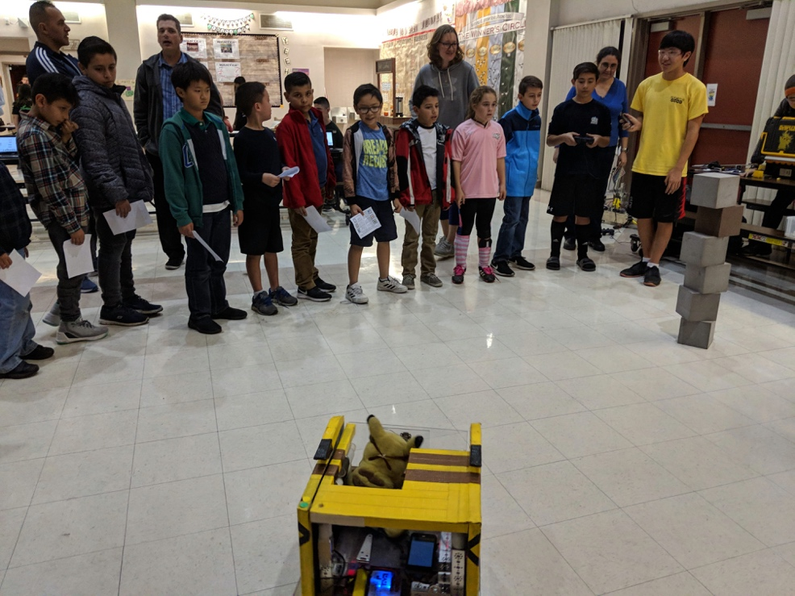
WHY IS COOPERTITION important
It encourages learning from your teammates, competitors, and mentors
It is what makes the FIRST program different
Many ways to show Coopertition
Lending a team a part if they need it, even if it helps them to score higher
Inviting teams to your house to teach them how to make better projects and teach them your robotics skills
You don’t solve the challenge for them and provide solutions. Instead, you inspire them and show them how to discover their own solutions

Slide 9
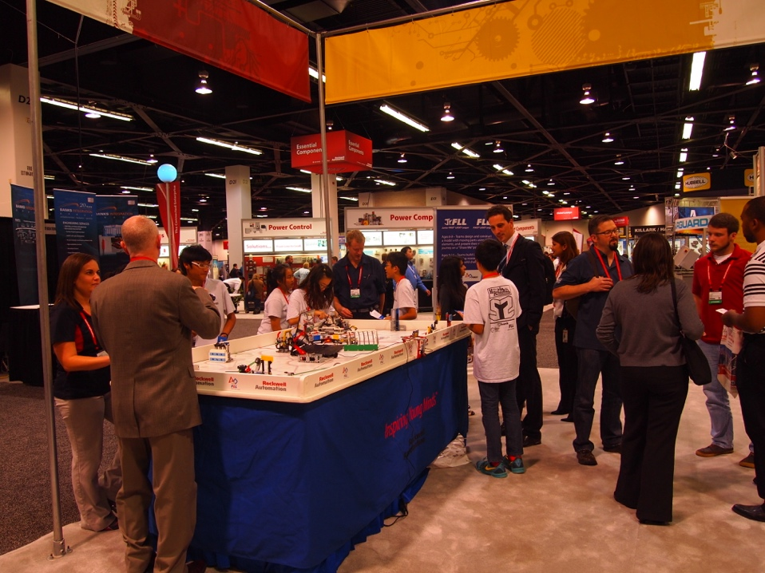
MOST IMPORTANT: Embrace CORE VALUES
Core Values is not just something you do.
It is a way, a METHOD of doing things that builds character and guides us throughout the whole experience!
9

Slide 10
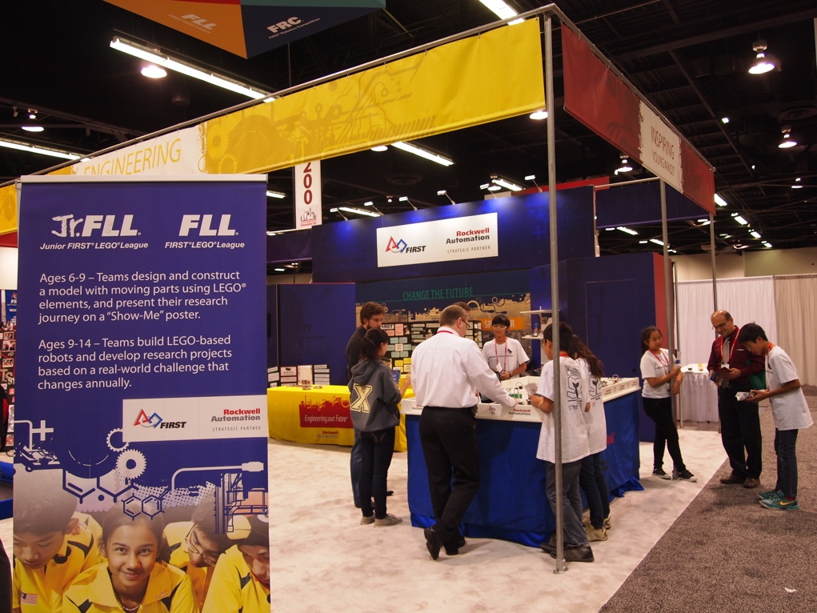
IS OUTREACH IMPORTANT in CHALLEGE?
Outreach can be one way of achieving Impact.
Share your knowledge
Share your passion for FIRST and STEM

Slide 11
CREDITS
The primary author of this lesson is Vicky Zhai from FTC 9873. Additional information from Christopher Haines and Chris Baker was incorporated into the lesson.
More lessons for FIRST LEGO League are available at www.flltutorials.com
Creative Commons Attribution-NonCommercial-ShareAlike 4.0 International License

