Slide 1
Lesson 3: Finding Lines On The Mat
Seshan brothers

Slide 2
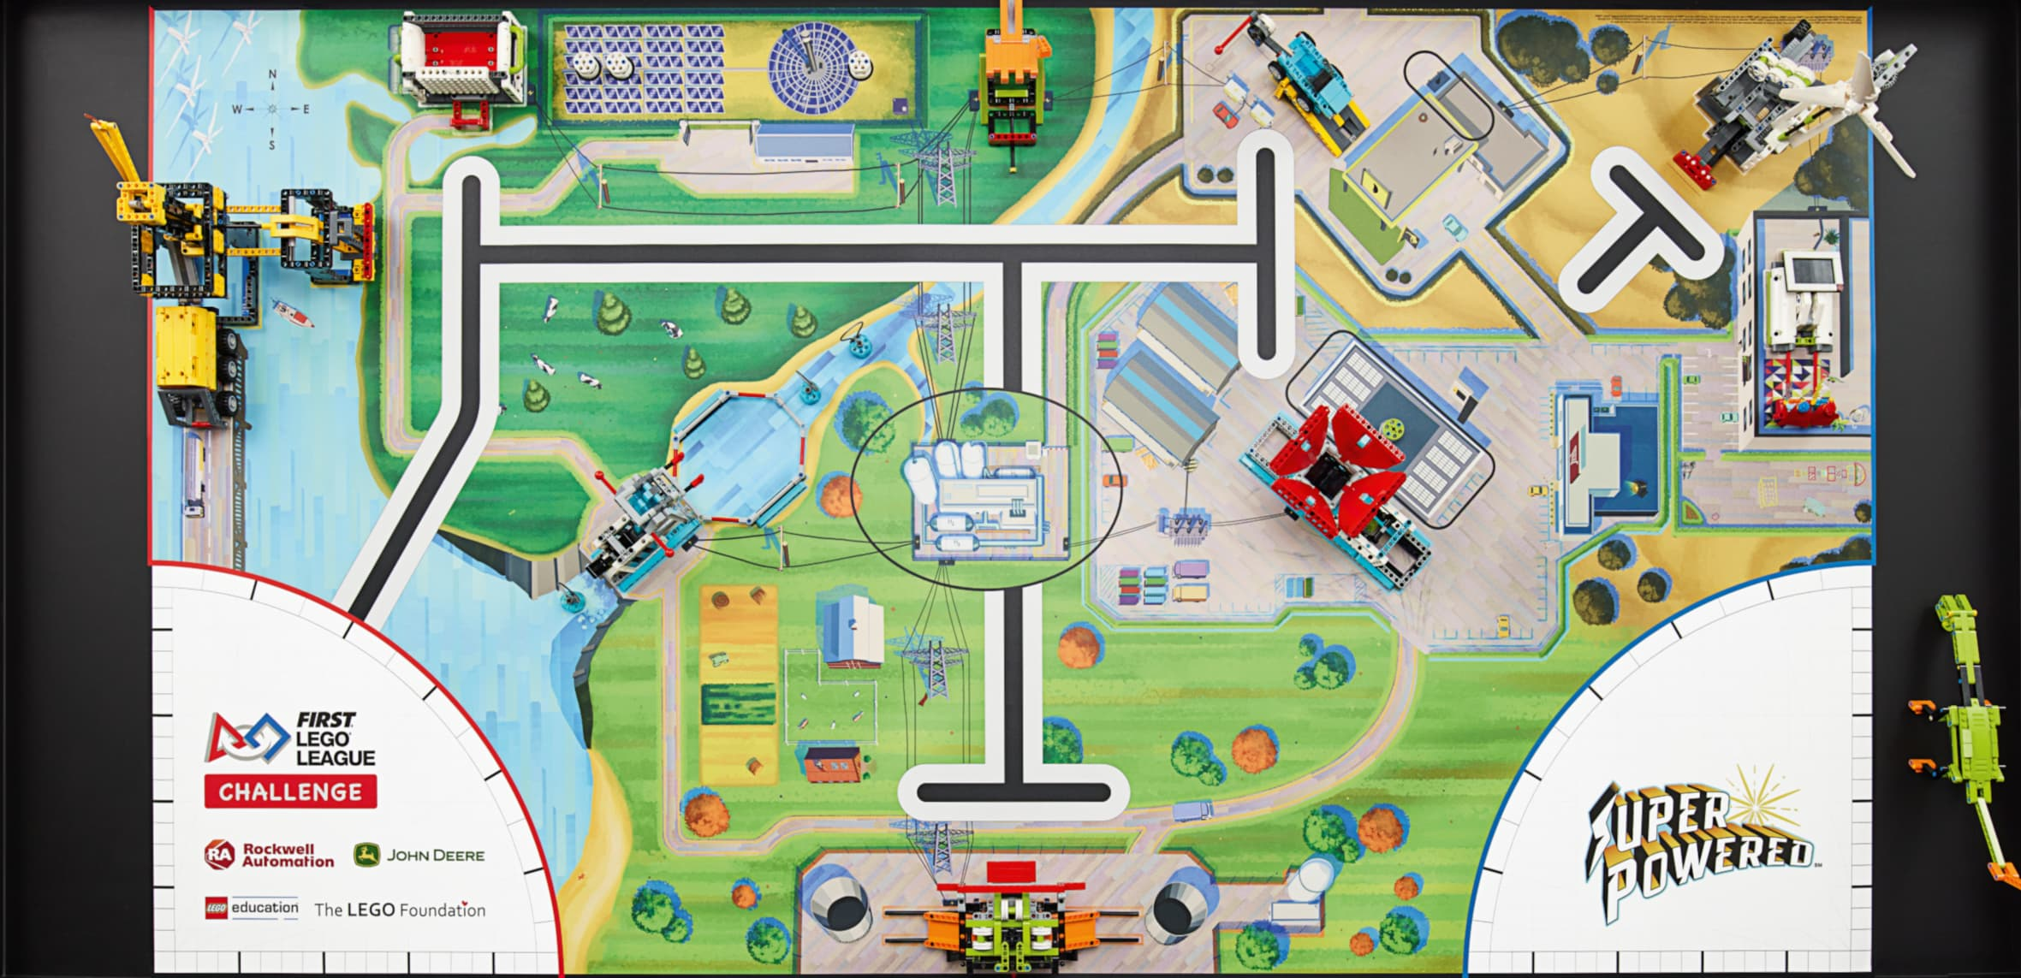
First Steps
In the below path, the first step is moving until the line across the board. Making this simple first step reliable can be tricky!
Using just distance is prone to error. If you set up your robot at a slight angle or too far forward/backward – your robot will not stop accurately on the line.
Our goal is to use the light sensor to stop the robot on the white or black part of the line
Move Until Line

Slide 3
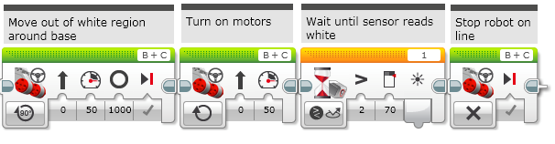
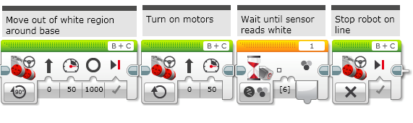
First Solution
We will try to stop at the white part. The issues with stopping on black are similar.
Below are two programs that attempt to perform this step. The top uses reflected light and the bottom uses color sensing.
Both begin by moving out of Launch and then turning on the motor until sensor reads white (or bright in the case of reflected light)
Unfortunately, neither solution is reliable! Why?
Move Until Line
Sample code in EV3-Lab

Slide 4
Color Sensing
In color mode, the sensor shines a whitish light on the board and tries to match the reflected light to of the standard LEGO brick colors.
Since the mat’s printing does not match LEGO brick colors the colors the sensor reports are often unpredictable. What looks green to you may look be closer to LEGO black than LEGO green.
The color sensor also reads regions of the table at a time. If it sees a bit of yellow and a bit of blue – it may report the color as green.

Slide 5
Reflected Light SensING
In reflected light mode, the sensor shines a red light on the board and reports the amount of light reflected back.
First, if you are using an EV3, you should try to calibrate your sensor if you are using reflected light mode. This will give you more predictable readings. You do not need to calibrate your color sensor on a SPIKE Prime.
Second, the mat looks very different to the robot under the red light than it does to us in normal room lighting.

Slide 6

Reliable Line Finding
The main problem is that if you try to find a white region over a large section of the mat, the sensor may report white in some spot before the line
One solution is to move close to the line before having the robot start searching for white
This significantly reduces the likelihood that your robot will stop at the wrong spot
Moving for Inches
Looking for White?
Looking for White?

Slide 7
Credits
This tutorial was created by Sanjay Seshan and Arvind Seshan
More lessons at www.ev3lessons.com and www.flltutorials.com
This work is licensed under a Creative Commons Attribution-NonCommercial-ShareAlike 4.0 International License.

