Slide 1
Introduction to Core Values
Vicky Zhai, FTC 9873

Slide 2
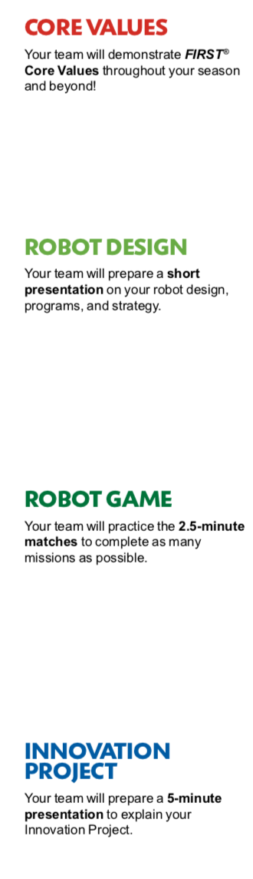
Core values
The Robot Design, Innovation Project and Robot Game are what teams DO.
The Core Values are how they do it.

Slide 3

FIRST CORE VALUES

Slide 4
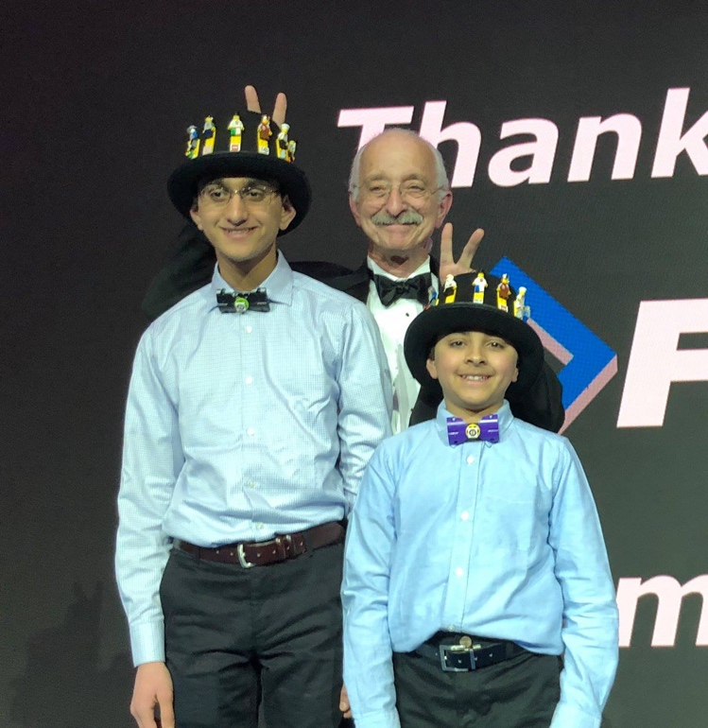
Gracious professionalism
“Learn and compete like crazy, but treat one another with respect and kindness”
Dr. Woodie Flowers, FIRST Distinguished Advisor

Slide 5
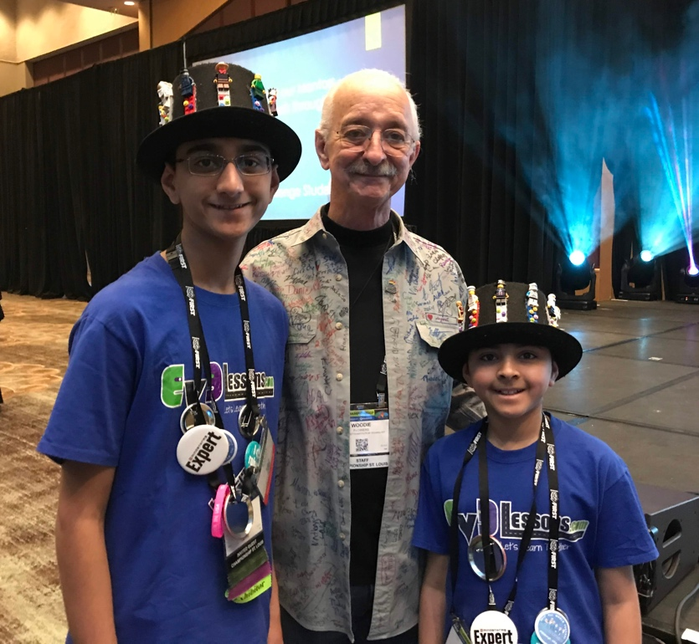
Coopertition
“ Teams can and should help and cooperate with each other even as they compete”
Dr. Woodie Flowers, FIRST Distinguished Advisor

Slide 6
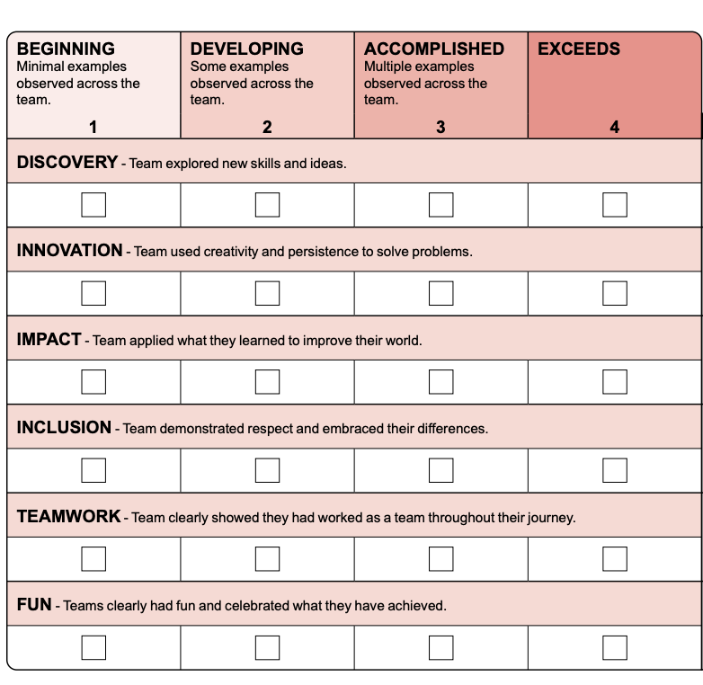
TERMS USED in the CORE VALUES RUBRIC
Look closely at the Rubrics and understand the meaning of each term
How will your team demonstrate that you understand the Core Value and used it?
Notes:
Have examples for each?
Animate that teamwork is judged by teamwork activity, other parts are judged using poster/presentation

Slide 7
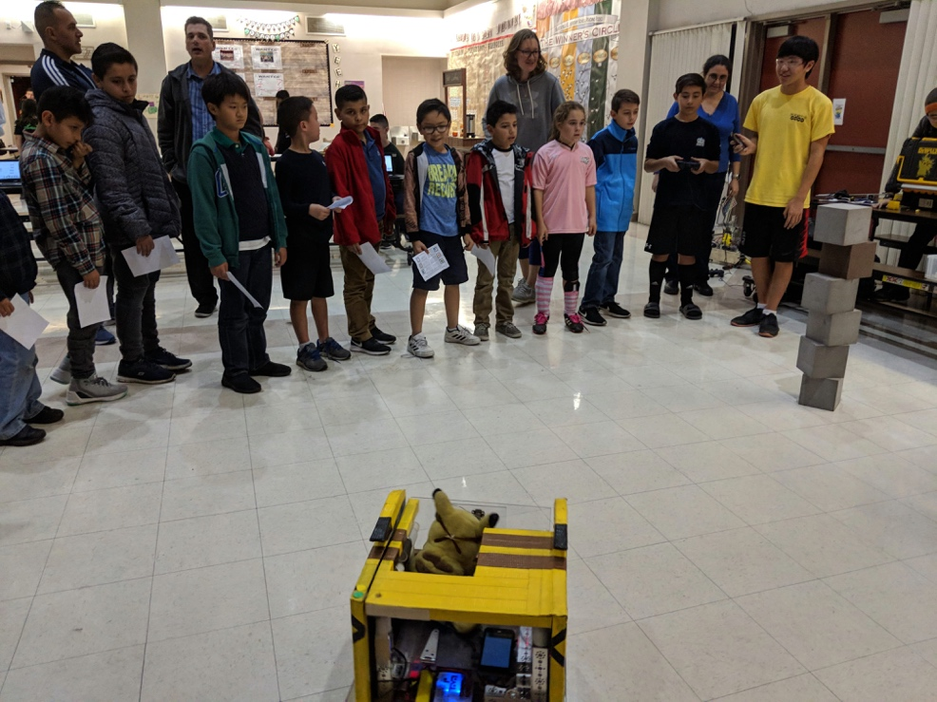
Displaying COOPERTITION is important
Why is it important?
It encourages learning from your teammates, competitors, and mentors
It is what makes the FIRST program different
Many ways to show Coopertition
Lending a team a part if they need it, even if it helps them to score higher
Inviting teams to your house to teach them how to make better projects and teach them your robotics skills
You don’t solve the challenge for them and provide solutions. Instead, you inspire them and show them how to discover their own solutions

Slide 8
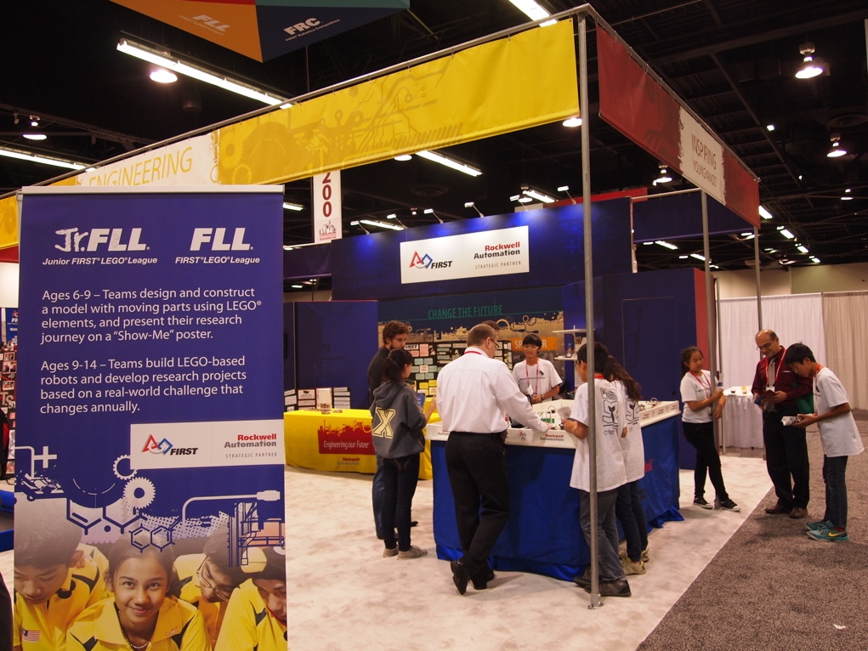
WHY DO OUTREACH ACTIVITES?
Give back to the community
Share your knowledge
Share your passion for FIRST and STEM
Encourage other students and adults to participate in FIRST

Slide 9
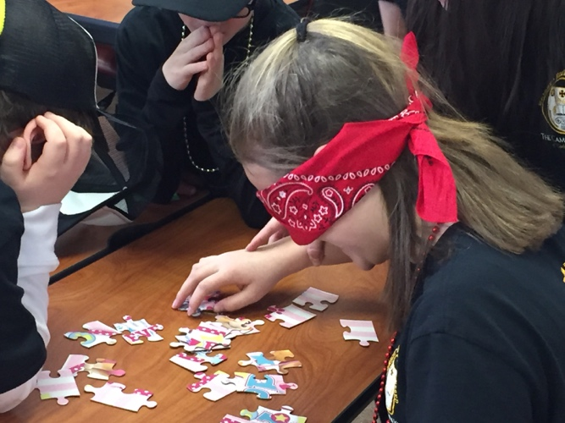
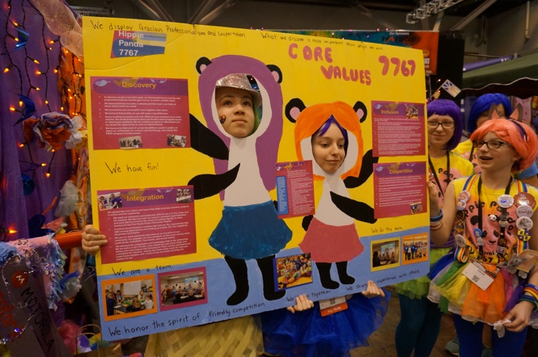
JUDGING CORE VALUES - OVERVIEW
Judges may ask you to do a team activity if this is required in your region
If your region requires a Core Values poster, you may be asked to present this in a short presentation
Judges will ask questions to help them fill in the rubric
9

Slide 10
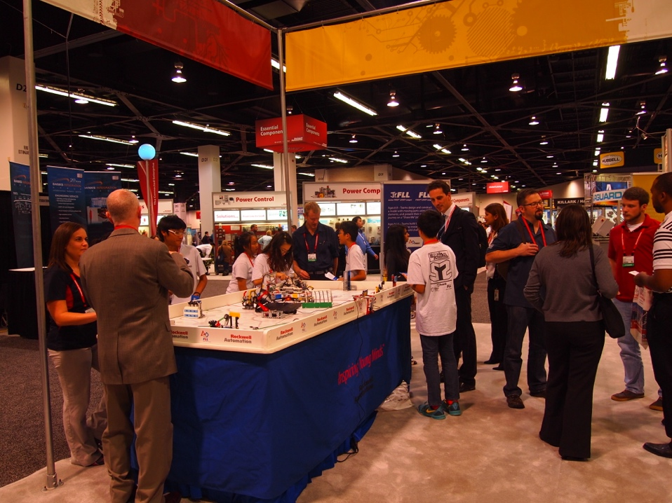
MOST IMPORTANT: Embrace CORE VALUES
Core Values is not just something you do.
It is a way, a METHOD of doing things that builds character and guides us throughout the whole experience!
10

Slide 11
CREDITS
The primary author of this lesson is Vicky Zhai from FTC 9873. Additional information from Christopher Haines and Chris Baker was incorporated into the lesson.
More lessons for FIRST LEGO League are available at www.flltutorials.com
Creative Commons Attribution-NonCommercial-ShareAlike 4.0 International License

