Slide 1
INCREASING EFFICIENCY IN THE ROBOT GAME
Seshan Brothers

Slide 2
OBJECTIVES
FIRST LEGO League robot runs only last 2 mins and 30 seconds
How do some teams manage to complete so many missions in that time while others do not?
This lessons shares some tips to increase your robot efficiency

Slide 3
GROUP MISSIONS together into a single Run
Your robot game strategy is important. Before you begin, think about which mission might be grouped together in a single lauch
Completing many missions every time you leave the Launch Area avoids time wasted in Home.
However, if something goes wrong in that run, you will lose a lot of points
Therefore, you have to make sure that all your robot runs are reliable if you plan to combine many missions
See 8 lessons related to Robot Reliability on FLLTutorials.com

Slide 4
MINIMIZE ATTACHMENTS
Attachment changes generally cost a lot of time
Students also tend to make mistakes during the attachment changes when they are nervous during a robot match
Minimizing the number of attachments and changes needed in Home will help
Try to think of ways in which a single attachment might serve more than one purpose

Slide 5
No Attachments/everything on the robot
One approach is to have no attachment changes at all!
Depending upon the season, this might be possible.
Either have one set of attachments on that complete all/most missions
Or have the approach of only taking off attachments from the robot (never adding anything new)
A lot of missions tend to be one action (e.g. push or lift).

Slide 6
MAKE CHANGES in HOME FASTER
Make adding and taking off attachments as easy as possible to save time
Using friction pegs to add attachments takes time
Attaching directly to a motor can take time
Think about how to slide on and lock attachments in place quickly
Practice the changes again and again with your teammates to reduce time spent in Home
Many teams struggle to align their robot in Launch Area
Think about how you can either pick just one location for every launch
Or avoid needing an exact location for a launch (e.g. robot finds lines or aligns immediately after a launch)

Slide 7
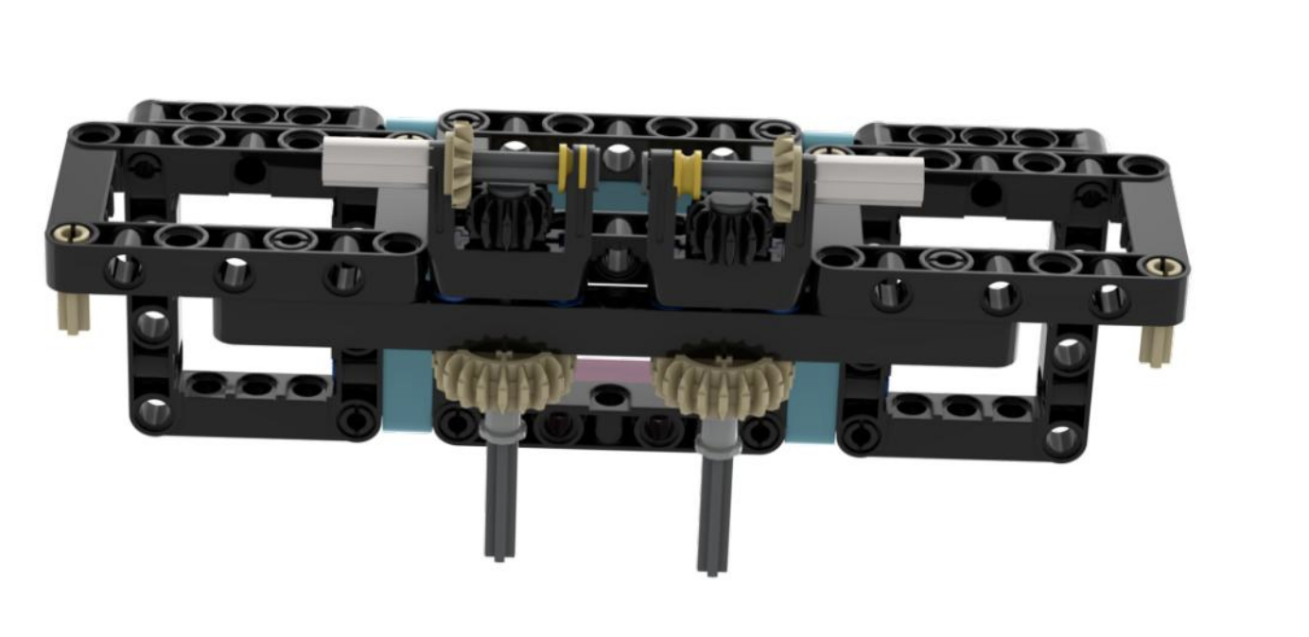
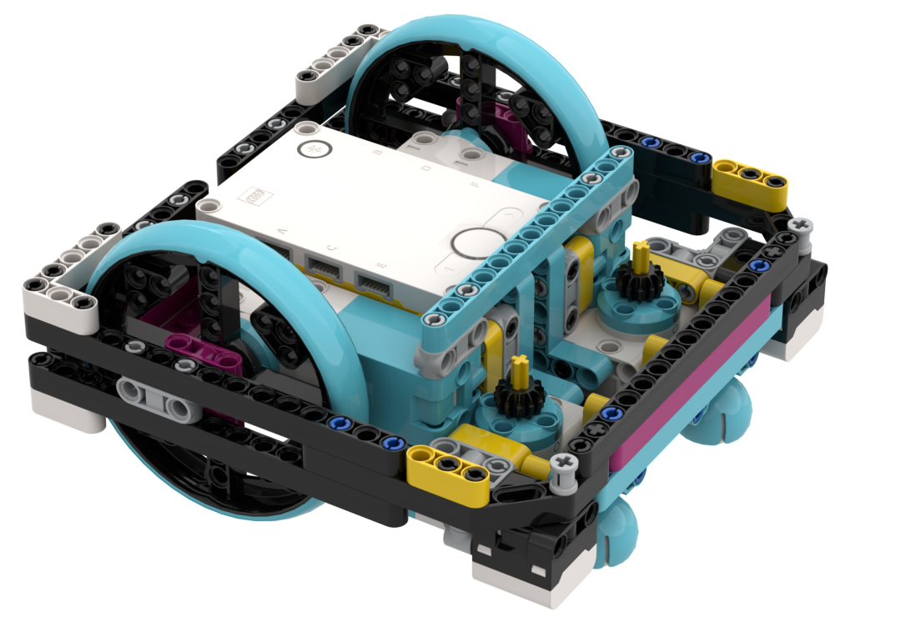
EaSY ON/OFF ATTACHMENTS
Drop on attachments
Connects to the gears

Slide 8
Credits
This tutorial was created by Sanjay and Arvind Seshan
More lessons at www.ev3lessons.com, www.primelessons.org, and www.flltutorials.com
This work is licensed under a Creative Commons Attribution-NonCommercial-ShareAlike 4.0 International License.

