Slide 1
INNOVATION PROJECT JUDGING
Seshan Brothers

Slide 2

About the authors
Seshan Brothers were on Team Not the Droids You Are Looking For
They were Global Innovation Award Semi-Finalists for their Trash-Trek Project. EV3Lessons.com was their award-winning World Class project. They have also won First Place Innovative Solution at the International Open in Toronto.
They are the Champion’s Team from World Festival 2018.

Slide 3
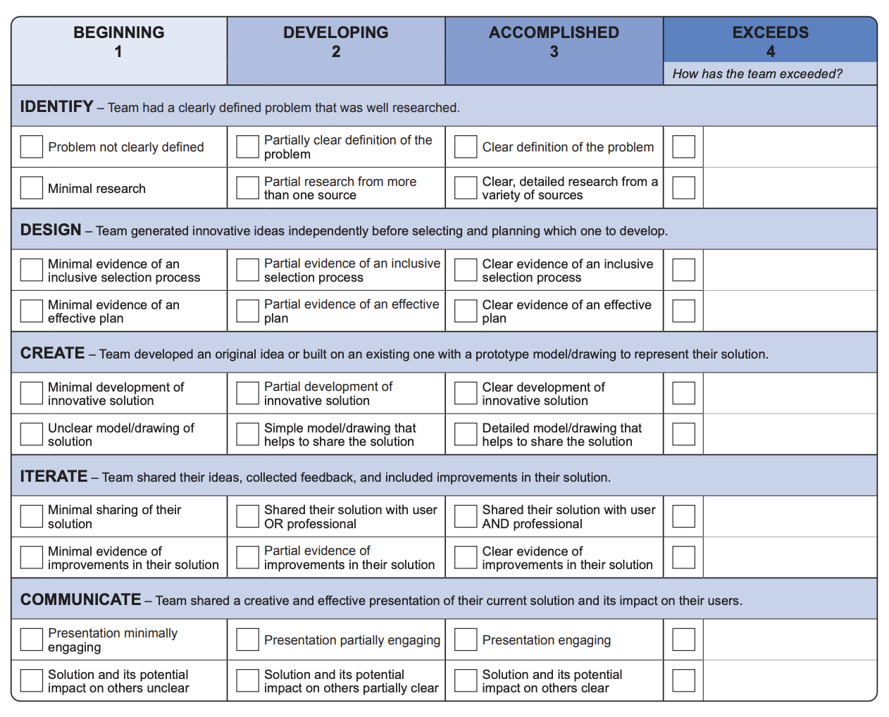
INNOVATION PROJECT JUDGING OVERVIEW
Innovation Project judging will focus on the contents of the rubric. Make sure that you address all aspects within the 5 mins.
Make sure that everyone on the team is involved. If you have anyone who is shy, try to help them or give them a role that will make them comfortable
During your 5-minute presentation, you need to cover all the components of rubric (do not wait until the Q&A to cover critical components)

Slide 4
FAQS
Do we have to do a creative skit?
Many teams choose this route as being creative can help you stand out. However, if if it is not the personality of your team do not force a skit upon your team. Also, be careful not to get so involved in a skit that it becomes hard for a judge to understand and mark the rubric.
Can we do a PowerPoint presentation?
Yes. However, keep in mind that your presentation is supposed to be live (not a recording) and that you may or may not have access to technology (or an electricity outlet) in the room. You will have to bring your own fully-charged device to share the slides.
What if we go over the 5 min limit?
Try to keep to the time limit. If you are a few seconds over, the judges should let you keep speaking. If you are not stopping, they are likely to cut you off, or not get a chance to ask you as many questions. This will hurt your team.
Do we have to memorize our lines?
It is helpful to have eye-contact with your judges. Memorizing can help with that. However, ideally, you do not memorize the exact words, but the general content you want to convey. You are allowed notes as well. Some teams hide notes behind props or posters.

Slide 5
COMMON JUDGE QUESTIONS
Describe the problem your team chose?
Why did you pick this problem? What other problems did you consider?
Did you have a plan for the season? How did you split the work?
What are the steps you took to solve this problem?
Whom did you share the solution with? What feedback did you get? How did you incorporate that feedback?
What would it take to implement this solution?
How does your solution help your community/solve the problem?

Slide 6

Credits
This lesson was written by Sanjay and Arvind Seshan
More lessons available on www.ev3lessons.com, www.primelessons.org and www.flltutorials.com

