Slide 1
Consolidated judging
Seshan brothers

Slide 2
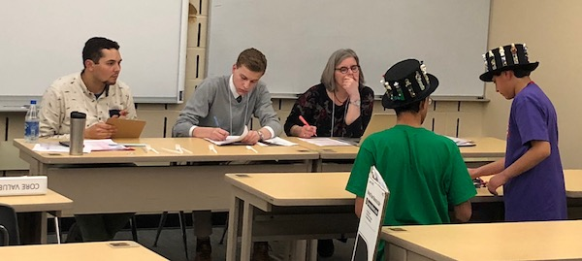
What is consolidated judging?
All regions in FIRST LEGO League should have moved to the 30-minute judging format
Instead of teams having to move from room-to-room, all judging happens in one room
Your team will have a 30-minute single judging slot that covers Robot Design, Project, and Core Values

Slide 3
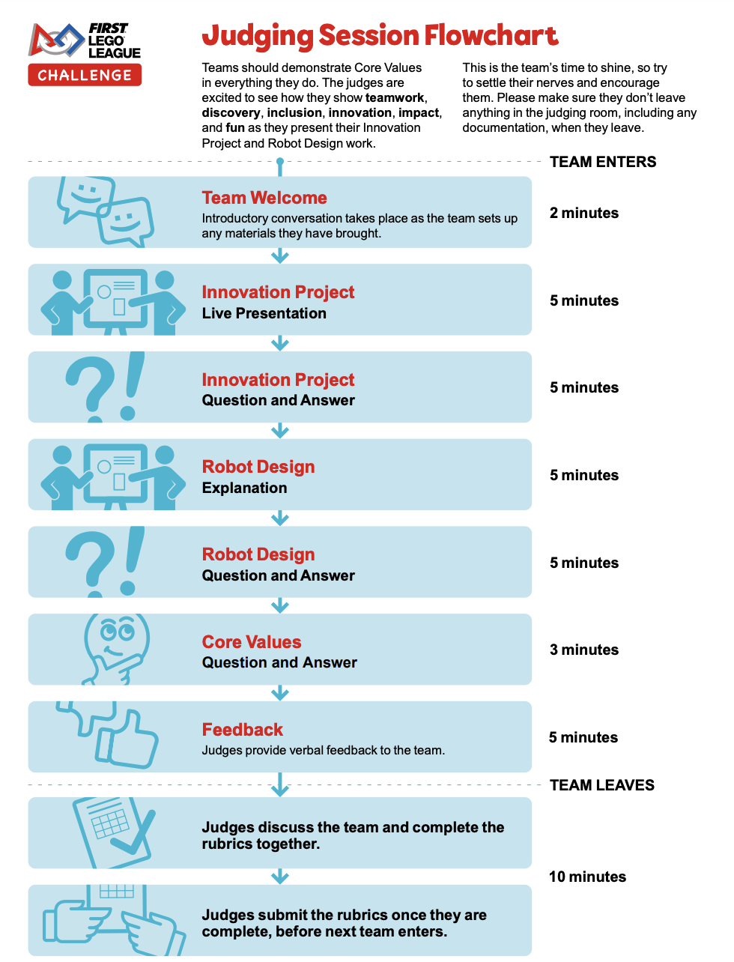
What happens in Consolidated judging?
Students will enter the room, introduce themselves and then proceed to present their Innovation Project.
The session will then proceed according to the flowchart on the left.
A team can transition to the next presentation on their own or the judges will keep track of the time and move the conversation to the next section.
Teams give a 5 min presentation for Innovation Project and Robot Design
Core Values is a time for judges to ask questions (no presentation). Core Values judges will be judging during the Team Welcome, Innovation Project and Robot Design as well

Slide 4
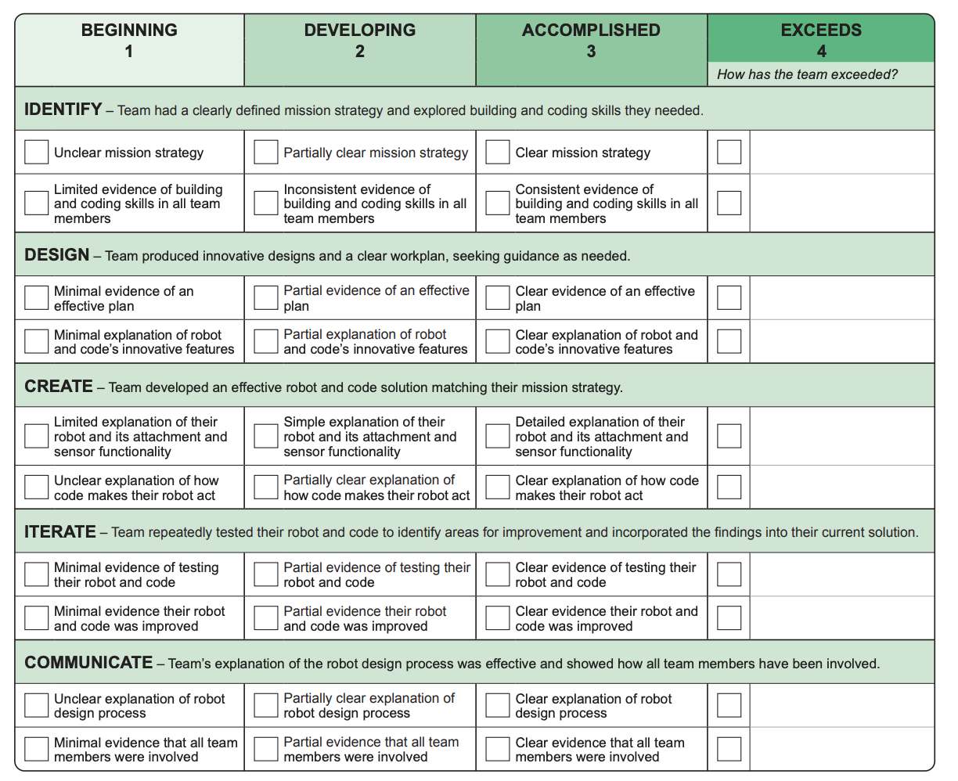
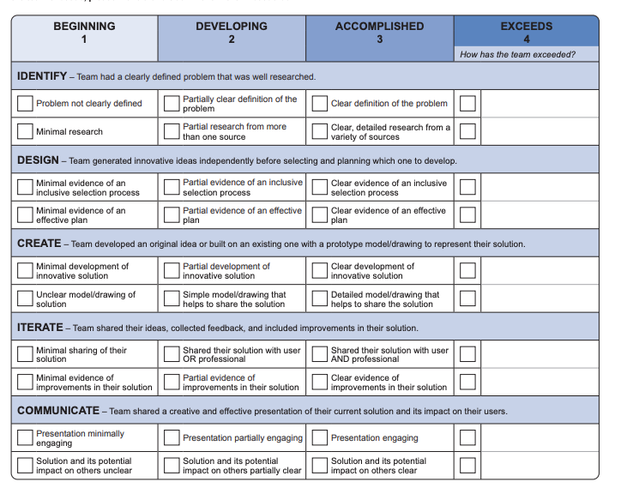
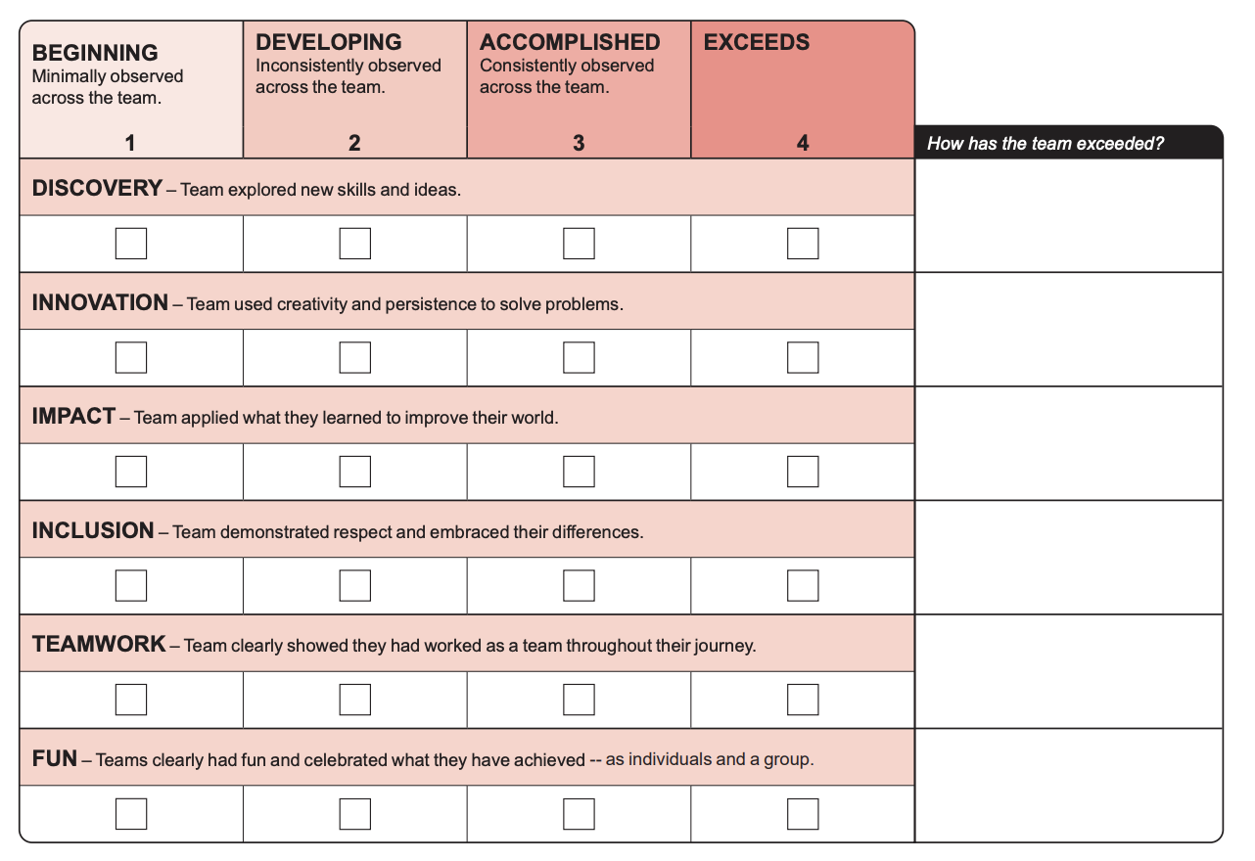
JUDGES will fill in all three rubrics

Slide 5
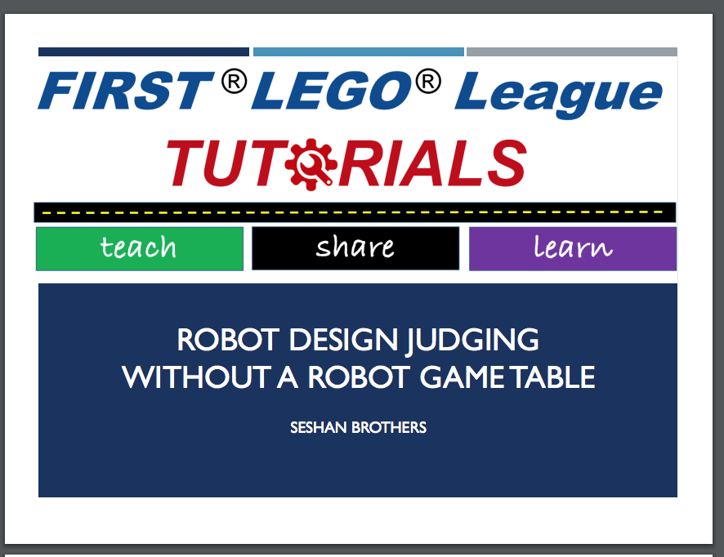
TIPS in judging
Be efficient. Timing starts as soon as you enter the room. Since project is first, be ready to go with costumes, props, etc. Minimize set up time.
Be prepared. Have everything ready for Robot and Core Values Presentations so that it is quick and easy to switch to the next presentation. Consider having everything on one cart.
Be ready to explain. There is no robot game table. Prepare to explain your process, not show your runs. (Take a look at the lesson on FLLTutorials for additional tips.)
Have a plan and communicate well. Make sure that you communicate everything you want to in your presentation time. Use the rubrics as your guide.
Leave a summary sheet if allowed. If you are allowed to leave documentation, include some highlights about your robot, project and core values.

Slide 6
Advantages of consolidated judging
Easier for teams as they do not need to find their next room
Gives a chance for teams to get to know their judges better
Judges can evaluate throughout the session this allows judges from each core area to evaluate and ask questions.
During deliberations, the judges can advocate for the teams with a deeper understanding of each of the core areas
Improved judging and training due to having to recruit less judges
Teams still get all the presentation time they would get in individual/separated judging slots.

Slide 7
Credits
This tutorial was created by Sanjay Seshan and Arvind Seshan
More lessons at www.ev3lessons.com and www.flltutorials.com
This work is licensed under a Creative Commons Attribution-NonCommercial-ShareAlike 4.0 International License.

