Slide 1

BEGINNER PROGRAMMING LESSON
Displaying Text and Graphics

Slide 2
LESSON OBJECTIVES
Learn to use the Display Block to display text and images
Understand why the Display Block can be useful in programming

Slide 3
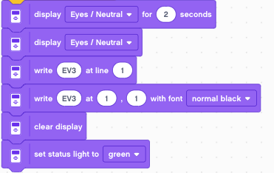
Display Tab
The Display Block to show information and pictures on the screen
You can control the location and size of text
You can also change the color of the EV3 lights
You can use this same block to display sensor readings and instructions

Slide 4

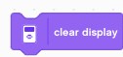
MORE ON Display Blocks
Line mode (Easier to use, only works for text mode)
12 lines of 10 pixels each
Normal characters are 1 line tall
Large characters are 2 lines tall
Pixel mode (Use for displaying images or text)
178 pixels left and right
128 pixels up and down
Notes:
Blocks will write over each other use Clear Display block to clear screen
The two display writes shown above are equivalent

Slide 5

Write at Coordinates With Font Block
Step 1:
Pick Display Text Block on right
Step 2:
Use the box on the left to enter the text you want to display
Step 3:
The two boxes in the middle give the x and y coordinates where the text will be drawn. The top left of the screen is (0,0).
Step 1:
Pick the font to use
Text to be displayed
Column to start display
Row to start display
Text size and color

Slide 6
DISPLAY BLOCK CHALLENGE 1
Can you write a program to display text in the middle of the screen?
Display “Hello World”
Make the display block run for 3 seconds
Can you also move while doing this?

Slide 7
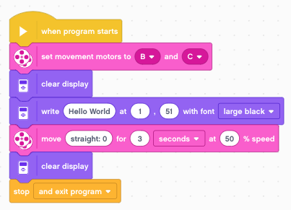
Challenge 1 solution

Slide 8
CHALLENGE 2: Two lines of Text
Now what if you want “Hello” to appear on one line and “World” to appear on the next line?
Hint: You will use two display blocks and don’t clear the screen on the second display block otherwise the first word will disappear!

Slide 9
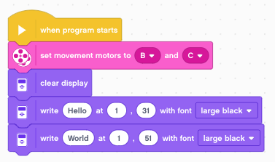
Challenge 2 Solution
Note that we don’t clear the screen after the display blocks and there is no End Program block. As a result, the message will be left on the screen.
The Large font is 20 pixels tall. Spacing the y coordinate from 31 to 51 ensure that the characters do not overwrite each other.

Slide 10

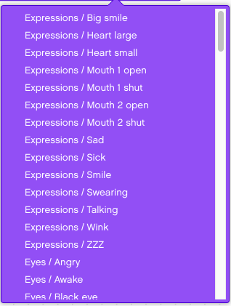

Displaying an image
Step 1:
Pick Display Image Block
Step 2:
Use the entry box to pick the image you want to display
The Display Image for Seconds block will display the image for the requested seconds before moving to the next block.

Slide 11
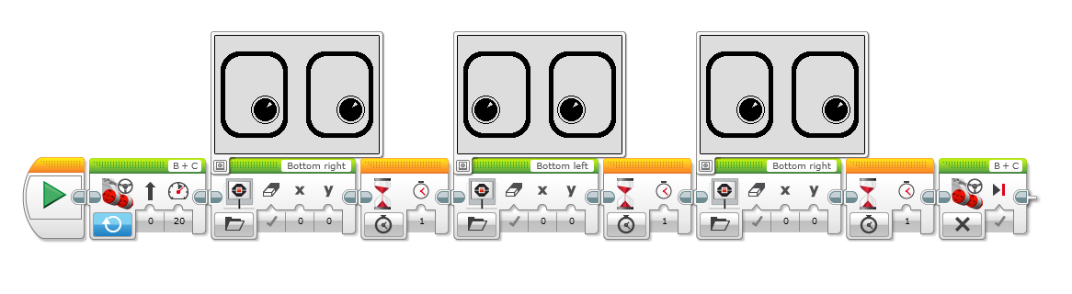


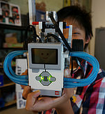
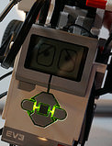
DISPLAY BLOCK CHALLENGE 3
Can you display eyes on the screen while moving? Alternate eyeballs that look left and right.
Use the Display Image for Seconds and Motor On blocks
Feel free to have fun with this challenge and make it yours!

Slide 12
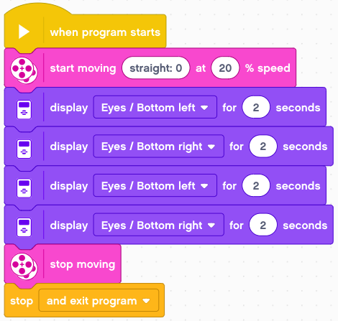
CHALLENGE 3 Solution
Motor On
Display Blocks
Motor Off

Slide 13
Discussion Guide
Why might you want to know how to use the display block?
You might want to know what the sensor value your robot is seeing
You might have to program a robot to stop when the robot reaches a red line but it stops before
Does the robot see the same thing you see?
You can display the value on the screen and check
It’s a great debugging tool. You can learn more about debugging code in one of our Intermediate lessons.

Slide 14
CREDITS
This tutorial was created by Sanjay Seshan and Arvind
More lessons are available at www.ev3lessons.com
This work is licensed under a Creative Commons Attribution-NonCommercial-ShareAlike 4.0 International License.

