Slide 1


BEGINNER PROGRAMMING LESSON
Installing on EV3

Slide 2
Lesson Objectives
Learn how to install Visual Code Studio
Learn how to prepare a microSD card for the EV3

Slide 3
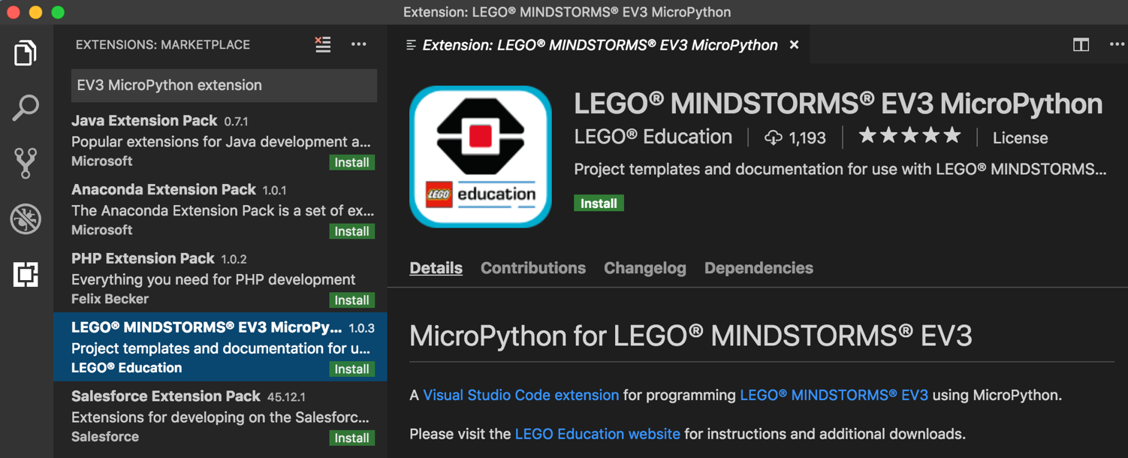
STEP 1: Installing Visual Studio
1. Download and Install Visual Studio Code (a source code editor) from the following page: https://code.visualstudio.com/Download
2. Launch Visual Studio Code
3. Click on Extensions in the left bar and then search for “EV3 MicroPython extension” in the search bar
4. Install the Extension

Slide 4
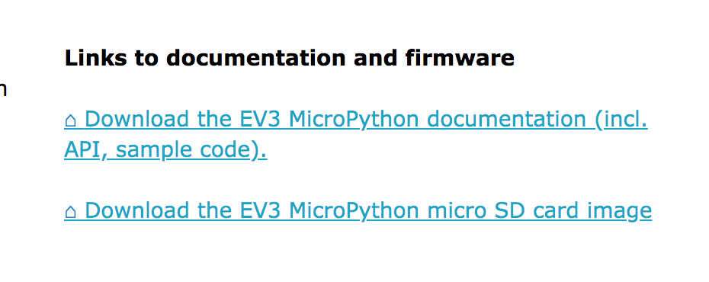
STEP 2: microSD Card
1, Download the EV3 MicroPython microSD card image file from the LEGO Education page (https://education.lego.com/en-us/support/mindstorms-ev3/python-for-ev3)
2. Download and install Etcher, microSD card flashing tool (https://www.balena.io/etcher/)
3. Place your microSD card in the computer and launch Etcher
In Etcher, select the EV3 MicroPython microSD card image file downloaded to the LEGO education site
Select the microSD card you inserted into the computer
Flash the card
April 25 Update:
There is a known bug. Use this version of Etcher:
https://github.com/balena-io/etcher/releases/tag/v1.5.26

Slide 5
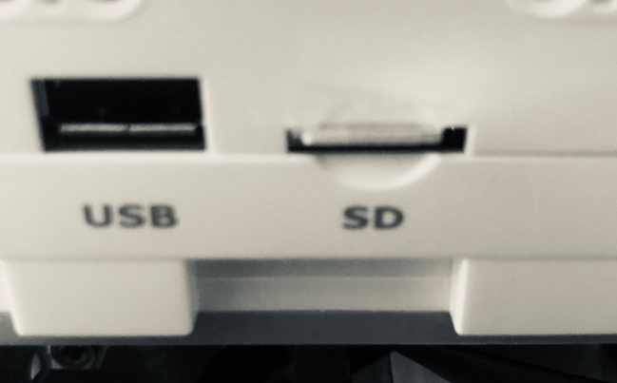
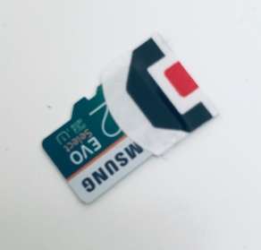
Step 3: Installing the microSD Card
1. Start with the EV3 brick off
2. Insert the microSD card into the EV3 brick
3. Turn on the EV3 Brick with the center button and wait till the light is green
Tip: The microSD card is hard to remove from the brick. Add a small piece of tape to the end before inserting.

Slide 6
Reverting back
If you want to go back to the original LEGO firmware, just turn off the brick
Remove the microSD card and turn the EV3 brick back on

Slide 7
CREDITS
Author: Sanjay and Arvind Seshan
More lessons are available at www.ev3tutorials.com
This work is licensed under a Creative Commons Attribution-NonCommercial-ShareAlike 4.0 International License.

