Slide 1


BEGINNER PROGRAMMING LESSON
Introduction to on EV3

Slide 2
Lesson Objectives
Learn about the menu on the screen
Learn how to create and download programs

Slide 3
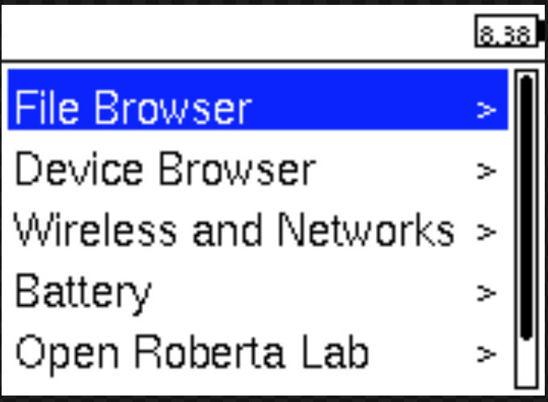
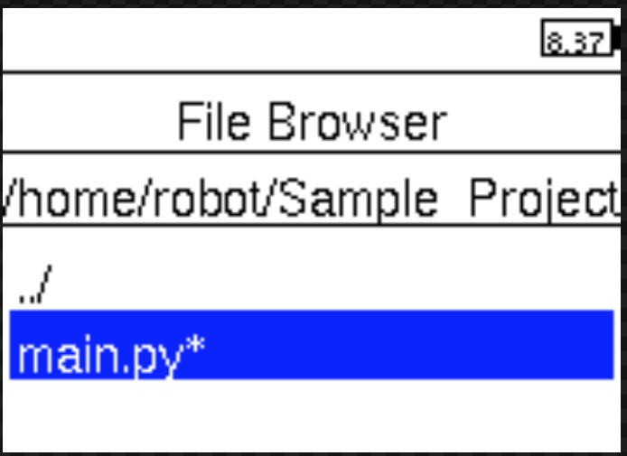
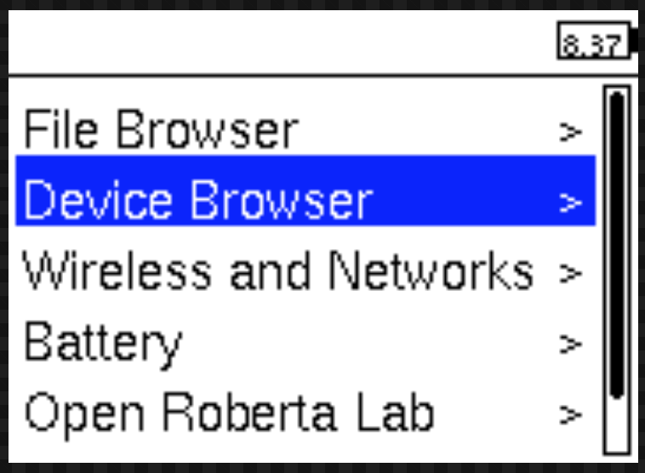
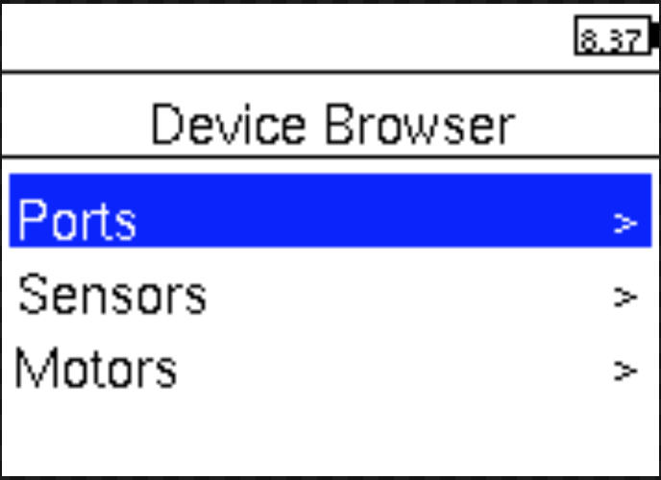
NAVIGATING the BRICK MENU
Finding Programs
Information about sensors and motors

Slide 4
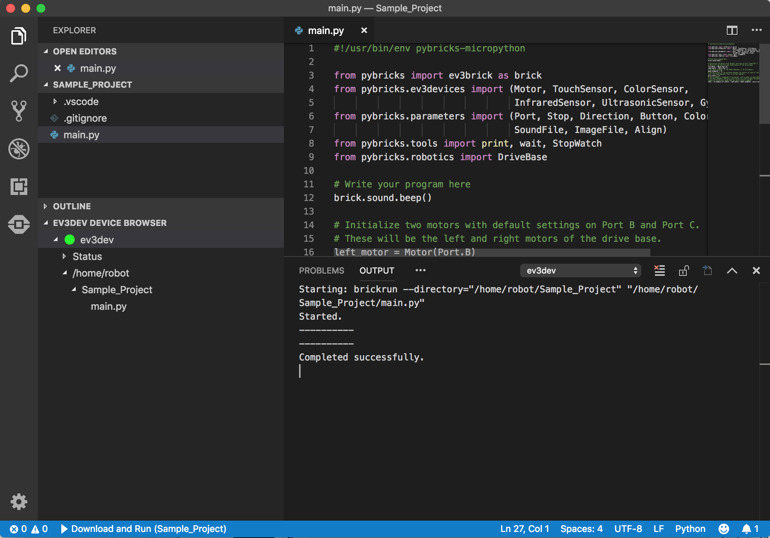
Navigating Visual Studio
Explorer
Search
Source Control
Debug
main.py
Extensions
EV3 MicroPython
Output

Slide 5
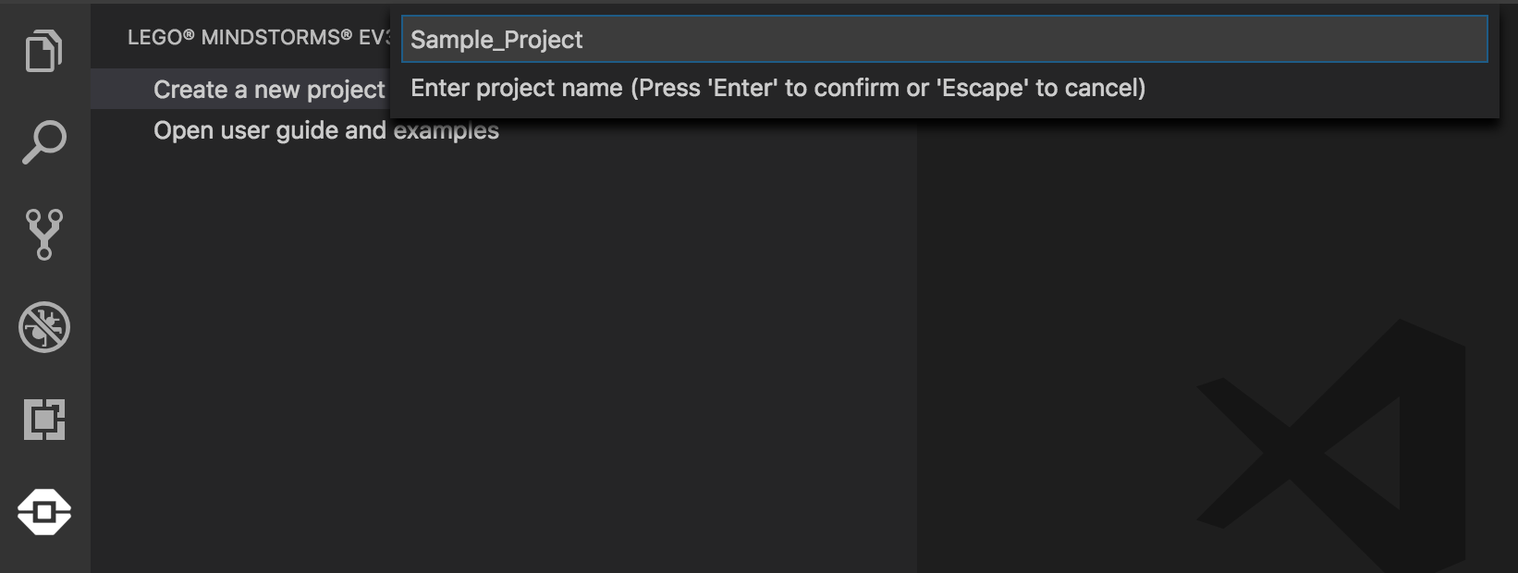
Creating a project
Click on the EV3 icon on the left bar
Click on “create a new project”
Enter a project name, choose a location for this project. Below, the name used is Sample_Project

Slide 6
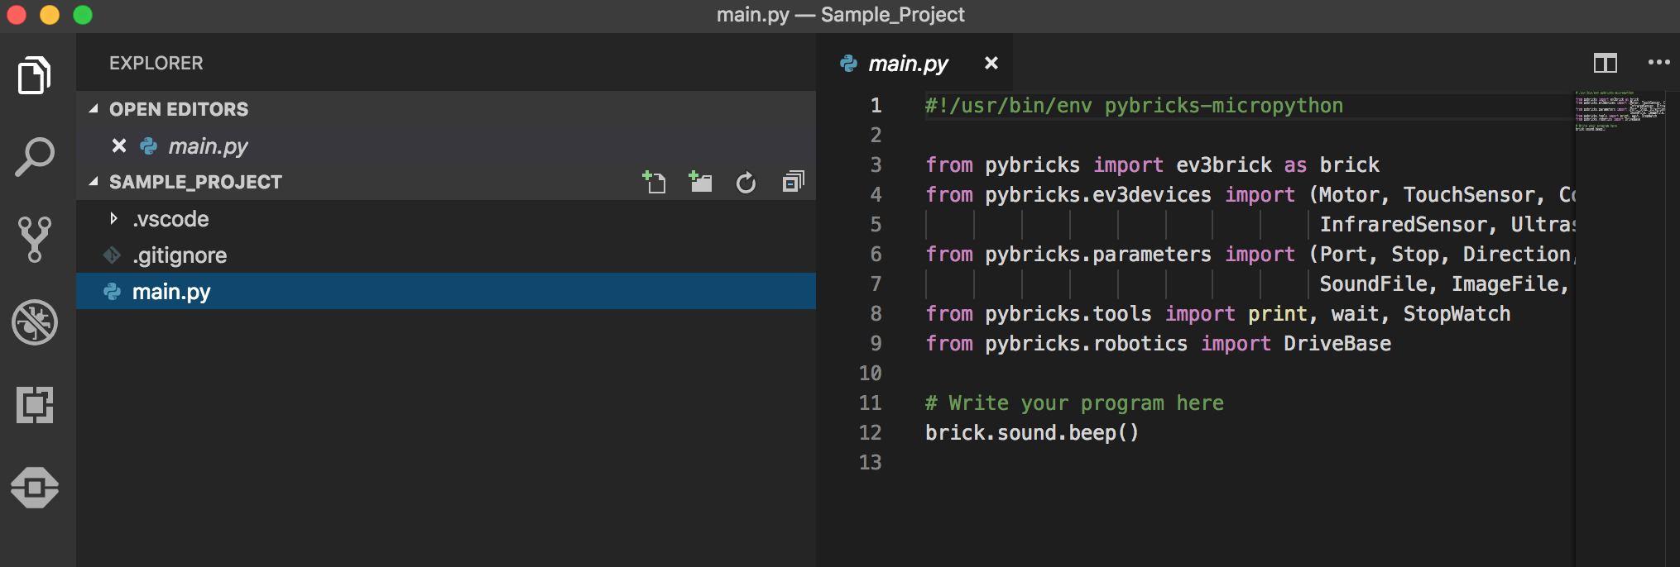
Start Programming
Click on main.py to start programming

Slide 7
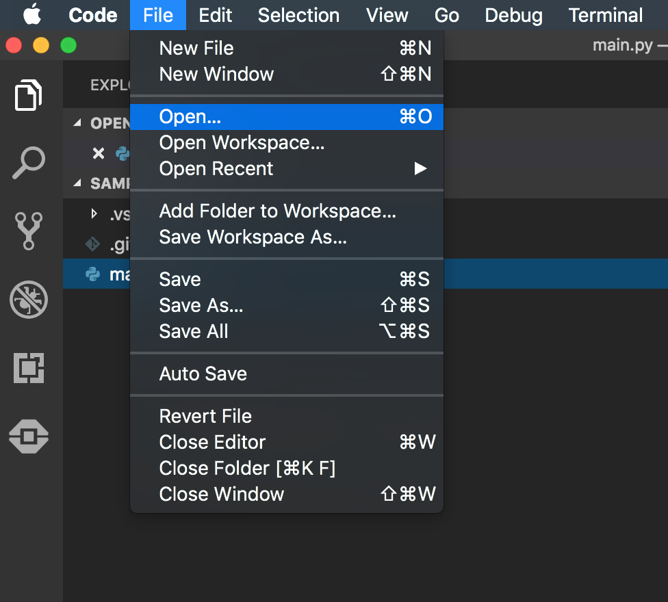
Opening a File
To open a project you created previously, click File and click Open Folder,
Select your project folder

Slide 8
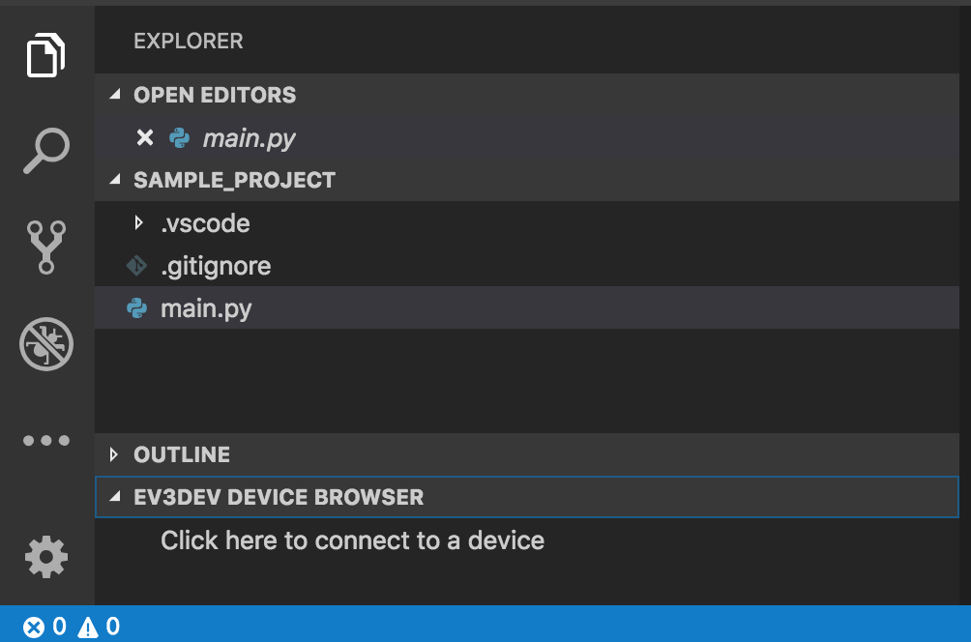
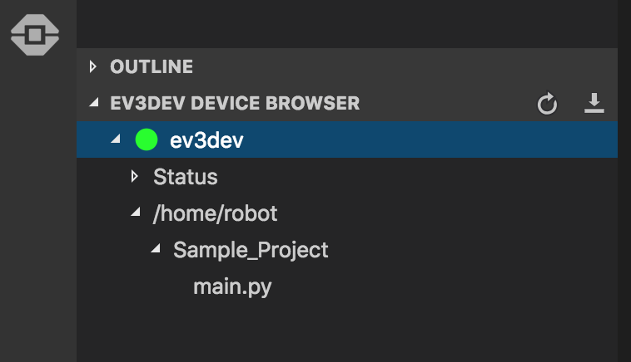
DOWNLOADING CODE TO EV3
To download code to to the EV3 brick, connect your EV3 to the computer with a mini-USB cable
Click on the Explorer/File icon on the left bar
Click on the EV3Dev Device browser, find your EV3, select the device and click to connect the device
To run the code on the brick, find the program using the file browser on the EV3 screen and press the center button on the EV3 to play the code

Slide 9
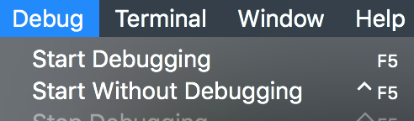
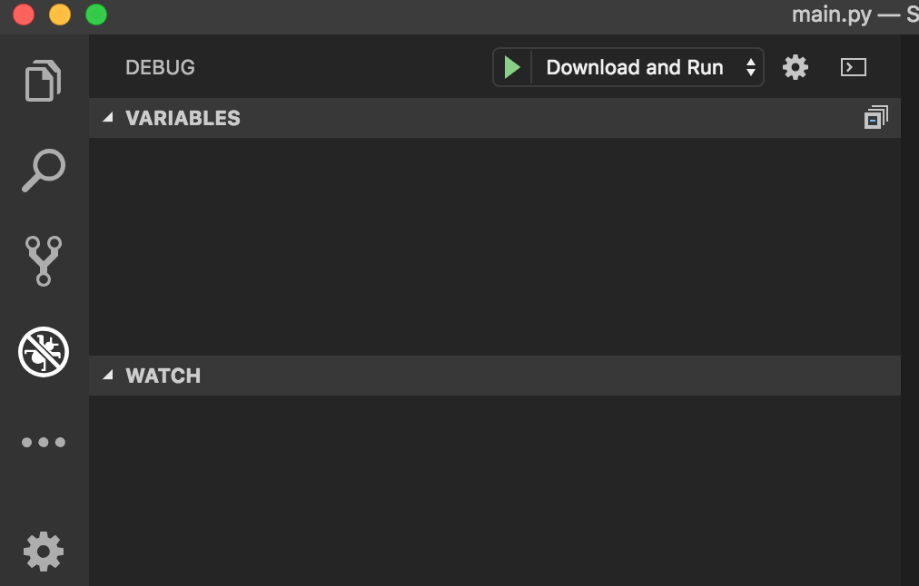
Downloading and running
To download and play from the computer, press F5
You can also go to the debug tab and press the green arrow next to “Download and Run”
To stop the program use the popup menu or hit the back button on the EV3 brick.

Slide 10
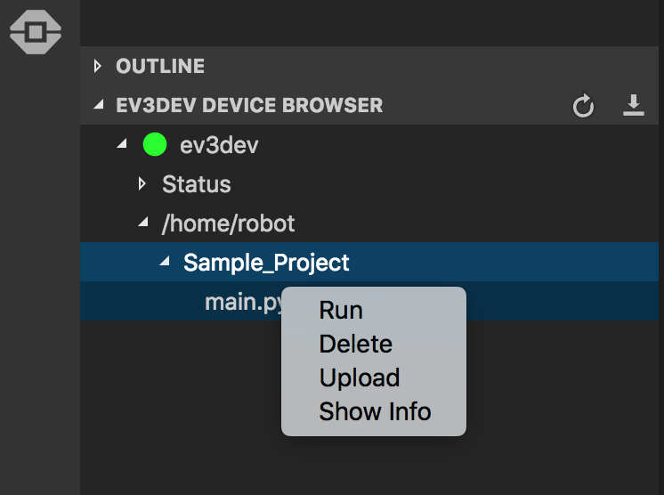
MANAGING FILES
The Device Browser area is very useful.
Once you have downloaded code to your EV3 brick, you can use this menu to run, delete or even copy a file back to your computer!
Right click on main.py to see the menu options
Note: In EV3-G, there is no way to recover a file that is on your brick but not on your computer. MicroPython lets to copy back code from the EV3 brick back to the computer.

Slide 11
CREDITS
Author: Sanjay and Arvind Seshan
More lessons are available at www.ev3tutorials.com
This work is licensed under a Creative Commons Attribution-NonCommercial-ShareAlike 4.0 International License.

