Slide 1
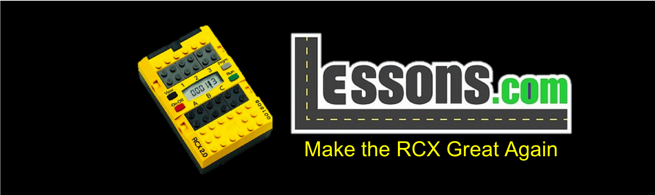

RCX PROGRAMMING LESSON
INTRODUCTION:
MAKE THE RCX GREAT AGAIN

Slide 2

Using the RCX in FLL 2018-19 INTO ORBIT™
There is a rumor that to make the INTO ORBIT FLL season more authentic, only technology similar to that which was used in the original Apollo missions can be used.
Therefore, only the RCX can be used, not the EV3 nor even NXT.
It is in your best interest to learn the RCX in the off-season.
Copyright © RCX Lessons 2018 (Last edit: 04/01/2018)

Slide 3
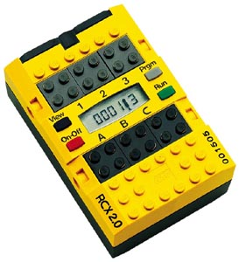
Why the RCX?
You probably have some lying around in your robotics lab. Why let them sit there in the dust?
If you don’t have some, they are inexpensive to purchase. Imagine how many RCX sets you can buy for the price of one EV3 set!
Keep it Simple Silly (KISS). There is not need for the LCD screen, gyro sensors, extra ports.
Infrared is way better technology than bluetooth or USB.
It’s the 20th anniversary of MINDSTORMS! Time to go retro and bring back 1998 MINDSTORMS and some old computers back to life.
Yellow is by far the best color. It is the color of the Sun and brings life to people on Earth.
It really is the best of the three MINDSTORMS systems. So, why wouldn’t you.
Copyright © RCX Lessons 2018 (Last edit: 04/01/2018)

Slide 4
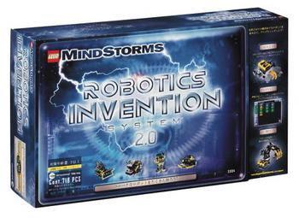
Lesson Objectives
Revive your old Windows XP PC
Install Robot Invention System 2.0
Copyright © RCX Lessons 2018 (Last edit: 04/01/2018)

Slide 5
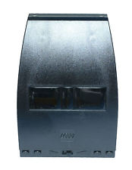
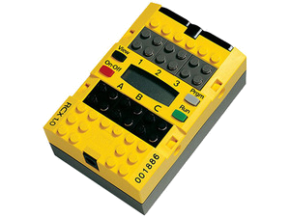
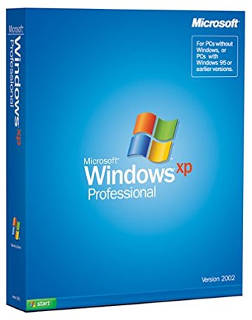
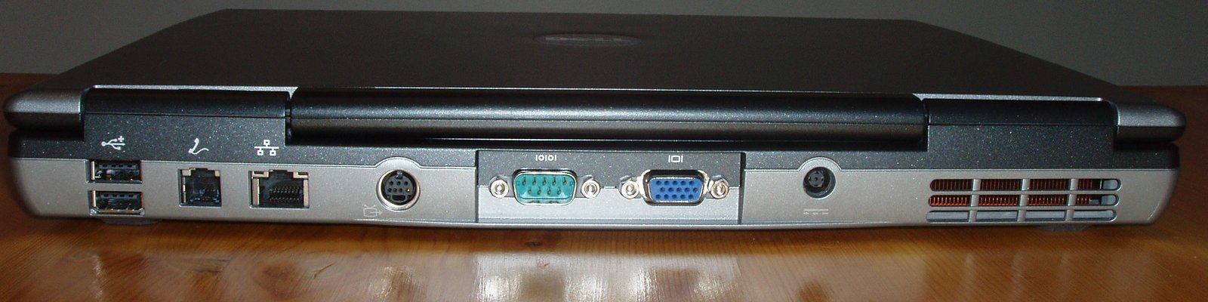
Get your RCX Out of the Basement
For this lesson you will need the following:
RCX Brick (1.0, 1.5, or 2.0) from the Robot Invention System Set
Serial IR Tower with cable
Dust off your Laptop/PC with a Serial Port
Windows XP install disc
CD image of RIS 2.0 from https://www.mediafire.com/folder/ohsruj4zmjy9g#718o6673jhpn9
You may have to buy these off eBay
Note: you probably should install Firefox (a modern browser) because IE6 won’t download these files, because it is too antiquated.
Copyright © RCX Lessons 2018 (Last edit: 04/01/2018)

Slide 6
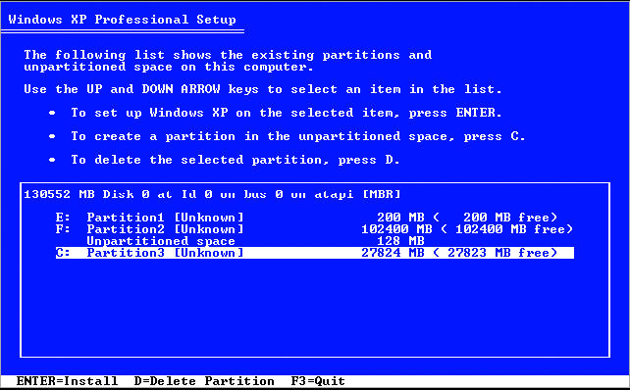
Install Windows XP on your PC (If not done so already)!
Everyone knows that Windows XP is superior so we recommend you install it
If you prefer, Windows 98SE or ME are also recommended by LEGO® and Microsoft. You can get a free copy at https://winworldpc.com/home
Everyone loves using outdated OS’s. 3% of the market still uses them.
Insert the CD and follow the install instructions, wiping out all your existing data on your hard drive!
Copyright © RCX Lessons 2018 (Last edit: 04/01/2018)

Slide 7
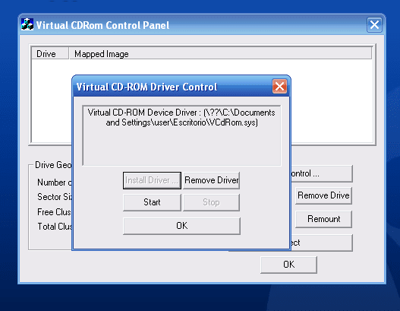
Get a ISO Reader for your new Windows XP PC
Download the file: https://www.microsoft.com/en-us/download/details.aspx?id=38780
Use it to mount the ISO file you downloaded for RIS 2.0
You will need to “install driver” in the panel first
Copyright © RCX Lessons 2018 (Last edit: 04/01/2018)

Slide 8
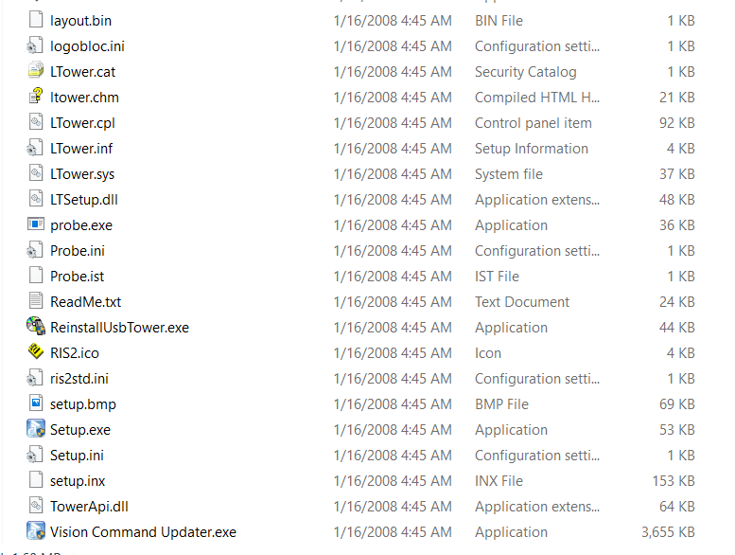
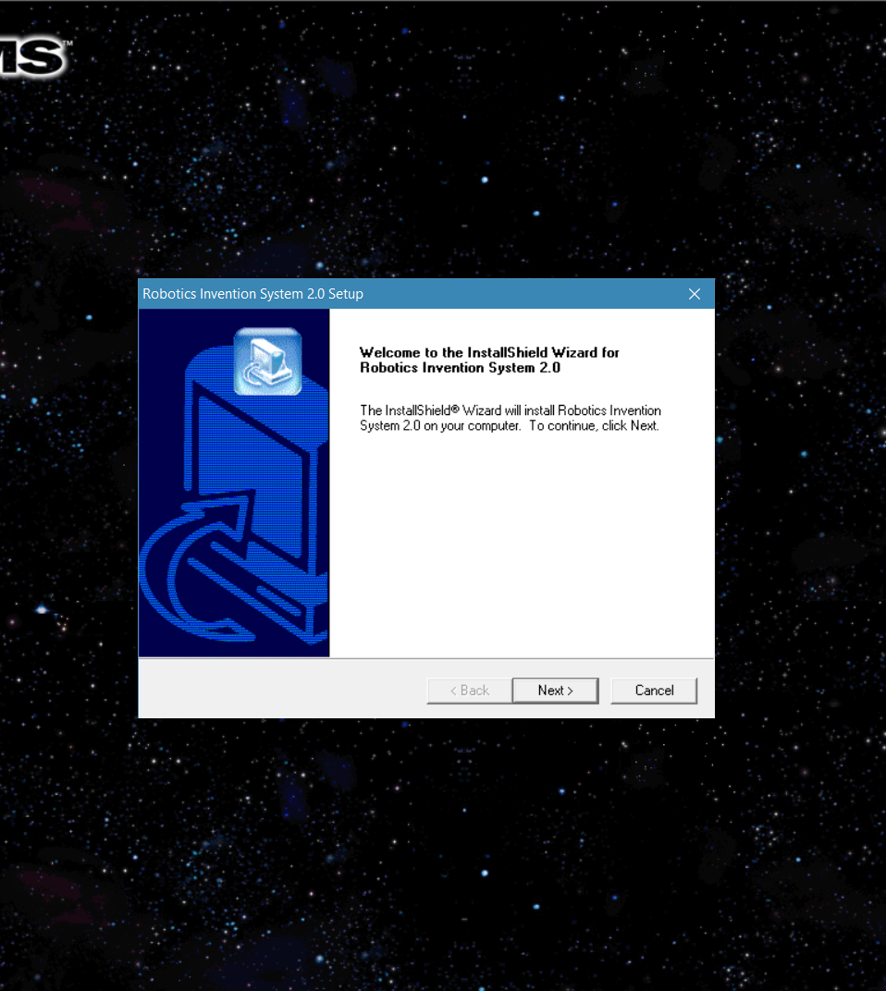
INSTALL RIS 2.0
Run Setup.exe in the new drive (mounted iso) that is found in Windows Explorer
Follow the instructions to install!!!
Copyright © RCX Lessons 2018 (Last edit: 04/01/2018)

Slide 9
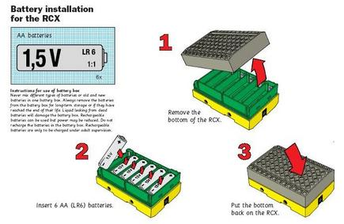
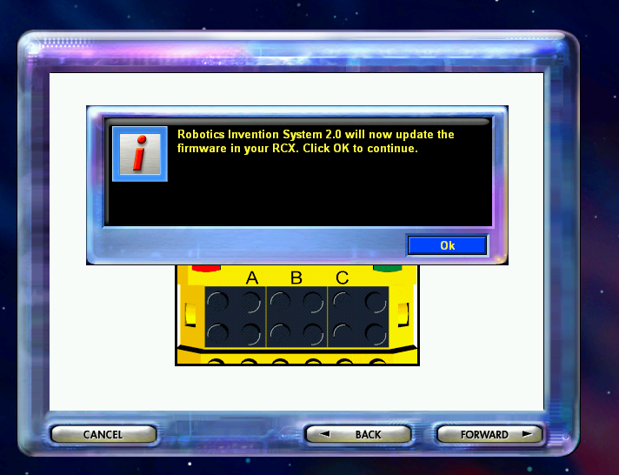
Setup RIS 2.0
Follow the onscreen instructions.
Plug in the IR tower with a 9V battery
Turn on the RCX and update the firmware
If you are lucky, everything will work perfectly!
Remember to put 6 AA’s into your RCX!
Copyright © RCX Lessons 2018 (Last edit: 04/01/2018)

Slide 10
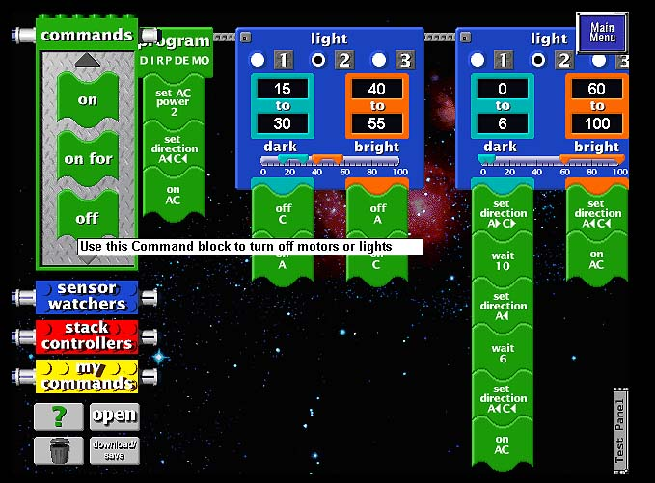
Success At Last!
Now, you have your fully functioning programming environment.
Download programs to your RCX through an extremely slow IR tower (learn patience, young Padawan)!
Have Fun!
Copyright © RCX Lessons 2018 (Last edit: 04/01/2018)

Slide 11
IMPORTANT NOTICE
After playing around with the RCX, we have found it to be superior to the newer platforms.
Therefore, from now on, we will only be making lessons for the RCX System
Copyright © RCX Lessons 2018 (Last edit: 04/01/2018)

Slide 12
CREDITS
Author: Sanjay and Arvind Seshan
More lessons are available at RCX Lessons.com
This work is licensed under a Creative Commons Attribution-NonCommercial-ShareAlike 4.0 International License.
Copyright © RCX Lessons 2018 (Last edit: 04/01/2018)

