Slide 1


EV3 Classroom: Daisy-chaining
By David Lechner

Slide 2
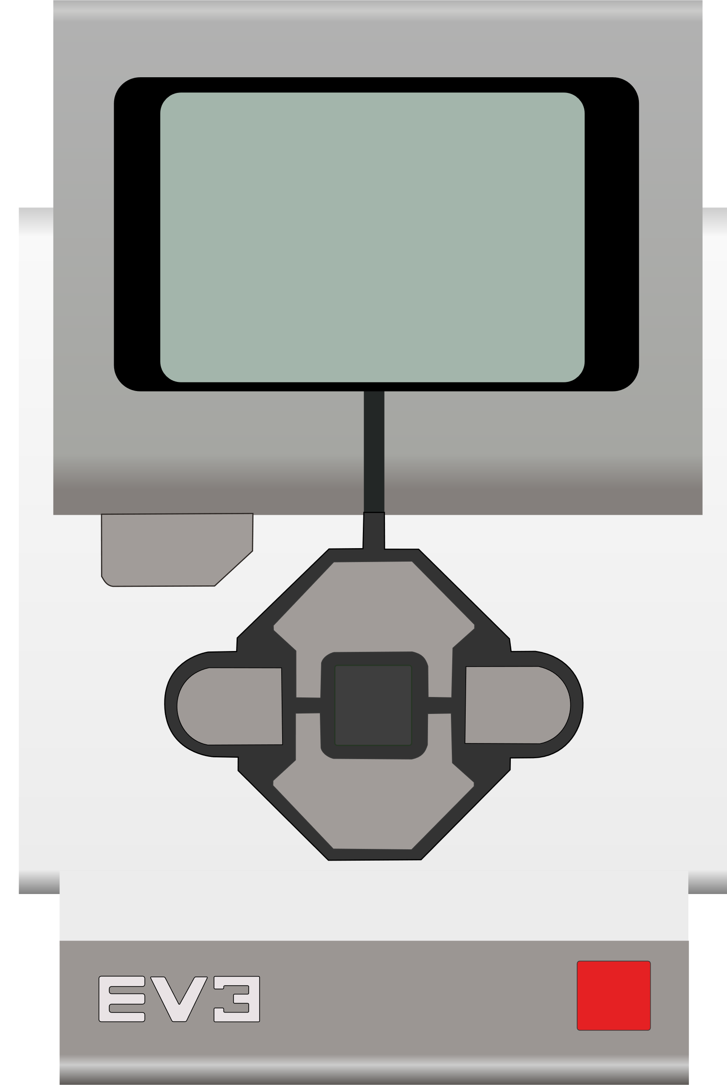
Lesson Objectives
Learn how to daisy-chain multiple EV3 bricks using USB cables
Learn how to write a program using daisy-chaining

Slide 3
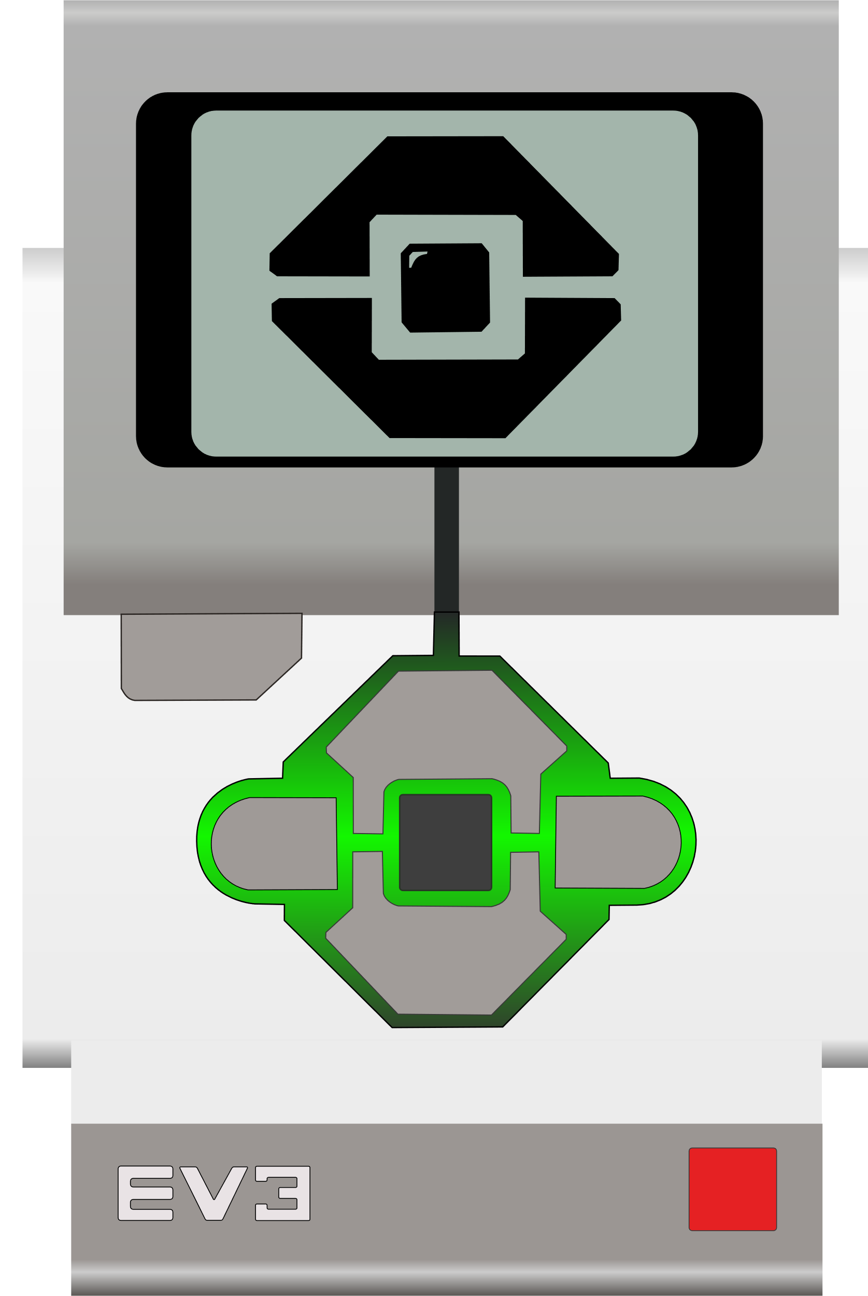
Connecting the EV3s
The side USB port gets connected to the top USB port on the next EV3 in the chain
Make sure to power on the last EV3 in the chain first
Notes:
The first EV3 brick in the chain is the one connected to the computer, either with USB or Bluetooth.

Slide 4
Layers
Each EV3 in the chain has a “layer” number
There can be up to 4 layers
1
2
3
4

Slide 5
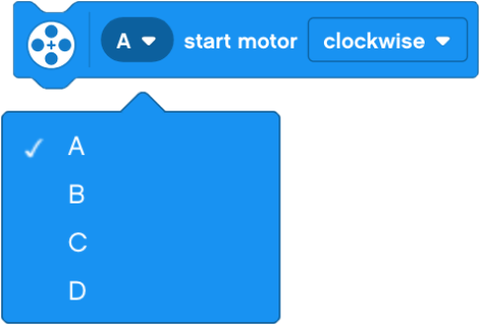
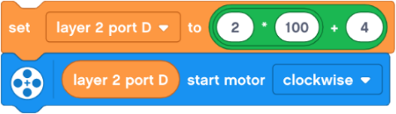

Selecting the layer and the port
In EV3 Classroom there is not a way to select the layer
Use variables with this formula instead
The layer and port are both numbers between 1 and 4
For output ports A = 1, B = 2, C = 3, and D = 4
$$layer ×100+port$$
?
✔

Slide 6
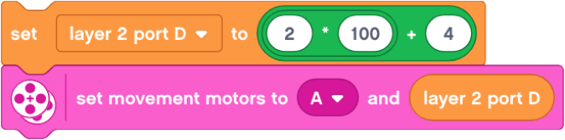
Movement blocks
For movement blocks only add the layer to the right motor port
Only one pair of motors can be used with the movement blocks per layer
Notes:
The limit of one pair of movement motors per EV3 is a limitation of the firmware, not the programming software.

Slide 7



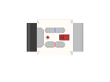
Super-tank example
Super-tank has 4 EV3 bricks, 8 motors and 1 infrared sensor
All port B motors drive the left tank tread and all port C motors drive the right tank tread

Slide 8
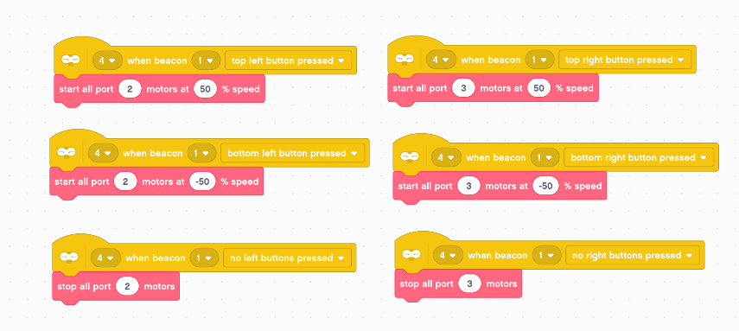
Super-tank example
The left buttons on the remote control the left motors connected to port B on each EV3 and the right buttons control the right motors connected to port C on each EV3
Notes:
Remember, B = 2 and C = 3. Positive speed goes forward and negative speed goes backward.

Slide 9
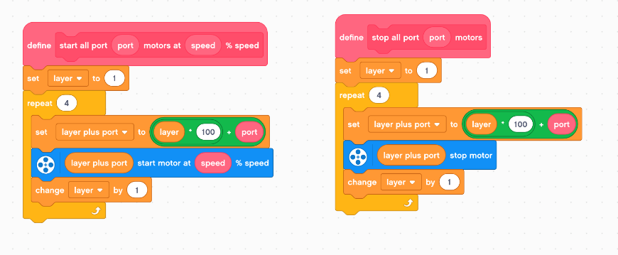
Super-tank example
The repeat loop tells the motor on each of the 4 layers to start or stop

Slide 10
Credits
This tutorial was created by David Lechner
More lessons at www.ev3lessons.com
This work is licensed under a Creative Commons Attribution-NonCommercial-ShareAlike 4.0 International License.

