Slide 1

Gyro Move Straight & Gyro Wall Follow
By Sanjay and Arvind Seshan

Slide 2
Lesson Objectives
Learn what proportional control means and why to use it
Learn to apply proportional control to get your robot to move straight
Lear to apply proportional control to the Gyro sensor to wall follow (move at a particular angle)
Prerequisites: Math Blocks, Data Wires, Proportional Control, Gyro Sensor

Slide 3
Tips For Success
You must go through the Proportional Control Lesson and the Proportional Line Follower Lesson before you complete this lesson
You must also complete the two Gyro Lessons.
The concept of proportional control is used in this lesson to go straight and wall follow
Just like for any other proportional control, you need to figure out how to measure error and an appropriate correction
Video of how the robot will behave: https://youtu.be/0gII2wZs44Y

Slide 4
Pseudocode/Hints
Application | Objective | Error | Correction
Gyro Straight | Make the robot at a constant heading/angle | How far you are from that heading/angle | Turn sharper based on how far you are from that angle
Line Follower | Stay on the edge of the line | How far are our light readings from those at line edge (current_light – target_light) | Turn sharper based on distance from line
Gyro Turn | Turn to a target angle | How many degrees are we from target turn | Turn faster based on degrees remaining

Slide 5
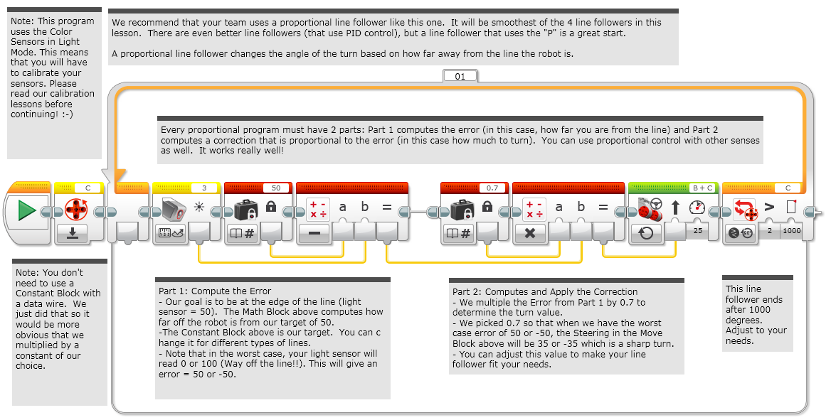
FYI: Proportional Line Follower

Slide 6
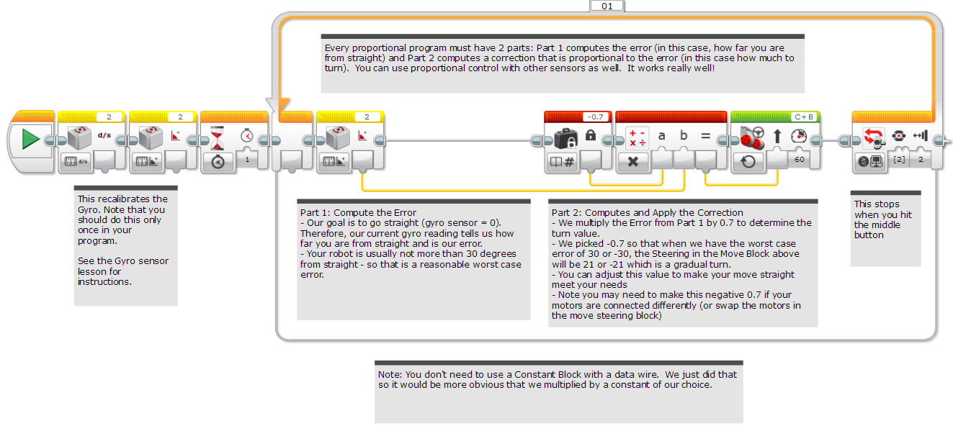
Code: Gyro Move Straight

Slide 7
Discussion Guide
Compare the proportional line follower code with the proportional move straight code. What similarities and differences do you see? Ans. The code is almost the same. The one difference is how the error is calculated. The error is calculated using the gyro sensor. The correction is identical!

Slide 8
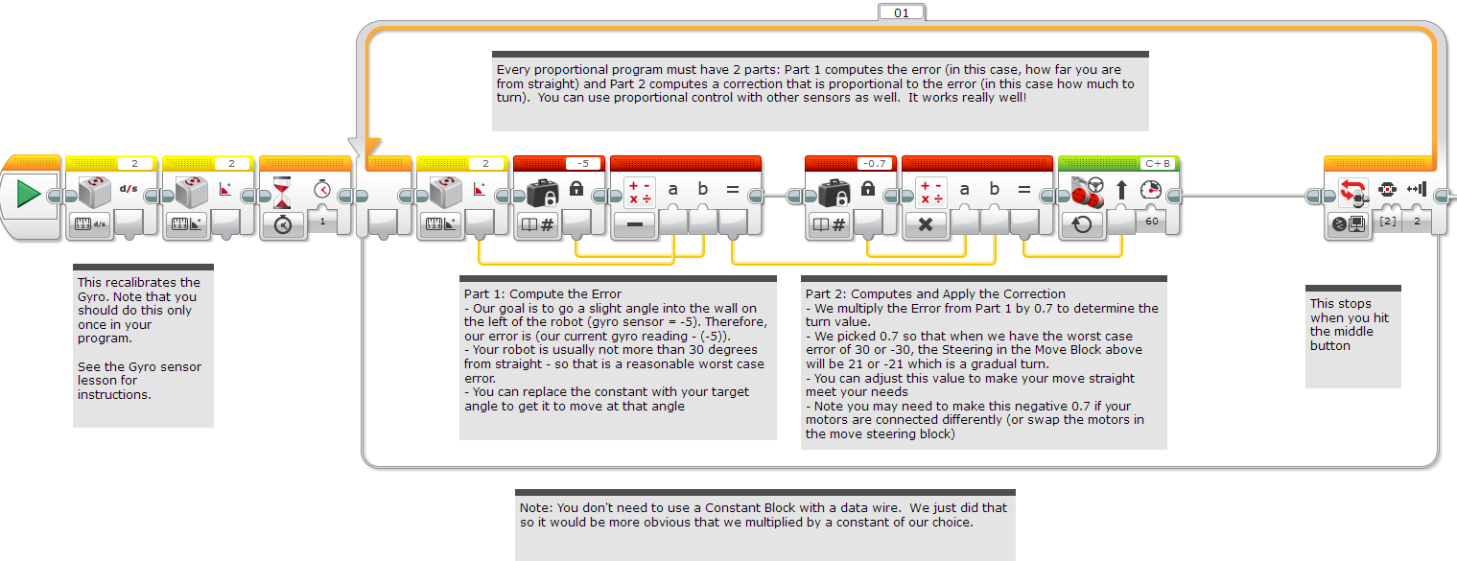
Code: Gyro Wall Follow

Slide 9
Discussion Guide
Compare the move straight code with the wall follow code. What similarities and differences do you see? Ans. There is no target angle for moving straight is 0. But when you want to wall follow, you have to enter a target value of how much you want to angle into the wall.

Slide 10
Credits
This tutorial was created by Sanjay Seshan and Arvind Seshan
More lessons at www.ev3lessons.com
This work is licensed under a Creative Commons Attribution-NonCommercial-ShareAlike 4.0 International License.

