Slide 1


EV3 Classroom: Gyro Turns
By Sanjay and Arvind Seshan

Slide 2
Lesson Objectives
Learn what Gyro Lag is
Learn one way to correct for this lag
Understand why it is important to explore alternative solutions to a problem
Prerequisites: My Blocks with Inputs and Outputs, Operator Blocks

Slide 3
Gyro Problem 2: Lag
What is lag?
The gyro sensor readings lag behind the true value sometimes
When the turn starts, it takes time for the gyro to begin changing
This lesson presents one way to deal with lag in a turn: reduce the amount of angle that you turn to compensate for lag

Slide 4
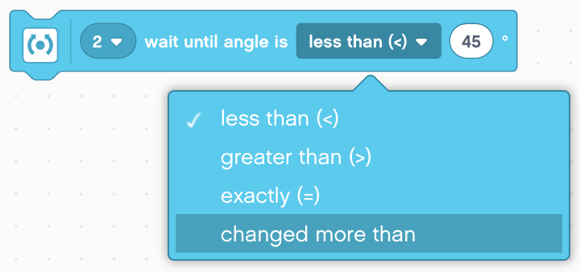
Change Mode in Wait Block
In this lesson we use the Wait Until Angle Is Block in the “changed more than" mode.
Advantages over Compare Mode (less than, greater than, exactly):
You do not need to reset the gyro beforehand
You can measure if the value has changed the target degrees by increasing or decreasing just by changing degrees from positive to negative (Don’t have to change the sign from greater than to less than also when turning left)

Slide 5
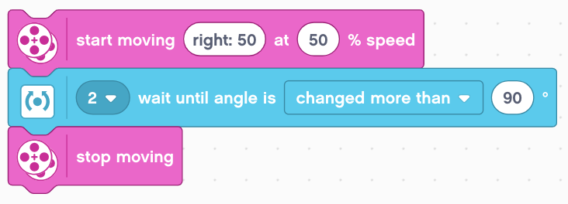
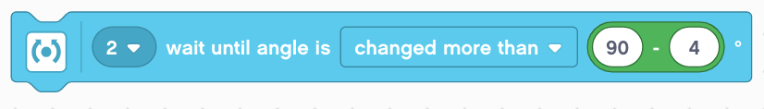
Gyro Turn in Four Easy Steps
STEP 1: Create a simple Gyro Turn program that turns 90 degrees using the Wait for Gyro block in Change Mode
STEP 2: Compensate for Lag
Compensate for the lag by reducing the amount of angle to turn based on your robot (e.g 86 degrees instead of 90 degrees)
Use a Math Block to create an automatic calculator to compensate for lag
STEP 3: Create My Block
STEP 4: Repeat the steps to make one for Left Turns vs. one for Right Turns.

Slide 6
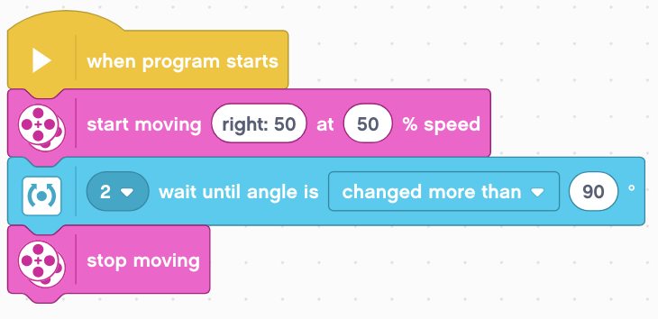
Step 1: Simple Gyro Turn
Start turning
Wait until the angle has changed by 90 degrees
Stop turning

Slide 7
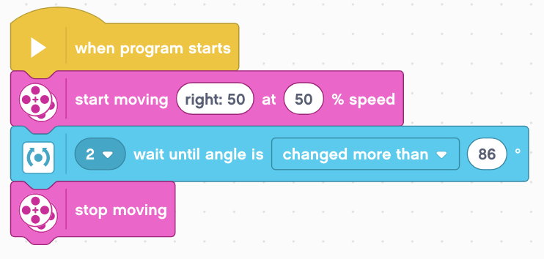
Step 2A: Dealing with Lag
Start turning
Wait until the angle has changed by 86 degrees. The robot will actually turn 90 degrees, but because of lag, it will read 86 when it has turned 90.
Stop turning

Slide 8
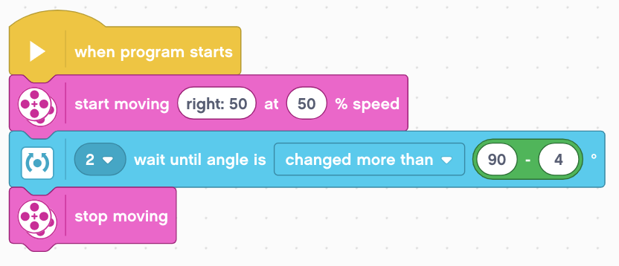
Step 2B: Automatically Correct for Lag
Math Block was added to automatically correct for lag. The user can type how many degrees they want the robot to go and it will compute the correct number to deal with lag (in this case 86)

Slide 9
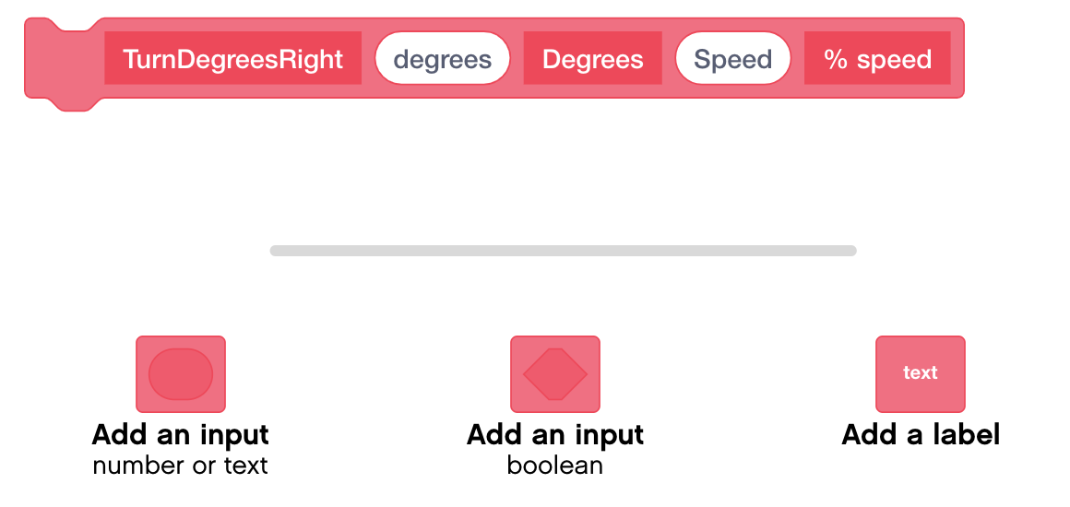
Step 3A: Create a My Block
Add 2 inputs for degrees and one for speed and corresponding labels
Refer to the My Blocks with Inputs & Outputs lesson if you need help setting up the My Block

Slide 10
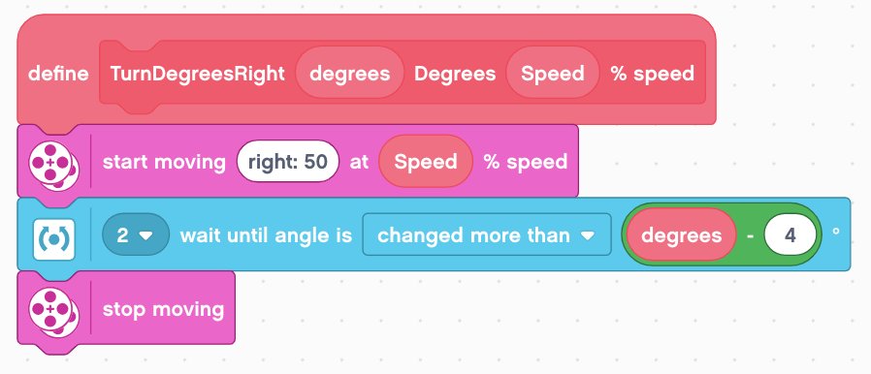
Step 3B: Add Blocks Under Define Block
Place the necessary blocks under the Define Block and and place the inputs in the correct spots as shown above.

Slide 11
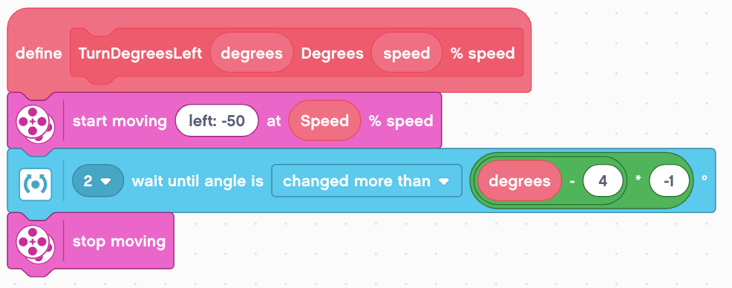
Step 4: Create Turn Left My Block
The only differences from the TurnDegreesRight My Block is that the Start Moving Block turns left and the input in the Wait Until Angle Is Block is made negative since the gyro value will be negative.

Slide 12
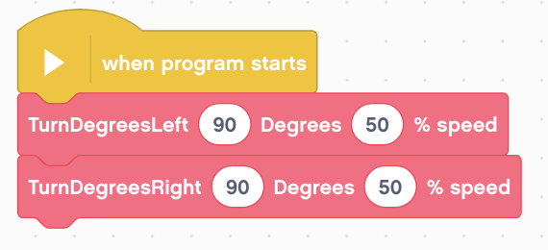
Using the My Block
Your My Blocks can now be found in the My Blocks tab.
The program on the left turns 90 degrees to the left and then 90 degrees to the right.
Remember to run the gyro recalibration code before you run this code in case the gyro is drifting.

Slide 13
Discussion
What is gyro lag?
Ans. The gyro sensor’s reading lags behind the true reading
What is one way to compensate for lag?
Ans: Reduce the number of degrees that you turn

Slide 14
Credits
This tutorial was written by Sanjay Seshan and Arvind Seshan
More lessons at www.ev3lessons.com
This work is licensed under a Creative Commons Attribution-NonCommercial-ShareAlike 4.0 International License.

