Slide 1

BEGINNER PROGRAMMING LESSON
Good Coding Practices: Using Comments

Slide 2
LESSON OBJECTIVES
Learn why to comment code
Learn the two types of comments available
Learn what makes useful comments

Slide 3
Why bother with comments?
Comments in code help the author of the code remember what they were trying to accomplish. You can use them to record the goals or pseudocode for the code.
It makes it easier to debug. You could use it to take notes on values
More importantly, comments allow someone other than the author of the code to understand the program.
Get into the habit of adding comments to your code

Slide 4

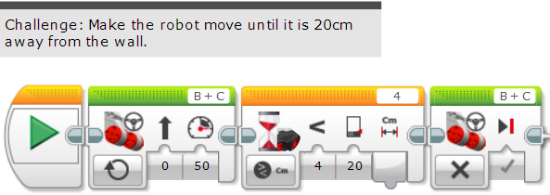
Types of Comments: Text Boxes
The EV3 allows you to add grey text boxes of any size.
They are found at the top right corner of your screen.
They can be used for lots of text, but will have to be manually moved with the corresponding code blocks if you add or delete code.

Slide 5
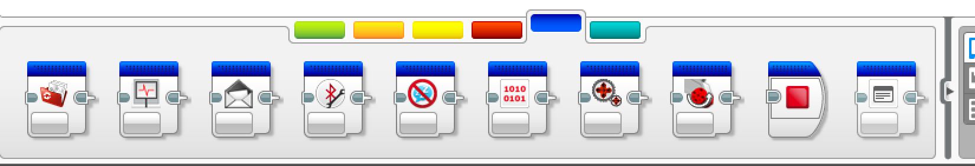
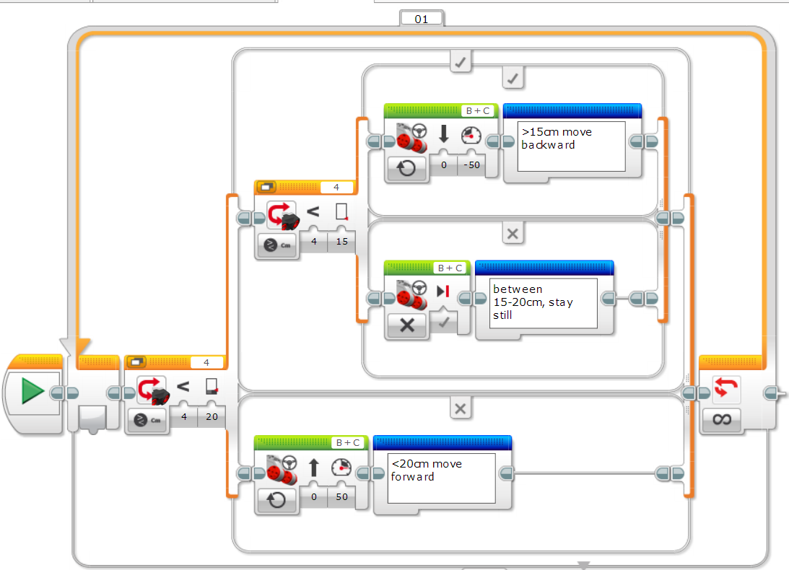
Types of Comments: Comment blocks
The Comment Block can be found in the Blue Programming Pallet Tab.
The advantage of using this block is that like any other block, it stays with the code as you modify it.

Slide 6
USEFUL & NOT USEFUL Comments
+ Telling the reader what the robot is doing at this point in the code (hitting the lever with motor A, turning to the right and going towards the Mission X)
- Repeating the contents of a block of code (e.g. Move straight 1040 degrees).

Slide 7
TIPS FOR COMMENTING CODE
Commenting your code is very important.
However, note that the blue comment blocks (even if used in a parallel beam) can change the timing of programs.
Therefore, if your team uses a lot of comments, try to use the grey text boxes instead.
Comment Block
Text Box

Slide 8
CREDITS
This tutorial was created by Sanjay Seshan and Arvind Seshan
More lessons are available at www.ev3lessons.com
This work is licensed under a Creative Commons Attribution-NonCommercial-ShareAlike 4.0 International License.

