Slide 1


BEGINNER PROGRAMMING LESSON
EV3 Classroom: Color Sensor

Slide 2
Lesson Objectives
Learn how to use the Color Sensor
Learn about Coast and Brake

Slide 3
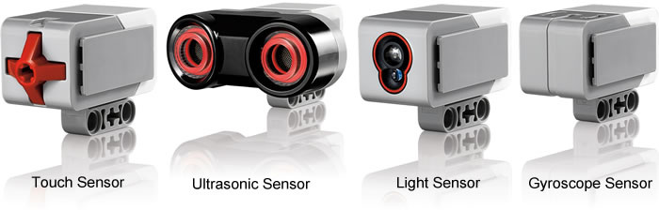
What is a sensor?
A sensor lets an EV3 program measure and collect data about is surroundings
The EV3 sensors include:
Color – measures color and darkness
Gyro – measures rotation of robot
Ultrasonic – measures distance to nearby surfaces
Touch – measures contact with surface
Infrared – measures IR remote’s signals
Color Sensor
Infrared Sensor
Image from: http://www.ucalgary.ca/IOSTEM/files/IOSTEM/media_crop/44/public/sensors.jpg

Slide 4
What is the color sensor?
What are they? Sensors that detect the intensity of light that enters it
Three modes: Color, Reflected Light Intensity and Ambient Light Intensity
Color Mode: Recognizes 7 colors (black, brown, blue, green, yellow, red, white) and No Color
Reflected Light: Measures the intensity of the light reflected back from a lamp that emits a red light. (0=very dark and 100=very light)
Ambient Light: Measures the strength of the light that enters the sensor from the environment. (0=very dark and 100=very light)
USES:
Move until a line, Follow a line, Find a color
Play a game using the color sensor
We will use COLOR MODE in this Lesson

Slide 5
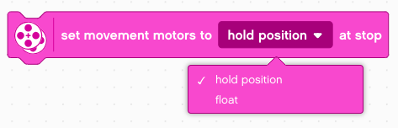
ANOTHER MOVE STEERING TIP: hold position or Float?
Something more about the Move Steering Block
You will notice you have an option to HOLD POSITION or FLOAT. This is the same as BRAKE and COAST in EV3-G.
Float will make the motors keep moving. Hold Position makes the motors stop immediately.
Which do you use to stop EXACTLY on a colored line?

Slide 6
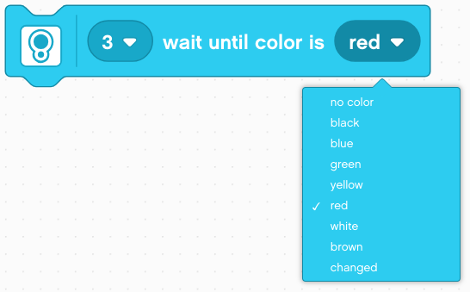
COLOR SENSOR CHALLENGE
Make the robot move up to a green line using the color sensor.
Step 1: Set up motors (e.g. hold position or float)
Step 2: Start Driving
Step 3: Wait for the color sensor to detect green using the Wait Until Color Is block
Step 4: Stop motors
Hint: You will use Move Steering (think about motor on and off) and Wait for “Color”

Slide 7
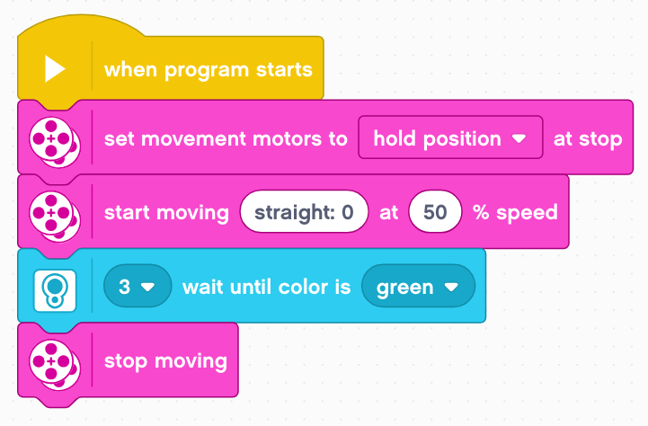
Color Sensor Challenge Solution
FINISH
Sets motors to hold position
Start Moving With Steering At Speed block starts moving the robot and moves on to the next block
Waits until Color is Green
Stops moving
START

Slide 8
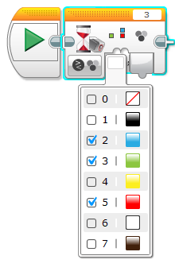
Notes For EV3-G Users
You can not look for more than one color with just the color sensor blocks
However, other code can be written that will have the same effect.

Slide 9
CREDITS
This tutorial was created by Sanjay Seshan and Arvind Seshan
More lessons are available at www.ev3lessons.com
This work is licensed under a Creative Commons Attribution-NonCommercial-ShareAlike 4.0 International License.

