Slide 1


BEGINNER PROGRAMMING LESSON
EV3 Classroom:
Port View & Using Sensor Data

Slide 2
Lesson Objectives
Learn how to retrieve and use data from your sensors
Learn how to use Port View on the EV3 Brick
Learn some examples of when and where Port View would be useful
Try to solve some common problems using Port View

Slide 3
WHY DO YOU NEED SENSOR DATA?
Sensor data can be….
Used to help program more easily (no more guess and check!!)
Used to help program more accurately
Used to debug code as well as build issues
PORT VIEW is an easy way to access SENSOR DATA!

Slide 4
How do you get to Port View?
Step 1:
Click the Left or Right buttons on the brick until you get to the third tab on the screen (icon with six small circles).
The first choice in this tab is Port View. (Click the middle button on the brick to select Port View)
Step 2:
Use the Left and Right Buttons to pick the port and sensor/motor you want
Left
Right
All images of the EV3 Brick in this lesson were obtained using screenshots of Cogmation’s Virtual Robotics Toolkit.

Slide 5
WHAT YOU SEE in PORT VIEW
A. PORT Number
B. SENSOR/MOTOR & MODE
C. If you select a particular sensor (middle button on brick), you can change the MODE
D. VALUE . You might want to start at “0” (e.g. If trying to measure degrees for a turn). To reset the value, exit Port View and return to back to this screen.
A
B
C
A
B
D
All images of the EV3 Brick in this lesson were obtained using screenshots of Cogmation’s Virtual Robotics Toolkit.

Slide 6
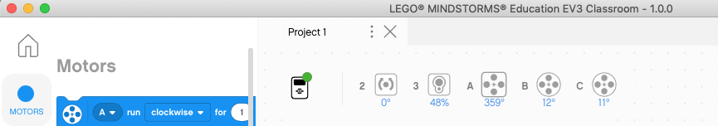
On Computer Port View
You can view the current sensor/motor readings on the computer when the robot is connected.
The readings will appear at the top of the programming canvas as shown below
To see a more detailed view of the sensors (Brick Dashboard) you can click on the brick icon with the green dot

Slide 7
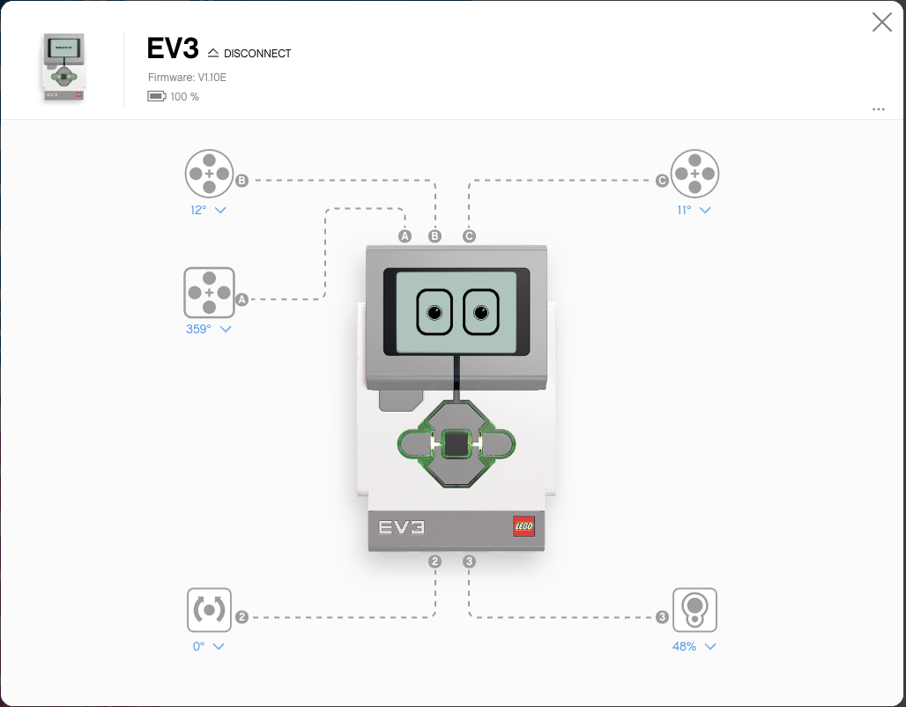
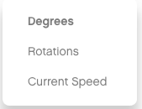
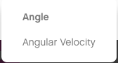
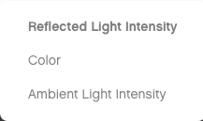
Brick Dashboard
The Brick Dashboard view shows you the connections more visually
You can also click on the sensor reading to change the measured quantity

Slide 8
PORT VIEW IS POWERFUL
As you go through the rest of the lessons on EV3Lessons.com, you will use Port View often
As you complete each challenge, think about how Port View might help you.
The next page has many several examples to think about.

Slide 9
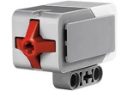
OTHER PROBLEMS YOU CAN SOLVE WITH PORT VIEW
Challenge 1: Program Easier/More Accurately
I want to go from a starting point up to a LEGO model. I keep having to guess and check. How can I figure out how far away the LEGO model is?
Challenge 2: Program Easier/More Accurately
I want my robot to turn 90 degrees. But 90 degrees in the real world is not 90 degrees in the steering block. So, how much does my robot have to turn to make a 90 degree turn?
Challenge 3: Debug Code
The robot does not folllow the green line like I programmed it to do. Why not? What color does the robot think that green line is? Try placing the robot on different objects or parts of mat/picture – what colors or reflected light values does the sensor read
Challenge 4: Check Builds
I built my robot with the touch sensor a little bit inside the robot. I am not sure that the touch sensor is getting pressed enough. How can I make sure the sensor is getting pressed?
Challenge 5: Test Sensors
I told my robot to stop when the Ultrasonic sensor is 20cm away. But it seems to stop earlier. Is the sensor working correctly? How can I see what the ultrasonic sensor sees?

Slide 10
CREDITS
This tutorial was created by Sanjay Seshan and Arvind Seshan
More lessons are available at www.ev3lessons.com
This work is licensed under a Creative Commons Attribution-NonCommercial-ShareAlike 4.0 International License.

