Slide 1


BEGINNER PROGRAMMING LESSON
EV3 Classroom: Sound Block

Slide 2
LESSON OBJECTIVES
Learn to use the Sound Block
Understand why the Sound Block can be useful in programming

Slide 3
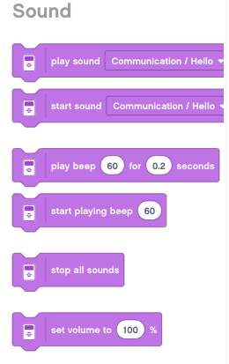
Sound Block
The Sound Block plays sounds to the EV3
You can play files, tones, and notes
Located in Sound tab

Slide 4
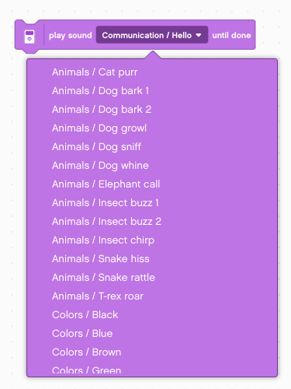
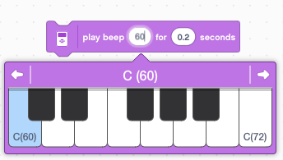
MORE ON Sound Blocks
Play Sounds
Play Tones

Slide 5
Sound BLOCK CHALLENGE 1
Make a program that plays hello after you press the touch sensor
Hints:
You will have to use a wait block
You will have to use the sound block in File mode

Slide 6
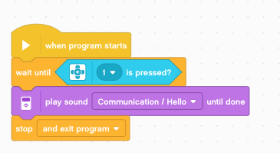
Challenge 1 solution
Wait for touch
Play Hello

Slide 7
Sound block CHALLENGE 2
Pick up your robot and place it on different colors. Check if the color sensor reads black. If so, have the robot say “black”. If the color sensor sees red, have the robot say “red”
For any other color, play a note of your choice for 0.01 seconds
Make sure that the sound waits for completion
Repeat this forever
Bonus Challenge: Can you the above while having the robot move? Have the robot drive over different colors to test your code

Slide 8
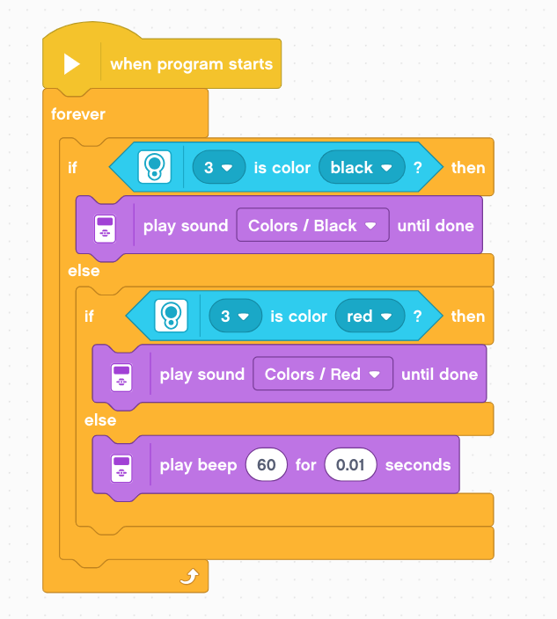
Challenge 2 Solution

Slide 9
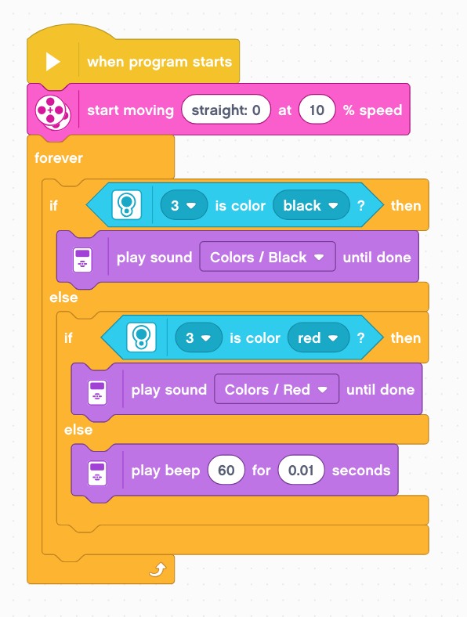
Bonus Solution

Slide 10
Additional Challenges
Add more colors to the switch so that as the robot drives over additional colors, it say “green”, “blue”, “yellow”, etc.
Make the code stop after the robot detects 5 colored bands

Slide 11
Discussion Guide
Why might you want to know how to use the sound block?
You might want to know what part of the code you are at. See Debugging lesson in Intermediate
The sound block is a fun way to add emotion to your robot
You can use sounds to interact with the user in a game by saying “good job”, “game over”, etc.

Slide 12
CREDITS
This tutorial was created by Sanjay Seshan and Arvind Seshan
More lessons are available at www.ev3lessons.com
This work is licensed under a Creative Commons Attribution-NonCommercial-ShareAlike 4.0 International License.

