Slide 1


BEGINNER PROGRAMMING LESSON
EV3 Classroom: Switches (If Then and If Then Else Blocks)

Slide 2
Lesson Objectives
Learn how to make your robot decide what to do out of different choices
Learn how to use a Switch Block

Slide 3
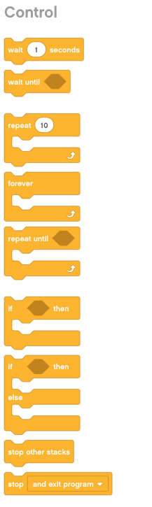
Switch (If Then) Blocks
Asking the robot a question and doing something different based on the answer
Example: Does the robot see a line? Or not?
Basically a YES/NO QUESTION
Switch blocks are found in the orange/flow tab
If Then Block
Run this code if the answer is yes
Run this code if the answer is yes
If Then Else Block
Run this code if the answer is no

Slide 4

Switch Block CHALLENGE 1
Challenge: Write a program that changes the display based on if the touch sensor is pressed or not pressed.
If pressed, your EV3 is happy! Display a smiley face. If not pressed, the EV3 is sad! Display a sad face.
Hint: You will need to use the display block, loops and switch blocks!

Slide 5
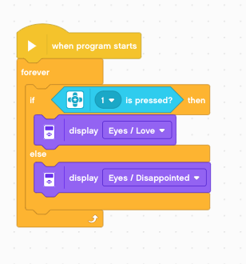
Challenge 1 SOLUTION
Loop
If Touch Sensor pressed
Display Happy Face/Eyes
Display a Sad Face/Eyes

Slide 6
CREDITS
This tutorial was created by Sanjay Seshan and Arvind Seshan
More lessons are available at www.ev3lessons.com
This work is licensed under a Creative Commons Attribution-NonCommercial-ShareAlike 4.0 International License.

