Slide 1


BEGINNER PROGRAMMING LESSON
EV3 Classroom: Ultrasonic Sensor

Slide 2
LESSON OBJECTIVES
Learn about the Ultrasonic Sensor
Learn how to use Wait Until Ultrasonic Block
Learn the difference between the Wait Until Ultrasonic Block and the Ultrasonic Block

Slide 3
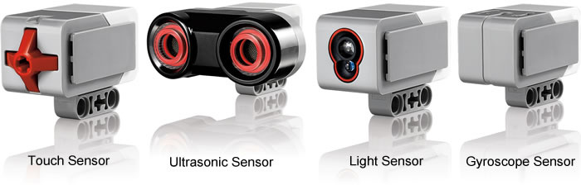
What is a sensor?
A sensor lets an EV3 program measure and collect data about is surroundings
The EV3 sensors include:
Color – measures color and darkness
Gyro – measures rotation of robot
Ultrasonic – measures distance to nearby surfaces
Touch – measures contact with surface
Infrared – measures IR remote’s signals
Color Sensor
Infrared Sensor
Image from: http://www.ucalgary.ca/IOSTEM/files/IOSTEM/media_crop/44/public/sensors.jpg

Slide 4
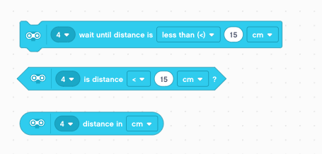
ULTRASONIC
An ultrasonic sensor measures distance.
You use it when you need to make sure you are a certain distance away from a target.
The distance can be measured in inches or centimeters.
To read the ultrasonic sensor, you use the Ultrasonic Block. To use the ultrasonic to do an action until a distance, you use “Wait Until”
Wait for Ultrasonic Value
Compare Ultrasonic Value
Read Ultrasonic Value
The first input on all the blocks is the port number. Change this to the port (1 to 4) that the ultrasonic sensor is connected to. The default port is usually 4.

Slide 5

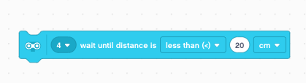

Ultrasonic CHALLENGE 1
Challenge: Make the robot move until it is 20cm away from the wall.
Pseudocode:
Step 1: Make a new project
Step 2: Drag in a Start Moving Block
Step 3: Drag in an Ultrasonic Wait Block
Step 4: Wait Until Distance is less than 20cm
Step 5: Stop Moving
Step 6: End Program

Slide 6
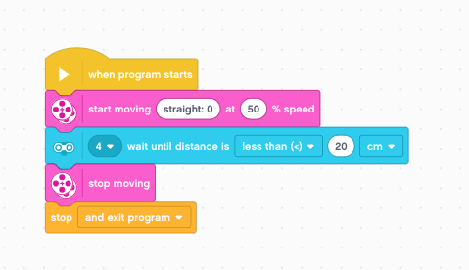
Challenge 1 solution

Slide 7
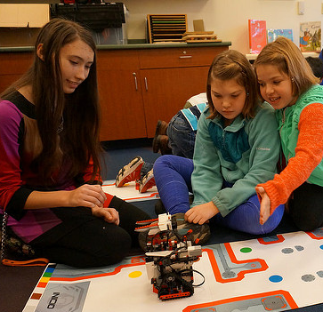
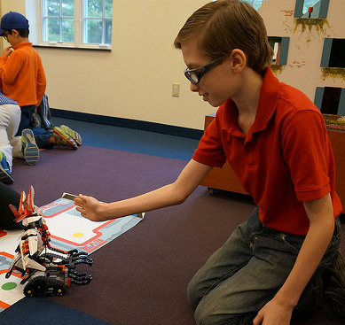
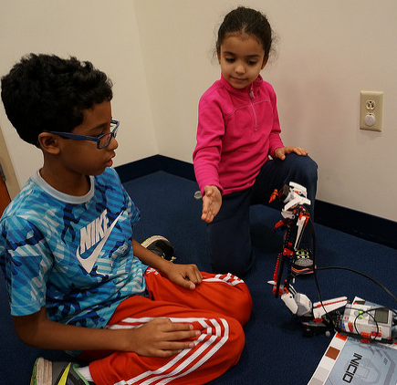
CHALLENGE 2: Use The Force To Control Your Robot!

Slide 8

Challenge 2: PSEUDOCODE
If the robot is closer than 20cm away from your hand move backward, otherwise move forward.
Step 1: Drag a Forever Loop block from the Control tab
Step 2: Drag an If-Else block from the Control tab
Step 3: Add an Ultrasonic Compare block from the Sensors tab to the if statement
Step 4: Add a Move Steering Movement block to move straight slowly if true
Step 4: Else set a second Move Steering block to move backwards slowly if FALSE

Slide 9
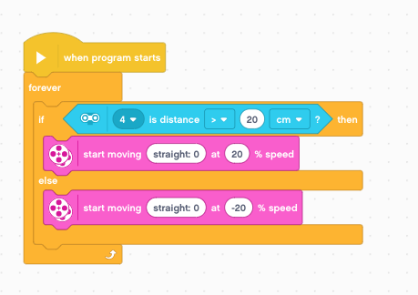
Challenge 2 solution

Slide 10
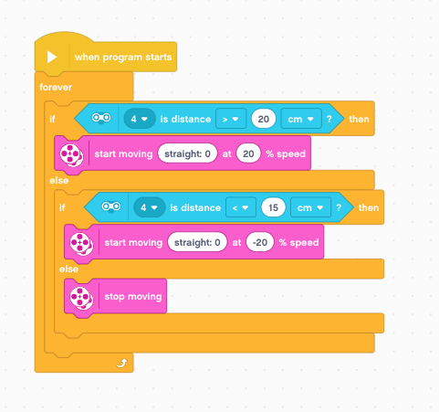
Learning To Master Your Force
The previous code kept the robot moving always. This version lets the robot rest if it is between 15-20 centimeters.

Slide 11
CREDITS
This tutorial was created by Sanjay Seshan and Arvind Seshan
More lessons are available at www.ev3lessons.com
This work is licensed under a Creative Commons Attribution-NonCommercial-ShareAlike 4.0 International License.

