Slide 1


Brick buttons AS SENSORS

Slide 2
Lesson Objectives
Learn how to use your brick buttons as sensors
Prerequisites: Display Blocks

Slide 3
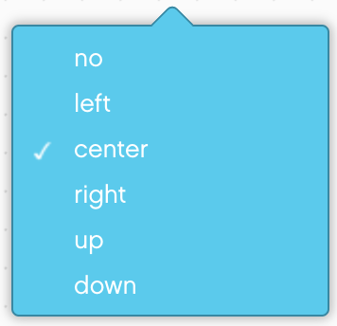
What are the Brick Buttons?
The Brick Buttons are the five buttons on the EV3 Brick (all buttons except the Back button)
They can be used as sensors to detect if a button has been pressed or released in order to control your program
Unlike in the EV3-G software, there is no option for bumped. (Same is true for the Touch Sensor)
Note: You cannot detect if two buttons are pressed at the same time with a single command. However, this can still be done.
The Brick Button blocks are found in the Sensors section of the programming blocks.

Slide 4
Challenge 1: Button Press & Debugging
CHALLENGE: Program your robot to move forward until a button is pressed. Just like in the beginner lessons that used sensors, you will use a Wait For block to complete this challenge.
A good use for such a program might be to help you debug. Adding a Wait For Button Press in your code helps you run parts of your code and check for errors.
STEP 1: Turn on motor in your Move Steering Block
STEP 2: Add a Wait For Button Press (Middle Button)
STEP 3: Stop Motors after the button is pressed.

Slide 5
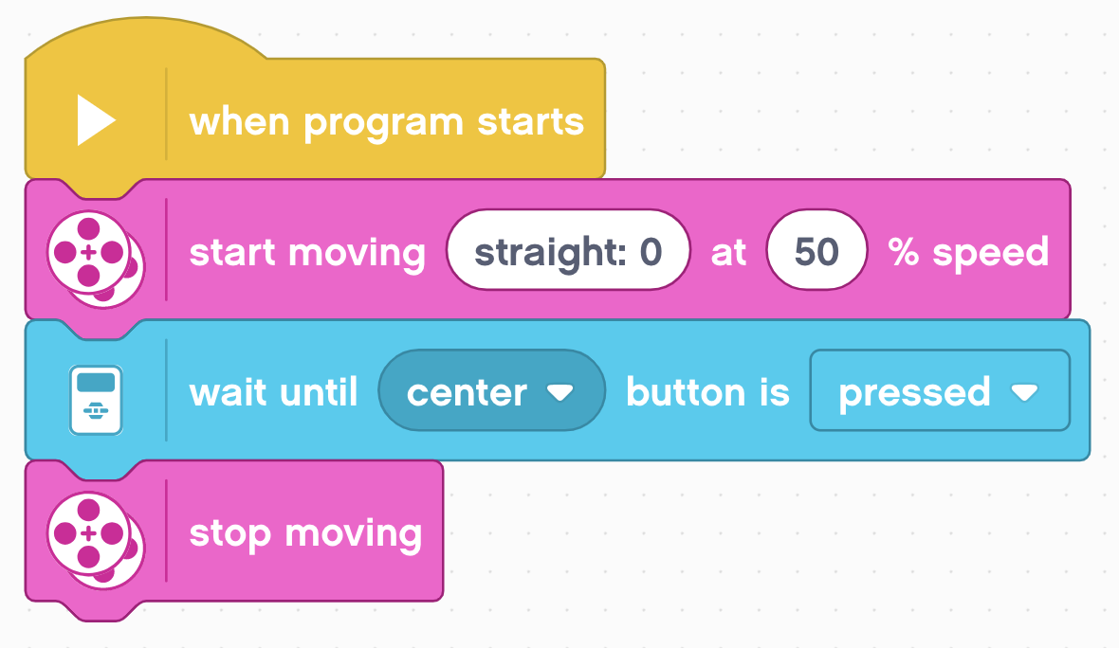
Challenge 1 Solution

Slide 6
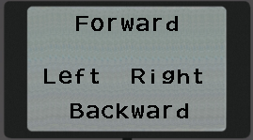
Challenge 2: Menu With Buttons
Create an onscreen menu using the brick buttons that does a different action based on which button is pressed. The actions to program are – go forward, backward, left and right
STEP 1: Use four Display Blocks to display the 4 actions on the screen so it will look like the image on the right
STEP 2: Wait for any of the four buttons to be pressed
STEP 3: Add four If Then Blocks and based on which button is pressed, run the code for the four actions – left, right, forward, backward
STEP 4: Place steps 2 and 3 in a loop that runs forever
Note for Step 2: In the EV3-G software, the wait for brick buttons block allowed for the user to select multiple brick buttons. This is not true in EV3 Classroom. The Or block in the Operators tab must be used.

Slide 7
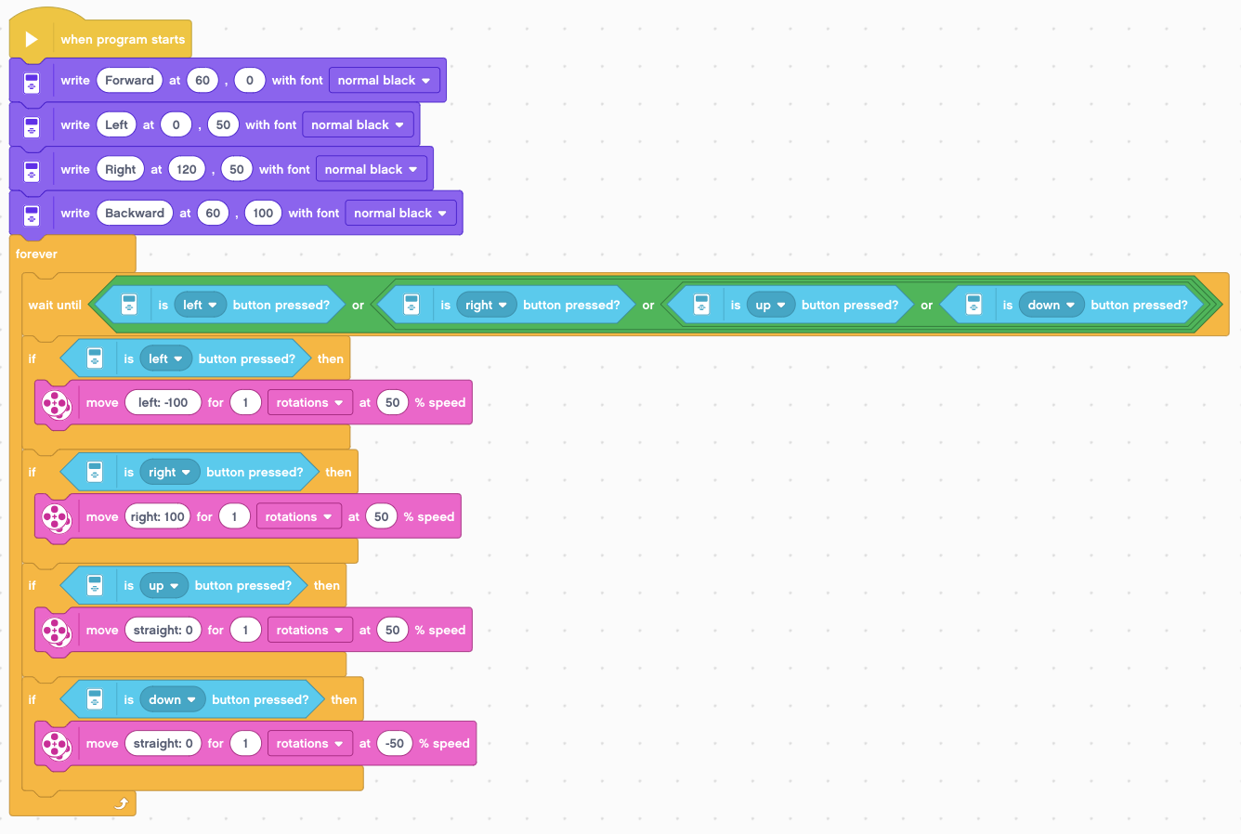
Challenge 2 Solution
Note that if the action in the If Then block is very quick (like adding to a variable or displaying a sensor value), the above loop and selected action will run multiple times

Slide 8
CREDITS
This tutorial was created by Sanjay Seshan and Arvind Seshan
More lessons are available at www.ev3lessons.com
This work is licensed under a Creative Commons Attribution-NonCommercial-ShareAlike 4.0 International License.

