Slide 1


INTERMEDIATE PROGRAMMING LESSON
EV3CLASSROOM:Calibrating Color sensors

Slide 2
Lesson Objectives
1) Learn why you need to calibrate your color sensors
2) Learn what calibration is
3) Learn how to calibrate your color sensors

Slide 3
Why Calibrate?
When you use your EV3 Color Sensor in Light Sensor Mode (e.g., reflected light mode), you should calibrate it (not for Color Mode)
Calibration means “teaching” the sensor what is “Black” and what is “White”
This makes White read as approximately 100 and Black read as approximately 0
It may still read over 100 or below 0. This is not an error.
Run your Calibrate Program whenever light conditions change once before you run your other programs.
If you have 2 Color Sensors, the same calibration will apply to BOTH sensors. You don’t have to make a different calibration program for each color sensor. Make it using 1 sensor on one of the ports and the values will apply to both.
If you have sensors that are very different from each other, you will need to write your own custom calibration that stores separate calibration for each sensor (this is not covered in this lesson).

Slide 4
Steps/Pseudocode for Calibration
Challenge: Write a program that will calibrate your EV3 Color Sensors for black and white.
Pseudocode:
Reset the existing calibration values
Display that the user should place the robot on “black” and press the center button
Use the Calibrate Reflected Light Intensity block.
Repeat above steps for calibrating “white”
Exit the Program

Slide 5
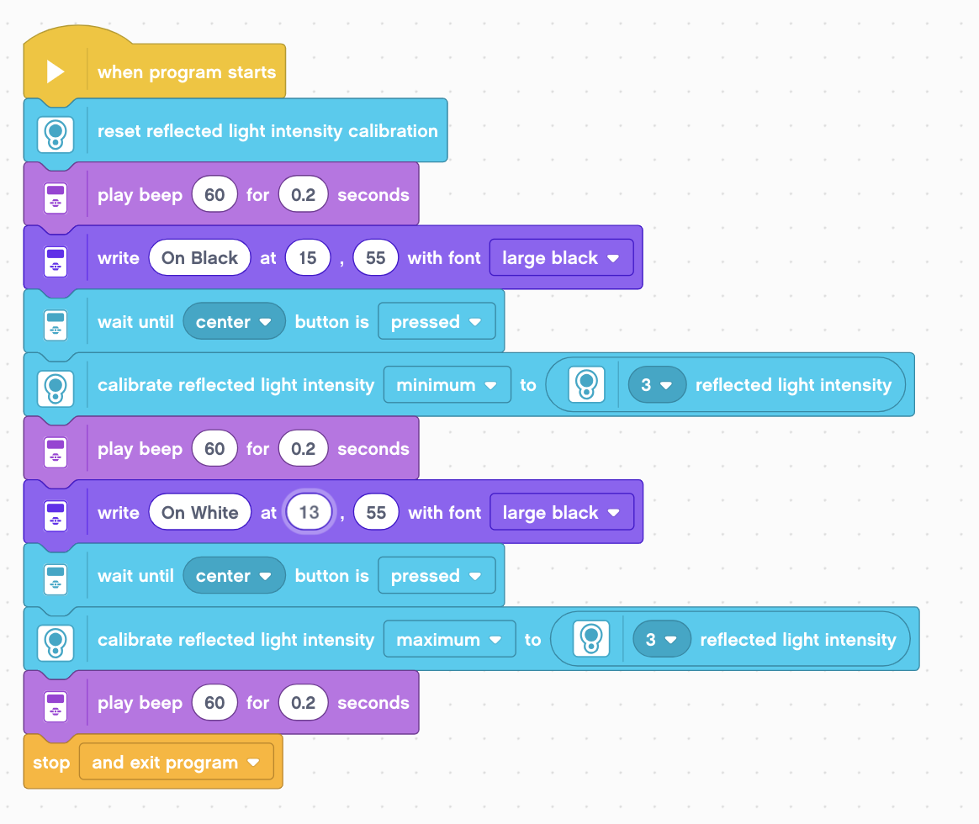
Calibrate Program Solution
Reset the color sensor value
Sound used to alert user
Display on screen – place on black
Wait until Center button is pressed
Calibrate Black
Display on screen – place on white
Wait until Center button is pressed
Calibrate White
Use Port View to verify calibration.

Slide 6
Discussion Guide
1. When do you need to calibrate your color sensor?
When it is used in reflected light mode
2. If I have two color sensors, do I need to calibrate each one?
Only one calibration value is stored on the brick and applies to all sensors. If you calibrate a second sensor, it will overwrite the first calibration.
3. What are you doing when you calibrate?
You are teaching the sensors what “black” and “white” mean
4. Should you calibrate for other colors (e.g. green) if you want to follow a green line?
No, you always calibrate for black and white.
5. How often do I need to calibrate?
Just once before you run all your other code. The values are saved to the brick.

Slide 7
Credits
This tutorial was created by Sanjay Seshan and Arvind Seshan
More lessons at www.ev3lessons.com
This work is licensed under a Creative Commons Attribution-NonCommercial-ShareAlike 4.0 International License.

