Slide 1
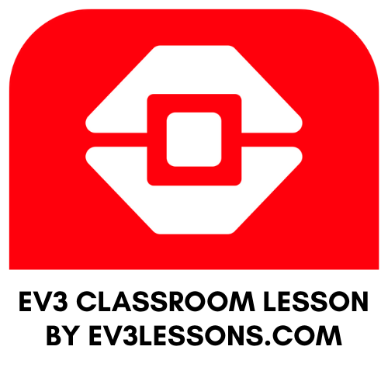
INTERMEDIATE PROGRAMMING LESSON
COLOR LINE FOLLOWER MY BLOCK WITH INPUTS: MOVE FOR DISTANCE

Slide 2
Lesson Objectives
Learn how to write a line follower that takes multiple inputs
Learn how to write a line follower that stops after a certain number of degrees
Practice making a useful My Block
Prerequisites: My Blocks with Inputs & Outputs, Variables, Loops, Switches.
The code uses Blue Comment Blocks. Make sure you are running the most recent version of the EV3 Software. EV3Lessons has Quick Guides to help you.

Slide 3
My Block Line Follower with Inputs
Making a My Block out of your line follower reduces the length of your code and makes it reusable
Learning to write a line follower that takes multiple inputs (power, degrees and color) can be very useful
Every time you want a line follower that goes a different distance, you just need to change the input!

Slide 4
Tips to Succeed
You will need to know how to make a Simple Color Line Follower program and how to make a My Block with inputs
Since you will use your EV3 Color Sensor in Color Mode, you will not have to Calibrate your color sensor for this lesson
Check which ports you have your color sensor connected to and adjust the code as needed
You may have to adjust the speed or direction to work for your robot. Make sure that the the color sensor is in front of the wheels in the direction of travel.
Make sure you place the robot on the side of the line that you are following. The most common mistake is placing the robot on the wrong side of the line to begin with.

Slide 5
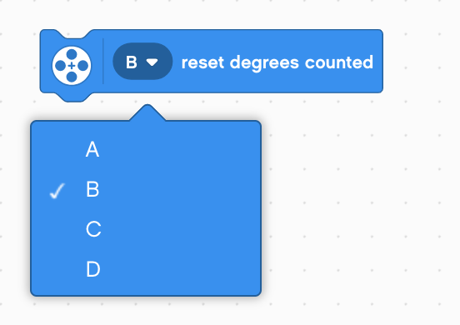
New Block
In this lesson, you will need to reset your motor’s rotation sensor
Since you want to line follow only for a certain distance, you have to first reset the value to 0.
Motors B or C are your drive motors so pick either of them.

Slide 6
Color Follower for Distance
STEP 1: Create a My Block with three inputs
STEP 2: Define the My Block to line follow with the exit condition of the loop as degrees
STEP 3: Use the My Block to follow a Black Line for 500 degrees
Challenge: Write a line follower My Block that follows a black line and stops after moving a certain number of degrees. The line follower should take three inputs (degrees, speed and color to follow).
Goal: Stop after 500 degrees

Slide 7
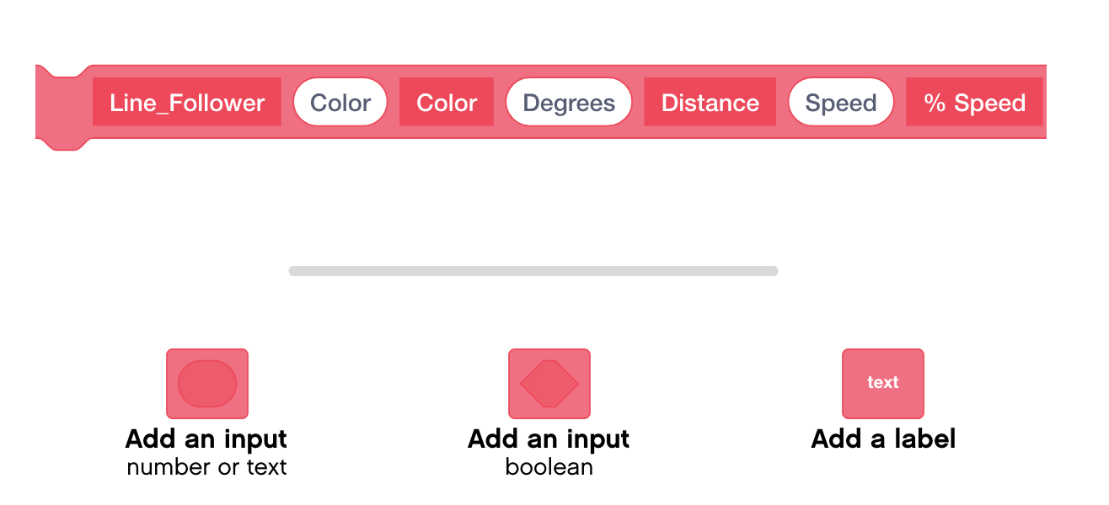
Step 1: Create the My Block
Add three Inputs and Labels

Slide 8
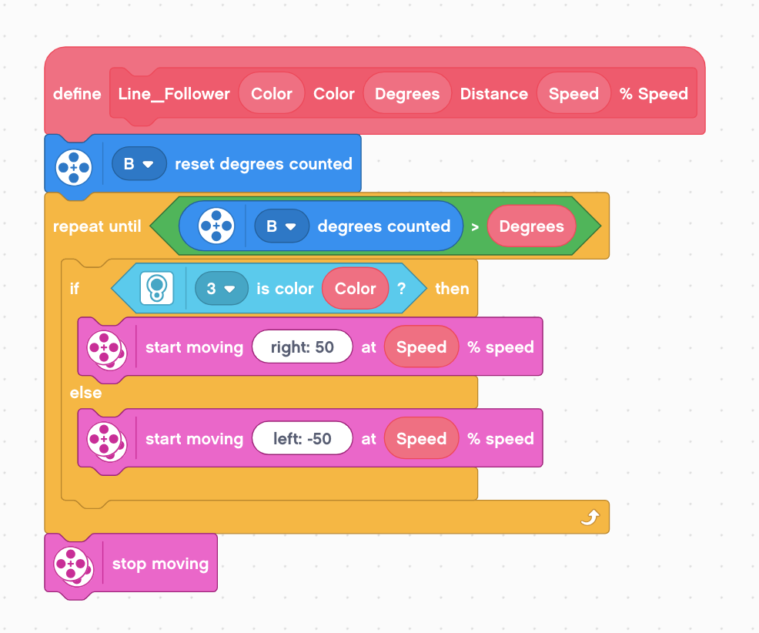
Step 2: Define the My Block
Drag variables as indicated
Reset the rotation sensor
Repeat the loop until the rotation sensor reads a certain number of degrees
If the color sensor reads the color of the line you want to follow, turn right, else, turn left
Stop motors

Slide 9
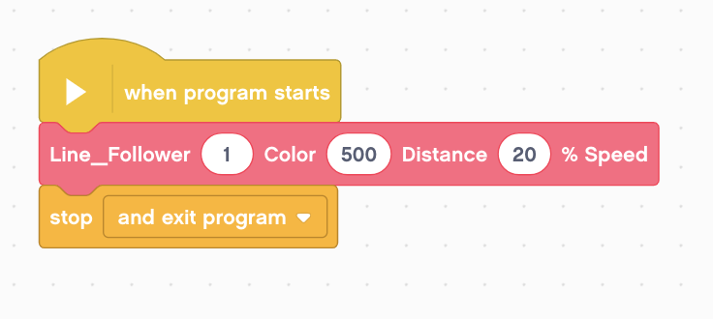
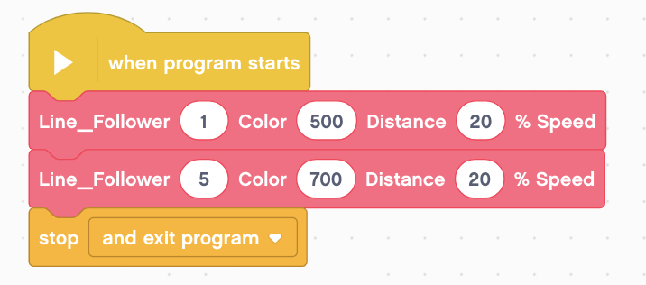
Step 3: Use and Reuse the My Block
Note: You have to enter a number into the parameter for the color. You cannot just spell out the color. The numbers are not very clearly defined in EV3 Classroom.
Line follow a Black Line for 500 degrees
Color Code:
0 - No Color
1 - Black
2 - Blue
3 - Green
4 - Yellow
5 - Red
6 - White
7 - Brown
Line follow a Black Line for 500 degrees and then a Red Line for 700 Degrees

Slide 10
Credits
This tutorial was created by Sanjay Seshan and Arvind Seshan
More lessons are available at www.ev3lessons.com
This work is licensed under a Creative Commons Attribution-NonCommercial-ShareAlike 4.0 International License.

