Slide 1

INTERMEDIATE PROGRAMMING LESSON
COLOR LINE FOLLOWER MY BLOCK WITH INPUTs: MOVE UNTIL BLACK

Slide 2
Lesson Objectives
Learn how to write a line follower that takes multiple inputs
Learn how to write a line follower that stops when it sees another line
Practice making useful My Blocks
Prerequisites: My Blocks with Inputs & Outputs, Variables

Slide 3
Tips to Succeed
You will need to know how to make a Simple Color Line Follower program and how to make a My Block with inputs
Since you will use your EV3 Color Sensor in Color Mode, you will not have to Calibrate your color sensor for this lesson
Check which ports you have your color sensor connected to the EV3 and adjust the code as needed
You may have to adjust the speed or direction to work for your robot. Make sure that the the color sensor is in front of the wheels in the direction of travel.
Make sure you place the robot on the side of the line that you are following. The most common mistake is placing the robot on the wrong side of the line to begin with.

Slide 4
Color Follower Until Color
Challenge: Create a line follower My Block that stops when it sees black
STEP 1:
Create a My Block with three inputs (Color of the Line to Follow, % Speed, Color to End on)
STEP 2:
Define the My Block so that it line follows in a loop until the exit condition (black color)
STEP 3:
Use the My Block to follow a Red Line until it sees Black.

Slide 5
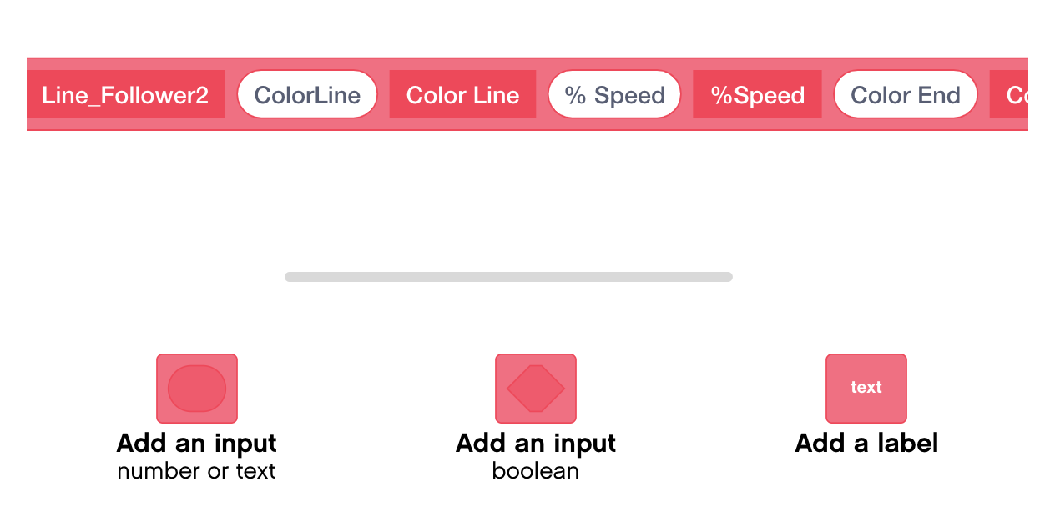
Step 1: Create the My Block
Add three Inputs and Labels

Slide 6
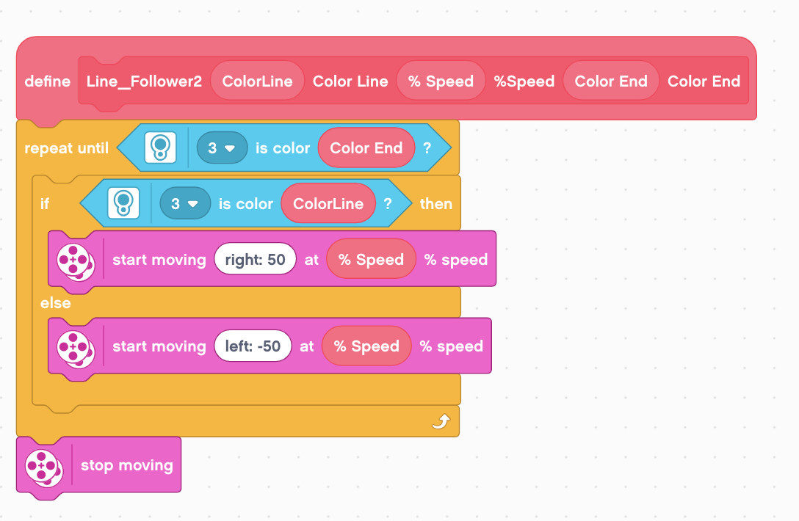
Step 2: Define the My Block
Drag variables as indicated
Repeat the line following loop until the the same color sensor sees the Color End
If the color sensor reads the color of the line you want to follow, turn right, else, turn left
Stop motors

Slide 7
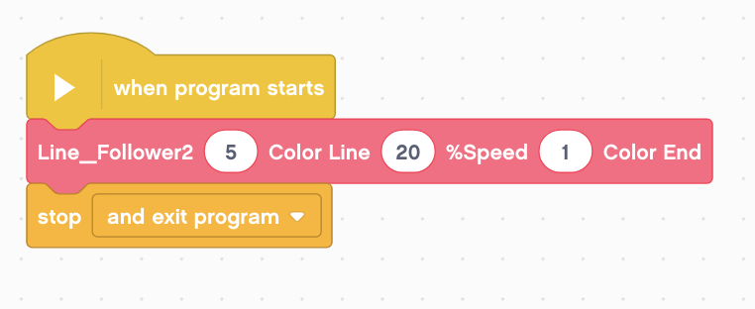
Step 3: Use and Reuse the My Block
Note: You have to enter a number into the parameter for the color. You cannot just spell out the color. The numbers are not very clearly defined in EV3 Classroom.
Line follow a Red Line until a Black Line
Color Code:
0 - No Color
1 - Black
2 - Blue
3 - Green
4 - Yellow
5 - Red
6 - White
7 - Brown
As with all the other My Block examples on EV3Lessons, you can now reuse this Line Follower My Block as many times are you need to.
Just remember that My Blocks only work in the Project they are in.

Slide 8
Next Steps
We use a simple line follower in this lesson. You can combine these techniques with any line follower.
Learn how to create a proportional line follower for light or a smooth line follower for color → check out our Advanced: Proportional Line Follower lesson.

Slide 9
Credits
This tutorial was created by Sanjay Seshan and Arvind Seshan
More lessons are available at www.ev3lessons.com
This work is licensed under a Creative Commons Attribution-NonCommercial-ShareAlike 4.0 International License.

