Slide 1

INTERMEDIATE PROGRAMMING LESSON
DEBUGGING TECHNIQUES

Slide 2
Lesson Objectives
Learn the importance of debugging
Learn some techniques for debugging your code

Slide 3
Why Debug?
Debugging is a useful strategy to figure out where in your program something is going wrong or what went wrong
Once your code starts to become long or complicated (e.g. using sensors), it can become hard to figure out where in the program you are
The following slides show you some ways of knowing where you are in your program or knowing what values your sensors see
You will see that these techniques can be VERY USEFUL to any programmer.
Locate Error
Think of Solution
Fix Error
Re-Test Program
HURRAY!

Slide 4
Different Techniques
Play Selected vs. Button Press
Very similar techniques
Lets you try out smaller portions of code
Play Selected requires bluetooth
Button Press requires some care so you don’t jostle the robot when pressing the button
EV3 Classroom does not have a Play Selected Mode.
Light, Sound and Display
Very similar techniques
Light and Sound are used in the same way
Teams enjoy the sound more and it is easier to identify sometimes
Display Block comes in handy for knowing what block is played if your robot gets stuck and if you want to see the sensor values

Slide 5
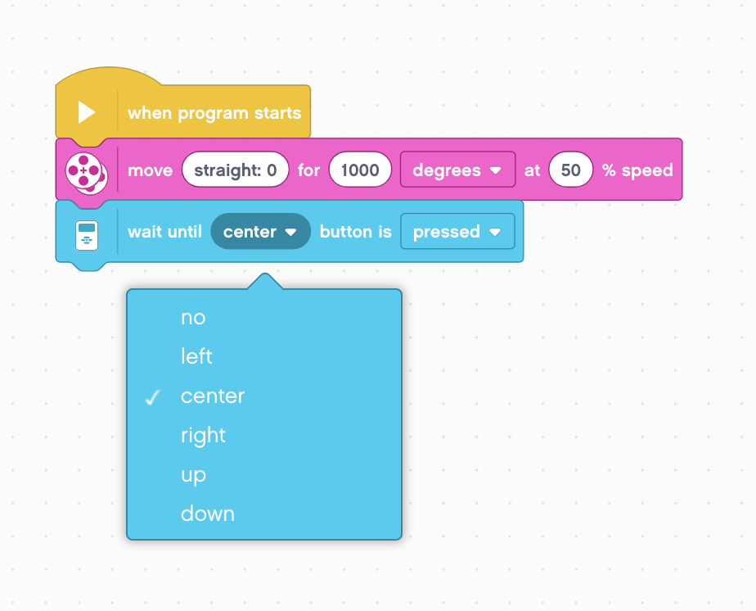
Wait For Button Press
To place a Wait for Button Press block in your program, place a wait block into your program
Go to the Sensor Tab and select the Wait for Button block. Choose which button needs to be pressed to continue the program
Place these wait for button presses every block or two close to where the robot is not working correctly
This can help you pinpoint which block is causing the robot to fail
The robot will stop and “wait for you to press the button”

Slide 6
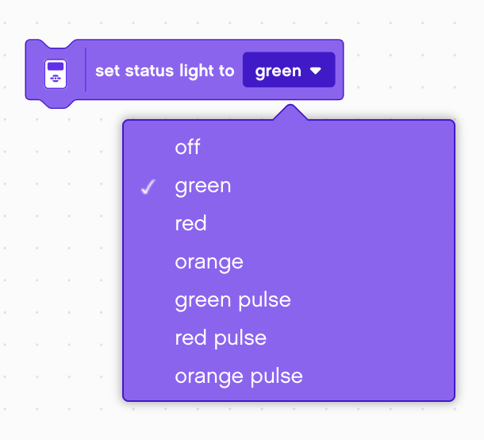
Visual Alerts: Brick Status Light
Place these blocks at critical steps in your program
You will then be able to visualize what block is playing and figure out where the error might be

Slide 7
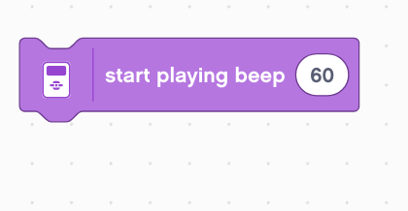
Sound Alerts: Sound Block
You can insert different sounds at intervals (about every 5 blocks or so, and then run the program again while listening for beeps.
These sounds can help you narrow down where in the program something is going wrong.

Slide 8
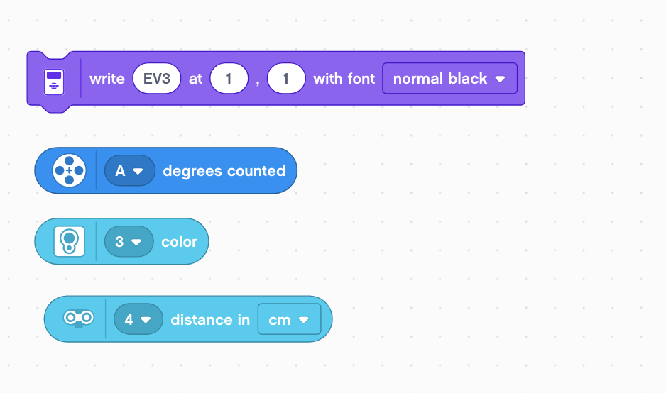
Print to Screen: Display Block
Use a display block to write values to the screen
Replacing the “EV3” with a motor degrees block lets you see how many degrees the motor has moved
Replacing it with a color sensor block lets you see what color the sensor is reading
Replacing it with an ultrasonic block lets you see how far away the object it.

Slide 9
Sample Video on Next Slide
The video on the next slide shows some of the debugging techniques
Wait for button press
Sounds alerts
Brick lights
Sensor readings displayed on brick

Slide 10
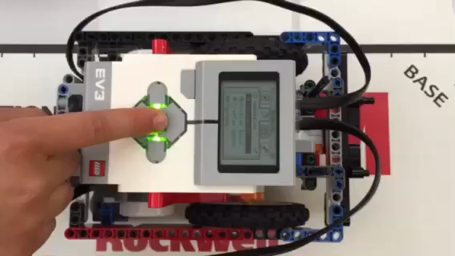
Sample Video – Click to Play

Slide 11


Other Methods
Recordings:
You can record your robot with a camera. Then watch the video and observe what went wrong
Comments:
You can also use “comments” to help debug – we add comments to remember what older values were entered into a block. We watch the robot and then adjust these values

Slide 12
CREDITS
This tutorial was created by Sanjay Seshan and Arvind
More lessons are available at www.ev3lessons.com
This work is licensed under a Creative Commons Attribution-NonCommercial-ShareAlike 4.0 International License.

