Slide 1

INTERMEDIATE PROGRAMMING LESSON
Infrared sensor

Slide 2
Lesson Objectives
Learn how to use an Infrared Sensor
Learn to make a remote control system and a program that follows the beacon.
Learn to use the Infrared Sensor in all three major modes
Learn the limitations of the Infrared Sensor
Prerequisites: Switches, Loops, Compare blocks, and Math blocks

Slide 3
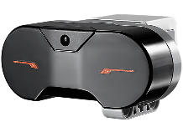
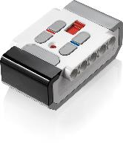
What does the Infrared Sensor do?
Measures proximity to beacon or object
Measures the angle of the beacon relative to the sensor
Measures which button is pressed on remote.
Beacon/remote can be set to 1 of 4 channels. Infrared sensor code must specify which channel to use. This allows you to use multiple remotes in the same room
Infrared Sensor
Beacon/Remote

Slide 4
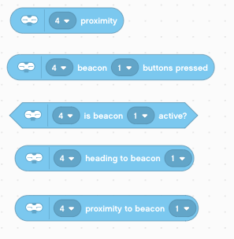
Modes
Works up to about 70cm away (or 100 proximity units)
Proximity Mode
Proximity to object (uses infrared reflection and is in % reflectance)
Beacon Mode
Beacon buttons pressed
Is the beacon active?
Heading [angle] to beacon
Proximity to beacon
Beacon # is the channel of the remote
The first input is the port the sensor is connected to
The Infrared Sensor block can be found in the blue sensor tab

Slide 5
Challenges
To learn how to use the Infrared Sensor you will complete three challenges:
Challenge 1: Create a remote control for your robot that does a different action based on which button you press on the Remote
Challenge 2: Proportional Dog Follower: The robot should move to wherever the Beacon is using proximity and heading
Challenge 3: Test how accurate the Infrared Sensor is for measuring distances

Slide 6
Pseudocode/Hints
Challenge | Hint/Pseudocode
Remote Control | Run different actions based on which button(s) are pressed on channel 1
Proportional Dog Follower | If the robot is <10 proximity from the beacon move backward If the robot is >10 proximity from the beacon move forward Use proportional control to adjust the steering base on the “heading” of the beacon Note: Proportional Control is covered in an Advanced Lesson on EV3Lessons.com. Please refer to this lesson.
Accuracy of Proximity | Measure distance using ultrasonic and measure proximity using infrared (use Port View on brick). Compare measurements for different distances to different surfaces.

Slide 7
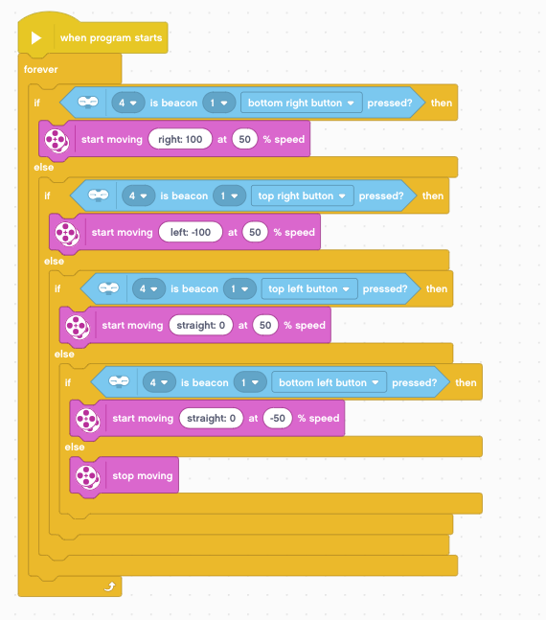
Solution: Remote Control
Make sure to set your beacon remote to channel 1 using the slider button on beacon
In a forever loop, use nested switches to determine which button is pressed. Run a different action for each button. In the example on the left, the robot will move Right, Left, Forward or Backward depending upon what button is pressed.
If no defined button is pressed, stop motors.

Slide 8
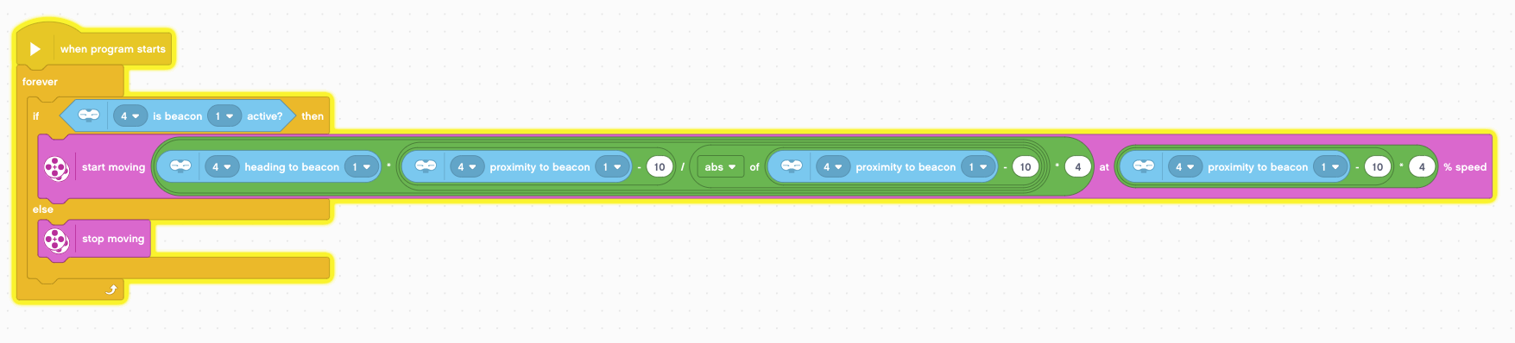
Solution: Dog Follower (Advanced)
Check if Beacon is on
The expression n/|n| will give +/- 1, determining the direction of the movement (|n| means absolute value of n, or the number without a + or -). The steering must be swapped based on the direction of movement. Multiplying by the heading, and a proportional constant of 4, gives us the desired steering.
(proximity-10)*4 is the proportional calculation to stay 10% proximity away from the beacon. This is the speed calculation.
If beacon is off, do not move
For a simple, non proportional version, try adapting the Ultrasonic Dog Follower in our beginner lessons.

Slide 9
Challenge 3: Compare Sensors
Surface | Actual Distance to Surface | Ultrasonic Measurement | Infrared Measurement
Aluminium Foil | 10CM
Wooden Table | 10CM
Black Paper | 10 CM
Glass | 10 CM
White Paper | 10 CM
Beacon | 10 CM
Instructions:
Hold the each sensor 10CM away from the material and check the sensor readings on Port View
Pick surfaces of varying reflectivity to try
Lesson:
The Infrared Sensor’s reading are based on the intensity of the reflected IR light from the object. It will not be as accurate as an ultrasonic sensor in measuring how far away an object is. Try different distances next. The Beacon should be more accurate as it produces an infrared signal.

Slide 10
Discussion Guide and Next Steps
What modes does the Infrared sensor have?
Ans: Proximity, Beacon and Remote
Can the Infrared sensor measure distance?
Yes, but not accurately because it is based on the reflected light intensity. So, it is going to vary based on the material the object is made of.
Next Steps:
Read the Advanced Lesson on Proportional Control.

Slide 11
Credits
This tutorial was created by Sanjay Seshan and Arvind Seshan
More lessons at www.ev3lessons.com
This work is licensed under a Creative Commons Attribution-NonCommercial-ShareAlike 4.0 International License.

