Slide 1
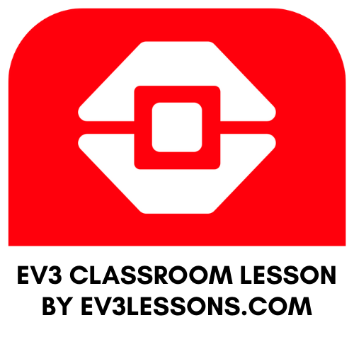
INTERMEDIATE PROGRAMMING LESSON
MOVE Distance My Block (Move_CM)

Slide 2
Lesson Objectives
Create a useful My Block
Learn why creating a My Block that takes measurements made with a ruler can be useful
Make a Move_CM My Block
Prerequisites: Moving Straight, Port View, My Blocks with Inputs and Outputs, Math Blocks, Variables

Slide 3
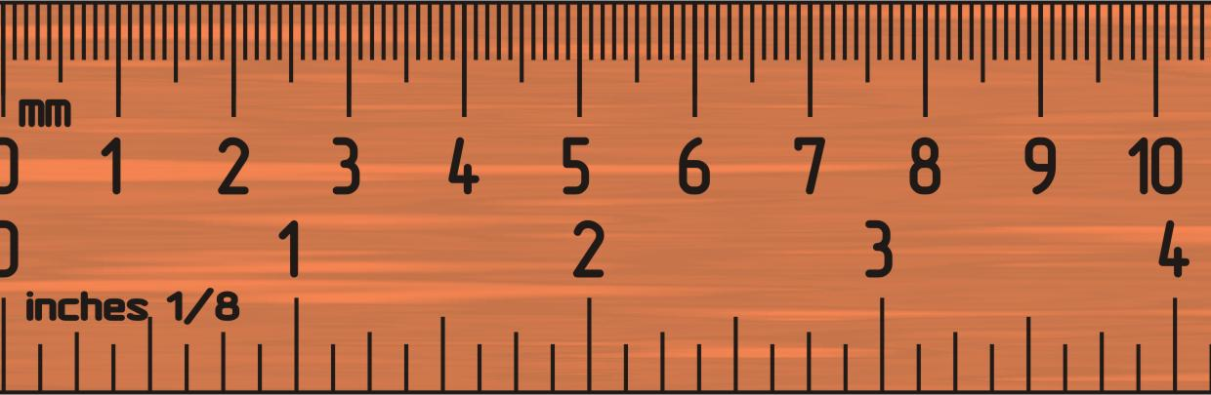
Why a Move Distance My Block?
Built-in move blocks will not take inputs (values) in centimeters or inches.
It is much easier to measure distance with a ruler than degrees or rotations.
If you change your robot design to have bigger or smaller wheels later on, you don’t have to re-measure every movement of your robot
Instead of changing distances in every single block you place, just go into your new Move Distance Block and change the value for how many inches/cm one motor rotation would take.

Slide 4
MOVE_CM IN THREE EASY STEPS
STEP 1: Determine how many motor degrees your robot moves in 1cm
STEP 2: Create a Move_CM My Block with 2 inputs – distance (CM) and speed (%)
STEP 3: Define the Move_CM My Block

Slide 5
Step 1: How Many Degrees Does The Robot Move in 1 CM?
Method 1:
Look up the wheel size in mm printed on your tire and divide by 10 to convert to cm (because 1cm=10mm)
Multiply the answer in step 1 by π (3.1415…) to compute circumference
Divide 360 degrees by value from step 2. This computes degrees in 1cm since you travel one circumference in 1 rotation and 1 rotation is 360 degrees
Example calculation using the standard EV3 Edu 45544 set wheels:
EV3 EDU (45544) wheels are 56mm = 5.6cm in diameter
5.6cm × π = 17.6cm per rotation
360 degrees ÷ 17.6cm = 20.5 motor degrees per cm
Helpful chart with common LEGO wheels and their diameters.
http://wheels.sariel.pl/

Slide 6
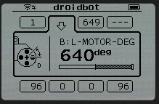
Step 1: Alternative Method
Alternate Method: Use Port View to find the Motor Degrees value. Use this method if you cannot find the diameter value printed on your wheel.
Put your ruler next to your wheel/robot at 0 centimeters (whatever part of the robot you use to align with 0, you should use to use to measure distance in step 2)
Roll your robot forward any amount of centimeters, making sure your robot does not slip.
Take the degree reading you see on the screen for the motor sensor and divide by the number of centimeters you moved (i.e. degrees measured/distance travelled)
The answer will be the number of degrees your robot's wheels turn in 1 centimeter.

Slide 7
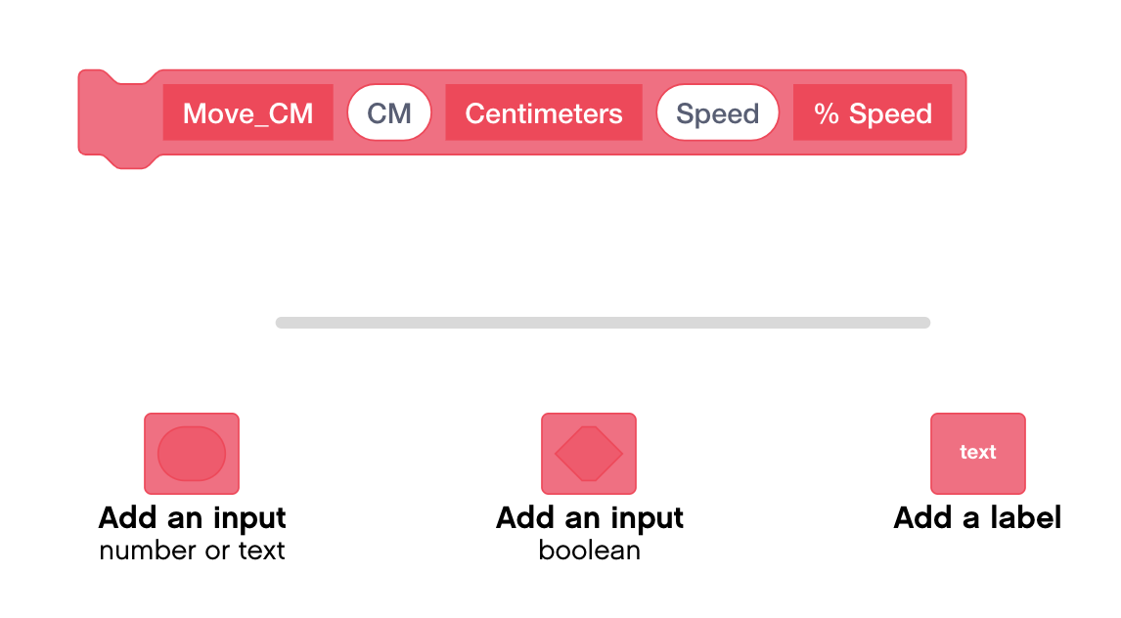
Step 2: Create a My Block with 2 Inputs

Slide 8
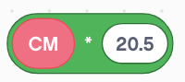
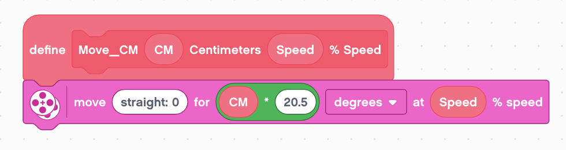
Step 3: Define the My Block
Use a Multiplication Math Block to Calculate the number of degrees the robot will move in 1CM
Drag the CM input into the first parameter of the math block
In the second parameter of the math block, enter the number of degrees your robot moves in 1 CM. (For Droidbot, this is 20.5)
Add a Moving Block under the define block
Place the Math Block in the distance parameter and the Speed input in the % Speed Parameter

Slide 9
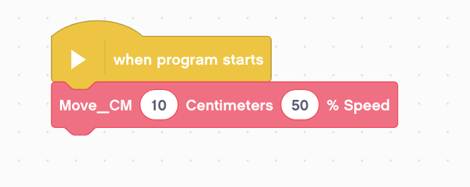
Step 4: Use the My Block
Now, when you drag the block into your programming canvas, you just need to enter the number of CM you want the robot to move and the speed it should move at.
In the example below, the robot will move 10CM at 50% speed

Slide 10
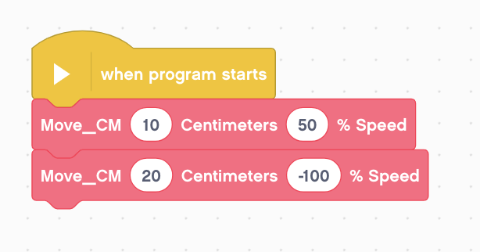
Reusable Move_CM Block
The same Move_CM My Block is used for two different moves. One moves forward 10cm at 50 % speed and the other moves backwards for 20cm at 100 speed. By changing the inputs, we can reuse the My Block.

Slide 11
Discussion
Why is a Move_CM My Block useful?
You can measure distances in centimeters and input this number into your block instead of programming in degrees or rotations
Will changing the inputs in one copy of Move_CM impact another copy of it?
No. That is exactly why a My Block is useful. You can use the same block multiple times, each time using a different number for power and centimeters (or any other parameter you set up).
Can you alter a My Block after it is made?
Yes. Right Click on the My Block and click Edit.

Slide 12
CREDITS
This tutorial was created by Sanjay Seshan and Arvind Seshan
More lessons are available at www.ev3lessons.com
This work is licensed under a Creative Commons Attribution-NonCommercial-ShareAlike 4.0 International License.

