Slide 1
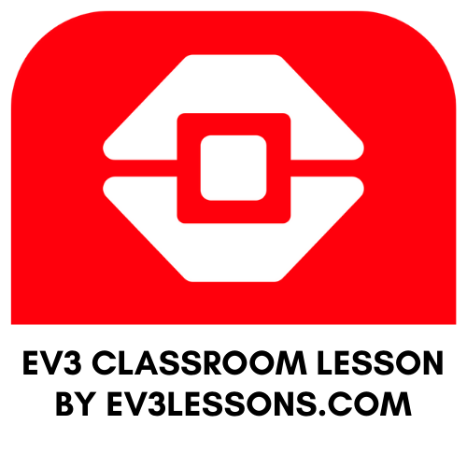
INTERMEDIATE PROGRAMMING LESSON
TURNING My BLOCK

Slide 2
Lesson Objectives
Create a useful My Block
Learn to make a My Block that will take inputs based on measurements with a protractor
Make a Turning My Block
Prerequisites: Turning, My Blocks with Inputs and Outputs, Data Wires, Math Blocks, Port View

Slide 3
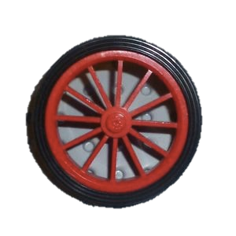
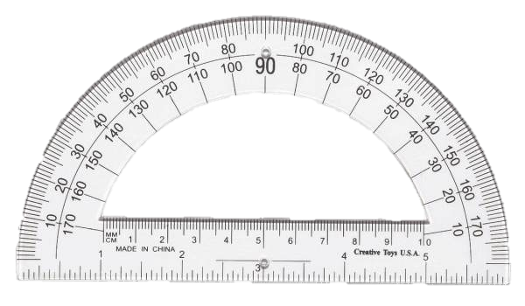
Rotation vs. Protractor Degrees
45 degree turn by the robot in the real world can be measured with a protractor. We call this protractor degrees.
You can use the EV3 to measure how much your wheel turns. We call this rotation degrees.
Just like Move_CM, you can also create a My Block for turns. In Move Centimeters, we had to figure out how much the robot wheels rotate for one CM.
To make a Turn Degrees My Block, you have to figure out how much your rotation sensor on the motor turns for one degree on a protractor.

Slide 4
Turn Degrees in 3 Easy Steps
STEP 1: How many rotation degrees does the robot turn for every 1 protractor degree?
STEP 2: Create a Turn_Degrees My Block with 2 inputs (Degrees and % Speed)
STEP 3: Define the Turn_Degrees My Block

Slide 5
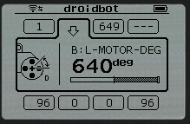
Step 1: Measuring Rotation Sensor
Calculate how many motor degrees are in 1 protractor degree
Go to Port View and pick the rotation sensor on your motor
Hold one wheel in place and only turn the other wheel (Pivot Turn). Turn the robot any number of degrees you choose. Make sure the wheels don’t slip when you do this.
Look at the Motor Degree value and divide by the number of protractor degrees you turned.
This is the number of rotation degrees in 1 protractor degree.
An example using Droid Bot
Robot was turned 90 protractor degrees
Using Port View, the motor moved 330 degrees
330 motor degrees/90 protractor degrees = 3.7

Slide 6
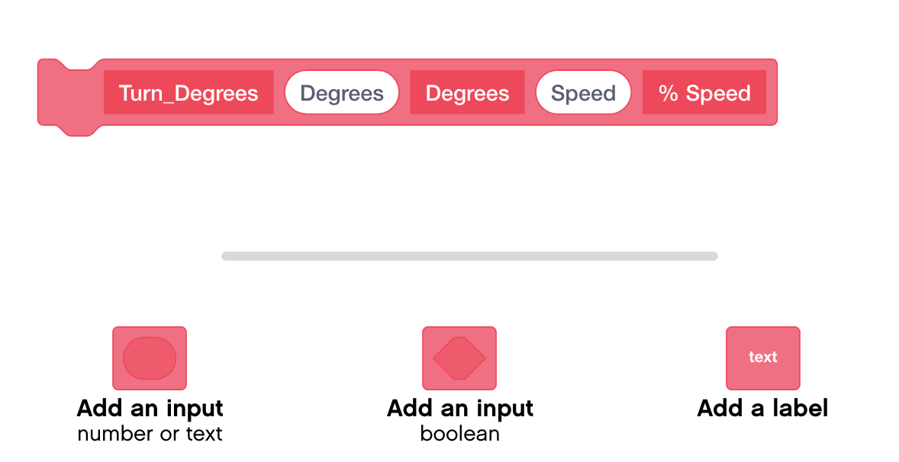
Step 2: Create Turn_Degrees My Block

Slide 7
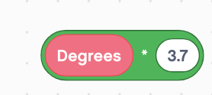
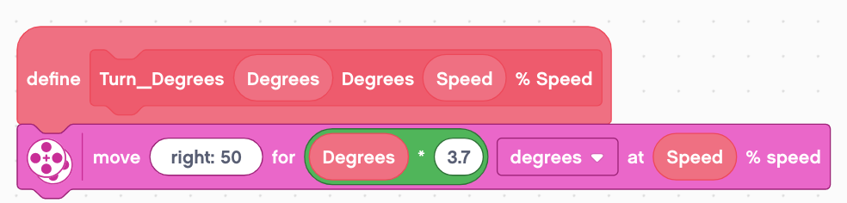
Step 3: Define the My Block
Use a Multiplication Math Block to Calculate the number of degrees the robot will turn in 1 protractor degree
Drag the Degrees input into the first parameter of the math block
In the second parameter of the math block, enter the number of degrees your robot turns for every protractor degree. (For Droidbot, this is 3.7)
Add a Moving Block under the define block
Place the Math Block in the distance parameter and the Speed input in the % Speed Parameter

Slide 8
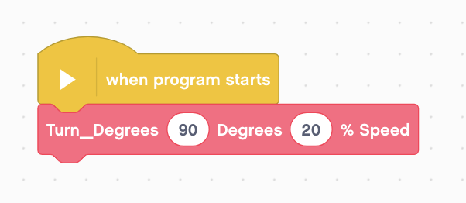
Step 4: Use the My Block
Now, when you drag the block into your programming canvas, you just need to enter the number of protractor degrees you want the robot to move and the speed it should move at.
In the example below, the robot will turn 90 degrees at 20% speed

Slide 9
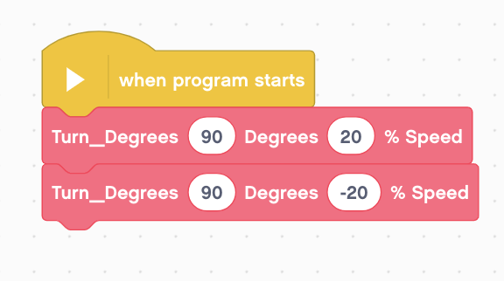
Reusable Turn_Degrees Block
The new Turn_Degrees My Block can be used multiple times.
In this example, it is used to turn 90 degrees right and left by changing the % Speed Input.

Slide 10
Discussion
Why is a Turn_Degree My Block useful?
You can measure turns using a protractor and input this number into your turn block
Will changing the inputs in one copy of Turn_Degrees impact another copy of it?
No. That is exactly why a My Block is useful. You can use the same block multiple times, each time using a different number for power and degrees (or any other parameter you set up).
Can you alter a My Block after it is made?
Right click on the My Block and click edit

Slide 11
Credits
This tutorial was created by Sanjay Seshan and Arvind Seshan
More lessons are available at www.ev3lessons.com
This work is licensed under a Creative Commons Attribution-NonCommercial-ShareAlike 4.0 International License.

