Slide 1

Arrays (Lists)
By Sanjay and Arvind Seshan

Slide 2
Lesson Objectives
Build upon skills from the Variables lesson in Intermediate
Learn how to read/write to arrays
Learn about the Array Operations block
Learn to use the loop count in a loop
Prerequisites: Data Wires, Loops, Variables

Slide 3
Why Use Arrays?
Simplify programs by storing multiple related values in a single variable
Can be used with loops to make compact and useful programs
Are useful for making a custom calibration program (see NXT Light Sensor in EV3 on our contributed lessons tab)

Slide 4
Lists
What is an array?
An array is a variable that holds multiple values
There are two types of arrays:
Numeric Array (Holds a set of numbers … 1,2,3,10,55)
Logic Array (Holds a set of logic … True, True, False)
They can be used as either Inputs or Outputs so you can either….
Write – put a value(s) into the array
Read – get the value(s) from the array out

Slide 5
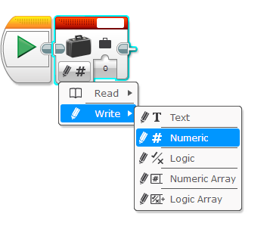
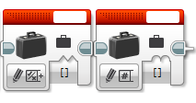
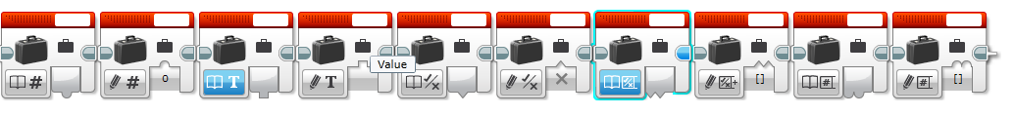
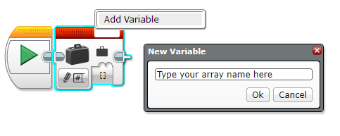
Array Blocks: Quick Guide
Modes
Logic Array
Numeric
Array
Key
Change to Array mode
Write (Inputs) have 2 bumps up
Read (Outputs) have 2 bumps down
Naming
Click add variable
Quiz
Read logic array
Write logic array
Read numeric array
Write numeric array
Identify if the variables are Inputs/Outputs and if they are Numeric/ Logic

Slide 6
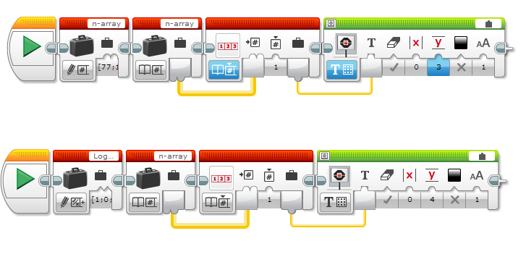
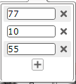
Array Indexes
Each value in an array is assigned an index
The first value would be at index 0
Logic arrays would store True/False instead of numbers
To add a value to an array click the plus +
This adds an entry at the next index value (i.e. index 3)
These are values for index 0,1,2

Slide 7

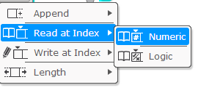
Block: Array Operations
This block is used to read or write to Logic or Numeric arrays
Different modes:
Append: Add a new entry after the last array index
Read at index: Reads the value at a certain index
Write at Index: Write a new value to a certain array index
Length: How many entries are in the array
Both write and append output an array → you will need to write this array back to the variable if you wish to update the stored array (see write/append slides)

Slide 8
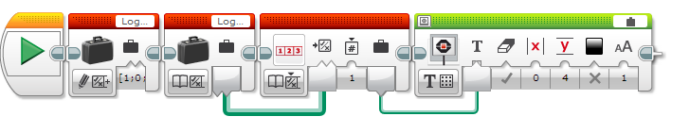
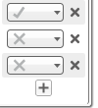
How do you use Arrays (Reading)?
Array operation block
Display the value on the screen
Read index 1 in the arrays
Above code will display 10
Below code will display 0 for false
Use “read at index” mode

Slide 9
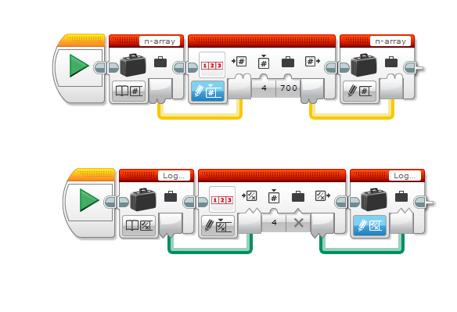
How do you use Arrays (Writing)?
This will write 700 to array at index 4
Read the array you want to write to
Use array operations to write a value to a certain index
Write the output back to the array
This will write False to array at index 4

Slide 10
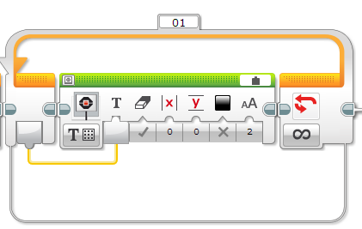
Block Setting: Loop Count
The loop count outputs the amount of times the blocks inside the loop have played.
This is useful to create a program that runs different code every time it goes in the loop
It is also useful for computing on each item of an array
Displays the loop count to the screen
Loop count

Slide 11
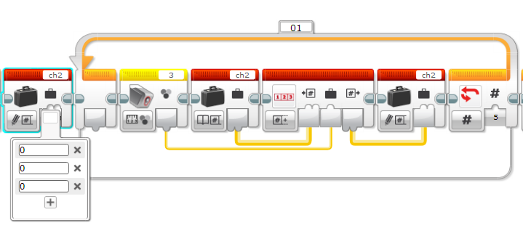
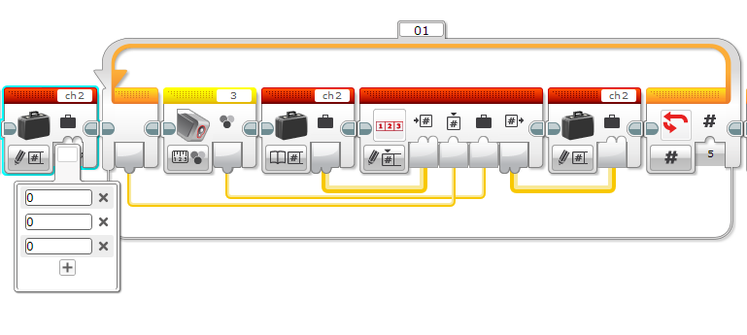
Note: Append vs. Write
Append adds entries to the end of an array (i.e. creates a new index value)
This code produces an array with 8 entries (three 0’s followed by 5 light readings)
Write overwrites the entry at the chosen index
This code produces an array with 5 entries (just 5 light readings)

Slide 12
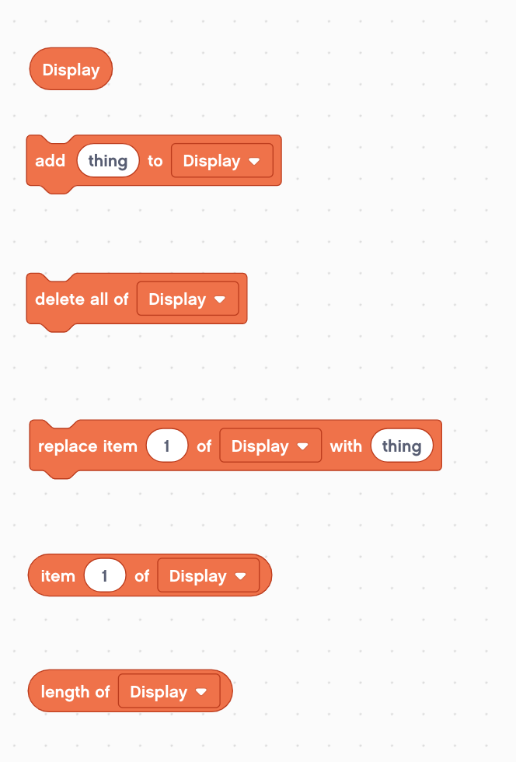
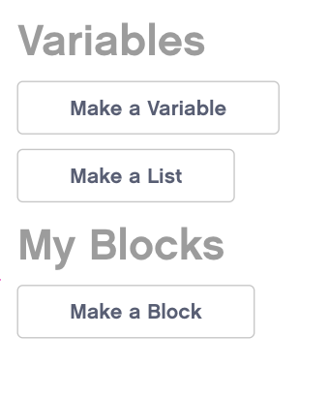

Slide 13
Challenge 1
Make a program that displays all the entries of an array. Display each index on a different line. You can use only one display block.
Tips: You will need to use loops, loop count, array block, array operations

Slide 14
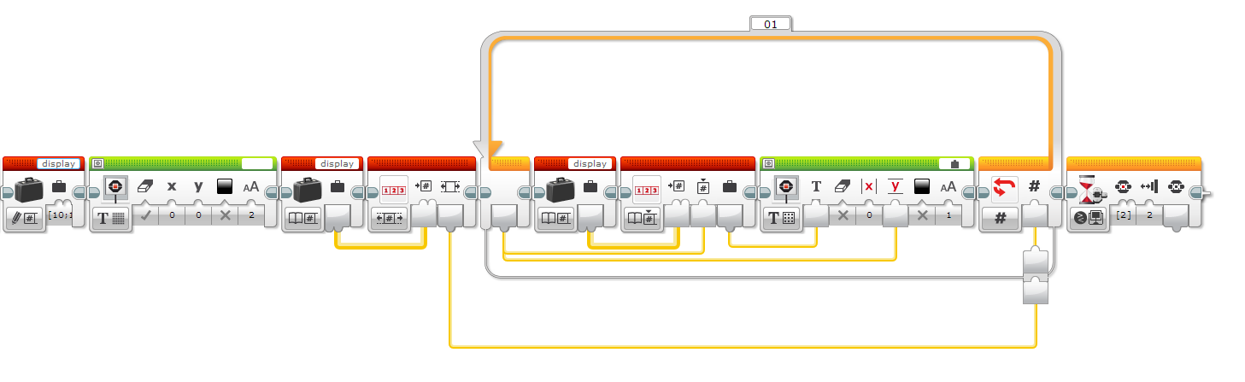
Challenge 1 Solution
Create/Write the display array
Read how many values are in the array
Use array operations to read each index for the loop count
Display the value on a different line for each loop count
Wait until you bump the button to exit
End after all the indexes have been displayed

Slide 15
Challenge 2
Make a program that adds up all the entries of an array. Display the sum.
Tips: You will need to use loops, loop count, array block, array operations

Slide 16
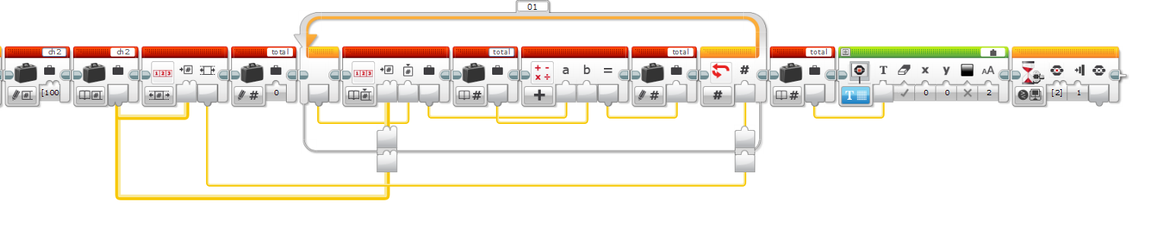
Challenge 2 Solution
Read how many values are in the array
Read the index based on the loop count
Add the array value to the sum of the past values
Display to the screen
Create the display array

Slide 17
Next Steps
Here are some fun things to try:
Make a program to compute the average value in an array
Make a program that always saves the last 4 light sensor readings in an array
Create an array that stores calibration values for each sensor port

Slide 18
Credits
This tutorial was written by Sanjay Seshan and Arvind Seshan
More lessons at www.ev3lessons.com
This work is licensed under a Creative Commons Attribution-NonCommercial-ShareAlike 4.0 International License.

