Slide 1


Displaying Text and Graphics
BEGINNER PROGRAMMING LESSON
Notes:
<number>

Slide 2
Lesson Objectives
Learn to use the display class to display text and graphics
Understand why the display class can be useful in programming
© EV3Tutorials.com, 2019, (Last edit: 2/8/2020)
<number>
Notes:
<number>

Slide 3
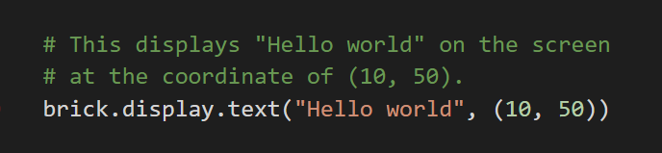
DISPLAY.TEXT METHOD
The display.text method is to show information on the screen.
You can control the coordinate of the text.
NOTE: The method uses only one font available and its size.
© EV3Tutorials.com, 2019, (Last edit: 2/8/2020)
<number>

Slide 4
The coordinate of the screen
x
-------------->
(0,0) __________________
| |
| | |
| | HELLO |
Y | | WORLD |
| | |
v | |
|__________________|
(177,127)
© EV3Tutorials.com, 2019, (Last edit: 2/8/2020)
<number>

Slide 5
The Syntax of display.text method
classmethod display.text(text, coordinate=None)
Display text.
Parameters
• text (str) – The text to display.
• coordinate (tuple) – (x, y) coordinate tuple.
It is the top-left corner of the first character. If no coordinate is specified, it is printed on the next line.
© EV3Tutorials.com, 2019, (Last edit: 2/8/2020)
<number>

Slide 6
CHALLENGE 1: Using display.text method
Can you write a program to display text in the middle of the screen?
Make the display method run for 3 seconds.
Can you also move while doing this?
© EV3Tutorials.com, 2019, (Last edit: 2/8/2020)
<number>

Slide 7
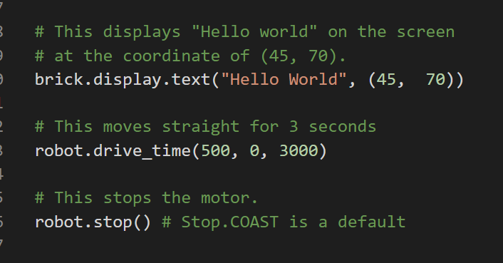
Solution of challenge 1
© EV3Tutorials.com, 2019, (Last edit:2/8/2020)
<number>

Slide 8
CHALLENGE 2: two lines of text
Now what if you want “Hello” to appear on one line and “World” to appear on the next line?
© EV3Tutorials.com, 2019, (Last edit:2/8/2020)
<number>

Slide 9
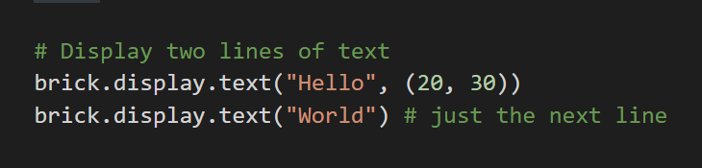
Solution of challenge 2
The line with “World” has no coordinate specified. Hence, it is on the next line.
© EV3Tutorials.com, 2019, (Last edit: 2/8/2020)
<number>

Slide 10
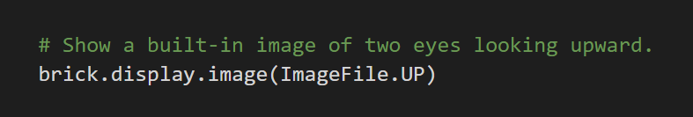
DISPLAY.image METHOD
The display.image method is to show an image on the screen.
The coordinate of the image is located at (0, 0) of the screen.
NOTE: It is possible to show a custom image from your project folder.
© EV3Tutorials.com, 2019, (Last edit: 2/8/2020)
<number>

Slide 11
The Syntax of display.image method
classmethod display.image(file_name)
Show an image file.
Parameters
• file_name (str) – An image
© EV3Tutorials.com, 2019, (Last edit: 2/8/2020)
<number>

Slide 12
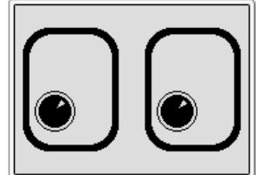
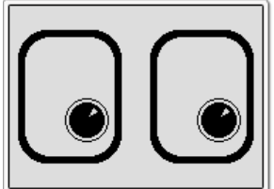
CHALLENGE 3: Using display.image method
Can you display eyes on the screen while moving? Alternate eyeballs that look left and right.
Can you display eyes on the screen while moving? Alternate eyeballs that look left and right.
Turn the motor on.
Use the display.image method.
Wait for 2 seconds.
Repeat steps 2 – 3 three times with alternating images.
Stop the motor.
Feel free to have fun with the challenge and make it yours!
© EV3Tutorials.com, 2019, (Last edit: 2/8/2020)
<number>

Slide 13
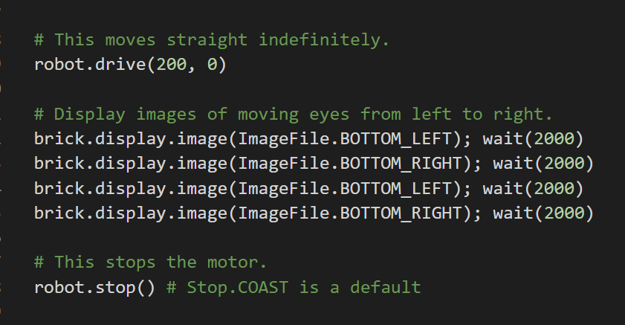
Solution of challenge 3
© EV3Tutorials.com, 2019, (Last edit: 2/6/2020)
<number>

Slide 14
Discussion guide
Why might you want to know how to use the display.text method?
You might want to know the sensor value your robot is seeing.
You might have to program a robot to stop when the robot reaches a red line but it stops before.
You might want to know the sensor value your robot is seeing.
You might have to program a robot to stop when the robot reaches a red line but it stops before.
You might want to know the sensor value your robot is seeing.
You might have to program a robot to stop when the robot reaches a red line but it stops before
Does the robot see the same thing you see?
You can display the value on the screen and check.
It’s a great debugging tool. You can learn more about debugging code in one of our intermediate lessons.
© EV3Tutorials.com, 2019, (Last edit: 2/8/2020)
<number>

Slide 15
CREDITS
This tutorial was created by Sanjay Seshan and Arvind Seshan
More lessons are available at www.ev3tutorials.com
This work is licensed under a Creative Commons Attribution-NonCommercial-ShareAlike 4.0 International License.
© EV3Tutorials.com, 2019, (Last edit: 5/25/2019)
<number>
Notes:
<number>

