Slide 1


BEGINNER PROGRAMMING LESSON
EV3 Classroom: Introduction to the EV3 Brick and EV3 Classroom Software

Slide 2
Lesson Objectives
Learn how the EV3 brick operates
Learn about the main components of the EV3 Classroom software
Connect to the EV3 brick
Note: This lesson uses the new Scratch-based Education software (EV3 Classroom). However, it is the same for the Retail version.

Slide 3
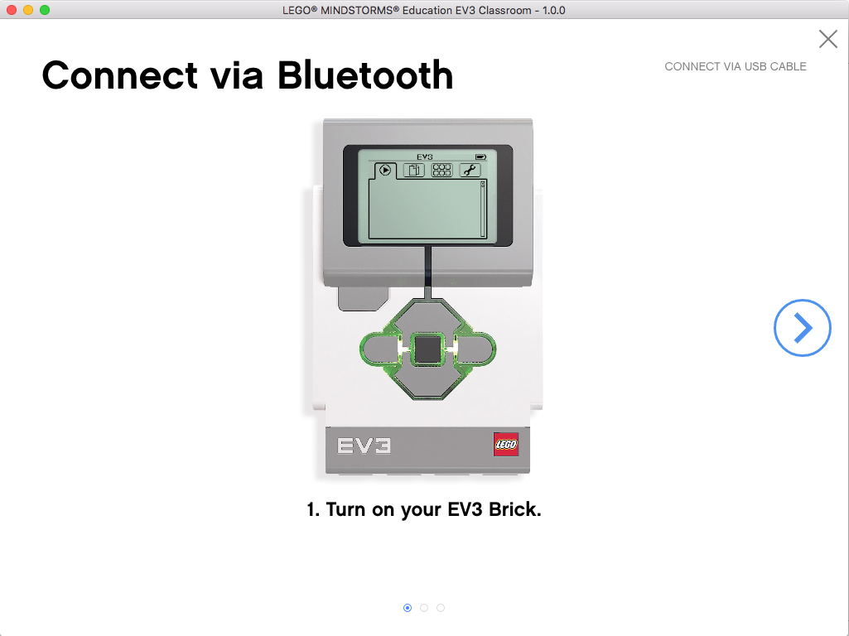
The “Brick” Buttons
1 = Back Undo Stop Program Turn robot off
2 = Center Button Select options Run Program/Project Turn robot on
3 = L, R, Up, Down Navigate menus
1
3
3
2
3
3

Slide 4
The “Brick” Screen
Tabs on Screen
Run Recent Find programs/projects you ran recently
2. File Navigation Find all programs by project
3. Brick Apps Port views
4. Settings Bluetooth, Wifi, Volume
1
2
3
4

Slide 5
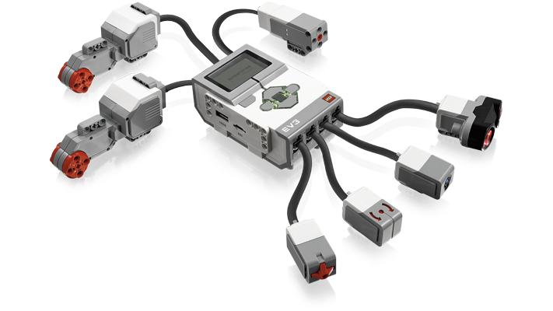
Ports, Sensors, motors
Ports A, B, C, D = Motors
Default setup assumes Right Motor in C, Left Motor in B
B
Default setup
Front
C
Ports 1, 2, 3, 4 = Sensors

Slide 6
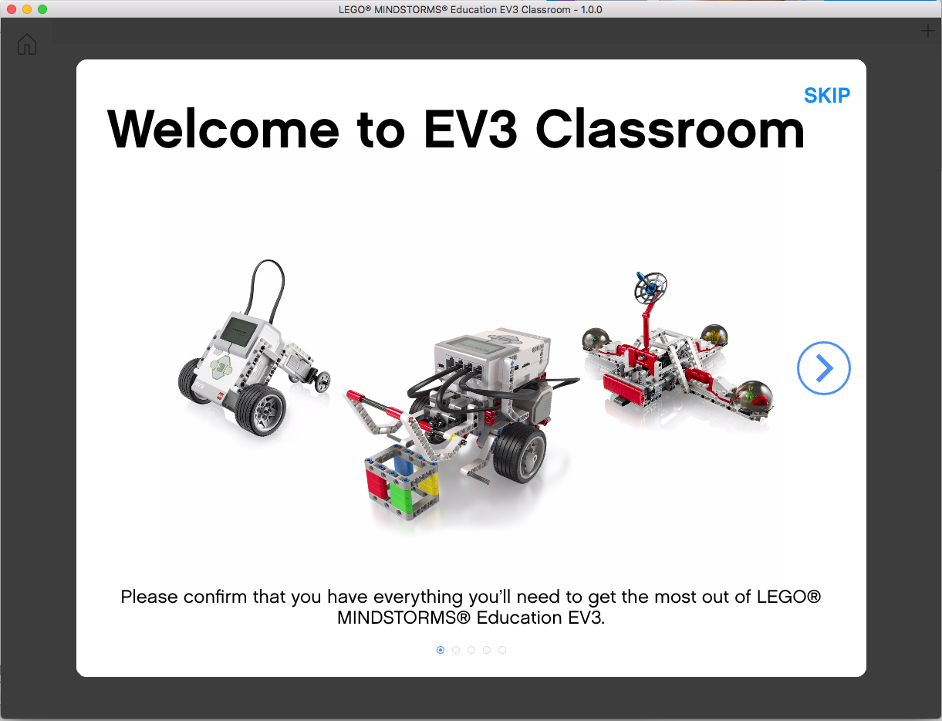
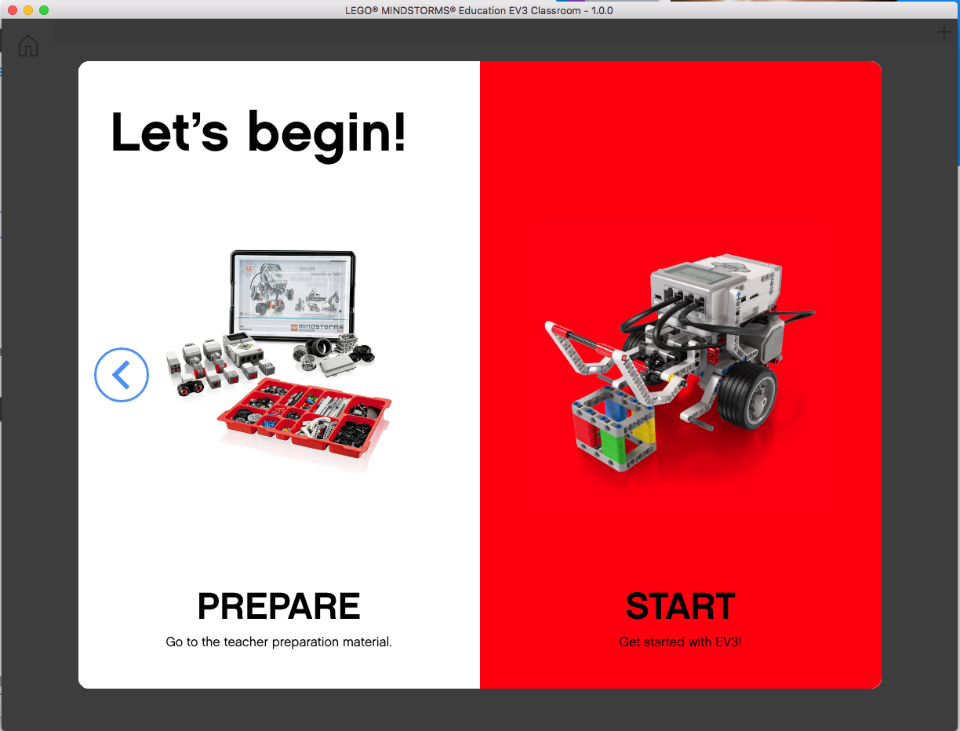
EV3 Classroom: getTING started
Follow the onscreen steps and then click “START” to access the programming environment

Slide 7
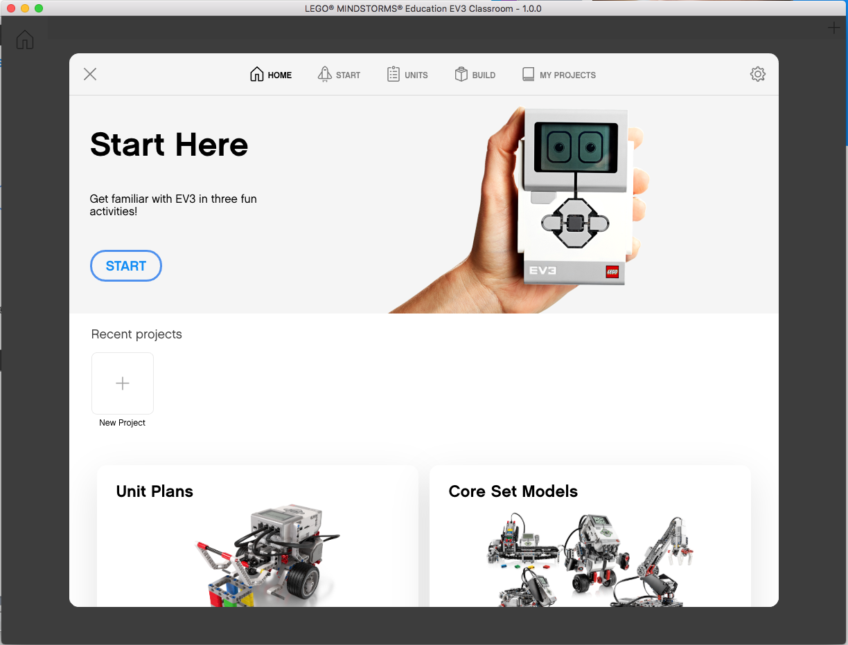
EV3 Classroom: Home
Open Saved Project
Start New Project

Slide 8
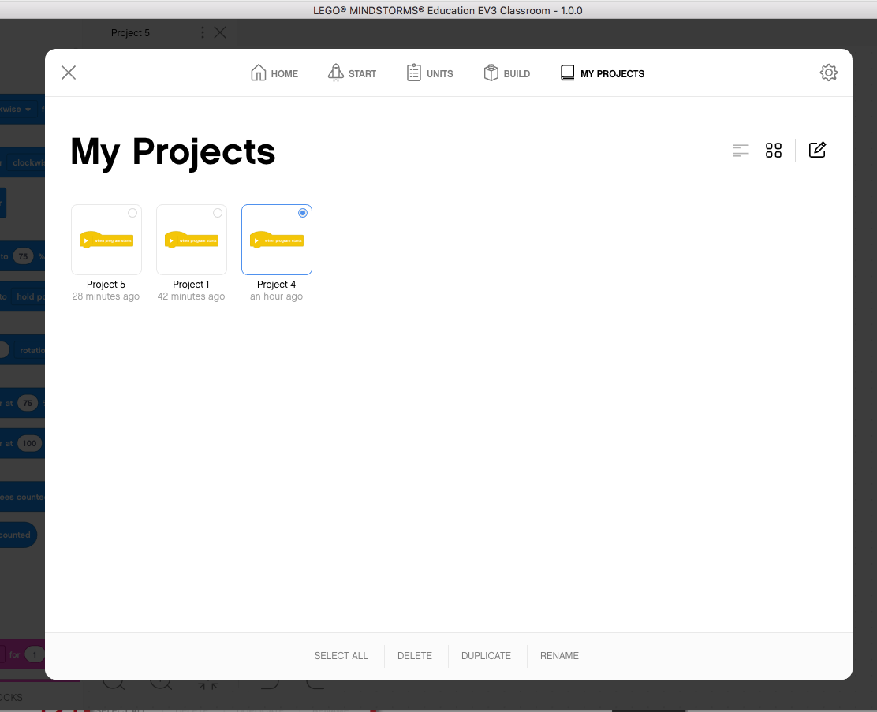
My Projects
My Projects shows a list of the projects you have made.
To edit an existing project click on the edit icon [1] and then select the project you want to modify. Select the desired action (delete/duplicate/rename) [2].
[1]
[2]

Slide 9
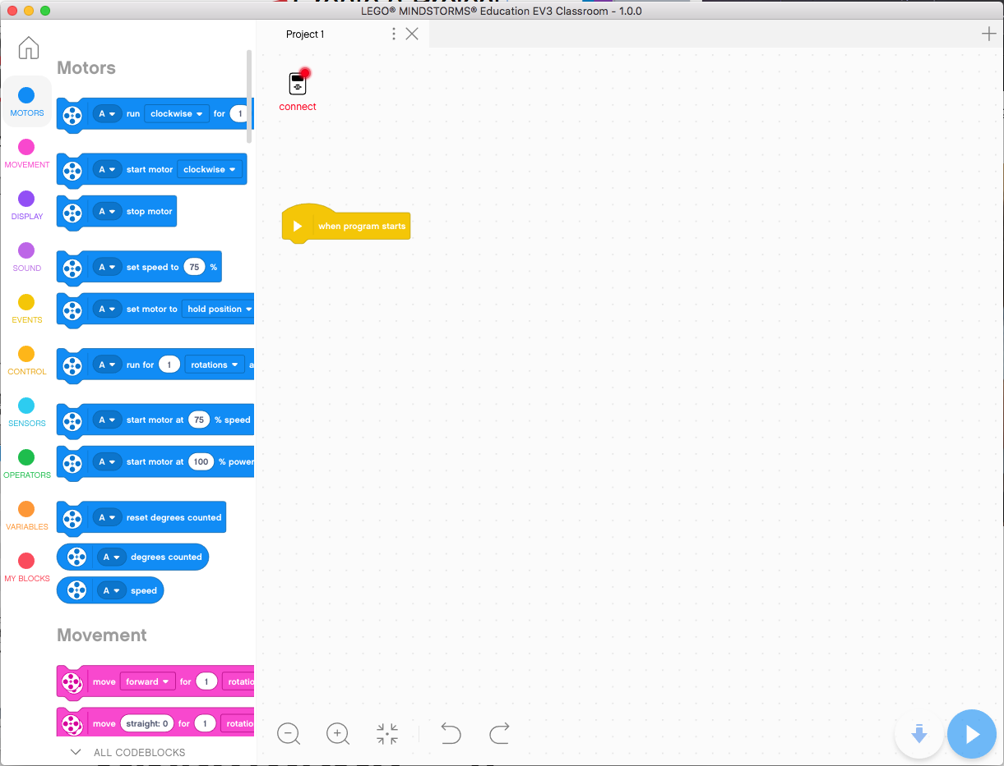
new Project
Back to Home
New Project
Project Properties Rename Project or Move File to new location (i.e. Save as)
Opened Projects
Toggle between showing all/fewer code blocks
We highly recommend you click this so that it will show all the blocks – our lessons require this.

Slide 10
Note about projects for ev3-g users
For those familiar with the LABVIEW based EV3-G software, there is no differentiation between projects and programs in this software.
Each project is a separate program
My Blocks cannot be used between Projects

Slide 11
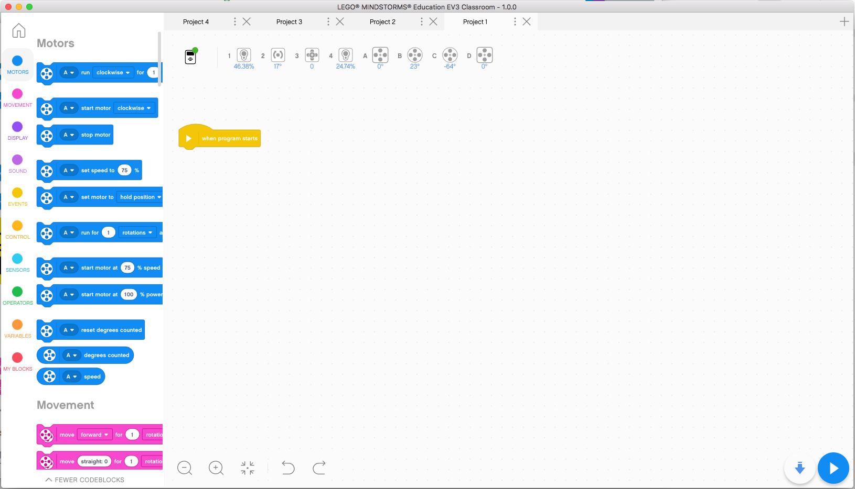
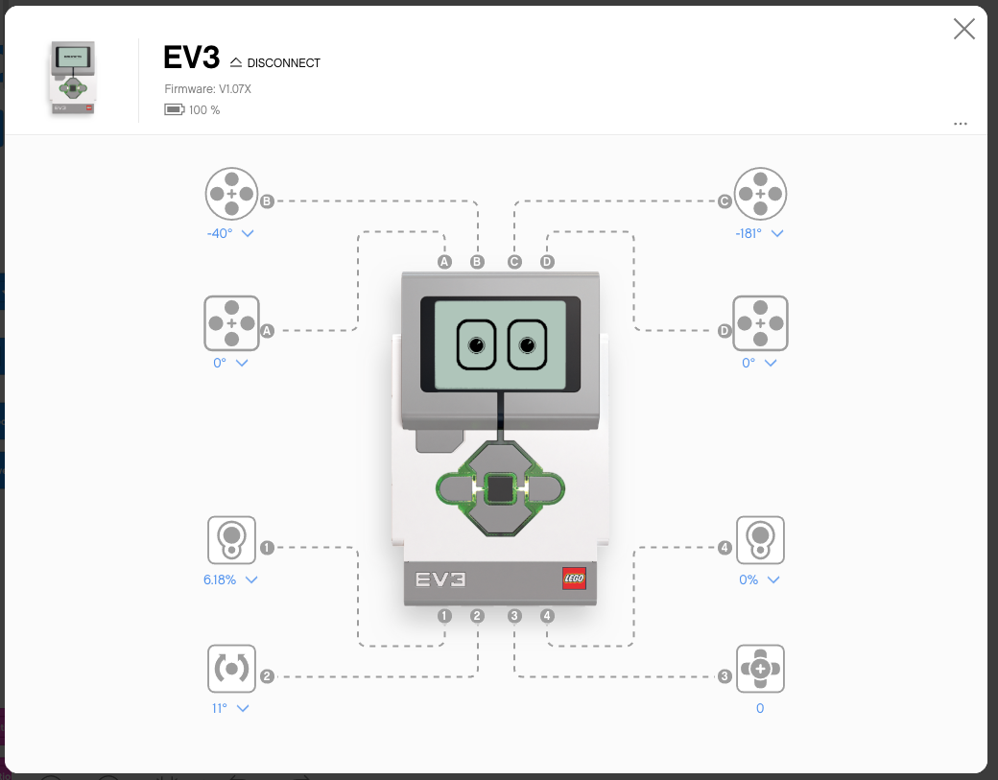
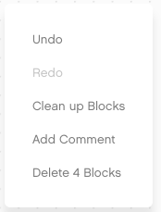
Programming CANVAS
Block Palette
Brick Dashboard
Programming Area
To add a comment or delete a block, right click on the programming area.
Download/Run

Slide 12
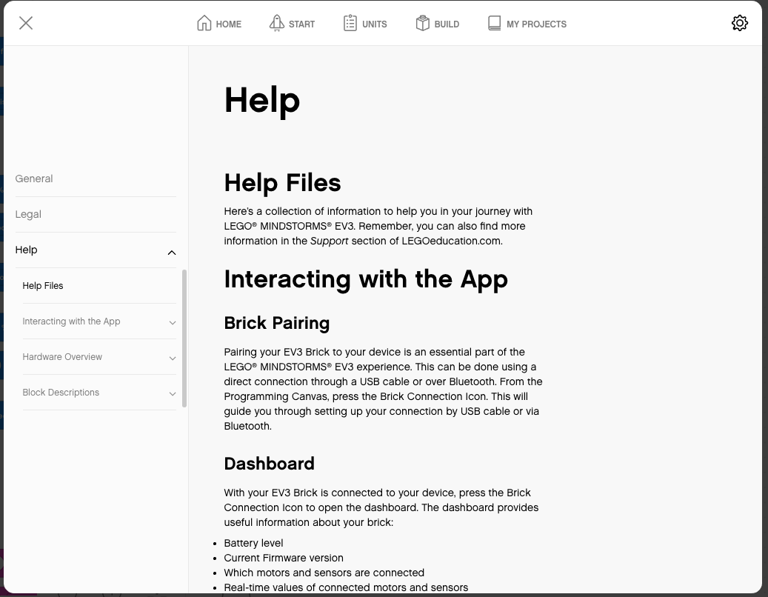
HELP MENU
Click the Settings icon in the Home screen
Navigate to Help on the left hand column

Slide 13
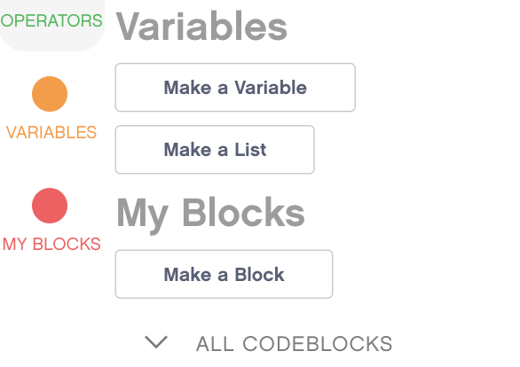
BLOCK PALETTE
Motors – Control an individual motor
Movement – Control 2 motors at a time with synchronization
Display – Write to screen
Sound – Play a sound
Events – Run actions based on events (e.g. sensor or timer)
Control – Loops, if/else statements, etc.
Sensors – Read a sensor value
Operators – Mathematics and logic
Variables – Store data in a variable or list
My Blocks – Custom defined blocks
Note: To see certain blocks, you may have to click on “ALL CODEBLOCKS”

Slide 14
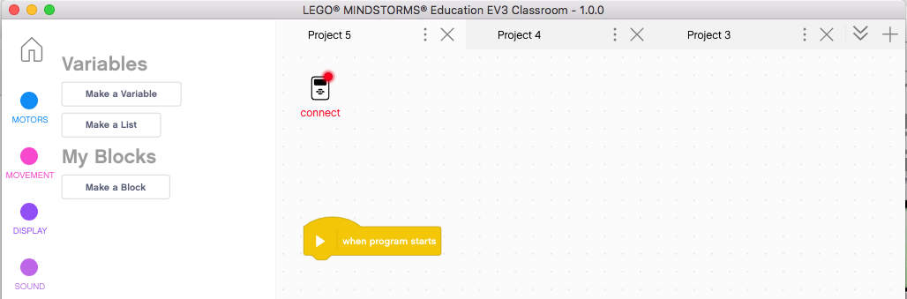
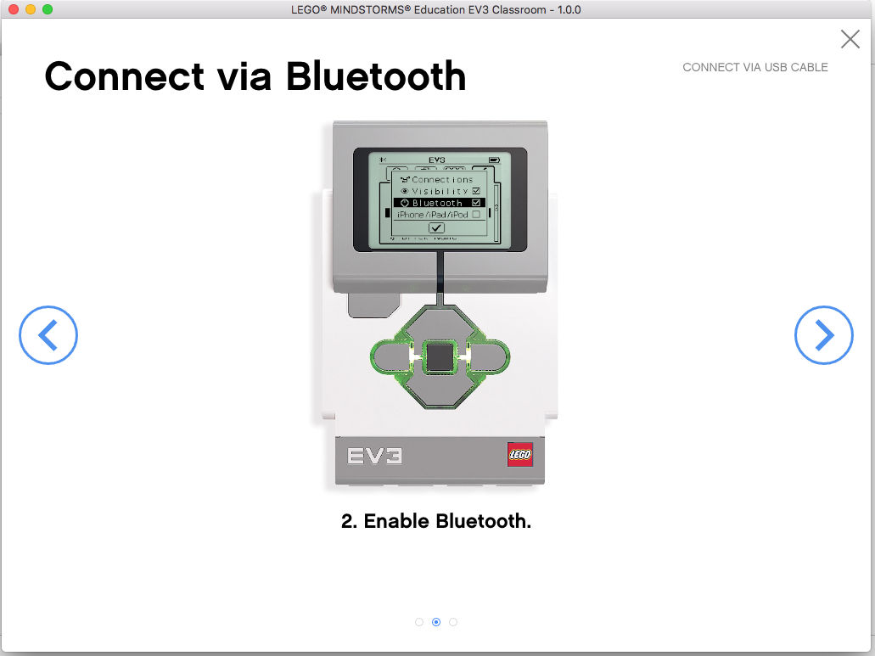
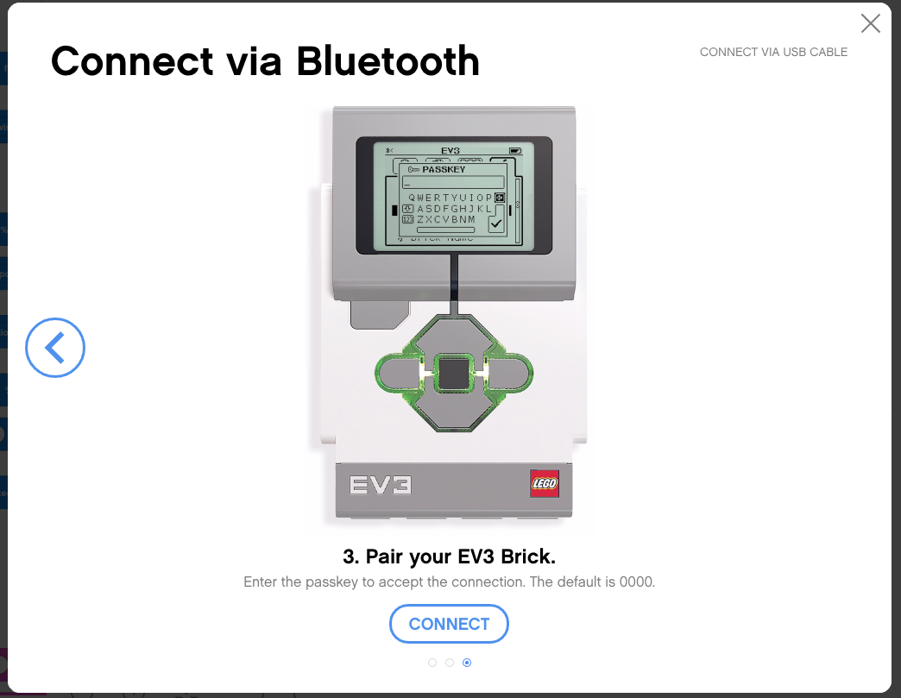
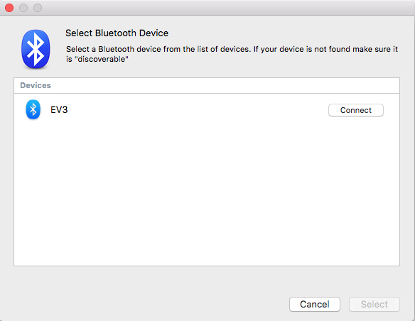
Connecting to brick
The software will auto-connect to the brick if you are using USB
To connect over Bluetooth, click the connect button. Enable Bluetooth as shown, and click connect. In the connect dialogue, select your EV3 brick’s name.
You might have to change to EV3 passcode to 0000 when asked if the connection fails.
Wi-Fi is unsupported in this version of the software

Slide 15
CREDITS
Author: Sanjay and Arvind Seshan
More lessons are available at www.ev3lessons.com
This work is licensed under a Creative Commons Attribution-NonCommercial-ShareAlike 4.0 International License.

