Slide 1


EV3 Classroom: Parallel Beam (Event) Synchronization
By Sanjay and Arvind Seshan

Slide 2
Lesson Objectives
Understand what the “synch problem” is when you use events
Learn techniques to to ensure that two events end before moving to the next block of code (Variables and Wait Blocks)
Prerequisites: Parallel Beams Lesson, Variables, Wait Blocks

Slide 3
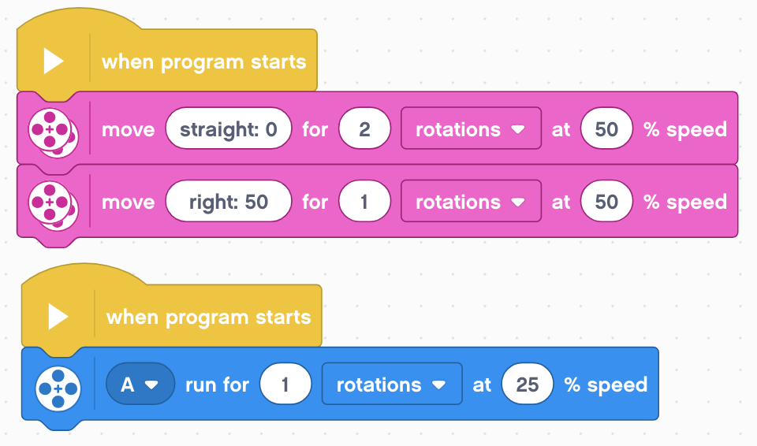
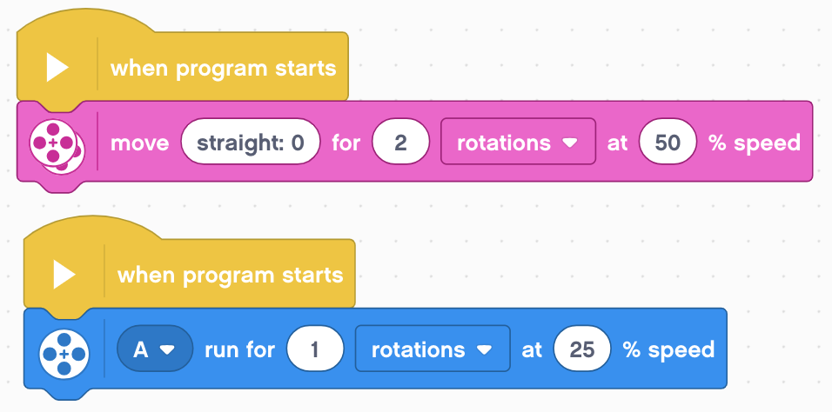
Using Events Inside Programs
Events are great for doing two things at the same time
Often want to do something after you complete the event
Hard to tell which event will finish first (called the “synch problem”)
Need to synchronize the events to make sure that blocks execute when you expect them to
In the picture below, will the turn start after motor A is done or before?
Answer: You do not know

Slide 4
Ensure That Both Beams Finished
In this example, we want both the 2 rotation move and the motor A move to finish before the 360 degree move steering (the turn)
In the EV3-G software, we gave several solution to fixing this problem including variables, data wires, loops, and My Blocks.
However, only the variable solution will work in the EV3 Classroom software and it will need to be altered to work.

Slide 5
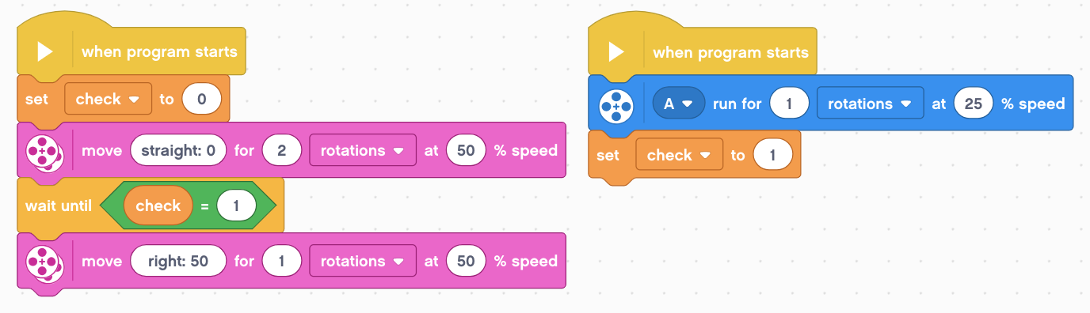
Use Variables To Synchronize
Set variable “check” to a number that is not 1
Move straight for 2 rotations
Wait for second event to finish by waiting for ”check” to be set to 1
Turn right for 1 rotation
Turn Motor A 1 rotation
Set check to 1

Slide 6
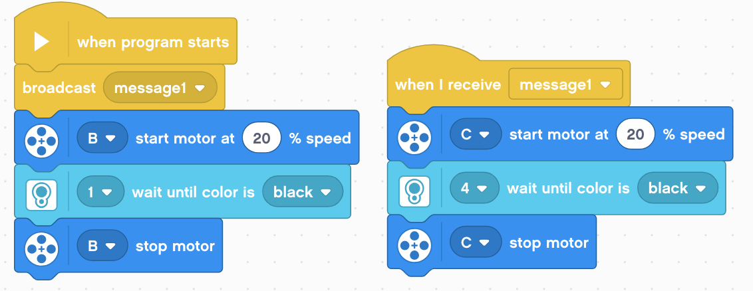
Challenge: Squaring on a Line
This example is from the Squaring on a Line Lesson
Synchronization is critical for aligning on a line using events
As a challenge, complete the Squaring on Line lesson.
Note: You must ensure that both events in an align are completed before moving onto the next block
Otherwise, the robot will not be straight on a line

Slide 7
Discussion Guide
What is the “sync problem”? Ans. When you write code with multiple events, you are not certain when the two events will complete. You don’t know if one event might finish before the other.
How can this be solved? Ans. The problem of synchronization can be solved by using Wait Until Blocks and Variables. The second event will set a variable to a specific value at its end and the first event will wait for that value to be set.

Slide 8
Credits
This tutorial was created by Sanjay Seshan and Arvind Seshan
More lessons at www.ev3lessons.com
This work is licensed under a Creative Commons Attribution-NonCommercial-ShareAlike 4.0 International License.

