Slide 1


BEGINNER PROGRAMMING LESSON
EV3 Classoom: Using Comments

Slide 2
LESSON OBJECTIVES
Learn why to comment code
Learn the two types of comments available
Learn what makes useful comments

Slide 3
Why bother with comments?
Comments in code help the author of the code remember what they were trying to accomplish. You can use them to record the goals or pseudocode for the code.
It makes it easier to debug. You could use it to take notes on values
More importantly, comments allow someone other than the author of the code to understand the program.
Get into the habit of adding comments to your code

Slide 4
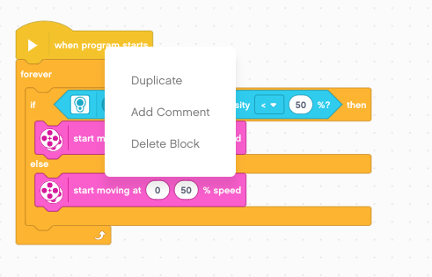
Adding Comments
Right click on any block to create a comment block attached to that block
You can also click on the canvas background to create a comment that is not attached to a block

Slide 5
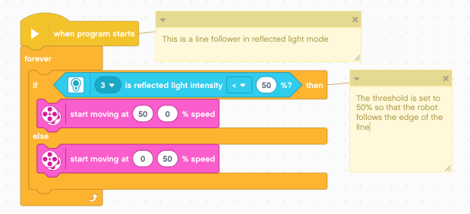
Type in the blocks, adjust size and move them around

Slide 6
USEFUL & NOT USEFUL Comments
+ Telling the reader what the robot is doing at this point in the code (hitting the lever with motor A, turning to the right and going towards the Mission X)
- Repeating the contents of a block of code (e.g. Move straight 1040 degrees).

Slide 7
CREDITS
This tutorial was created by Sanjay Seshan and Arvind Seshan
More lessons are available at www.ev3lessons.com
This work is licensed under a Creative Commons Attribution-NonCommercial-ShareAlike 4.0 International License.

