Slide 1


EV3 ClASSROOM: ADJUSTING MOTORS

Slide 2
Lesson Objectives
Learn how to adjust motors before a launch
Note: This lesson focuses on reliability issues faced by FIRST LEGO League teams. Many concepts are applicable to non-competition situations, but the terminology in the lesson and the main focus is for competition robots.

Slide 3
Sources of Problems
Problem | Impact
Adjusting motors/attachments in base | First move out of Launch Area may behave differently each time. Attachments don’t work the same each time

Slide 4
Adjusting Attachments for Launch
Just like the robot body, you need to set up your attachments in the same way each time for improving reliability
Jigs that allow the attachment arm to only move to a certain level to make sure the arm is set the same way each time
In Senior Solutions, we used a jig to make sure the arm that picked up the pill box always started at the right level
Indicators on the robot (e.g. bright peg) might help you remember where to reset the arm to
In Food Factor, we had a red peg in a hole to remember how far back to move the arm
You can use a touch sensor to detect the position of an attachment at the start of a run

Slide 5
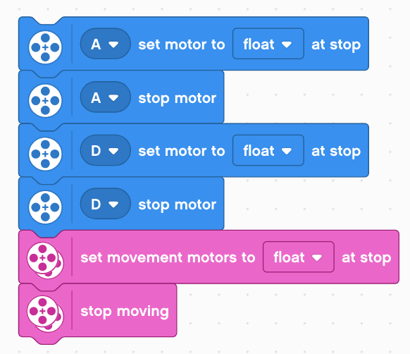
Adjusting Motors in Launch Area
Moving attachments or wheels
When the program is stopped you can move wheels and attachments easily and it has no impact
If a program is running, there are multiple steps to doing this same task
You need to put the motors into “float” mode
1) Put all the motors you use on coast so you can move the motors by hand to adjust

Slide 6
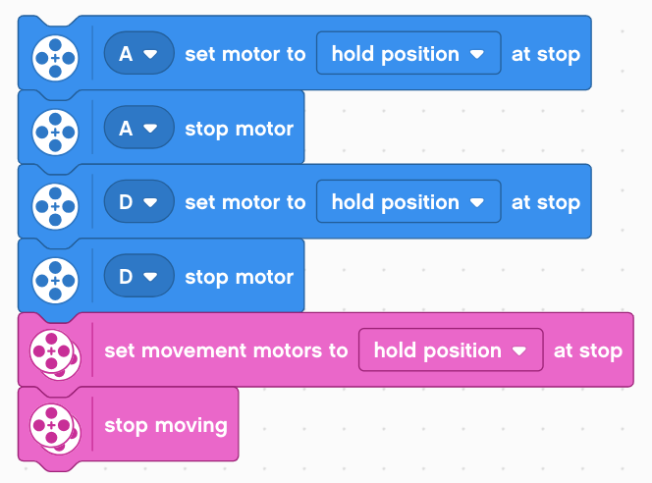
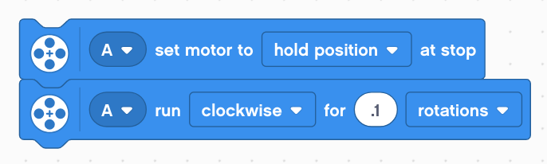
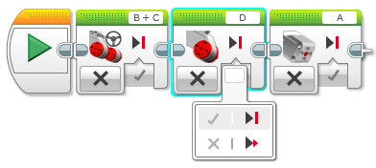
Adjusting Motors in Launch Area
Moving attachments or wheels
When the program is stopped you can move wheels and attachments easily and it has no impact
If a program is running, there are multiple steps
You need to put the motors into “coast” mode
If you move the motors in coast mode, the motors will move back to the original position on the first move!
You need to “reset” the motor after an adjustment and before you start your run
1) Put all the motors you use on coast so you can move the motors by hand to adjust
2) Now you have to “reset” the motors

Slide 7
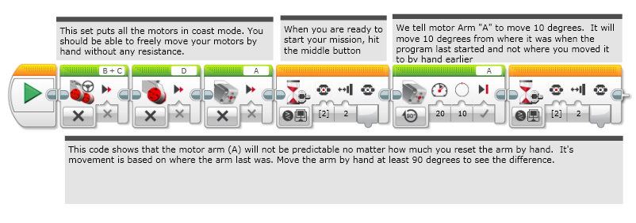
Using Coast
Doesn’t work well. Not as reliable!

Slide 8
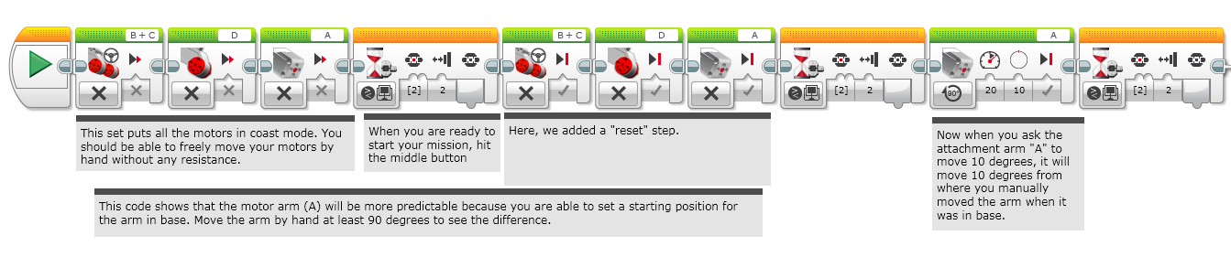
Using Coast & Reset
More reliable!

Slide 9
Credits
This lesson was written by Sanjay and Arvind Seshan
More lessons are available at www.ev3lessons.com
This work is licensed under a Creative Commons Attribution-NonCommercial-ShareAlike 4.0 International License.

