Slide 1


INTERMEDIATE PROGRAMMING LESSON
EV3 CLASSROOM: PARALLEL BEAMS (EVENTS)

Slide 2
Lesson Objectives
Learn what an event is and how to use them
Learn when you might use events

Slide 3
What are Events?
Events allow you to run two or more blocks at the same time.
What if you have one or more attachment arms connected to motors and you want to turn these arms while the robot is moving to complete a mission
Robot lifting up hoops and driving forward.

Slide 4
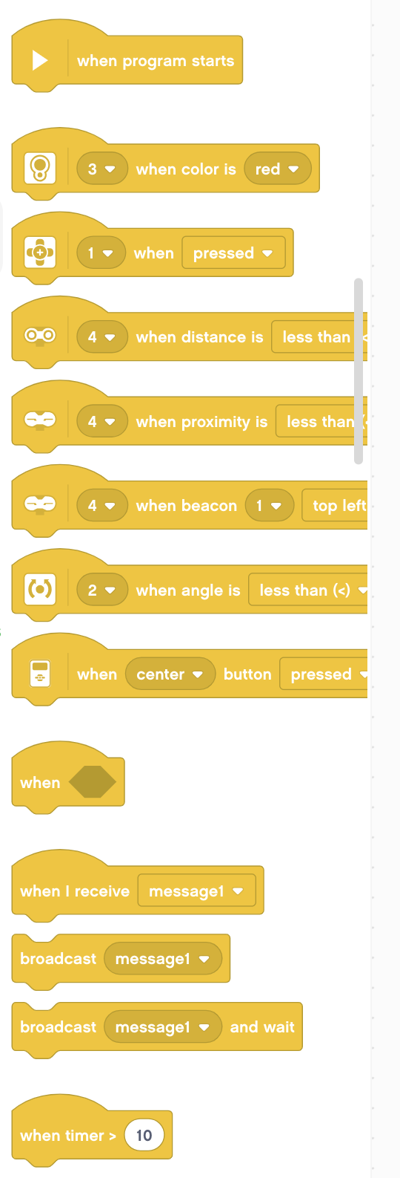
Event Blocks
Events are triggered by different conditions (e.g. sensor values, message broadcasts, or when a program starts)
In this lesson we provide an example of each.

Slide 5
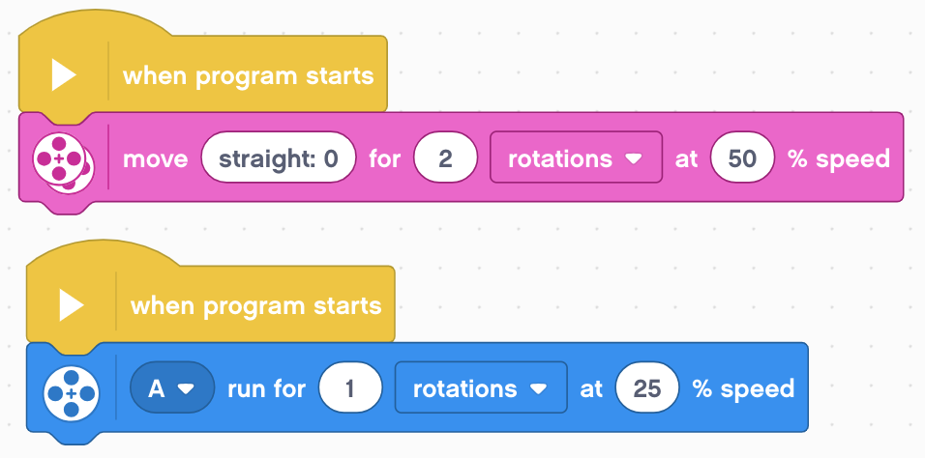
When Program Starts
This block is used to start your programs.
If you have more than one in a project, you can have two separate pieces of code run when the program starts.
In the example on the right, the robot will move straight for two rotations while simultaneously running Motor A for 1 rotation

Slide 6
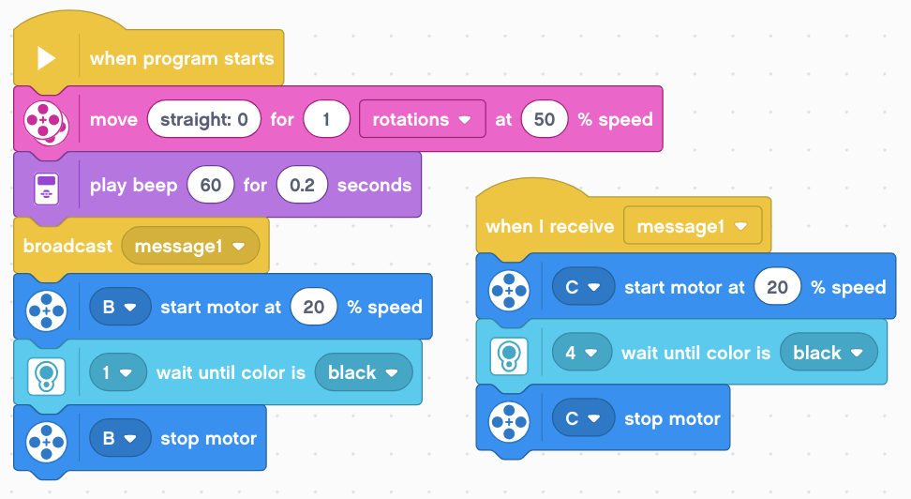
Broadcast Messages
Messages can trigger events when you want to (even in the middle of code)
Broadcast message: sends the message and then continues the rest of the code below it.
Broadcast message and wait: sends the message and waits for all the code under that received message finish and then continues the code under the broadcast message block

Slide 7
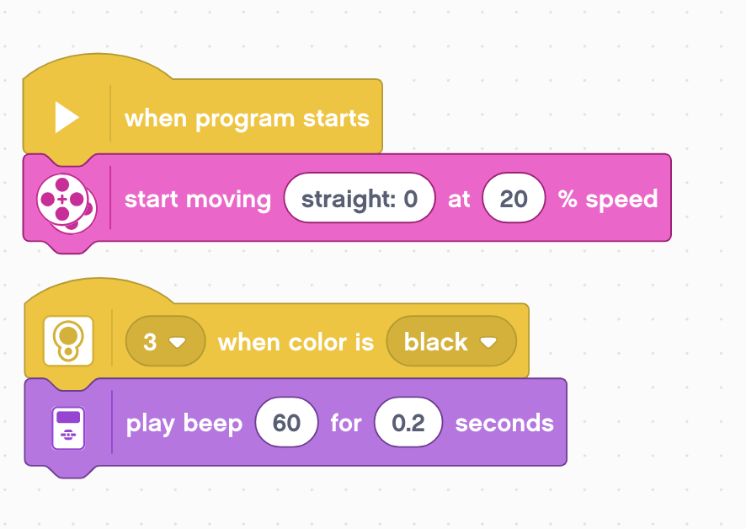
Sensor Activation
You can use the Event Sensor blocks to trigger an event when a sensor condition is met.
In the example below, the robot moves forward and checks for the color black at the same time.
Moves forward
Simultaneously checks color
Plays a beep when black is found

Slide 8
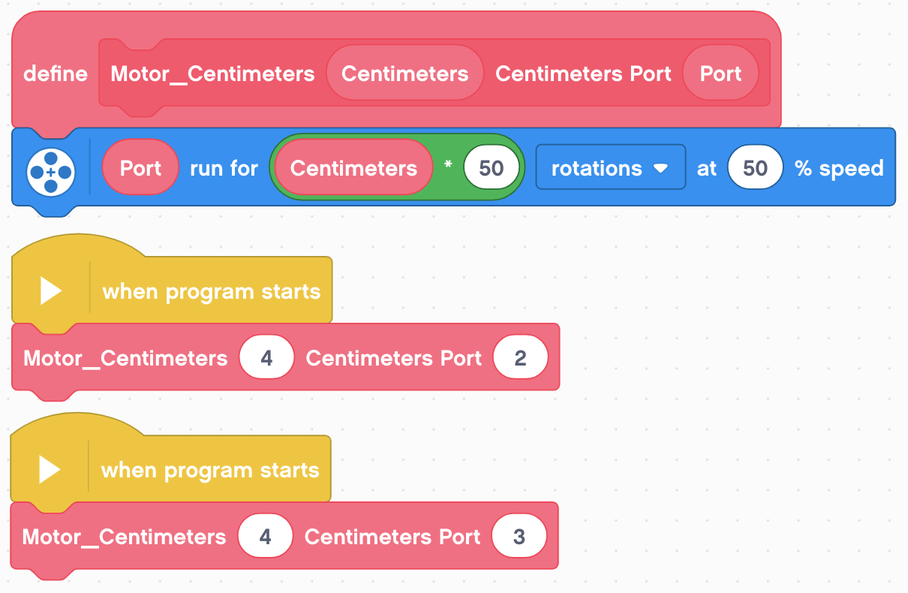
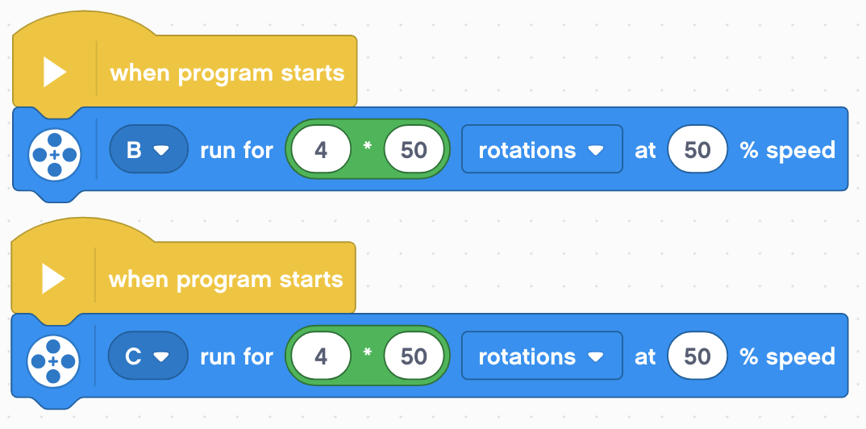
Events and My Blocks
Using My Blocks
Without My Blocks
The code on the left and right may seem the same, but they are not. Only the code on the right will work properly.
The EV3 does not allow multiple identical My Blocks to run simultaneously.

Slide 9
Challenge
Can you write a program that uses parallel beams that have to move and pick up an object at the same time?

Slide 10
Credits
This tutorial was created by Sanjay Seshan and Arvind Seshan
More lessons at www.ev3lessons.com
This work is licensed under a Creative Commons Attribution-NonCommercial-ShareAlike 4.0 International License.

