Slide 1


EV3 Classroom: Introduction to Gyro Sensor and Drift
By Sanjay and Arvind Seshan

Slide 2
Lesson Objectives
Learn what the Gyro Sensor does
Learn about 2 common problems with using the gyro sensor (drift and lag)
Learn what “drift” means
Learn how to correct for drift with a gyro “calibration” technique
Learn about how older and newer generations of gyro sensors effect the calibration process
Prerequisites: Loops, Operators, Wait Blocks

Slide 3
What is the Gyro Sensor?
Gyro sensor detects rotational motion
The sensor measures the rate of rotation in degrees per second (rate)
It also keeps track of the total rotational angle and therefore lets you measure how far your robot has turned (angle)
The accuracy of the sensor is ±3 degrees for 90 degree turn

Slide 4
Gyro Sensor Problems
There are 2 common Gyro issues – drift and lag
Drift – readings keep changing even when the robot is still
Lag – readings are delayed
In this lesson, we focus on the first problem: drift.
We will cover lag in the Gyro Turn lesson
Solution to drift: gyro calibration
The source of the drift problem is that the gyro must “learn” what is still.
For a color sensor, you have to “teach” the robot what is black and white
For your gyro, you need to calibrate the sensor to understand what is “still”

Slide 5
Gyro Calibration to Solve Drift
The gyro auto-calibrates when the robot is turned on or the gyro wire is connected. If the robot is moving during calibration, the gyro “learns” the wrong value for “still” – this causes drift!
Unfortunately, there is no gyro calibration block. However, there is a way to force a calibration of the sensor.

Slide 6
Terms to Know
Reset: Current value of the gyro sensor angle is set to “0”. This is what the gyro block with mode set to “reset” does.
Calibration: The gyro calibrates what it considers to be “still”. This sets both the current gyro sensor rate and angle to “0”. This typically occurs when the gyro is connected.
Some people refer to calibration as a “hard reset”. We will call this calibrate through this lesson to reduce the amount of confusion.

Slide 7
Different Generations of Gyro Sensors
We discovered that there were two different generations of gyro sensors. Sensors made on of before 2013 and sensors made after that.
We did extensive testing on both types of sensors with the help of the extended MINDSTORMS community and discovered that there was a hardware change between 2013 and 2014.
As a result, the commonly seen gyro sensor calibration techniques out there do not work on all gyro sensors. Be careful using code you may find online as it may no longer work on newer gyro sensor

Slide 8
Only Known ways to Calibrate the Gyro
Hardware Solution
Software Solution
Unplug and re-plug your gyro sensor while making sure your robot is still
But, this technique requires access to the EV3 ports and is prone to failure since you may shake the robot as you re-plug the wire.
If you read the port the gyro is connected to as an infrared sensor and then read it again as a gyro sensor, it seems to force a recalibration of the gyro.
This solution works reliably on any generation of sensor.
EV3Lessons.com provides Gyro Drift Test code for EV3-G.

Slide 9
Important Notes for Success
Keep the robot still when you calibrate the gyro
You should not not run this every time you need to read the gyro
You should calibrate in a separate program and run it once before you run your code

Slide 10
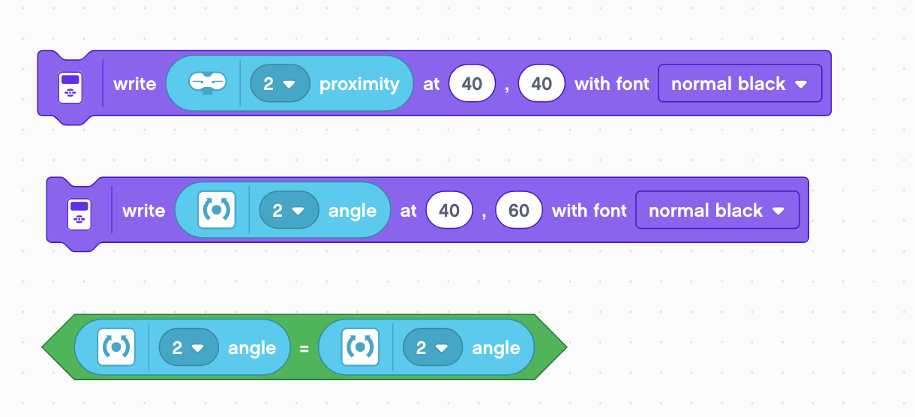
Key Code Components
Reading the Gyro Sensor port as Infrared and then reading as a Gyro Sensor will cause the Gyro Sensor to reset
While it is resetting, the gyro will return a special value called Not a Number (NAN).
Comparing to see that reading is a valid number makes sure that your calibration is completed. If the reading is Not a Number (NAN), it should return false.

Slide 11
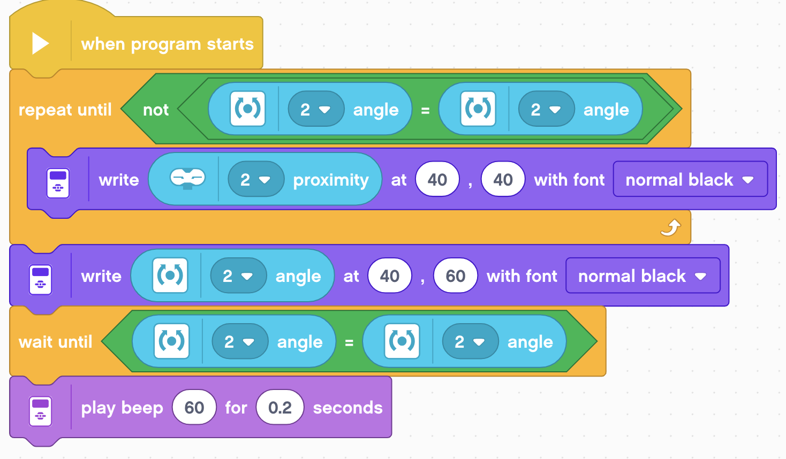
Recalibration Code
Read the port of the gyro as an infrared sensor. Unfortunately, in the EV3 Classroom software, the infrared does not force the gyro sensor communication to timeout properly every time when reading it on the gyro port. To ensure that it works, a loop keeps reading the infrared on port 2 until the gyro angle is not equal to itself. When the gyro disconnects, it reads as NAN, and NAN is not equal to NAN. Therefore, it will repeat until the gyro is successfully disconnected.
Read port 2 back as a gyro sensor.
Wait until the angle is equal to itself, or the gyro has been reconnected.
Play a beep so that the user knows that the recalibration has been completed
NAN: Not a Number

Slide 12
Discussion Guide
What are 2 common problems when programming with the gyro?
Ans. Gryo drift and Gyro lag
What does Gyro drift mean?
Ans. The Gyro readings keep changing even when the robot is still
Can you move your robot when you calibrate your gyro?
Ans. No. Keep the robot still.
Do you need to calibrate your gryo before every move?
Ans. No. Once before you run your entire program

Slide 13
Credits
This tutorial was written by Sanjay Seshan and Arvind Seshan
More lessons at www.ev3lessons.com
This work is licensed under a Creative Commons Attribution-NonCommercial-ShareAlike 4.0 International License.

