Slide 1


BEGINNER PROGRAMMING LESSON
Device Browser

Slide 2
Lesson Objectives
Learn how to retrieve and use data from your sensors
Learn how to use Device Browser on the EV3 Brick
Learn some examples of when and the data from the Device Browser would be useful
Try to solve some common problems using this data

Slide 3
WHY DO YOU NEED SENSOR DATA?
Sensor data can be….
Used to help program more easily (no more guess and check!!)
Used to help program more accurately
Used to debug code as well as build issues
Device Browser is an easy way to access SENSOR DATA!

Slide 4
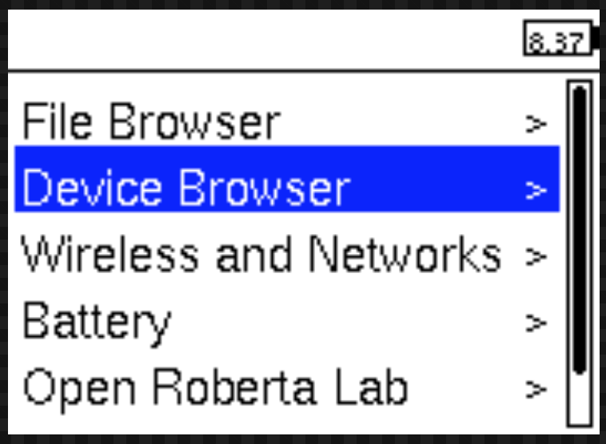
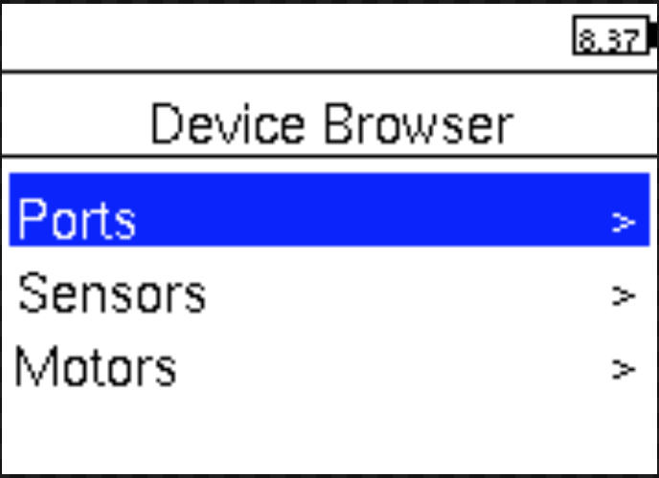
HOW DO YOU GET to port view?
Information about sensors and motors can be found in the Device Browser
From the menu, use the down arrow on the EV3 brick to navigate to the Device Browser.

Slide 5
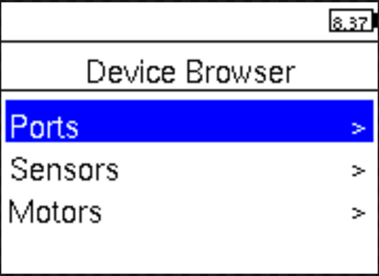
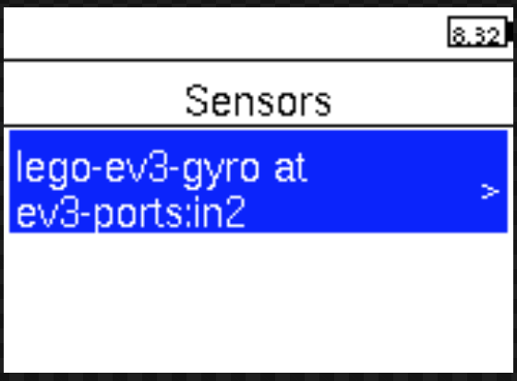
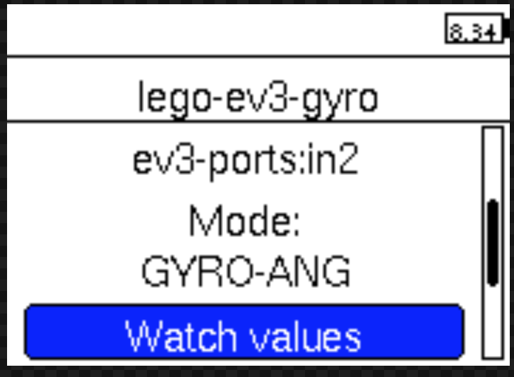
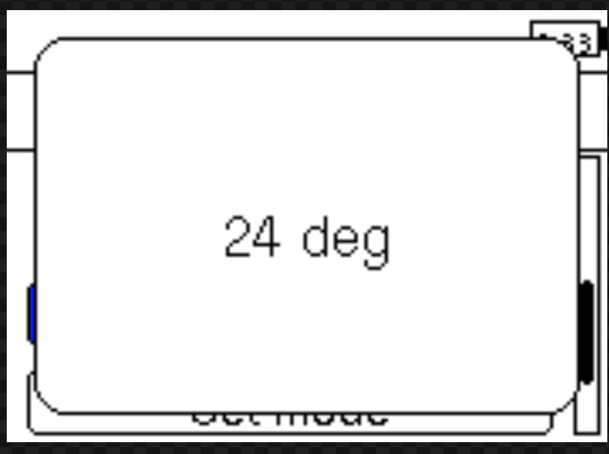
Obtaining Sensor values
Example: Gyro sensor in port 2
Inside Device Browser, use the down button the EV3 brick to get to Sensors
Pick the sensor you want
Go down using the down button to Watch Values
Select Watch Values using the middle button on the EV3 brick

Slide 6

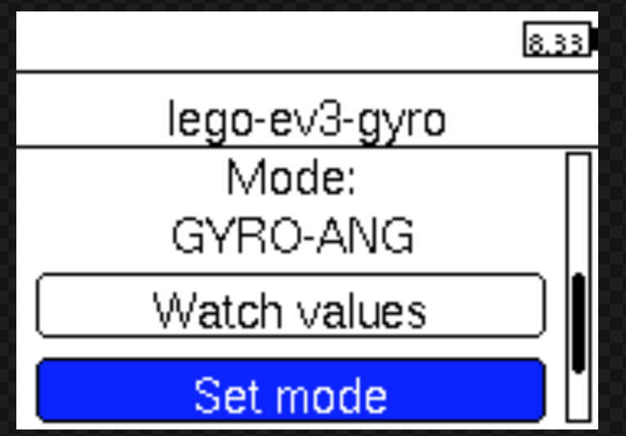
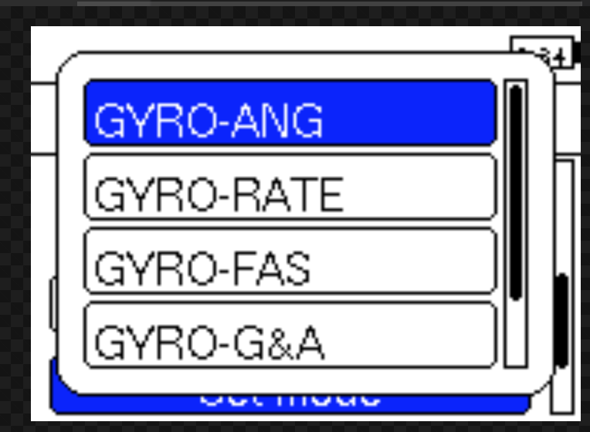
setting Sensor Modes
Example: Gyro sensor in port 2
Scroll down to Sensors in Device Browser using the down button on the brick
Pick the sensor you want and scroll down to Set Mode
Change the modes of the sensor
You can access more modes on the Gyro Sensor in Python than you can using EV3-G
See http://docs.ev3dev.org/projects/lego-linux-drivers/en/ev3dev-stretch/sensor_data.html#lego-ev3-gyro

Slide 7
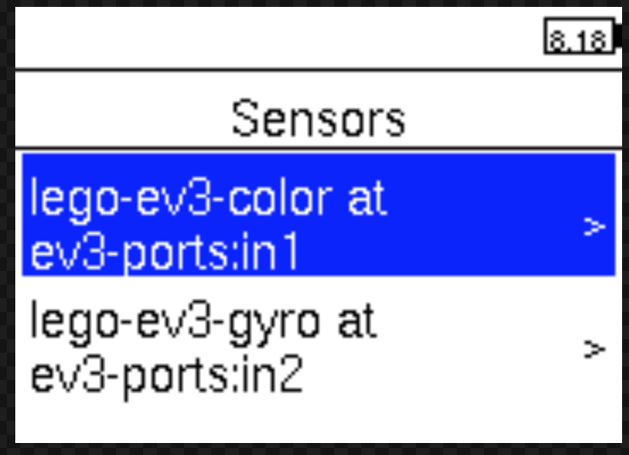
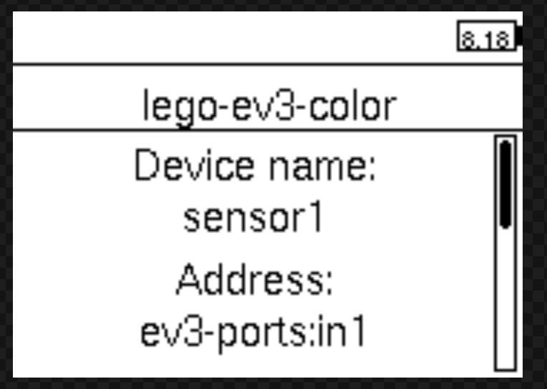
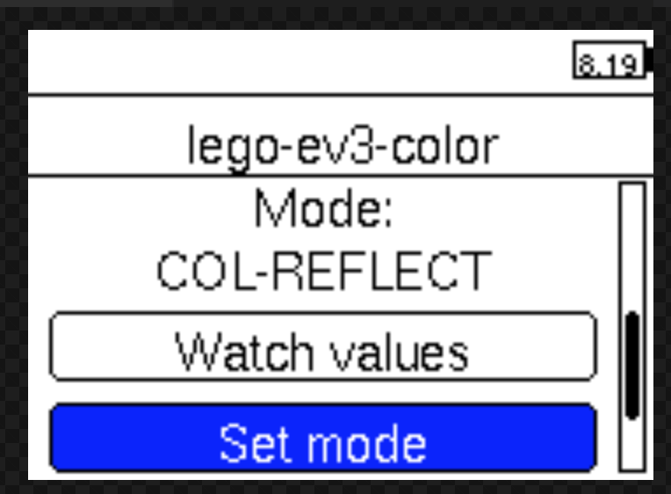
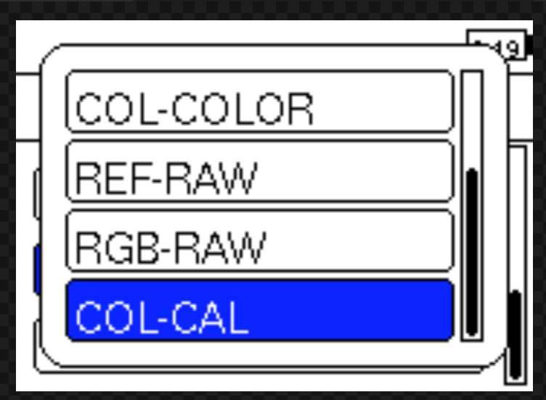
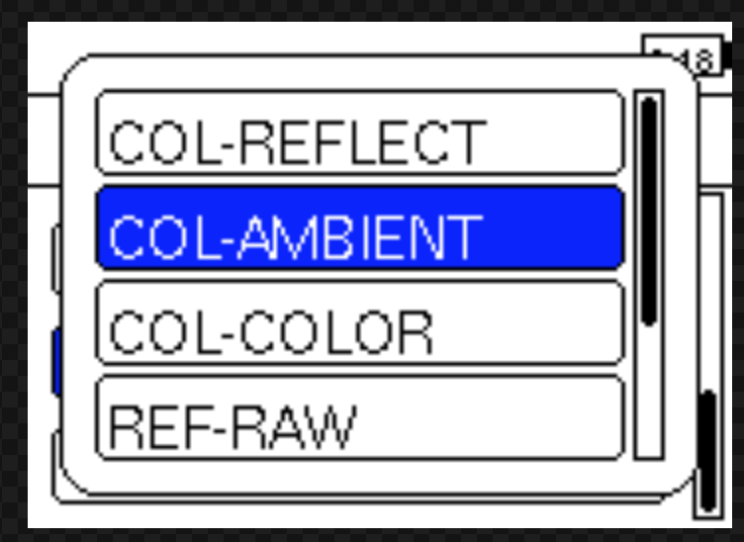
Another EXAMPLE: COLOR sensor in Port 1
You can access more modes on the Color Sensor in Python than you can using EV3-G
See http://docs.ev3dev.org/projects/lego-linux-drivers/en/ev3dev-stretch/sensor_data.html#lego-ev3-color

Slide 8
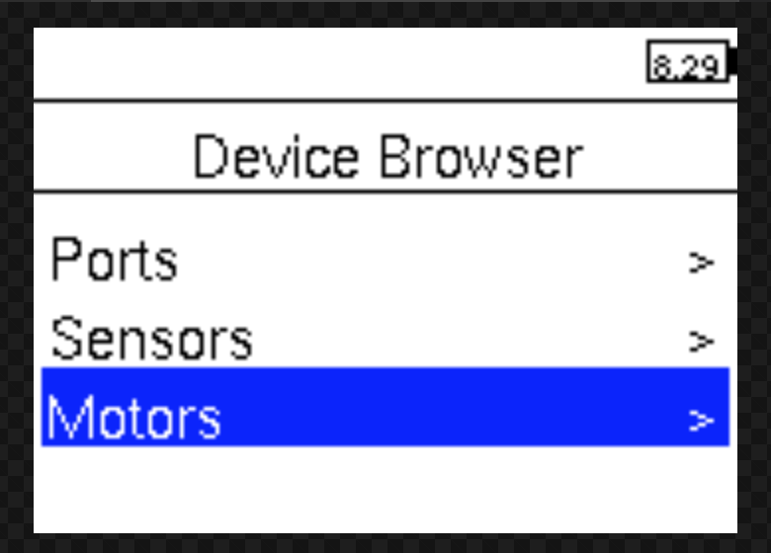
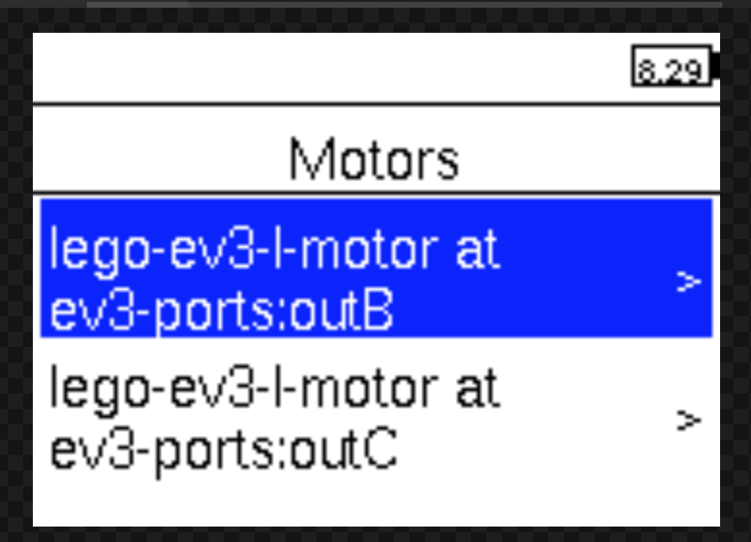
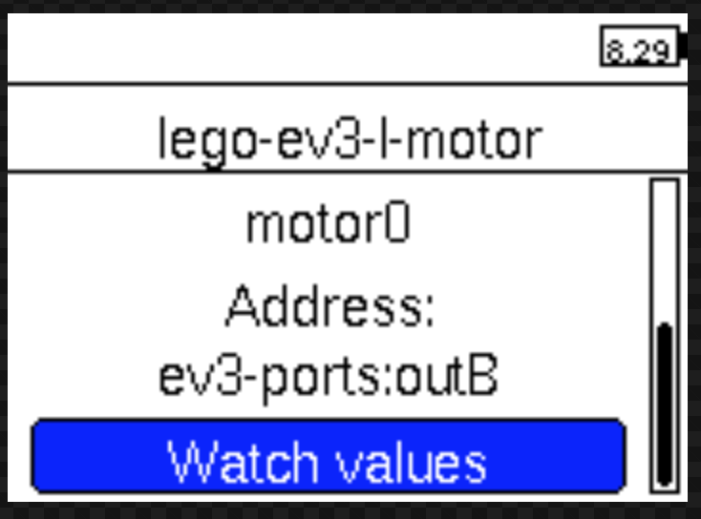
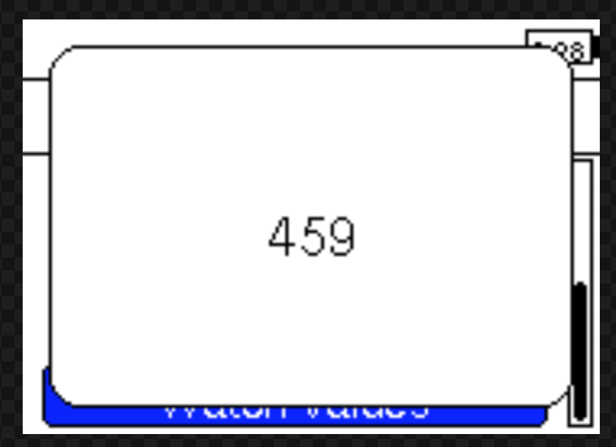
obtaining Motor Values
Device Browser → Motors
Select Motor
e.g. Motor B
Select Watch Values
Rotate a motor and watch the values change

Slide 9
Device Browser can be POWERFUL
As you go through the rest of the lessons on EV3Tutorials.com, you might need to use this feature on the EV3 brick
As you complete each challenge, think about data from Device Browser might be helpful
The next page has many several examples to think about.

Slide 10
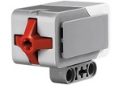
OTHER PROBLEMS YOU CAN SOLVE WITH PORT VIEW
Challenge 1: Program Easier/More Accurately
I want to go from a starting point up to a LEGO model. I keep having to guess and check. How can I figure out how far away the LEGO model is?
Challenge 2: Program Easier/More Accurately
I want my robot to turn 90 degrees. But 90 degrees in the real world is not 90 degrees in the steering block. So, how much does my robot have to turn to make a 90 degree turn?
Challenge 3: Debug Code
The robot does not folllow the green line like I programmed it to do. Why not? What color does the robot think that green line is? Try placing the robot on different objects or parts of mat/picture – what colors or reflected light values does the sensor read
Challenge 4: Check Builds
I built my robot with the touch sensor a little bit inside the robot. I am not sure that the touch sensor is getting pressed enough. How can I make sure the sensor is getting pressed?
Challenge 5: Test Sensors
I told my robot to stop when the Ultrasonic sensor is 20cm away. But it seems to stop earlier. Is the sensor working correctly? How can I see what the ultrasonic sensor sees?

Slide 11
CREDITS
Author: Sanjay and Arvind Seshan
More lessons are available at www.ev3tutorials.com
This work is licensed under a Creative Commons Attribution-NonCommercial-ShareAlike 4.0 International License.

