Slide 1
LEGO MINDSTORMS and Raspberry Pi Communicator

Slide 2
Objectives
Learn how to make the EV3 communicate with a Raspberry Pi
Prerequisites:
Must have basic Python programming knowledge
Must be comfortable using a Raspberry Pi (Unix/Linux commands & GPIO)
Must be familiar with EV3 Bluetooth Messaging

Slide 3
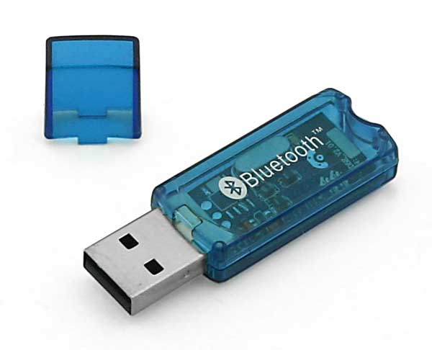
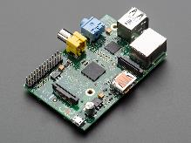
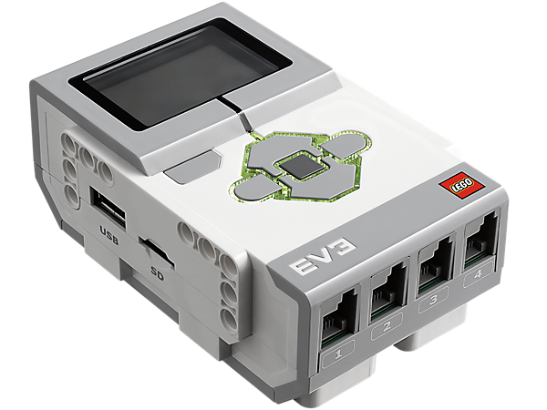
Materials
Raspberry Pi (Tested on Model B Edition 1 using Raspbian)
EV3 brick
USB Bluetooth (for the Raspberry Pi)

Slide 4
Step 1: Pi Setup
Install software on the Raspberry Pi
sudo apt-get update
sudo apt-get upgrade
sudo reboot
sudo apt-get install bluetooth bluez-utils blueman

Slide 5
Step 2: Bluetooth EV3 to Pi
Run hcitool scan to find the mac address of EV3 (will look something like this: 00:16:53:3F:2F:C3)
Run bluetooth-agent 1234 & :proxy for entering passcode for ev3
Run sudo rfcomm connect /dev/rfcomm0 MAC_ADDRESS & :to connect the ev3 (press enter if any message(s) appears on the screen)
Replace MAC_ADDRESS with the Mac Address
If you are not returned to a terminal, try pressing “Return/Enter”. If that did not work you probably forgot the & symbol.

Slide 6
Step 3: Base Code
Download Pi Base Code
This code will decipher EV3 Bluetooth messages on the Pi
The code only deciphers text messages

Slide 7
Challenge 1: Send a Message From the EV3 to the Pi
Create EV3 test program to send “hello” to the name of your Pi
Play the base code on the Pi and the code you made on the EV3.
You should then see the message you sent on the Pi.
If there are errors that probably means that the Bluetooth is not connected properly

Slide 8
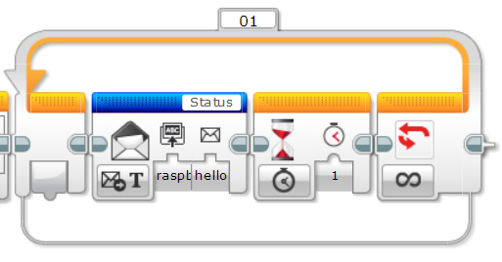
Challenge 1: Solution

Slide 9
Challenge 2: Run Actions Based on the EV3 Message
Use Python to print “Hello EV3” if the EV3 message is “hi”
Hint: to make the if statement work in this scenario you will need to use
if ‘hi’ in message: instead of if message == ‘hi’:
You can use the base code to collect EV3 messages provided by EV3Lessons.com (See Slide 10)
Be sure to read the comments to understand how the code works
Download solution code from EV3Lessons.com

Slide 10
Extra: Send Message from the RPi to the EV3
The message, mailbox name and the message type needs to be encoded into a format that the EV3 can understand
The data needs to be sent over Bluetooth to the EV3
We have the code for this posted on EV3Lessons.com
You will need this code for Challenge 3

Slide 11
Challenge 3: Receive RPi Message
Make an EV3 program that will receive the RPi’s message and print it on the screen
Play the program on the Raspberry Pi and the EV3

Slide 12
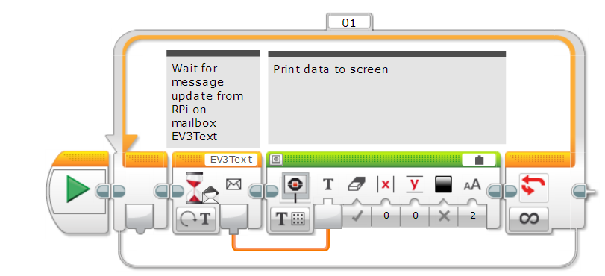
Challenge 3 Solution

Slide 13
CREDITS
This tutorial was created by Sanjay Seshan and Arvind Seshan from Droids Robotics.
More lessons are available at www.ev3lessons.com
Author’s Email: team@droidsrobotics.org
Credits: gipprojects for the code to connect a Raspberry Pi to an EV3
This work is licensed under a Creative Commons Attribution-NonCommercial-ShareAlike 4.0 International License.

