Slide 1
MINDSENSORS PSP-Nx Controller for LEGO® MINDSTORMS®

Slide 2
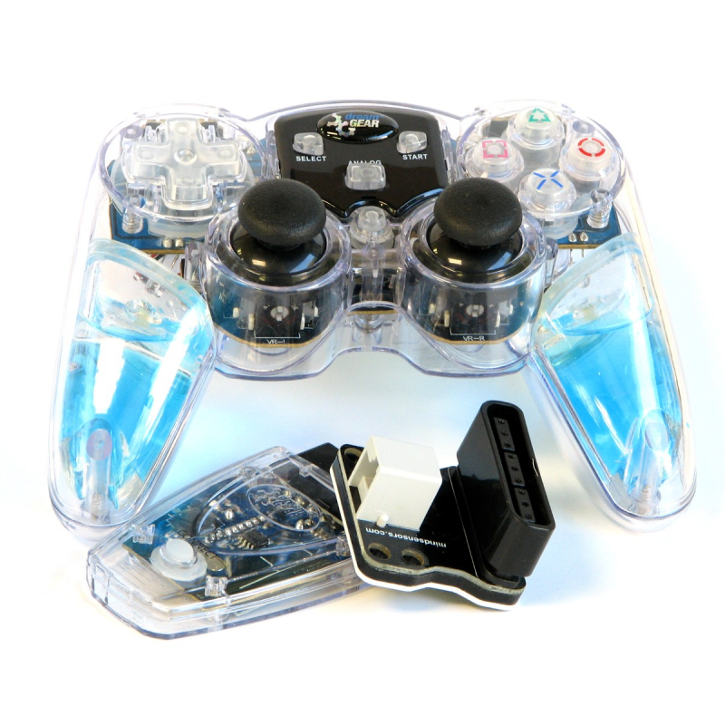
What is the PSP-Nx Controller?
The controller is a PS2 controller with a matching receiver
There is an adapter to connect the receiver to a LEGO sensor port

Slide 3
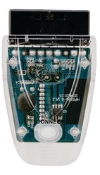
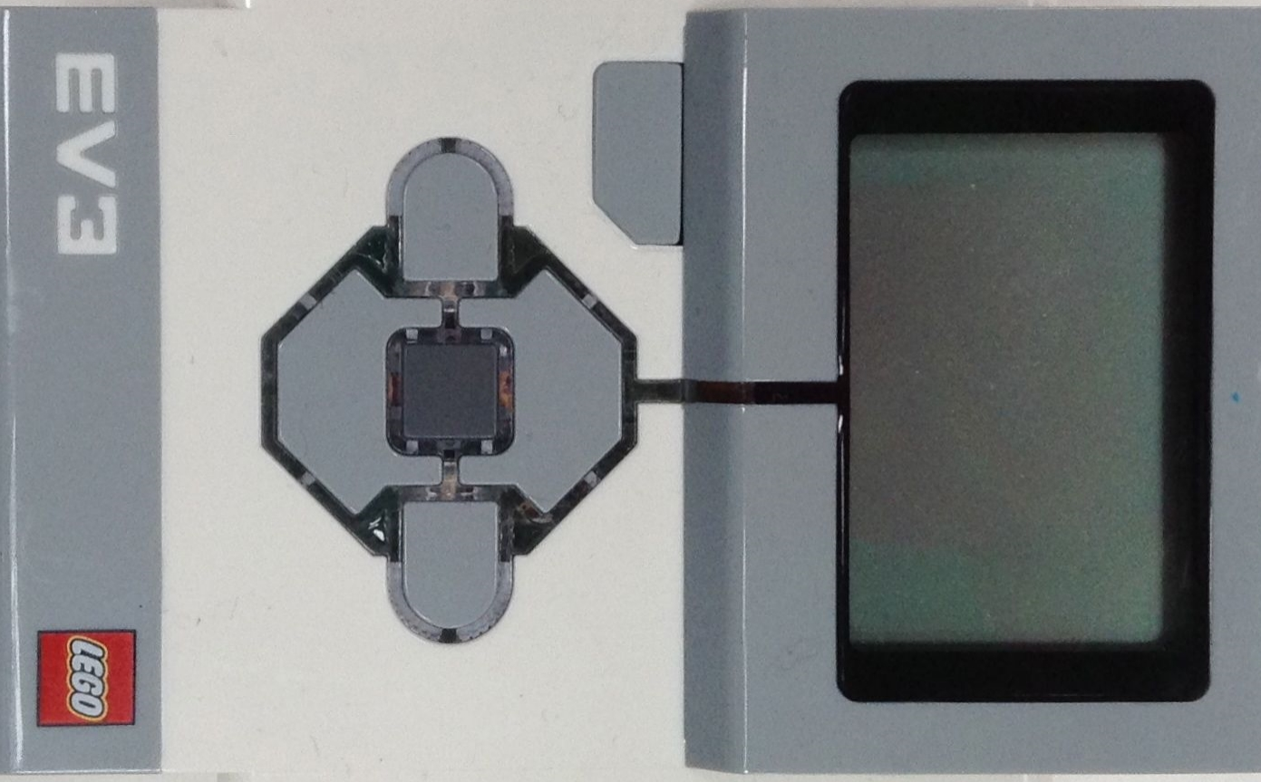

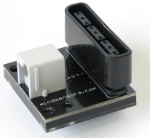
Step 1: Assembling the Receiver
Follow the manufacturer’s recommendations at all times.
Attach the receiver into the adapter board
A standard EV3/NXT cable will work with the adaptor board to the EV3

Slide 4
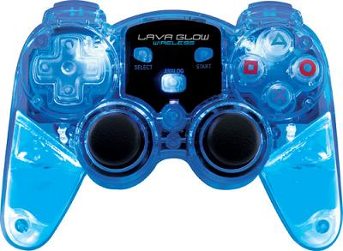
Step 2: Connect the Remote
Put two AA batteries in the controller’s hatch on the back
Turn the controller on by sliding the switch on the back of the controller
Press the connect button on the receiver while pressing the middle button on the remote
Press some keys on the controller. If there is a green light on the adapter board, your controller is paired

Slide 5
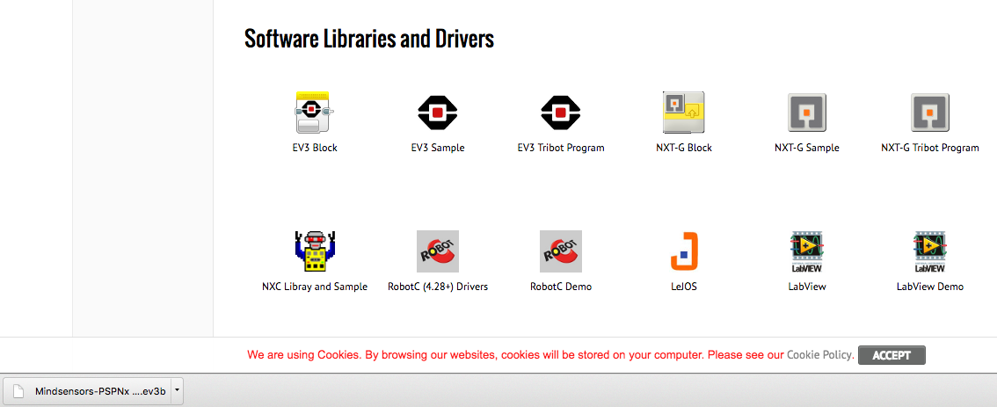
Step 3: Download Block
Download the necessary block online from http://www.mindsensors.com/ev3-and-nxt/32-psp-nx-combo-with-wireless-controller
Import it into your software by following our Importing Additional Blocks lesson
Downloads

Slide 6
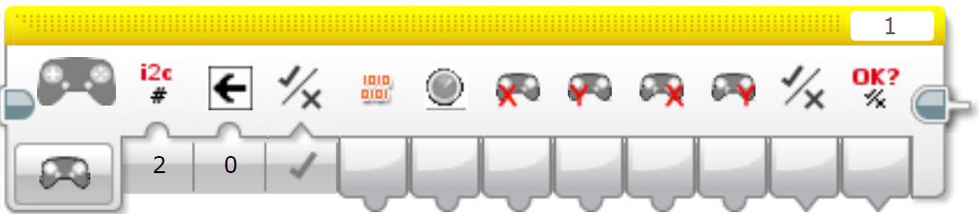
New Block: Mindsensors PSPNx
This new block should show up in the Yellow sensor block pallet
Input 1 → i2c: Do not change this input if you do not completely understand i2c (i2c is the data sent out by the EV3 UART ports)
Input 2 → Desired Button: Which button do you want to compare
Input 3 → Pressure: Enables or disables Button Pressure (Output 2)
Output 1 → Button Bits: Raw button value. Returns different integers based on the buttons pressed
Output 2 → Button Pressure: How much is the desired button pressed in
Output 3,4 → Left Axis: Returns the X,Y values of the left axis
Output 5,6 → Right Axis: Returns the X,Y values of the right axis
Output 7 → Button pressed: Checks if the desired button is pressed
Output 8 → Success: Checks if data was read successfully

Slide 7
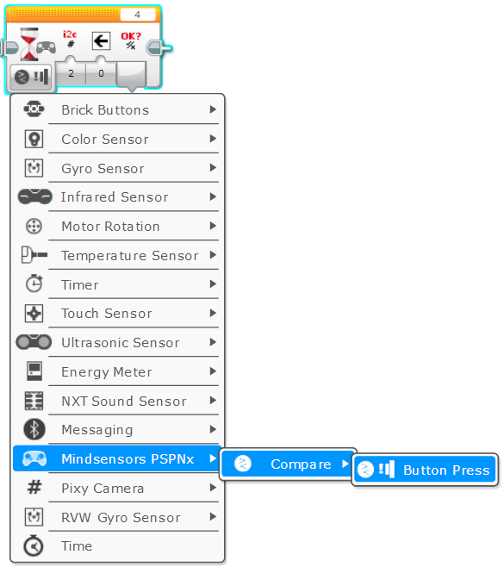
New Block: Wait – Mindsensors PSPNx
To get to the Wait Mindsensors PSPNx mode, click Mindsensors PSPNx → Compare → Button Press
Input 1 → i2c: Do not change this input if you do not completely understand i2c (i2c is the data sent out by the EV3 UART ports)
Input 2 → Desired Button: Which button do you want to compare
Output 1 → Success: Checks if data was read successfully

Slide 8
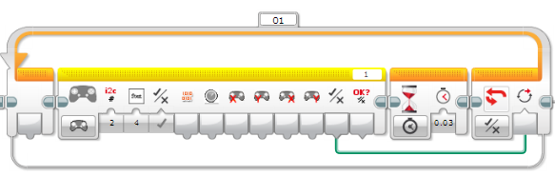
Warning: Read Error and False Readings
A read error is when the outputs of the PSPNx blocks all read 0 continuously
The read error happens when the program is rapidly reading from the PSP-Nx remote
There is bug in the EV3 which causes this read error when the reading speed is too high which happens in the Wait block
Mindsensors’ Technical Support suggests that you use a loop instead of a wait until block to prevent using a Wait block
Unfortunately the block can occasionally give a false reading.
Mindsensors’ Technical Support suggests you add a 30 millisecond delay into the loop. The 30 millisecond delay is added to give time to prevent false readings.
We found that this delay only reduces the frequency of a false reading. It does not eliminate it. There are situations where the delay can help, but our tests showed that in some conditions a delay is not necessary

Slide 9
Challenge 1:
Keep moving until the X button is pressed
Tips
You will need to use the Wait – Mindsensors PSPNx block described on page 7
Note: You can use a Wait block in this situation

Slide 10
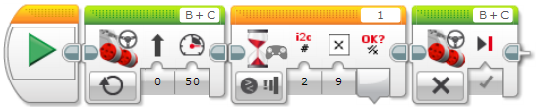
Challenge 1 Solution:
Step 1: Turn on the motors
Step 2: Wait for the X button to be pressed
Step 3: Turn off the motors

Slide 11
Challenge 2:
Create a simple Remote Control program that waits for the Start button to be pressed before controlling the robot
Tips
You will need the Mindsensors PSPNx Sensor block
In this situation, you will need to use the alternate code, described on page 8, for waiting until a button is pressed. The Wait for seconds block to reduce false readings will not be needed for this challenge
The X output for the joystick should be the steering
The Y output for the joystick should be the power
You will use the left joystick for both steering and power of the wheels

Slide 12
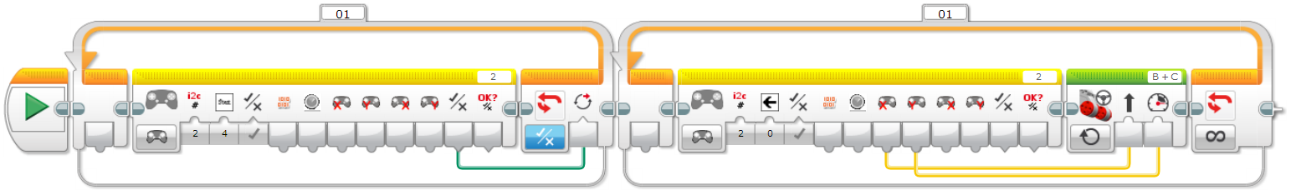
Challenge 2 Solution:
Wait until the Start button is pressed using the alternate method without a Wait for seconds block
Read the PSP controller left axis (for X and Y) and wire it up to the steering and the power

Slide 13
Tips for Success
You can update the program to include a math block that either multiplies or divides the X output for the joystick before going in the steering input
If you need to invert your controls, just multiply the X,Y values by -1

Slide 14
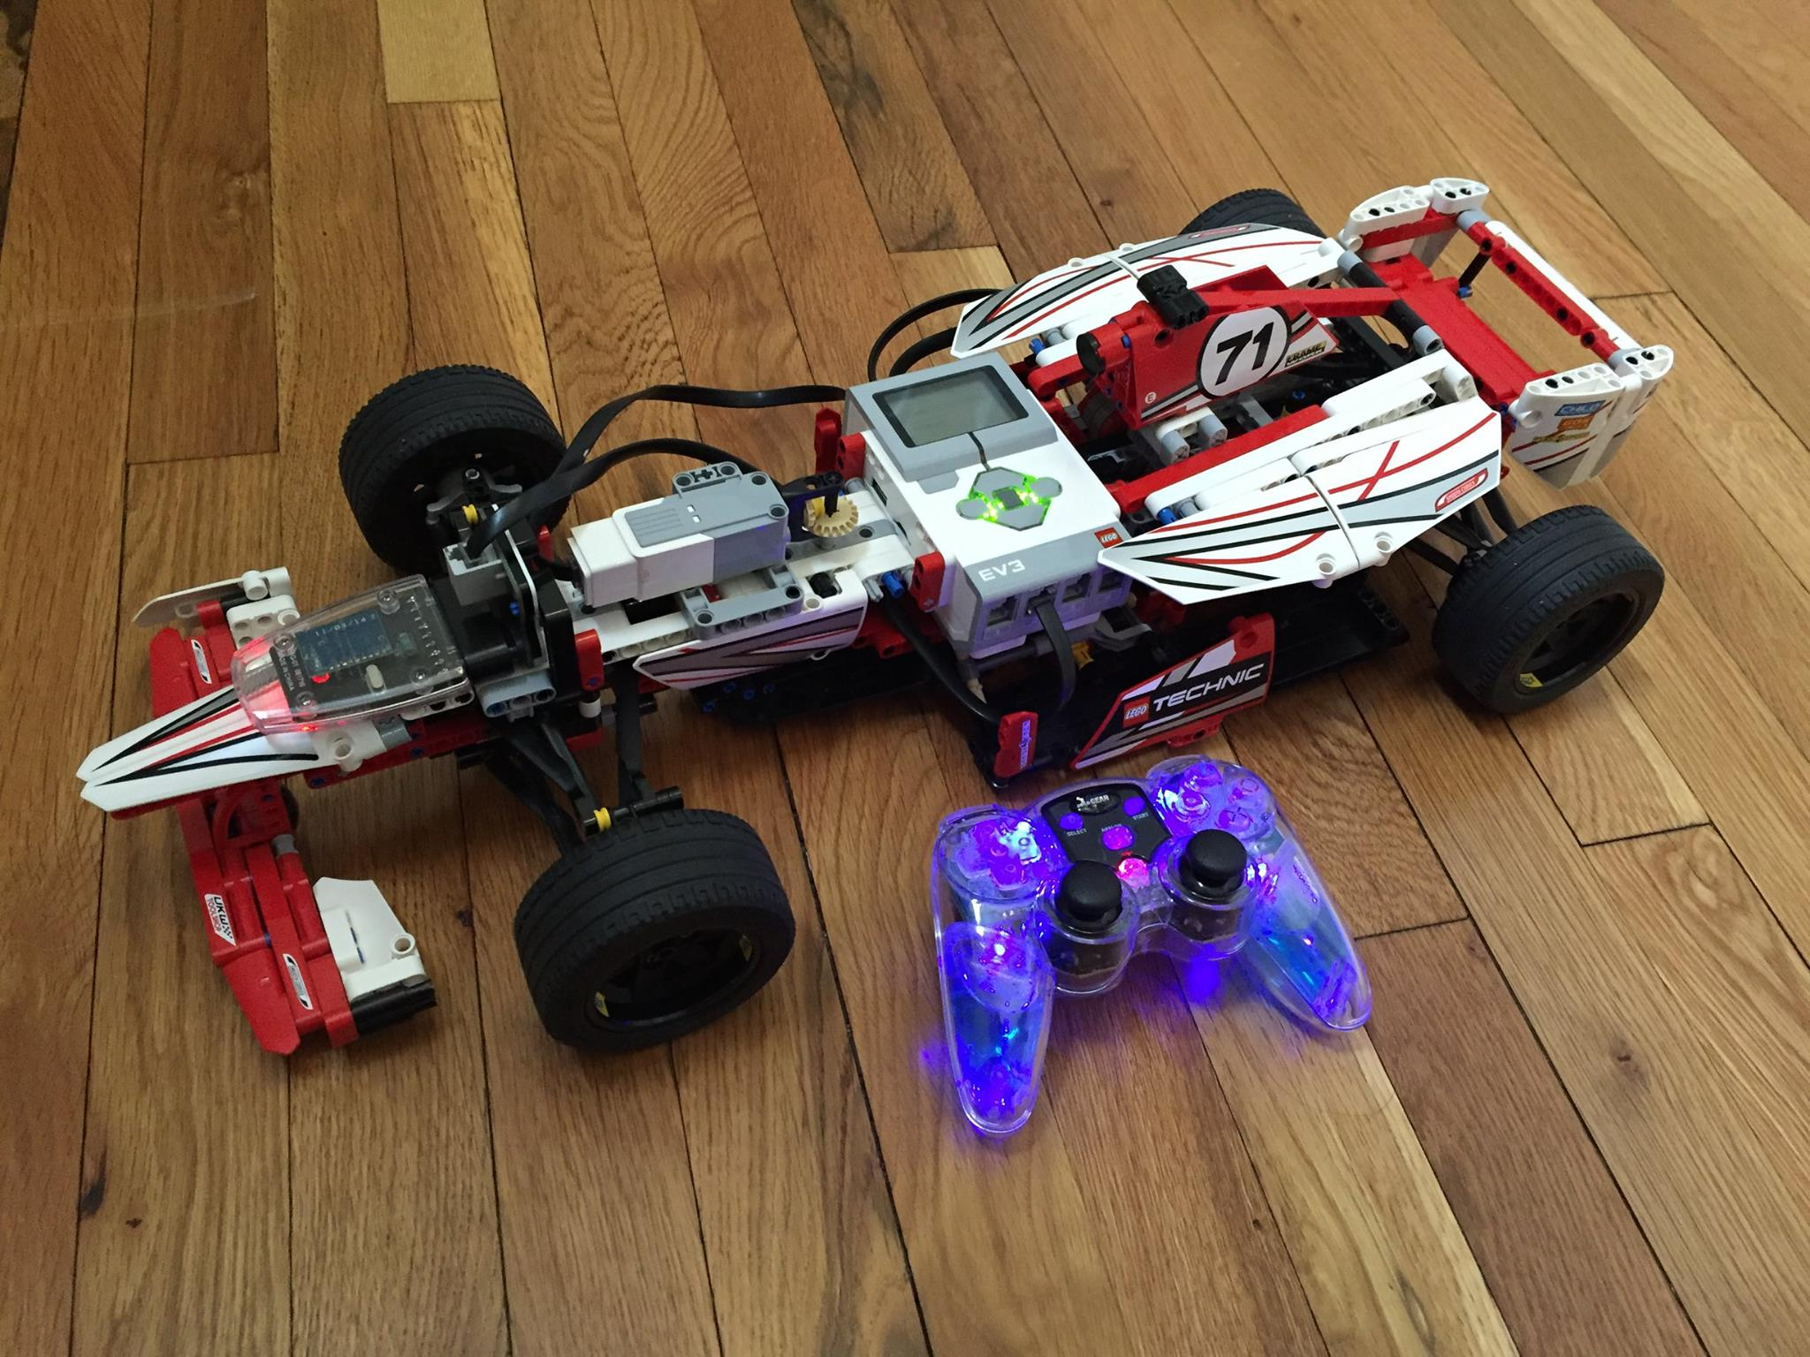
Next Steps: Project Ideas
Make a remote control program that uses the left joystick for power and the right joystick for steering
Make a game using the buttons
Create a remote controlled LEGO race car like the one in the photo on the left

Slide 15
CREDITS
This tutorial was created by Sanjay Seshan and Arvind Seshan
More lessons are available at www.ev3lessons.com
This work is licensed under a Creative Commons Attribution-NonCommercial-ShareAlike 4.0 International License.

