Slide 1
Mindsensors PSP-Nx Controller Simon Game

Slide 2
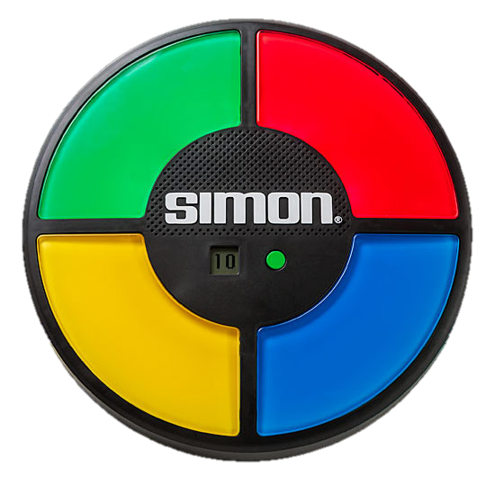
What is the Simon Game?
It is an electronic memory game
The game consists of four buttons that are different colors
Each button corresponds to a tone
When the game starts, the tones play and the buttons light up in a random order
The player has to memorize the order and press the buttons in that order
The length of the sequence gets longer after each level

Slide 3
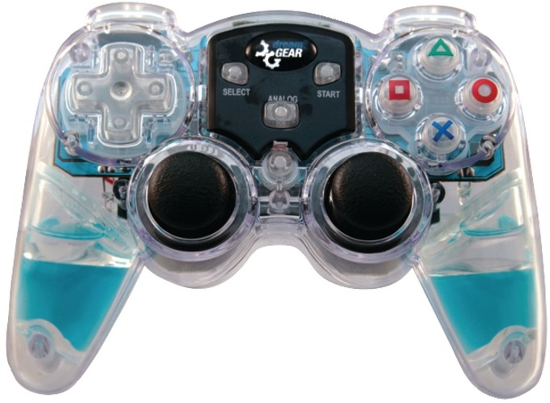
Playing Simon with the PSP-Nx Controller
The four buttons on the right side of the remote are perfect for a Simon Game
There are the correct number of buttons
There are four different colors and shapes
The EV3 brick can be used to display shapes
You can also add corresponding tones
The robot will then will check if the order that the player pressed on the PSP-Nx Controller is correct and either move on to a harder level or exit the game

Slide 4
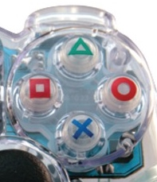

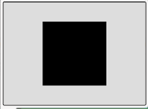
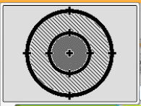
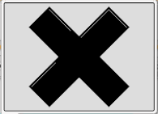
Shapes Used
PSP-Nx Controller
Similar shapes on EV3 brick
You can also use your own shapes (see EV3Lessons Beginner – Custom Images and Sounds)

Slide 5
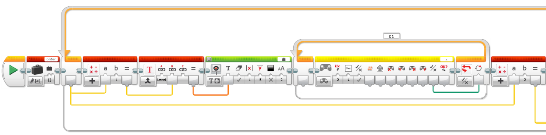
Simon Program - Step 1
The program starts by creating a numeric array which will keep track of the sequence. Next, the program enters the main loop. The current level is calculated using the loop count and is displayed to the screen. The robot waits for the player to press the Start button on the controller to begin the level. Finally, the length of the sequence is calculated using the loop count.

Slide 6
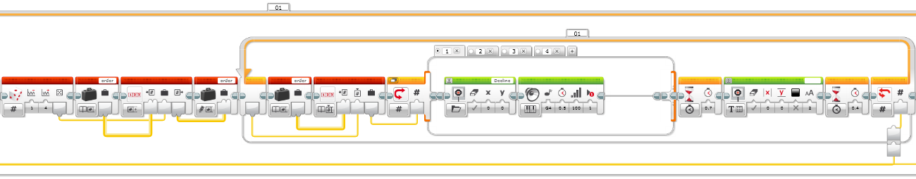
Simon Program – Step 2
The program uses a random block to randomly choose the next shape for the sequence. It is added to the array that was created in Step 1. The program then enters a second loop that is inside the main loop. This part of the program reads the array and displays the correct shapes in the correct order on the screen. It also plays the correct tone. The length of the sequence, calculated in Step 1, goes into the input of the loop to read the array the correct number of times.

Slide 7
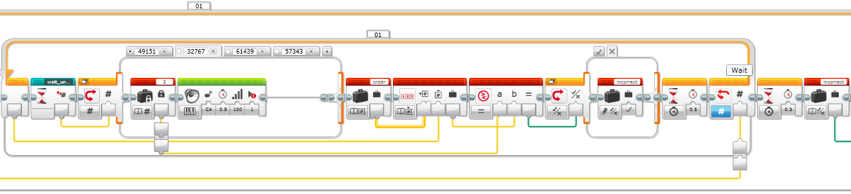
Simon Program – Step 3
The program enters an additional loop that is inside the main loop. This part of the program uses a My Block that waits until any of the four buttons are pressed. The My Block outputs the button bits which gives a different number depending on which button is pressed. As each button is pressed, a corresponding tone is played. These button bits are then converted into a number 1 through 4 so that they can be compared with the array values. A compare block is used to decide whether the player won or not. The length of the sequence, calculated in Step 1, goes into the input of the loop so that the robot reads the correct sequence length.

Slide 8
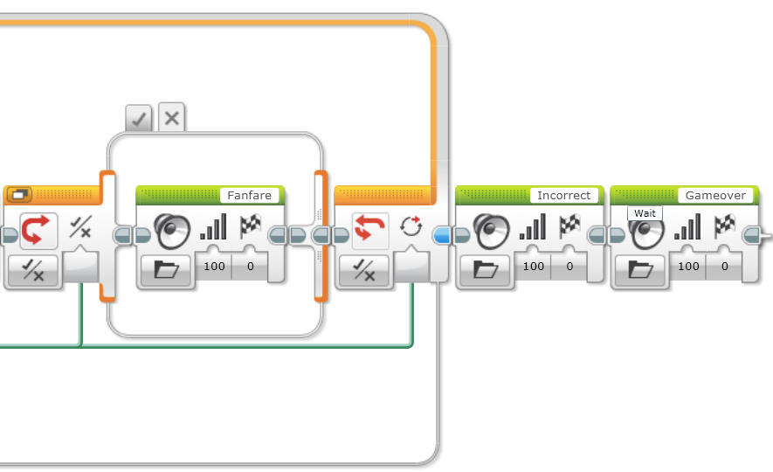
Simon Program – Step 4
This part of the program uses the data of if the player won, that was calculated in Part 3, to either play a fanfare sound and return to the beginning of the loop, or end the game.

Slide 9
Where Can You Get the Code?
If you would like to try out the code, there is a link on ev3lessons.com so you too can play our game.
The code provided has Steps 2 and 3 as My Blocks

Slide 10
Next Steps: Ideas
Make the game more complicated by adding modes
Simon Rewind
The player has to input the sequence shown in reverse order
Simon Revenge
Multiplayer version where each player does one shape in the sequence
If you completed our Random Block lesson on EV3Lessons (Advanced), you discovered that the Random Block is not very random.
Find a way to make the Simon Game you just created more random

Slide 11
CREDITS
This tutorial was created by Sanjay Seshan and Arvind Seshan
More lessons are available at www.ev3lessons.com
This work is licensed under a Creative Commons Attribution-NonCommercial-ShareAlike 4.0 International License.

