Slide 1
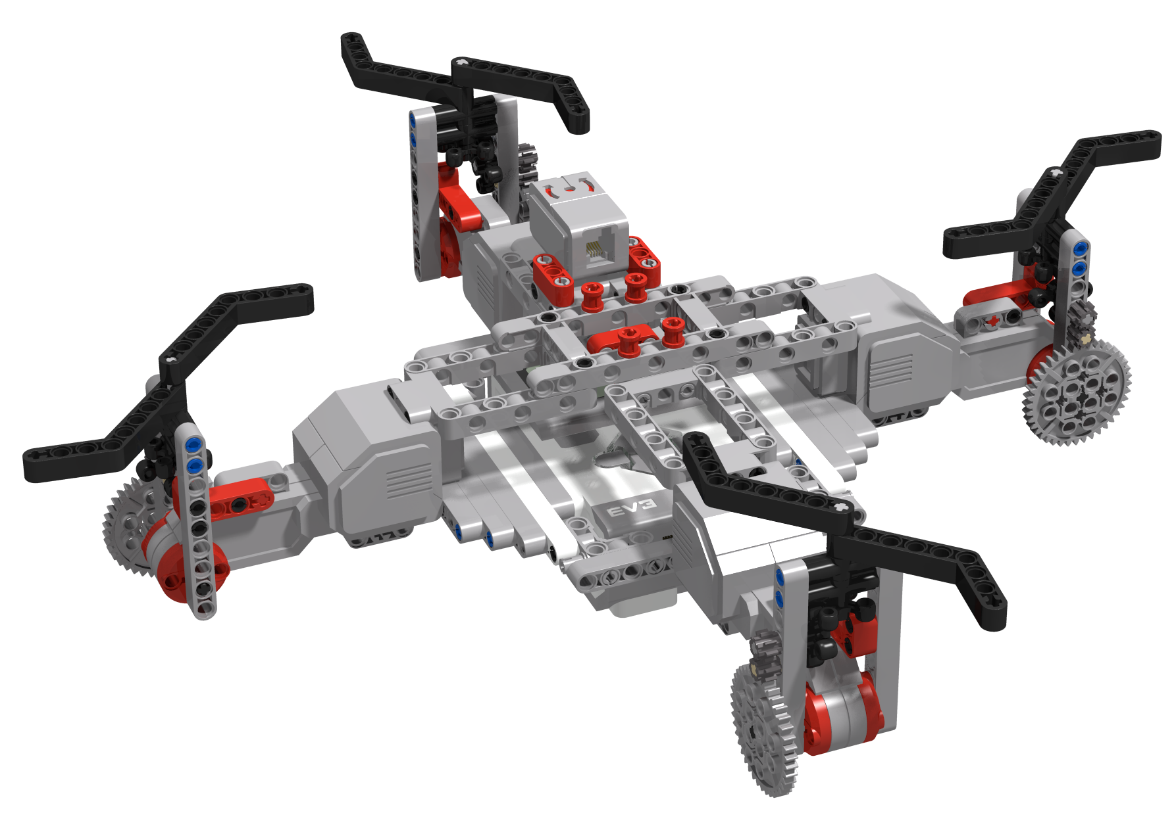
How does a Quadcopter work?
By Sanjay and Arvind Seshan

Slide 2
Objectives
In this lesson you will learn the basic physics associated with a quadcopter
You will build your own MINDSTORMS “Quadcopter” to see these physics principles in action
Note: You will not be creating a flying MINDSTORMS model – it is just meant to show the physics involved

Slide 3
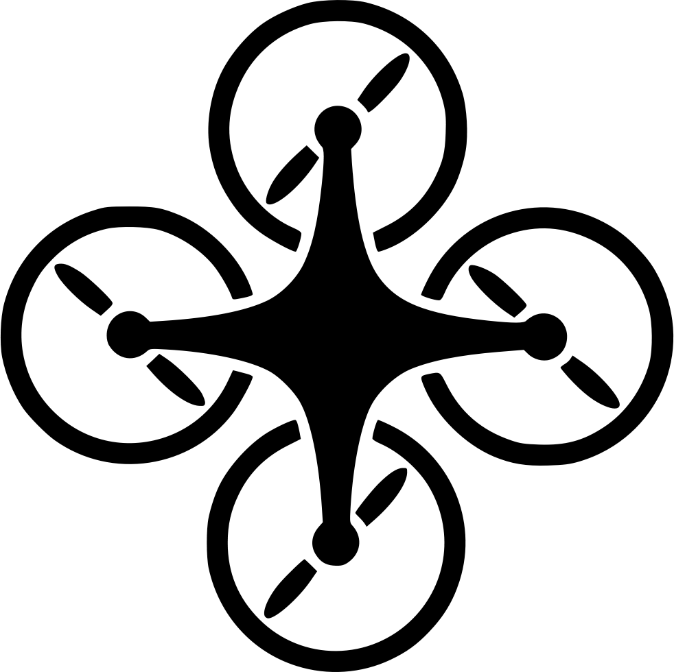
What is a quadcopter?
Quadcopters use four propellers and four motors with propellers
The use of four propellers allows the quadcopter to balance the different forces involved and maintain stable flight

Slide 4
Build your MINDSTORMS QuADCOPTER
Use the Build Instructions provided
As you build, connect the wires from the motors and gyro sensor to the ports as indicated in the image on the right
Tie a long string through the middle of the frames at the center so that you can hang your quadcopter.
A
2
B
D
C

Slide 5
Propeller Forces
Force on propeller
What would happen if you turned on a single motor?
Newton’s Third states “For every action, there is an equal and opposite reaction.”
To make the propeller turn, the quadcopter body must apply a force
There must be an equal and opposite force applied by the propeller on the quadcopter body
This will make the propeller spin in one direction around point “A” and the quadcopter body spin the opposite direction around point “A”
A
Force on quadcopter body
A

Slide 6
Propeller Forces
Force on propeller
What would happen if you turned on four motors?
Each propeller spins in one direction around its attachment point
This applies an equal and opposite force at each of A, B, C and D
The end result is that the body will spin around the center of the forces – it will spin counter-clockwise around point E
A
D
E
B
Force on quadcopter body
C
A
D
E
B
C

Slide 7
Unbalanced Forces
Force on propeller
Let’s try this out..
Write a program where all four motors are turning clockwise for 10 seconds
You will begin by hanging your quadcopter
Wait till the EV3 Quadcopter is still before running your program
Observe what happens
A
D
E
B
Force on quadcopter body
C
A
D
E
B
C

Slide 8

Unbalanced Forces Code Solution
Because of propeller forces, the quadcopter spins when all four motors are turning clockwise

Slide 9
Balancing Forces
Force on propeller
How can we prevent the quadcopter from spinning when we turn on the motors?
We need to make sure that the forces balance out!
Two motors rotates in clockwise(CW) and other two rotates in counter-clockwise(CCW).
Motors A and C rotate in clockwise and motors B and D rotate in counter-clockwise direction.
If we look at the forces on the quadcopter body – each pair (A & C – and B & D) make the body spin around point E.
However, the spin from each pair is an opposite direction and cancel out. The total angular momentum is zero.
Write a program where all motors A &.C are turning clockwise and motors B & D are turning counter-clockwise for 10 seconds
A
D
E
B
Force on quadcopter body
C
A
D
E
B
C

Slide 10

Balancing Forces Code Solution
Because the forces balance out, the quadcopter stays still

Slide 11
Summary
In this real quadcopter…
B and D motors are rotating counterclockwise
A and C motors are rotating clockwise
With the two sets of quadcopter motors configured to rotate in opposite directions, the total angular momentum is zero. This prevents the quadcopter from spinning in an uncontrolled fashion
A
B
D
C

