Slide 1
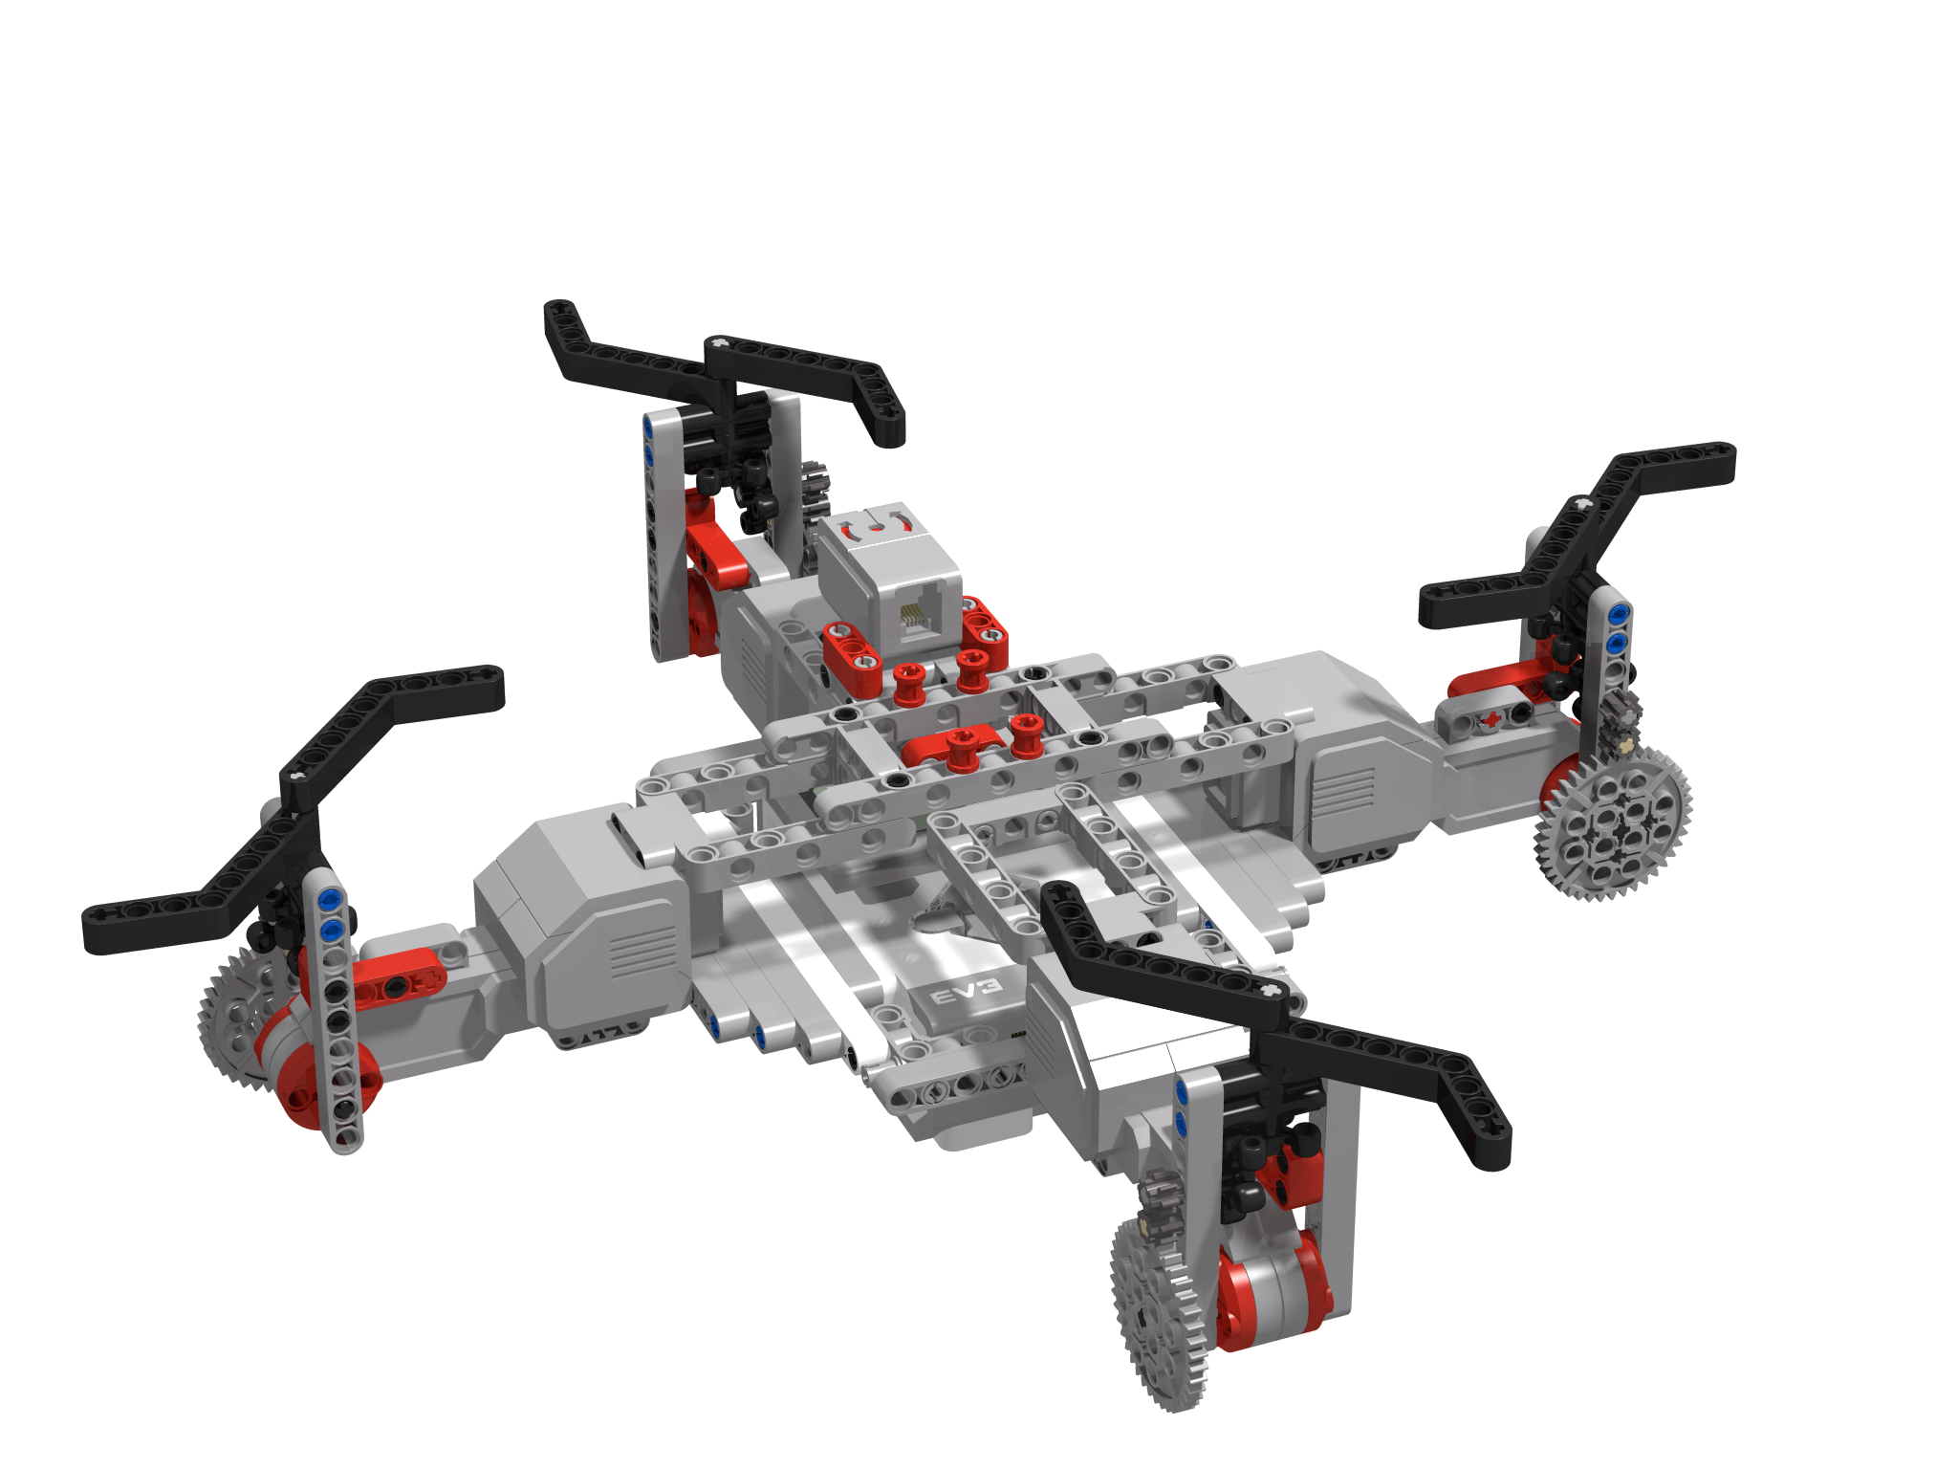
Controlling your quadcopter
By Sanjay and Arvind Seshan

Slide 2
Objectives
In this lesson you will learn about the different movements a quadcopter can make and how they are controlled using a remote control
You will build your own remote control for your MINDSTORMS Quadcopter
You will learn how to use Bluetooth to create the remote control for your MINDSTORMS Quadcopter

Slide 3

WHAT is Yaw, PITCH AND ROLL?
Yaw is moving the head of the quadcopter either to right or left,
Pitch is moving either forward and backward.
Roll is making the quadcopter fly sidewards, either to left or right.

Slide 4
Mapping on to your controller
This is how the movement would map on to a traditional controller
Throttle Up
Pitch Down
Yaw Left
Yaw Right
Roll Left
Roll
Right
Throttle Down
Pitch Up

Slide 5
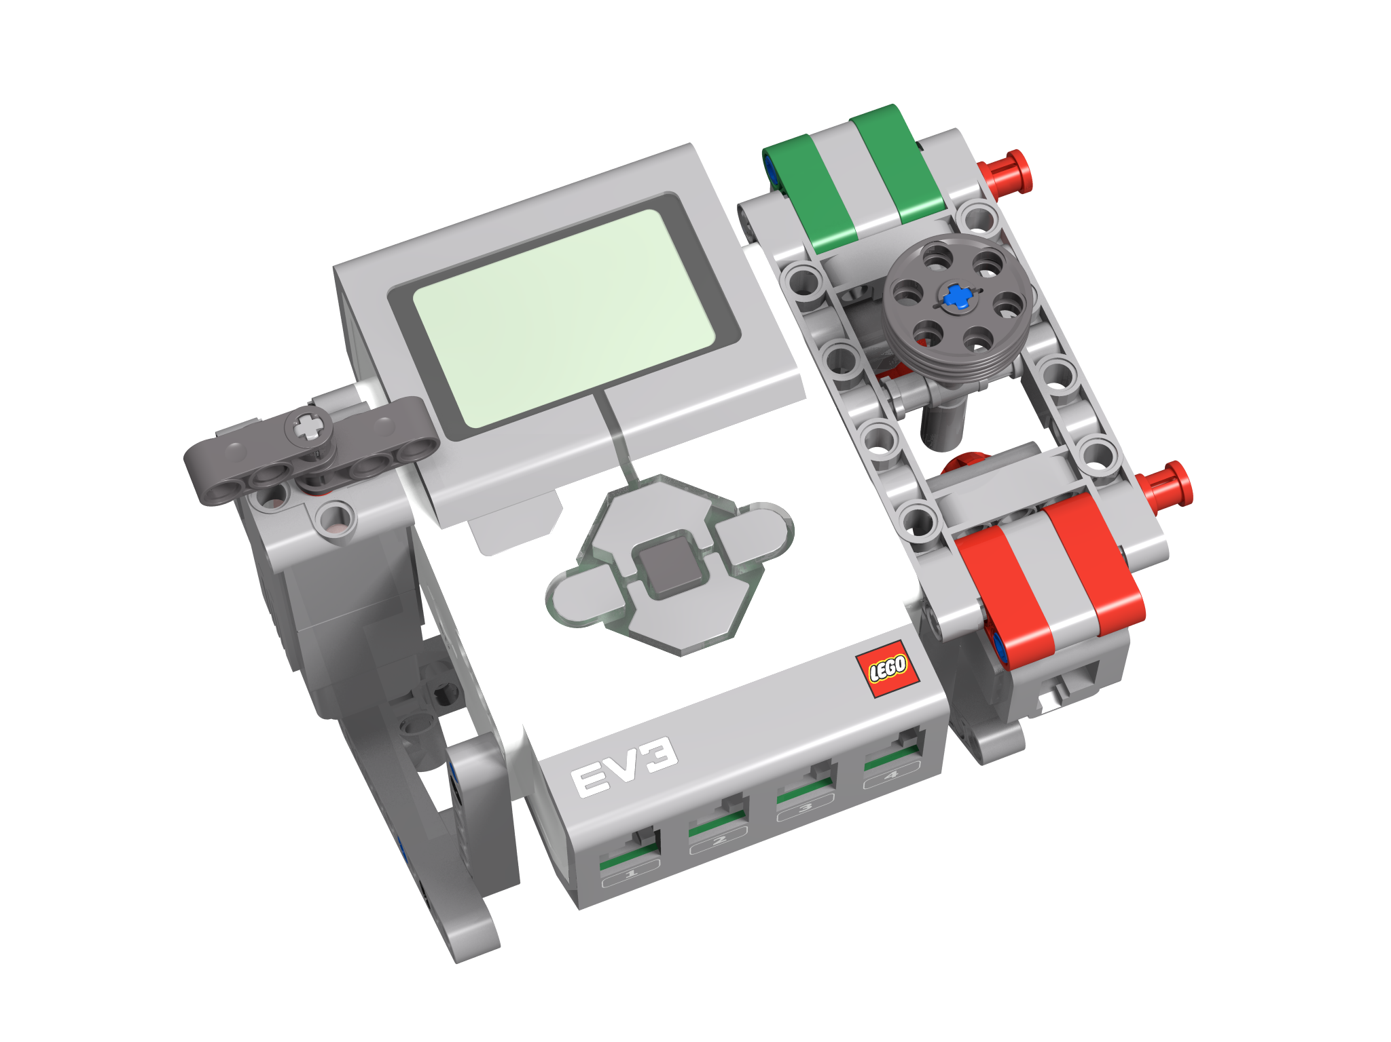
BUILDING THE EV3 REMOTE CONTROL
Follow the build instructions and construct the controller
Connect the cables as indicated in the image on the right
Note that the controller is not designed to be exactly the same as a real Quadcopter controller
Your EV3 Quadcopter will not fly/behave in the same way as a real one
The goal is to show you one way in which devices can communicate similar to a remote control and a quadcopter.
4
A
1

Slide 6
How Does The Remote Communicate With The QuadCopter?
The EV3 also uses a Bluetooth link to connect to other EV3s
What is Bluetooth?
Bluetooth uses radio frequencies to communicate between devices
The EV3 also uses Bluetooth to download programs wirelessly

Slide 7
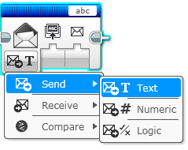
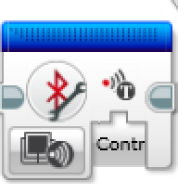
EV3 BLOCKS YOU WILL USE
Messaging block in Send Mode and Receive Mode
Bluetooth Connection Block in Initiate Mode
You will also use loops, switches, math blocks, compare blocks, variables, constants, data wires, and unregulated motor blocks.

Slide 8
STEP 1: NAMING THE BRICKS
Give each brick an unique name (in this exercise use “Quadcopter” and “Controller”)
If you are doing this in a large group or classroom, add a group number to each brick name (e.g. Quadcopter2 and Controller2 for group 2). This will avoid confusion when different groups are
Use an USB cable for downloading code to the bricks (rather than Bluetooth). You cannot connect the EV3s to each other and download using Bluetooth from a PC at the same time

Slide 9
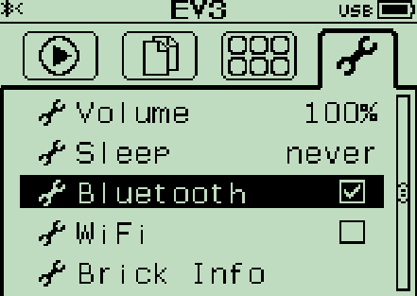
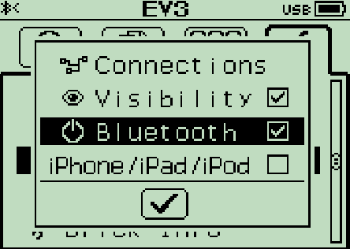
STEP 2: Activate Bluetooth on the EV3
Turning on Bluetooth:
On the Controller EV3 menu, go to the symbol that looks like a wrench
Go down to the word “Bluetooth” and activate it
To connect to another brick go back into the Bluetooth menu
Go to “Connections”
Select “Search” and find the other brick’s name (Quadcopter)
You can also manage your connections with the Bluetooth Connection Block. But we do not use this block in this lesson.

Slide 10
STEP 3: CHALLENGE 1
Objective: Send messages from the Controller to the Quadcopter
You will send a Hello Message from the Controller EV3 to the Quadcopter EV3 each time you press a brick button
Key steps:
On the Controller, have a loop that waits for button press and then sends a message using Bluetooth
On the Quadcopter, connect to the Controller first. Then, loop waiting for a message. When you receive a message perform an action to show that you have received it.

Slide 11
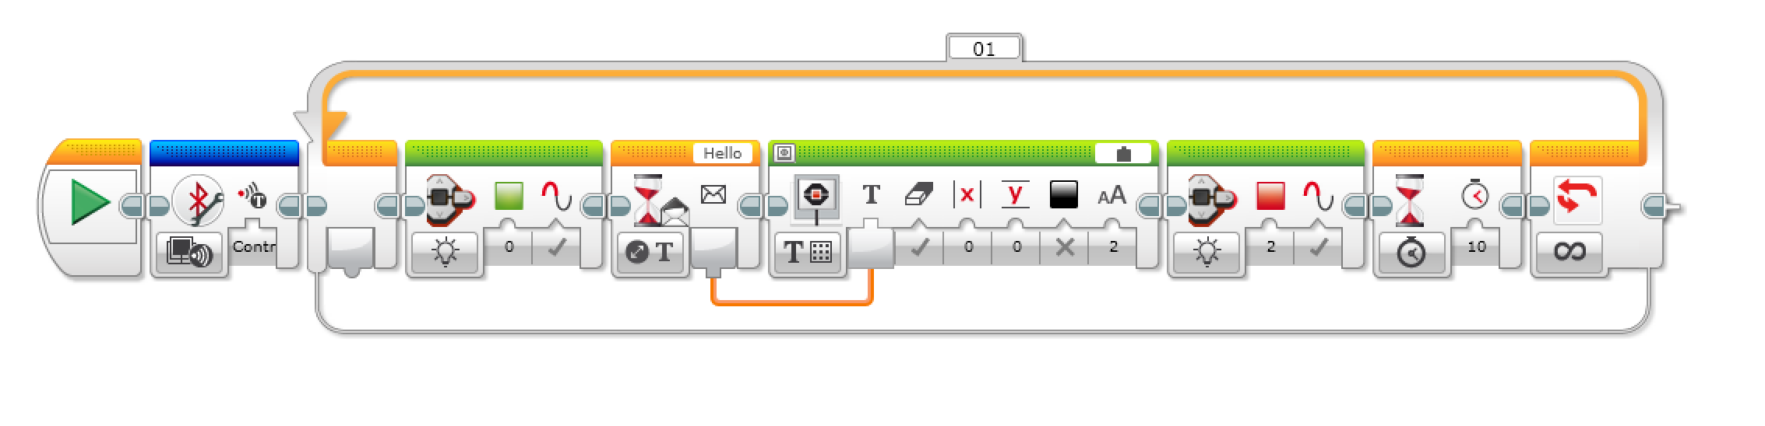
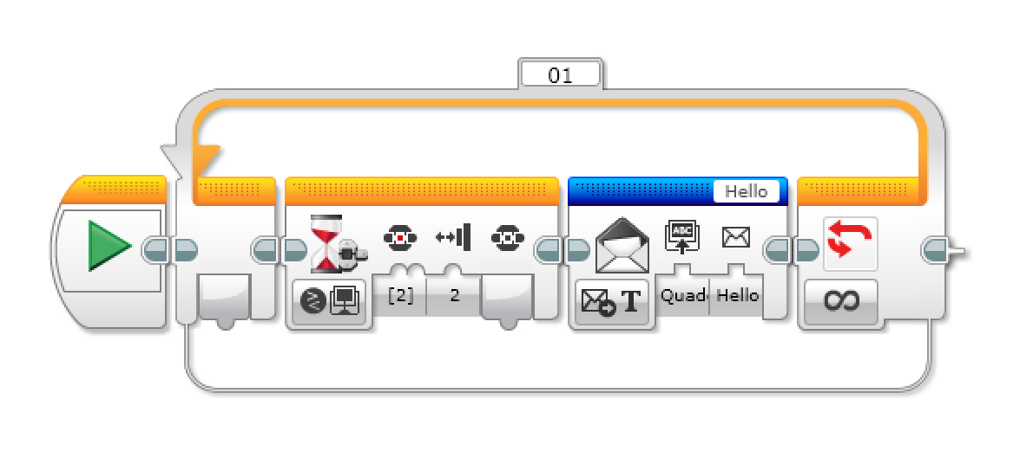
CHALLENGE SOLUTION
Quadcopter
In the Quadcopter code, the brick color also changes to indicate that it has received a message
Controller

Slide 12
Challenge 2
You will program the left toggle to turn the blades left or right depending on the direction of the toggle
You will program the right joystick to increase and decrease the power of the motors
You will program the center button to enable and disable counter rotation

Slide 13
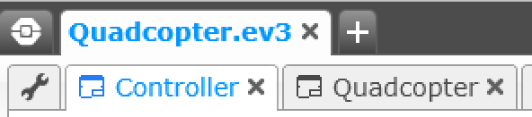
CHALLENGE 2 – Setup
Create two programs
Name the programs Controller and Quadcopter
We will start with the Quadcopter code since it is simpler. The key steps are:
Start a Bluetooth connection
Loop waiting for messages from the controller
The controller messages should provide power levels for each of the quadcopter motors

Slide 14
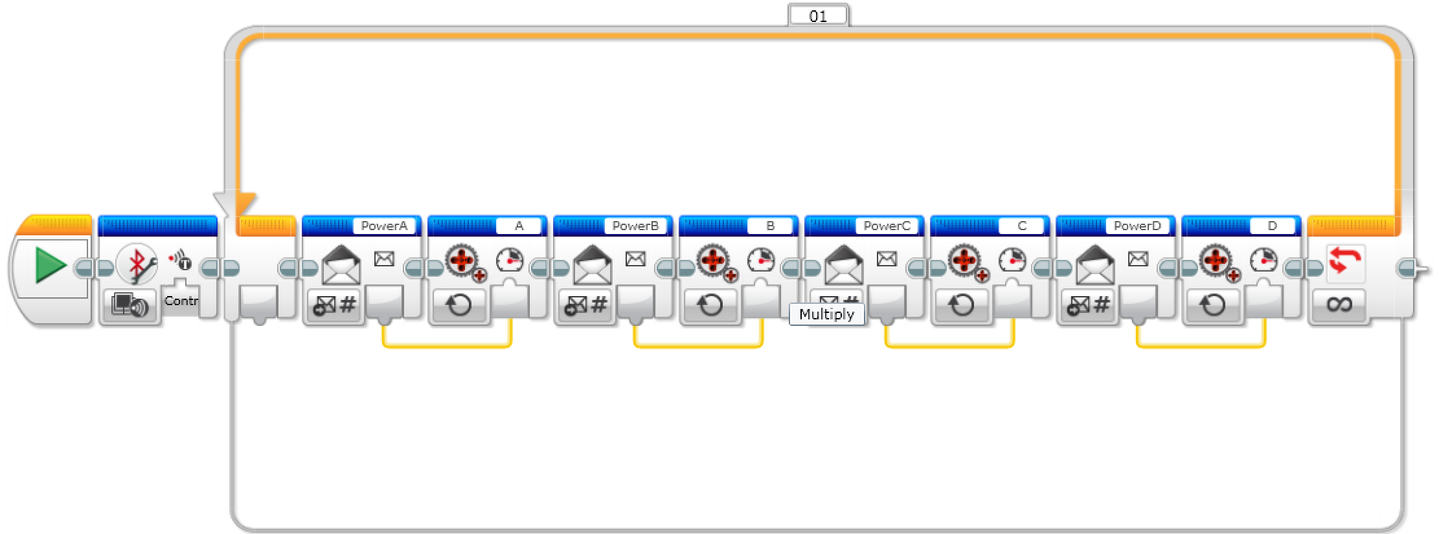
CHALLENGE 2 – Quadcopter PSEUDOCode
Open the program called “Quadcopter”
Add a Bluetooth Connection Block in Initiate mode and set the parameter to connect to “Controller”. This will make sure that the two robots are connected
Change “Controller” to whatever name you used for the controller’s brick
Add a loop
Add a Messaging Block in Receive – Numeric mode and set the message title to “PowerA”
Add an Unregulated Motor Block set to Port A and drag the data wire from the Messaging Block into the power input of the Unregulated Motor Block
Repeat steps 4 and 5 for motors B, C, and D

Slide 15
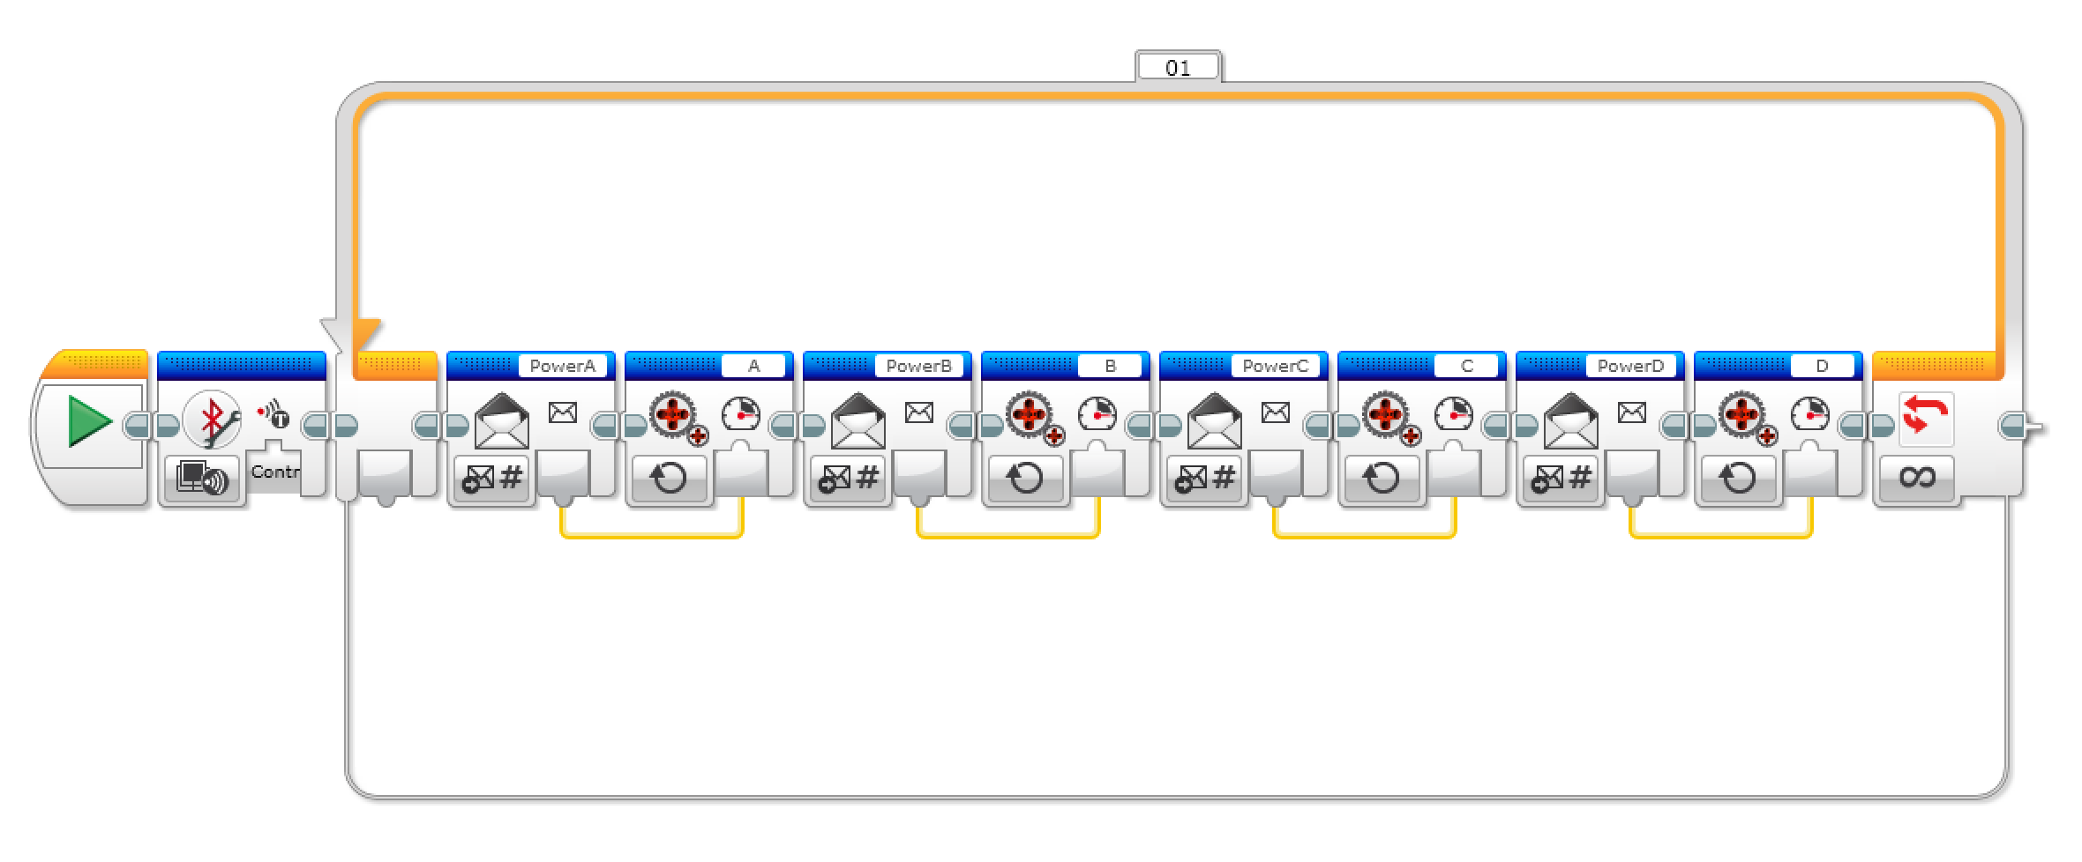
Challenge 2 Quadcopter Code

Slide 16
CHALLENGE 2 – Setup
Now lets look at the controller program. The key steps are:
We will use the two touch sensors to control the power of the Quadcopter blades
A variable called Power will store this value
The motor dial will determine if the blades go forward or backward
The middle brick button will determine if alternate blades rotate in opposite directions
A variable called Counter Rotation will store 1 if they are rotating in the same direction and -1 if they are in opposite directions

Slide 17
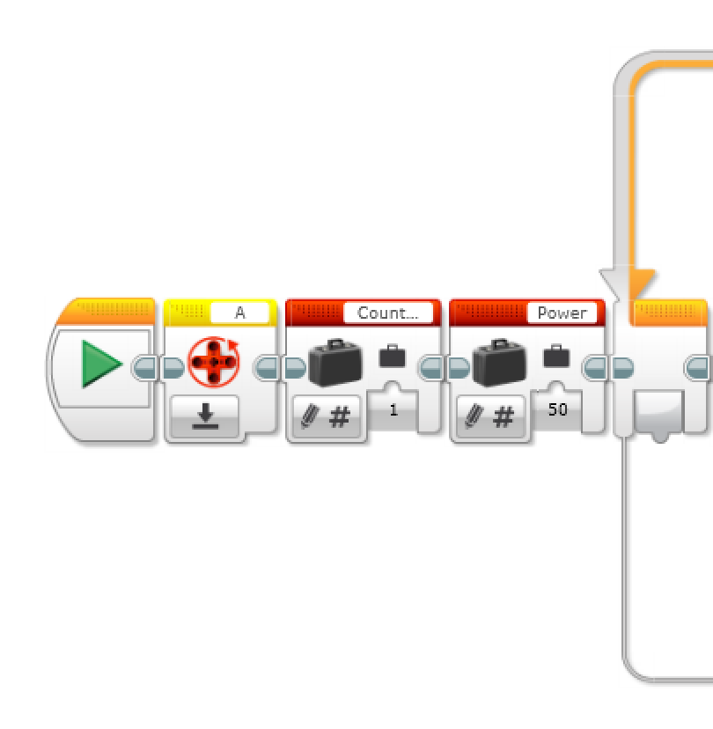
CHALLENGE 2 – Setup
Now lets look at the controller program.
In the Controller program, create two numeric variables, “Power” and “Counter Rotation”
Write the “Power” variable to 50 and the “Counter Rotation” variable to 1
Reset the rotation sensor for motor A since the motor rotation will be used for the left toggle
Create a loop

Slide 18
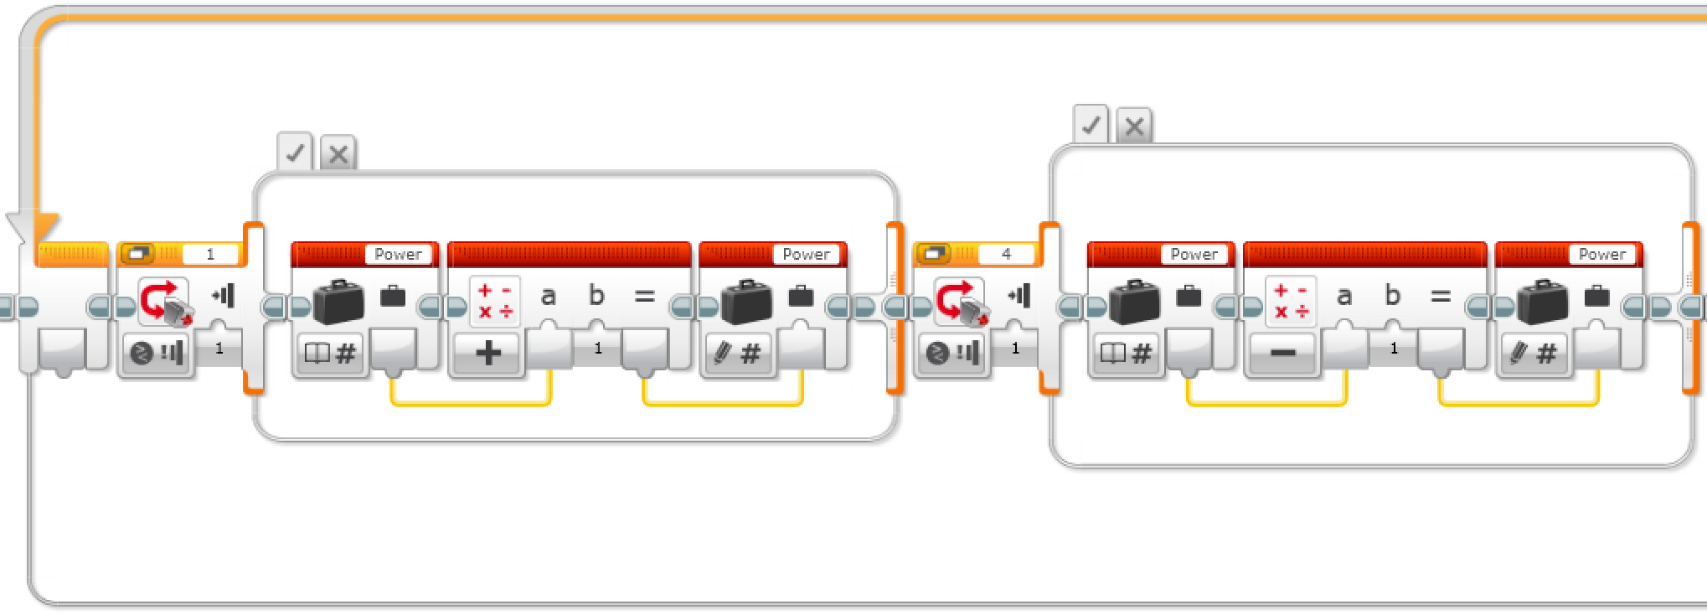
CHALLENGE 2 - Right Joystick
The first part of the loop controls the power.
Add two switches into the loop
Make sure they are in Touch Sensor – Compare – State Mode
Set the first switch to Port 1 and the second switch to Port 4 (The ports for the touch sensors)
In the true statement on the first switch, read the “Power” variable, add 1 to it using a math block and write the output back into the variable
In the true statement on the second switch, read the “Power” variable, subtract 1 from it using a math block and write the output to the “Power” variable

Slide 19
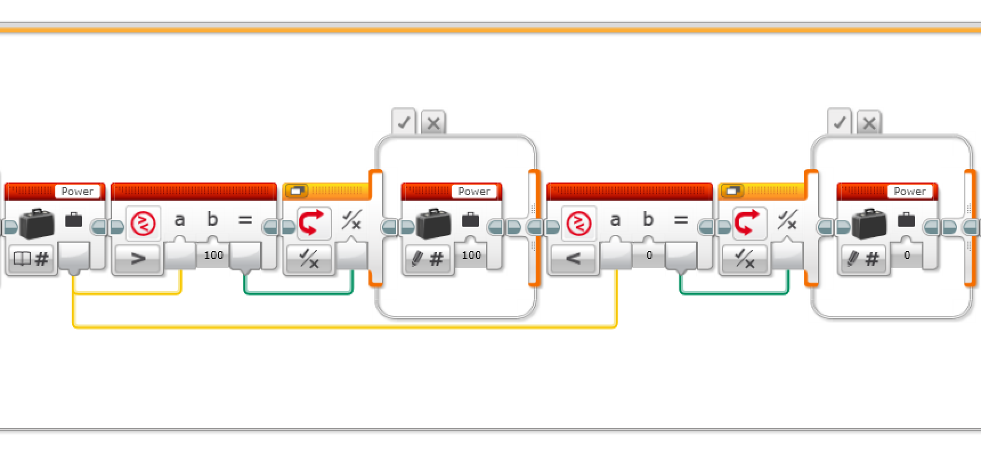
CHALLENGE 2 - Limiting the Power Variable
Read the “Power” variable
Drag the data wire into a compare block and make it check if the variable has exceeded 100
Draw the data wire for the output into a switch in logic mode
In the true statement of the switch set the “Power” variable to 100
Add another compare block after the switch that checks if the variable has gone below 0
Draw the data wire for the output into another switch in logic mode
In the true statement of the second switch set the “Power” variable to 0

Slide 20
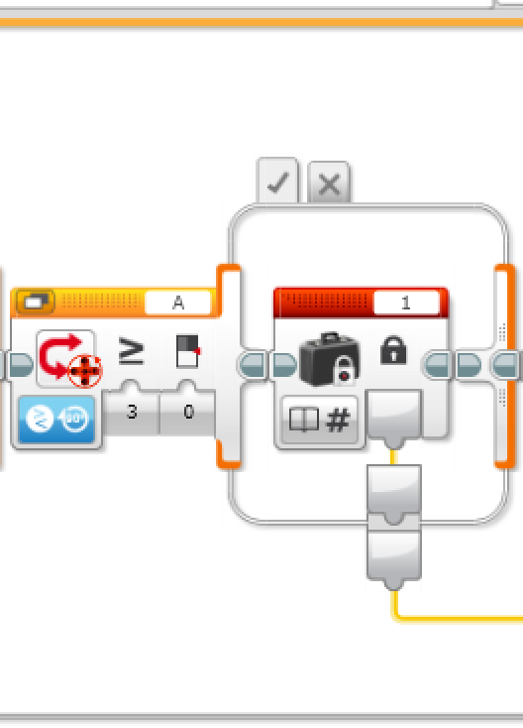
CHALLENGE 2 – Left Toggle
Add a switch and set it to Motor Rotation – Compare – Degrees
Set it to Port A and set the parameters to greater than or equal to 0
In the true statement, add a constant and set it to 1
In the false statement, add a constant and set it to -1
We will use this 1/-1 to control the direction of the motors.

Slide 21
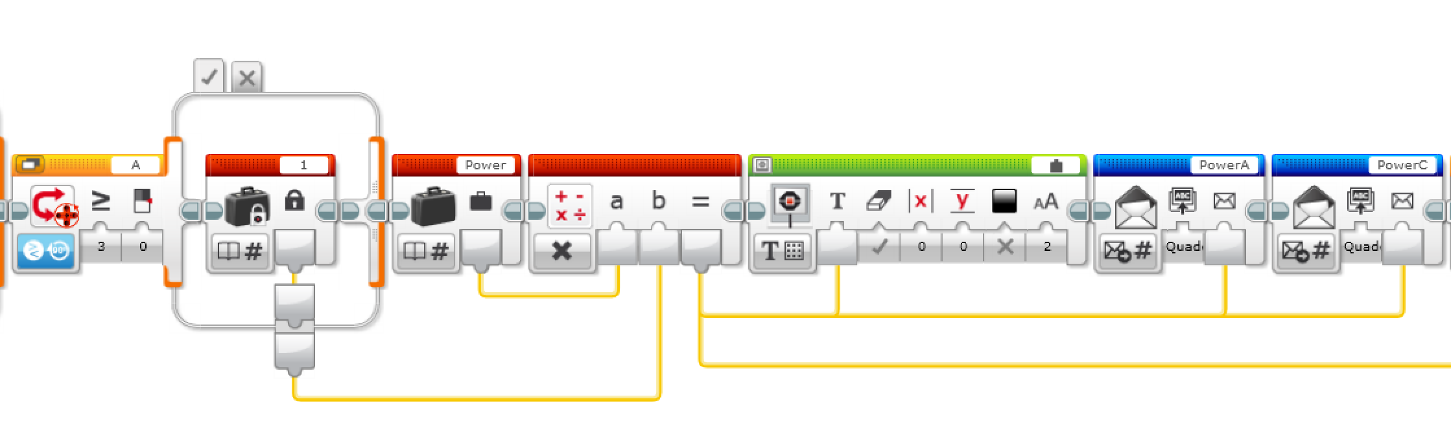
Challenge 2 – Sending Power Levels for Motors A & C xxx
Add a switch in Motor Rotation - Compare – Degrees on Port A
Set the parameters to greater than or equal to 0
In the true statement, add a constant set to 1
In the false statement, add a constant set to -1
After the switch, read the “Power” variable
Multiply the variable by the constant in the switch (1 or -1)
Drag the data wire of the output into a Display Block on Text – Grid mode
Drag the data wire into two separate Messaging Blocks set to Send – Numeric mode. The messages should be sent to the ”Quadcopter” brick and the message titles should be ”PowerA” and “PowerC”

Slide 22
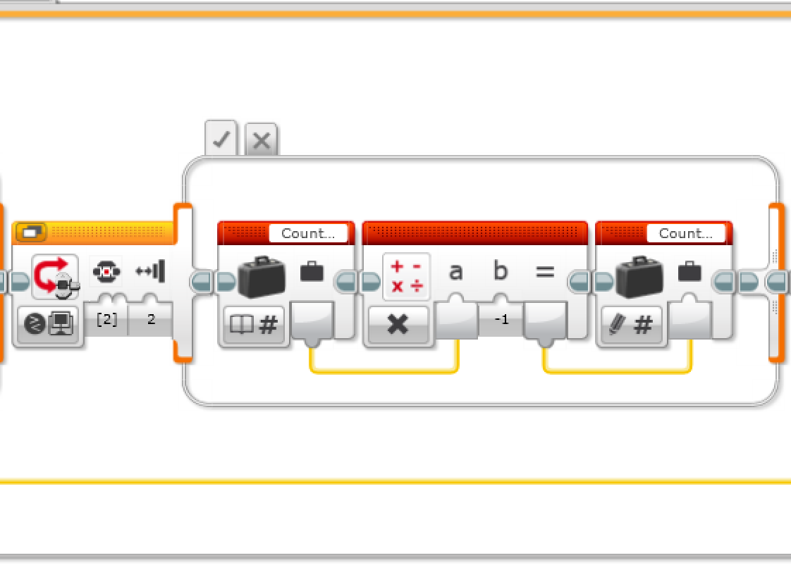
CALLENGE 2 – Counter Rotation
Next, we need to determine what power to use for the other pair of blades. The Counter Rotation variable will be 1 or -1 based on whether the blades spin in the same or opposite directions from motors A & C.
Add a switch and set it to Brick Buttons– Compare
Set the parameters to check if the center button (id 2) is bumped
In the true statement of the switch, read the “Counter Rotation” variable, multiply it by -1 and write the output back into the variable

Slide 23
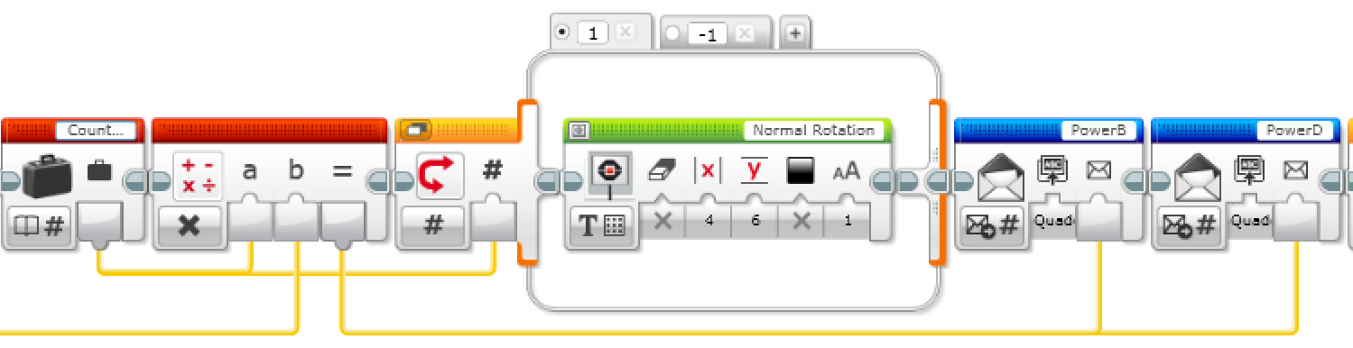
CHALLENGE 2 Displaying And Sending The Data
We now take the “base” power that was computed and multiply this by the “Counter Rotation” setting
Next, add a switch in Numeric mode;with the counter rotation variable as input. Make two tabs in the switch and name them 1 and -1
In the “1” tab, display the text ”Normal Rotation” with (X, Y) = (4, 6) and Font: 1. Make sure to set the “Clear Screen” parameter to False
In the “-1” tab, do the same thing, but display the text “Counter Rotation”
Drag the output calculated in step 1 on this slide into two separate Messaging Blocks set to Send – Numeric mode. The messages should be sent to the ”Quadcopter” brick and the message titles should be ”PowerB” and “PowerD”

