Slide 1
Robot DESIGN Lesson
Introduction to Attachments

Slide 2
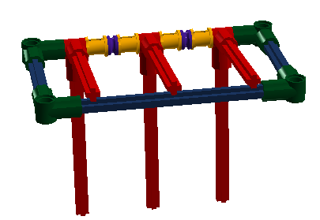
What is an attachment?
A mechanism you build that can assist your robot in accomplishing a task(e.g. pick up an object, drop off an object)
This mechanism is “attached” to the base robot
For a competition robot, the goal is to design attachments that work consistently every time you run the robot and also take up the least amount of time and space

Slide 3
PASSIVE VS. MOTORIZED
Passive vs. Motorized
Passive attachments do not require any motor power
Motorized attachments require a connection to a motor
Power sources in MINDSTORMS
Motors – can be control by software and reusable across many missions, but physically large
Pneumatics – relatively powerful, but need to pump up in advance and be careful regarding pressure and leaks
Rubber bands – compact and easy to use but can get lost/wear out over time
Gravity – make things fall using gravity

Slide 4
TEN Tips FOR ATTACHMENTS DELETE ME
Tip #1: Reduce errors/time wasted by avoiding adding/removing attachments. Design attachments that can stay on for entire time.
Tip #2: Removing attachments may be easier, less error-prone than adding them.
Tip #3: Reduce space and complexity of attachments by building attachments that can work for multiple missions
Tip #4: Reduce time by making all attachments connect to the robot in a similar way
Tip #5: Reduce time by making attachments that connect easily (e.g. adding and removing pins and attaching directly to a motor take time and effort)
Tip #6: Use gears to deliver power to where you need it on the robot and in the direction that you need it
Tip #7: Attachments need to repeat their task reliably. Setup should be easy and consistent for a run
Tip #8: Leave room for error. If your robot is slightly off, will your attachment still work?
Tip #9: Size matters! Consider the added weight and size and its impact on your robot’s movement
Tip #10: Think outside the box. Do you really need a motor for a mission? Try coming up with a passive design (e.g. rubber bands or pneumatics)

Slide 5
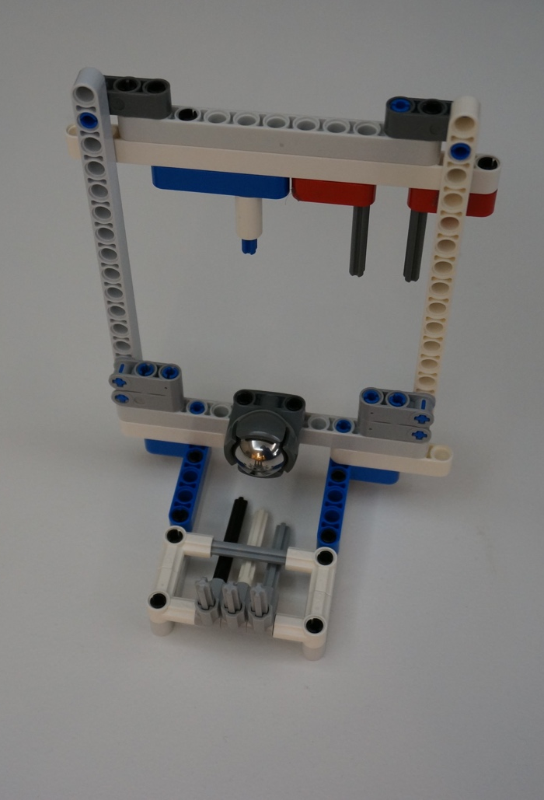
Easy On and Off
Create attachments that go on and off the robot easily
In the image on the right, the attachments connect to the robot only using the three axels you see protruding off the top beam

Slide 6
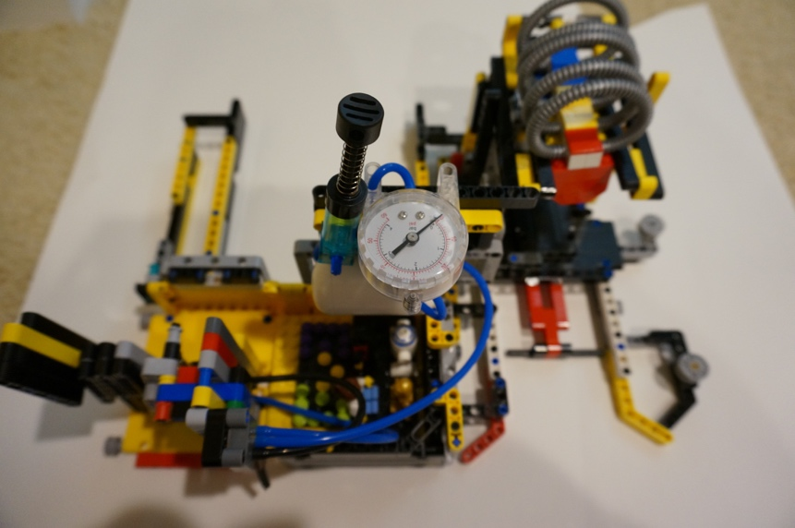
Create Attachments that can do multiple tasks
Instead of having to switch attachments, the same attachments can perform multiple tasks
In the image on the left, the attachment hangs hoops and pushes a lever at the same time

Slide 7
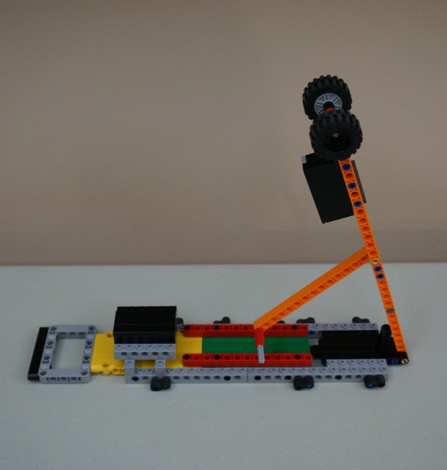
Use Gravity – it’s free and easy
Gravity can be your friend
In the image on the right, the arm drops when the robot moves due to gravity

Slide 8
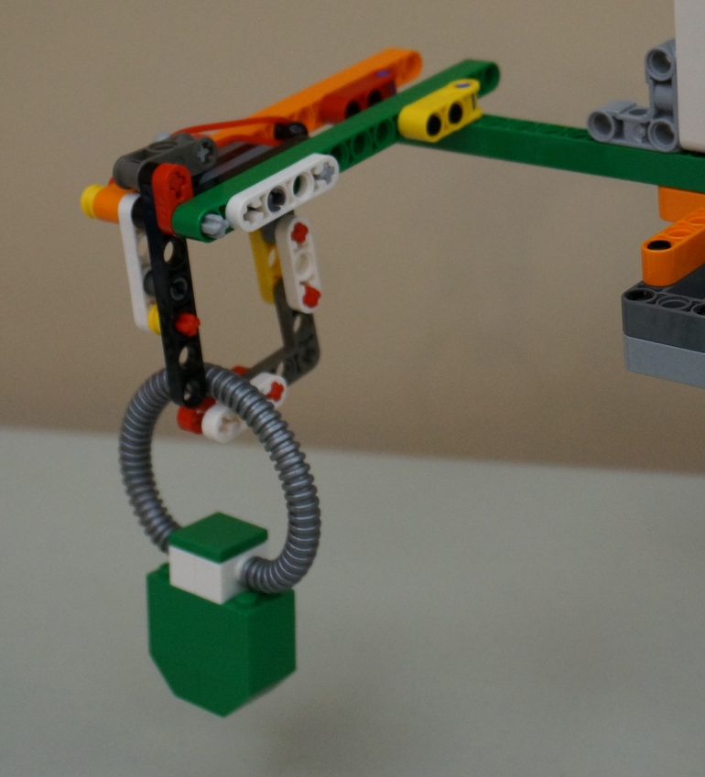
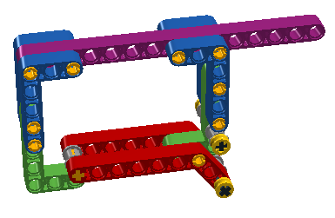
NO MOTOR, NO PROBLEM
You don’t always have to use a motor
You can use numerous passive mechanisms from carabineers to one-way gates

Slide 9
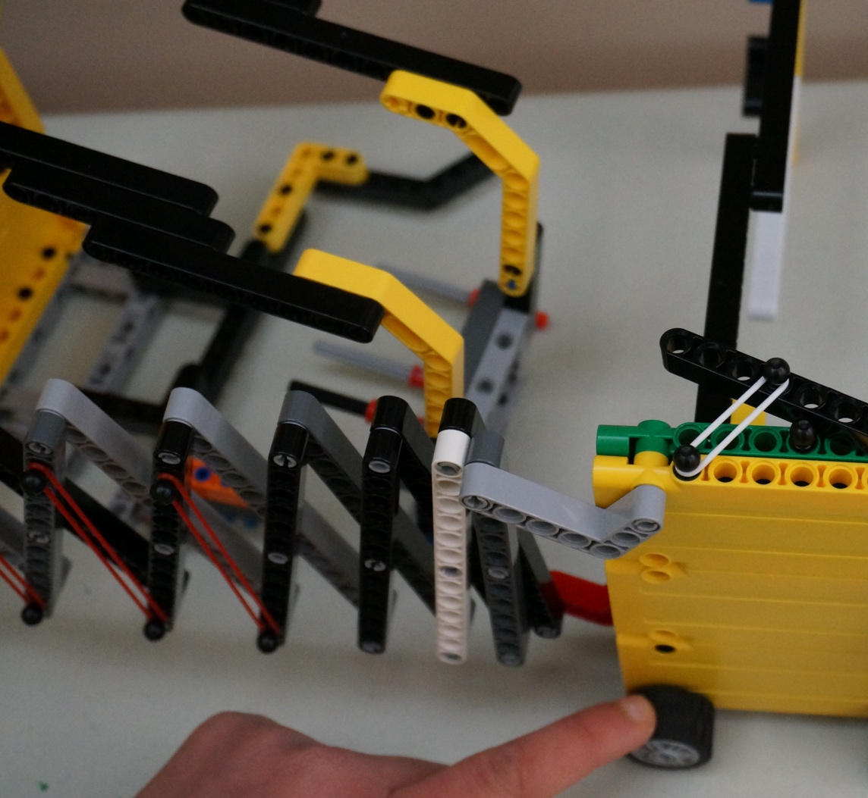
RUBBER BANDS STORE ENERGY
Rubber bands are a great way of storing energy
They release quickly and can be used to lift up, pick up and even extend out

Slide 10
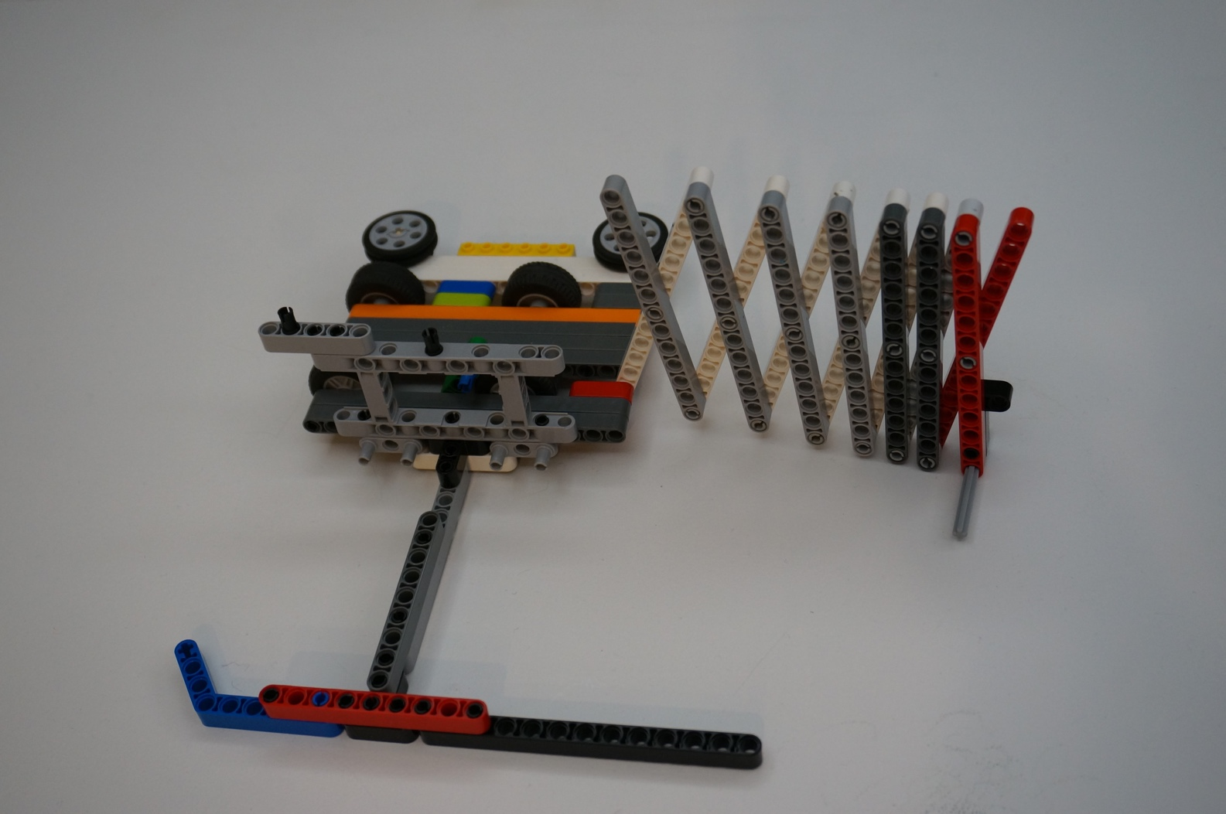
Reaching out DELETE

Slide 11
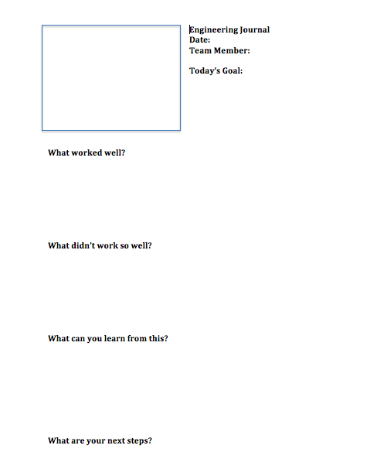
Keep track of your ideas
Not all ideas will work. Some will get abandoned.
Not all ideas will work the first time. Some will go through dozens of changes before the day of your competition.
Keep a record of these ideas and trials in an Engineering Journal.

Slide 12
Credits
This tutorial was created by Sanjay Seshan and Arvind Seshan
More lessons at www.ev3lessons.com
This work is licensed under a Creative Commons Attribution-NonCommercial-ShareAlike 4.0 International License.

