Slide 1

ROBOT DESIGN LESSON
Building a Robot for Our Lessons

Slide 2
EV3Lessons works with all robots!
You can use any EV3 robot you wish with EV3Lessons.com because we teach you program the EV3 regardless of the model you build. You will just have to modify the challenges to suit your robot.
If sensors need to be in a particular location for a lesson, we usually let you know
We do provide a robot design for the #45544 Set (EV3 Discovery) and #31313 (Enterprise).
You can also consider using the EV3 Educator model from the #45544 set, as well as the Riley Rover by Dr. Damien Kee as an alternative.

Slide 3
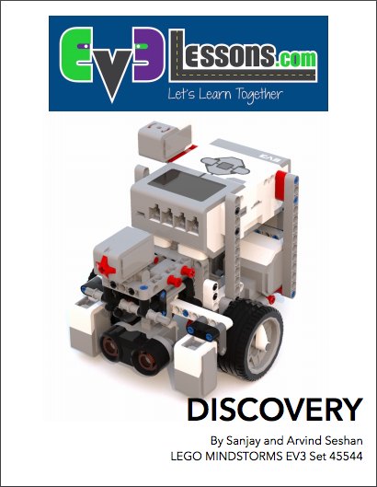
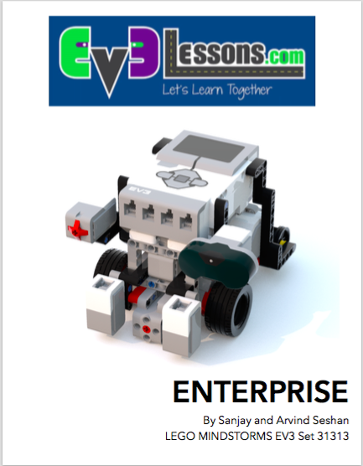
DISCOVERY & ENTERPRISE
These robots are designed to use only parts available in the #45544 and #31313 EV3 sets
The base robots use less than 100 LEGO elements
The sensors and medium motor are modular and can be added when needed
We do provide instructions for where to mount the additional sensors (e.g. gyro) in Enterprise
We also provide a location for a second color sensor (needed for the Squaring on Line lesson in Advanced)

Slide 4
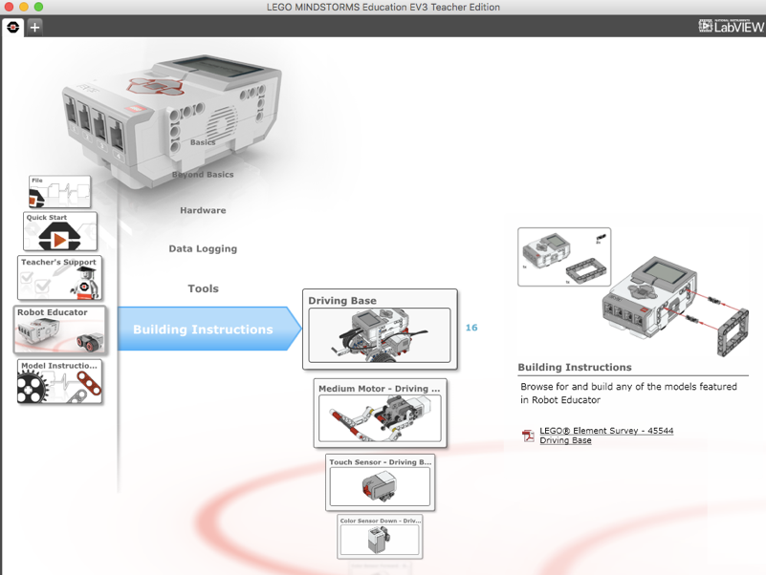
EV3 ROBOT EDUCATOR
The base robot design in the EV3 Edu set (#45544) will work for majority of our lessons without any changes
Remember to install the color sensor facing down for the line follower lessons
You will need to add a second color sensor for our Line Squaring Lesson
Additional sensors (e.g. infrared) can be added to this design as needed.
Build instructions are available on the EV3 Edu software and comes printed with the #45544 kit

Slide 5
RILEY ROVER BY DAMIEN KEE
This robot is a quick build robot by Dr. Damien Kee
If you are short on time for your class, you can build this robot and still use EV3Lessons materials
Add or move sensors as needed
A link to this robot is provided on our Robot Designs page under “Contributed”

Slide 6
Credits
This tutorial was created by Sanjay Seshan and Arvind Seshan
More lessons at www.ev3lessons.com
This work is licensed under a Creative Commons Attribution-NonCommercial-ShareAlike 4.0 International License.

