Slide 1

ROBOT DESIGN LESSON
Common Parts on a LEGO robot

Slide 2
WHY know the names?
Having a common vocabulary for parts helps you
Find the part you need
Reorder parts you might run out
Communicate to a teammate which part you want them to get you

Slide 3
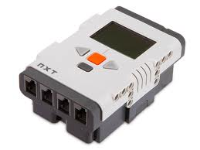
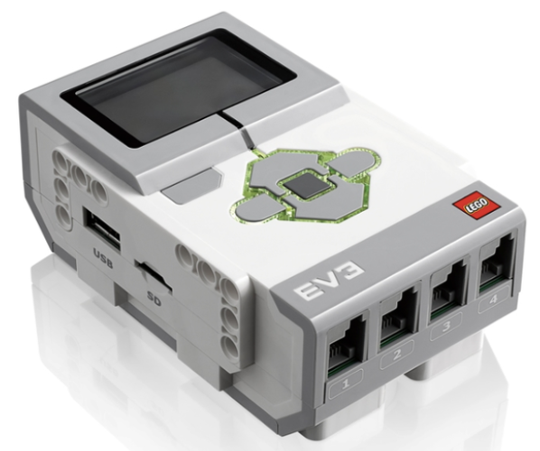
PROGRAMMABLE BRICKS
EV3
2013
NXT
2006

Slide 4
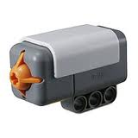
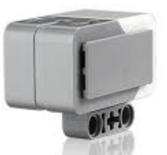
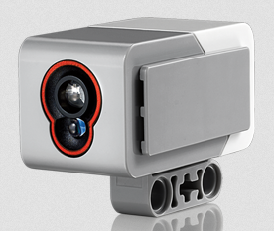
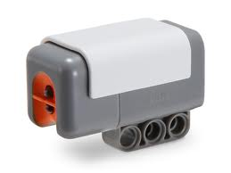
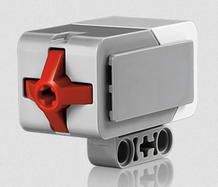
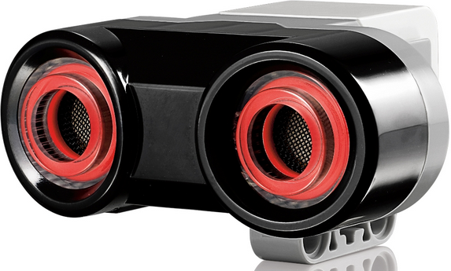
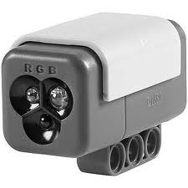
SENSORS
EV3
Gyro
Sensor
NXT Touch Sensors
NXT Light Sensors
NXT
Ultra Sonic Sensors
EV3
Color
Sensor
NXT
Sound
Sensor
EV3
Touch
Sensor
NXT Color Sensors
EV3 Ultrasonic Sensor

Slide 5
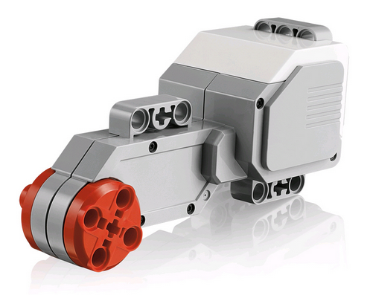
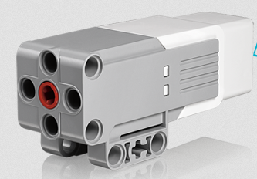
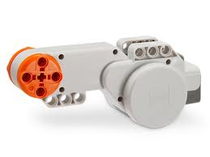
MOTORS
EV3 Motors

Slide 6
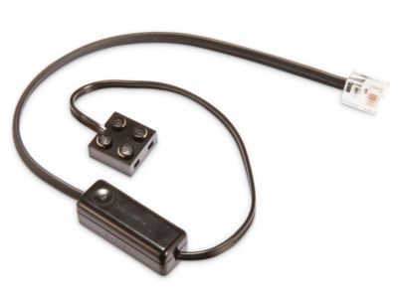
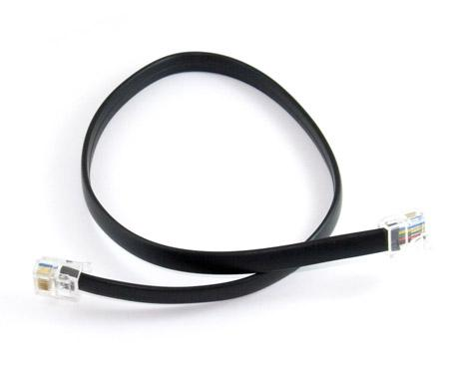
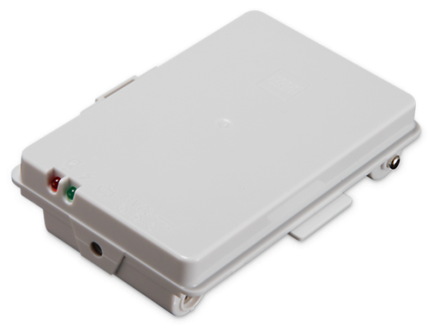
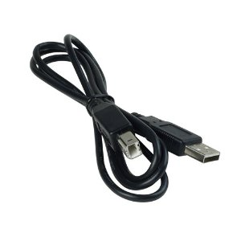
CABLES & BATTERIES
Used to connect motors and sensors to p-brick
Batteries

Slide 7
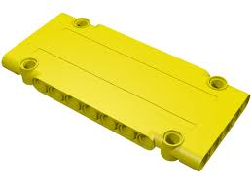
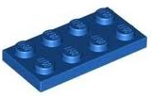
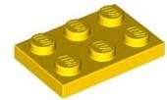
Technic Panels
“2 by” Plates
“2 by” Plates
“2 by” Plates
“2 by” Plates
“2 by” Plates

Slide 9
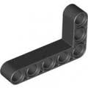

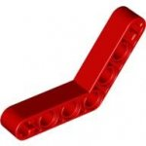
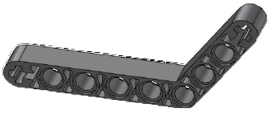
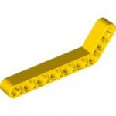
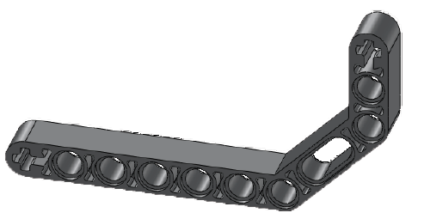
LIFTARM
2 by 4 Angle Beam
(small L beam)
5 by 3 Angle Beam
(large L beam)
4 by 4 Angle Beam
6 by 4 Angle Beam
7 by 3
Angle Beam
9 by 5 Angular Beam

Slide 10
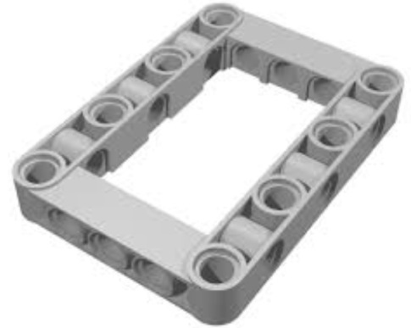
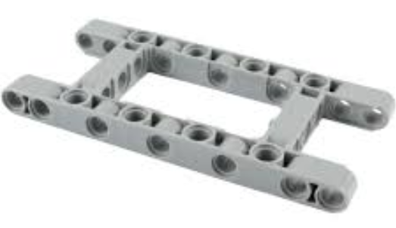
FRAMES
7 x 5 Open Frame
11 x 5 Open Frame

Slide 11



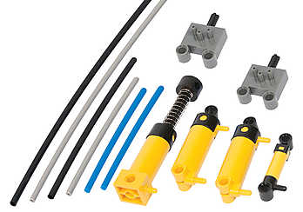

Gear
Boxes, Casings, &
Driving Rings
36 Tooth
Double
Bevel
Gear
24
Tooth
Gears
40 Tooth
Gear
Lego Tubing
Pneumatic
Pieces

Slide 12
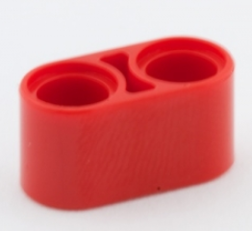

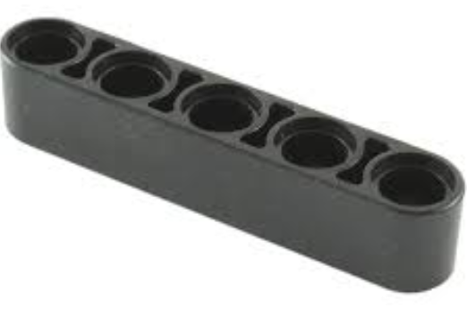





13-mod Beam
2-mod Beam
15-mod Beam
3-mod Beam
7-mod Beam
5-mod Beam
9-mod Beam
3 by 3 angular beam (T-beam)
2-mod Beams
11-mod Beam

Slide 13
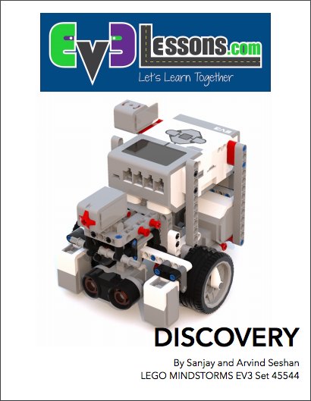
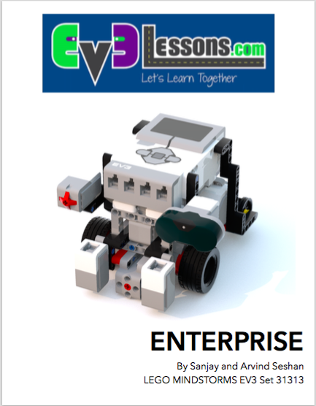
DISCOVERY & ENTERPRISE
These robots are designed to use only parts available in the #45544 and #31313 EV3 sets
The base robots use less than 100 LEGO elements
The sensors and medium motor are modular and can be added when needed
We do provide instructions for where to mount the additional sensors (e.g. gyro) in Enterprise
We also provide a location for a second color sensor (needed for the Squaring on Line lesson in Advanced)

Slide 14
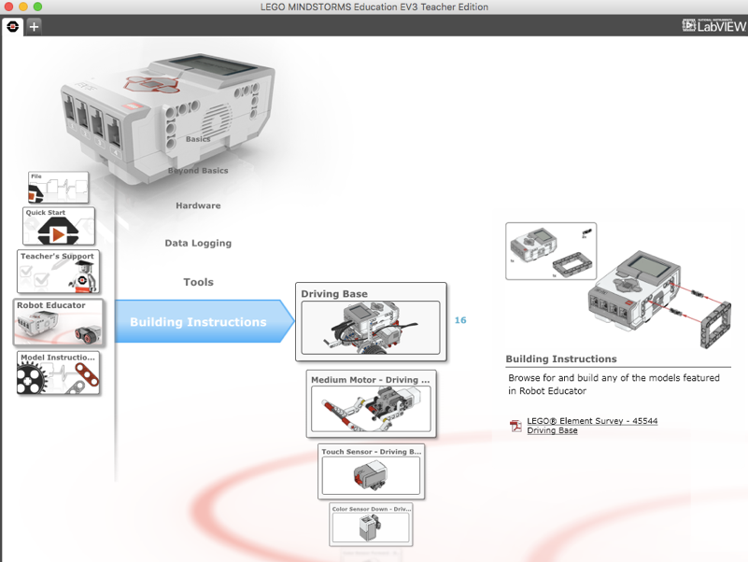
EV3 ROBOT EDUCATOR
The base robot design in the EV3 Edu set (#45544) will work for majority of our lessons without any changes
Remember to install the color sensor facing down for the line follower lessons
You will need to add a second color sensor for our Line Squaring Lesson
Additional sensors (e.g. infrared) can be added to this design as needed.
Build instructions are available on the EV3 Edu software and comes printed with the #45544 kit

Slide 15
RILEY ROVER BY DAMIEN KEE
This robot is a quick build robot by Dr. Damien Kee
If you are short on time for your class, you can build this robot and still use EV3Lessons materials
Add or move sensors as needed
A link to this robot is provided on our Robot Designs page under “Contributed”

Slide 16
Credits
This tutorial was created by Sanjay Seshan and Arvind Seshan
More lessons at www.ev3lessons.com
This work is licensed under a Creative Commons Attribution-NonCommercial-ShareAlike 4.0 International License.

