Slide 1

Robot DESIGN Lesson
LEGO CAD Software

Slide 2
Why use LEGO CAD SOFTWARE?
Can be an easy way to share your designs with others
EV3Lessons shares many designs using LEGO Digital Designer (LDD)
Can help you document your designs and enable someone to create a duplicate of make repairs
FIRST LEGO League and WRO teams often create their design in LDD for documentation purposes
Can be used to upload you design into some virtual robotics environments
Tools such as Cogmation’s Virtual Robotics Toolkit enable users to upload their own robot designs in a simulated environment

Slide 3
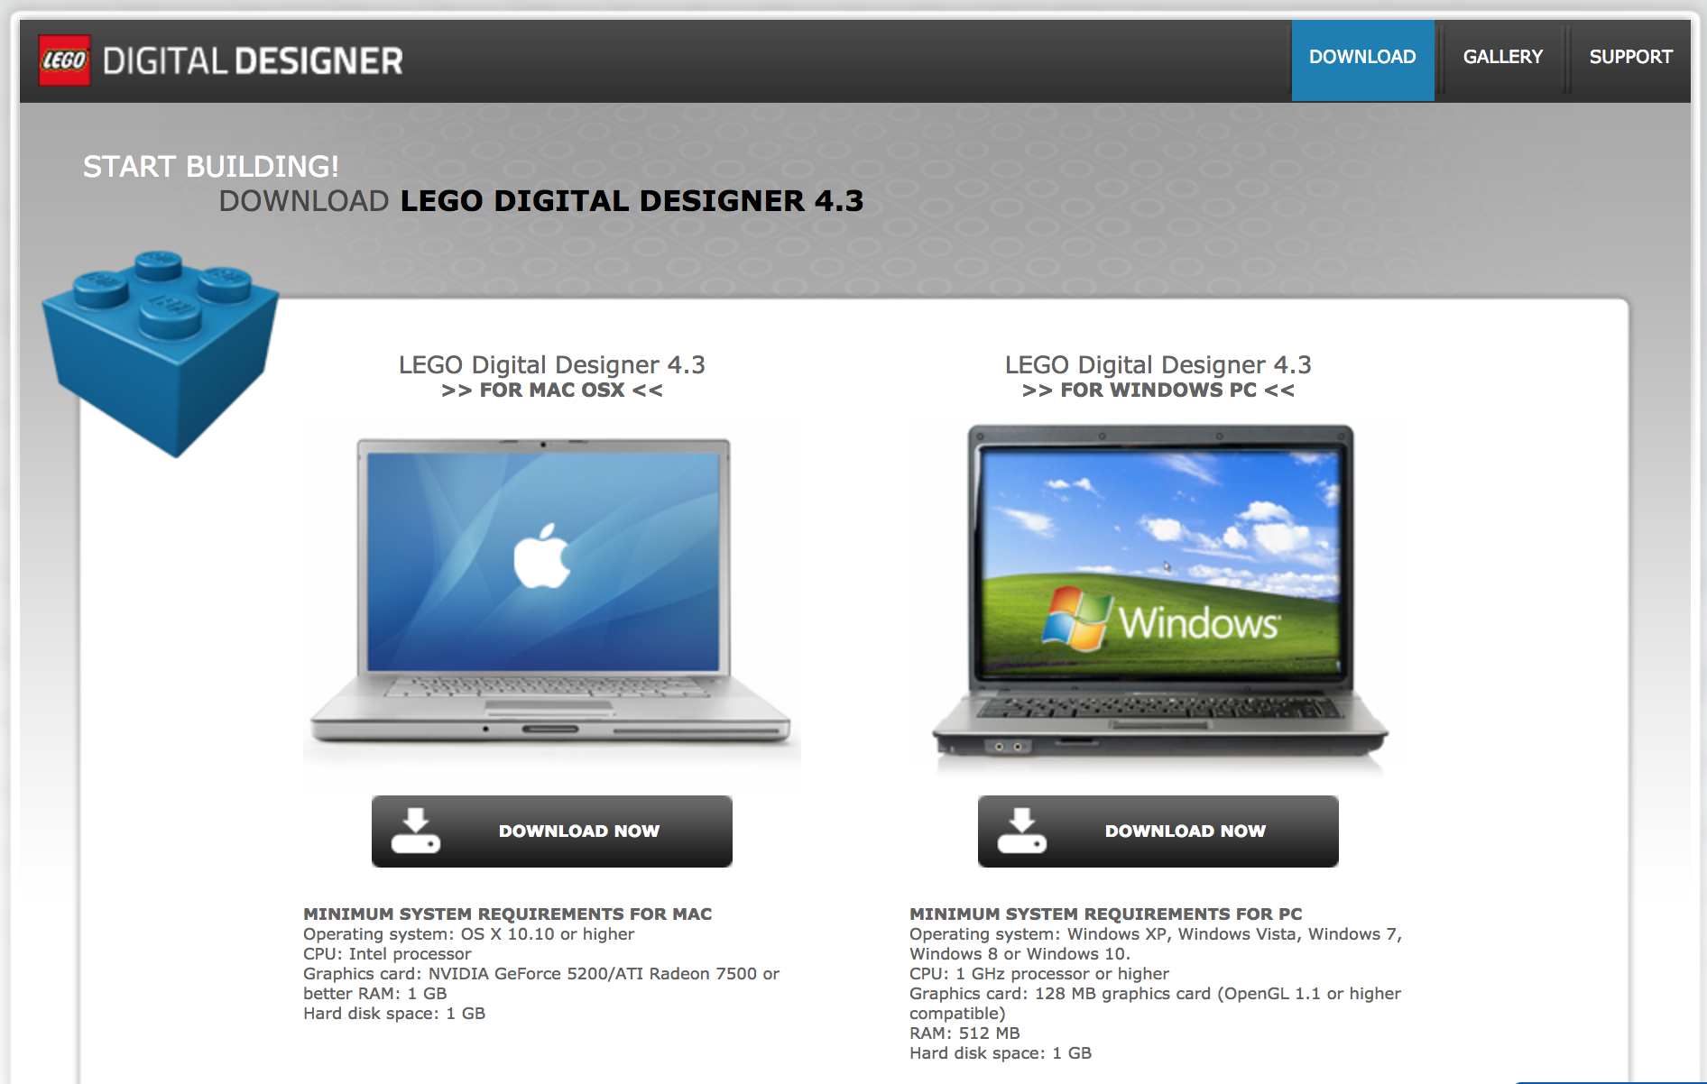
LEGO digital designer
There are many tools available for creating LEGO designs
LEGO Digital Designer (LDD) is frequently used and free to download here: http://ldd.lego.com/en-us/download
You can open .lxf files on EV3Lessons.com using this software

Slide 4

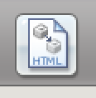
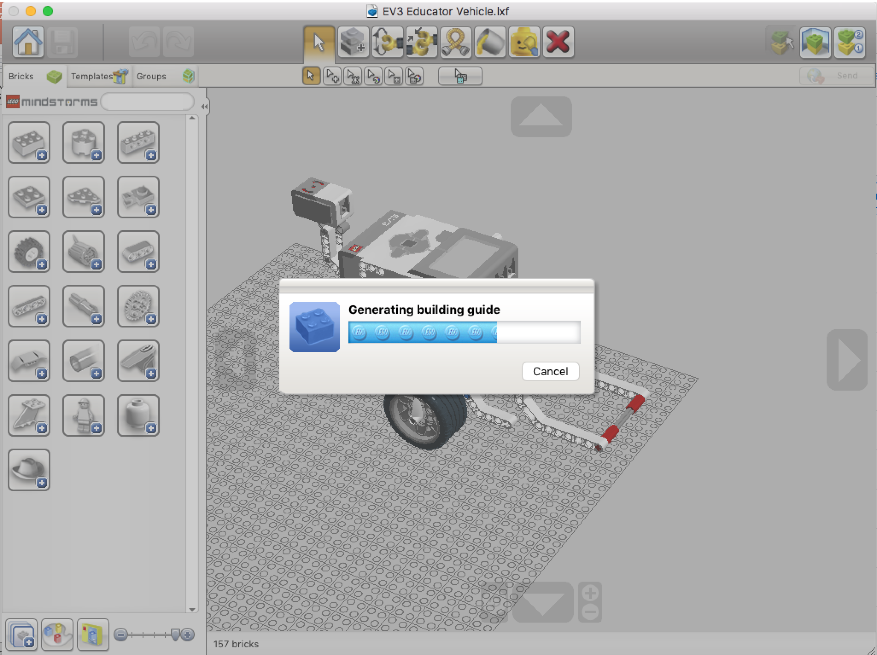
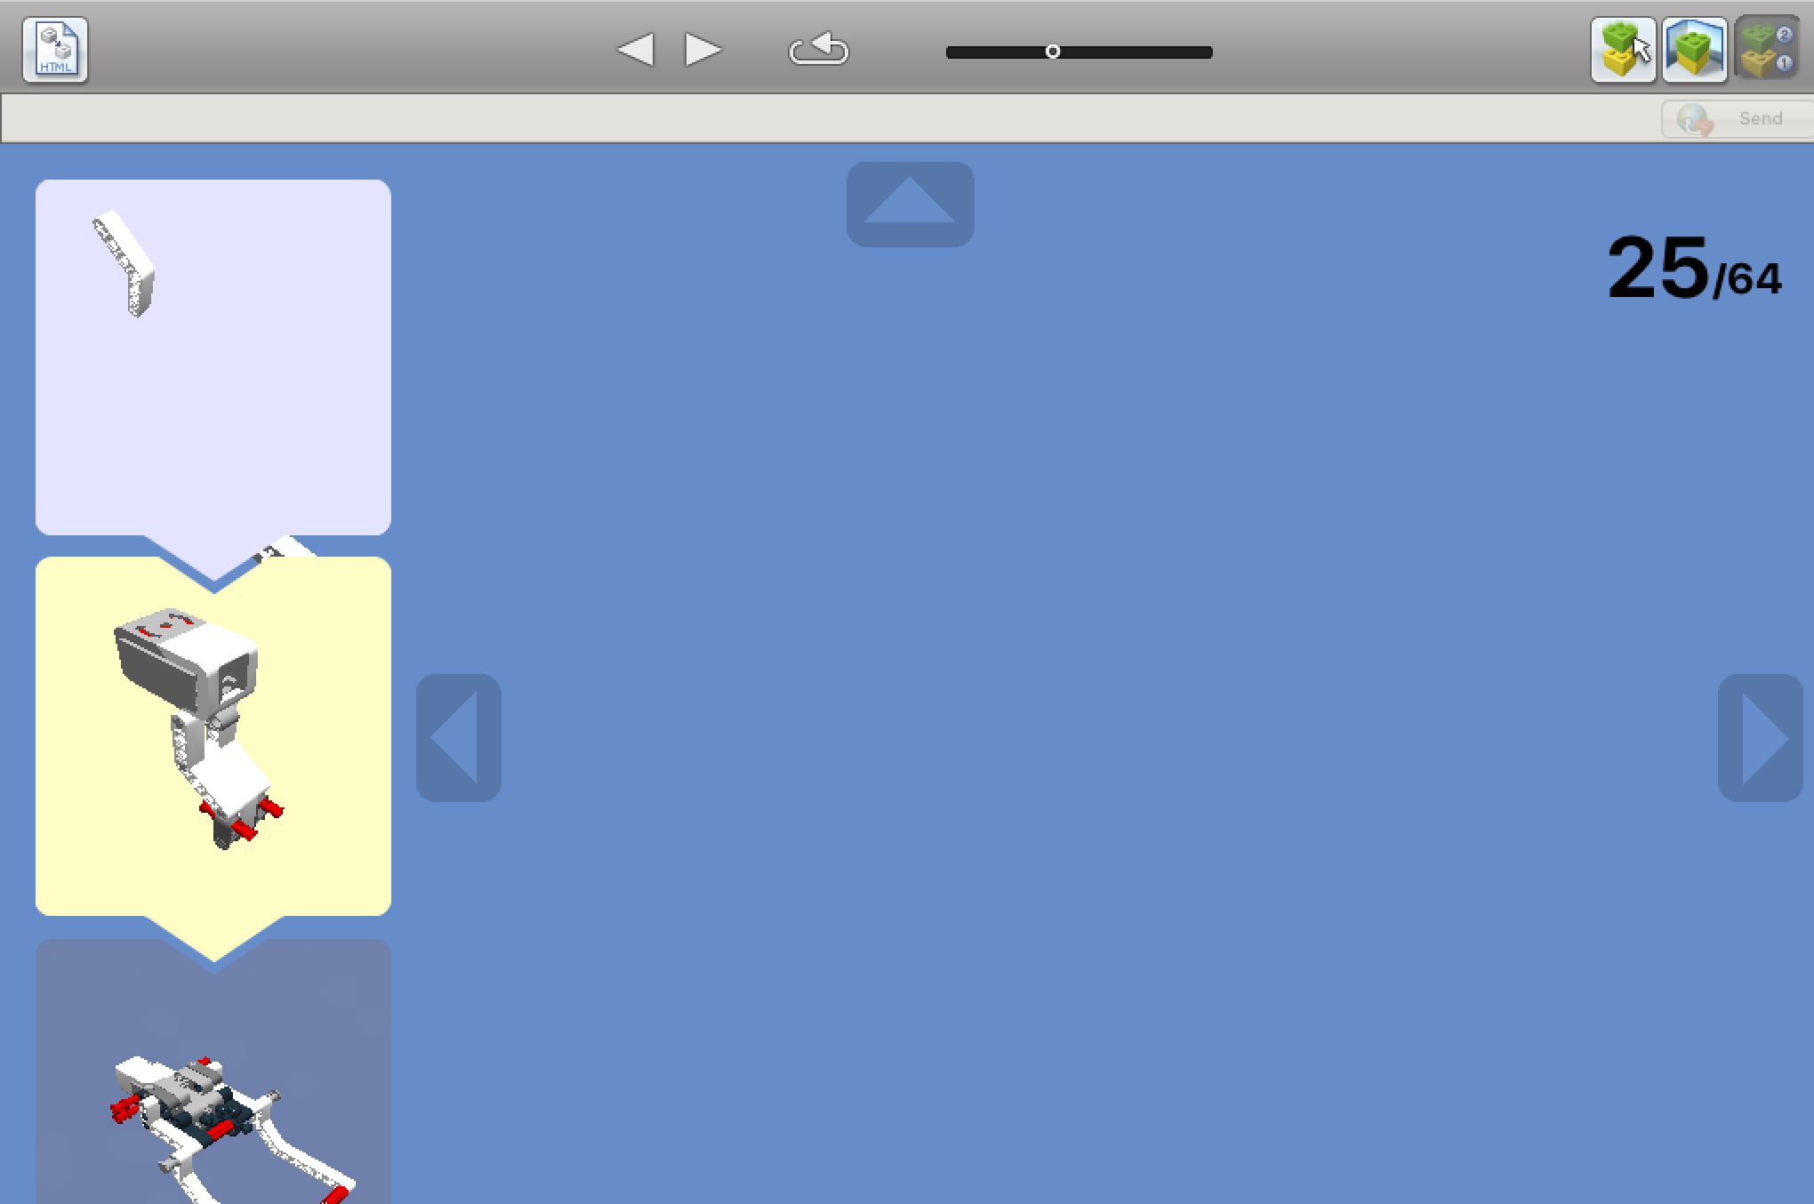
Generating HTML Building guide from .lxf files
Select Building Guide Mode Icon
Select HTML Icon
Note: Building Instructions created by LEGO Digital Designer often don’t make sense and cannot be customized

Slide 5
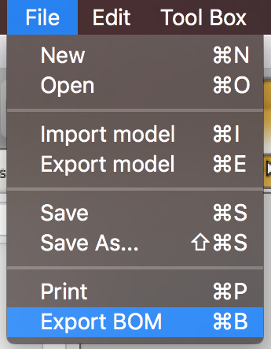
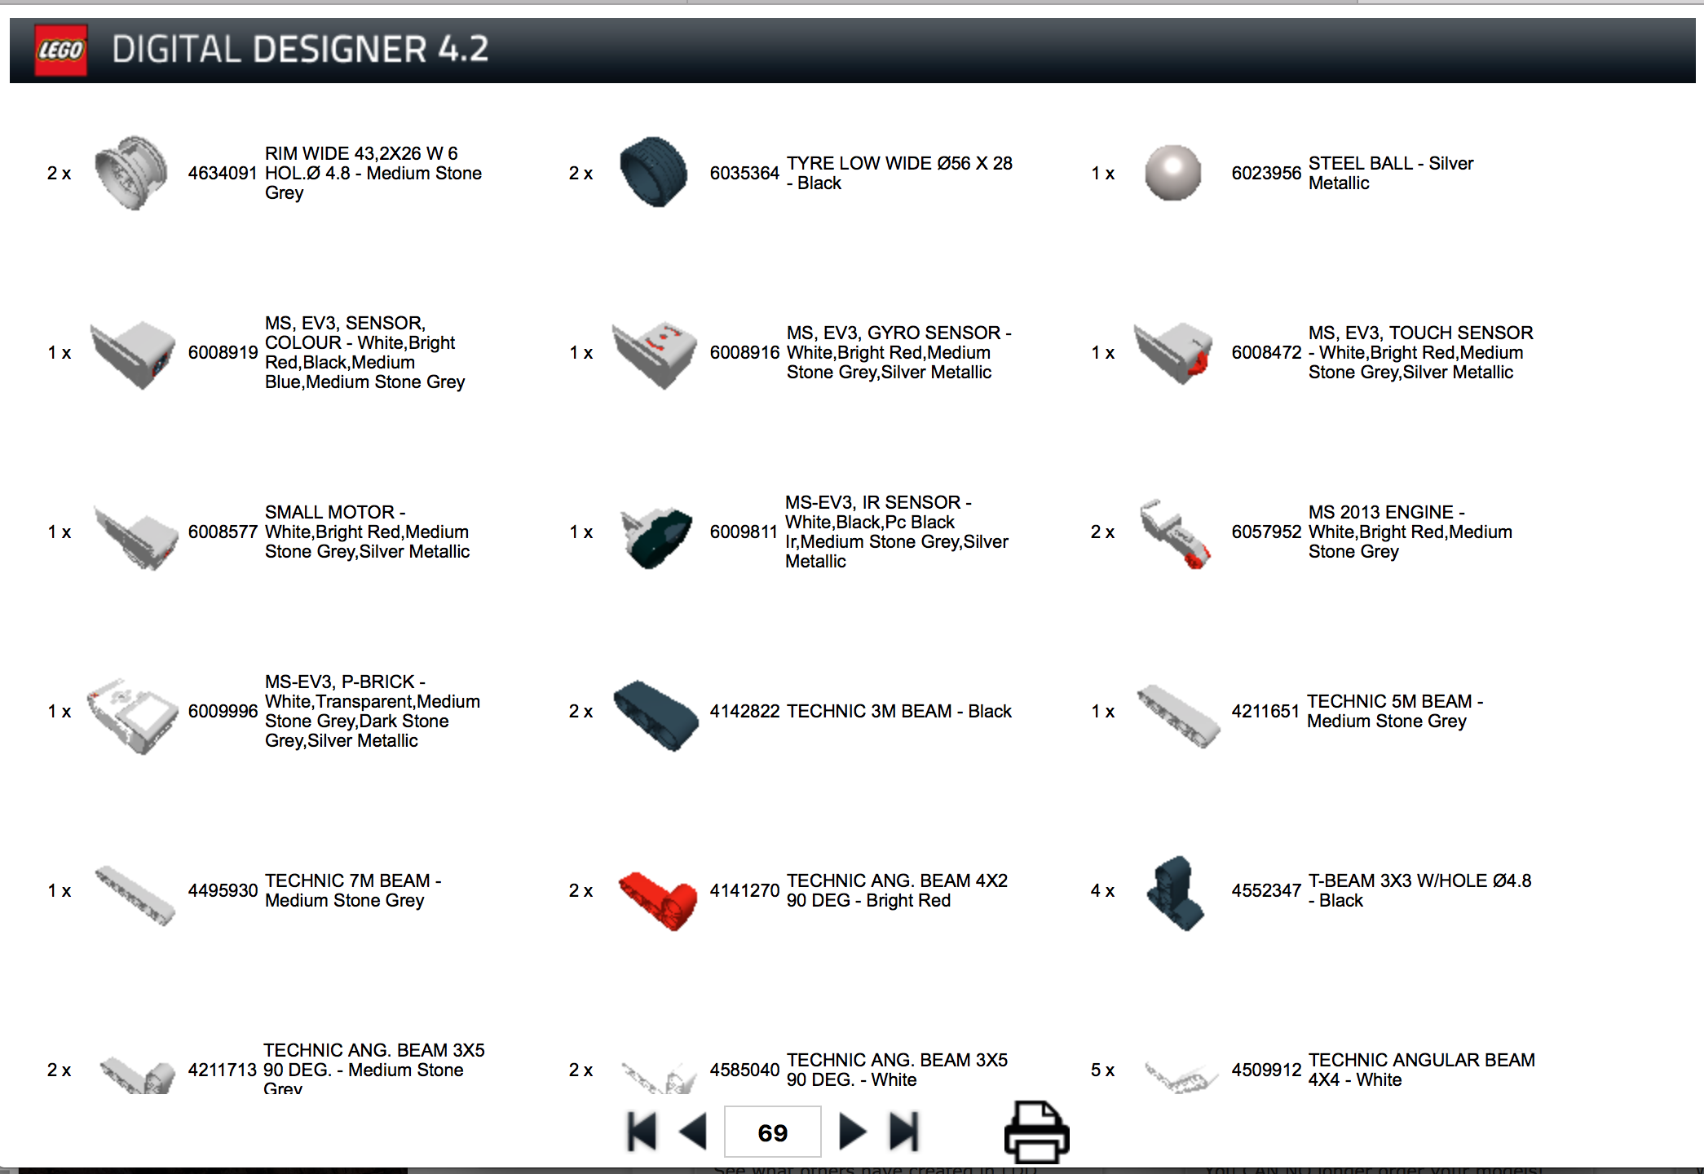
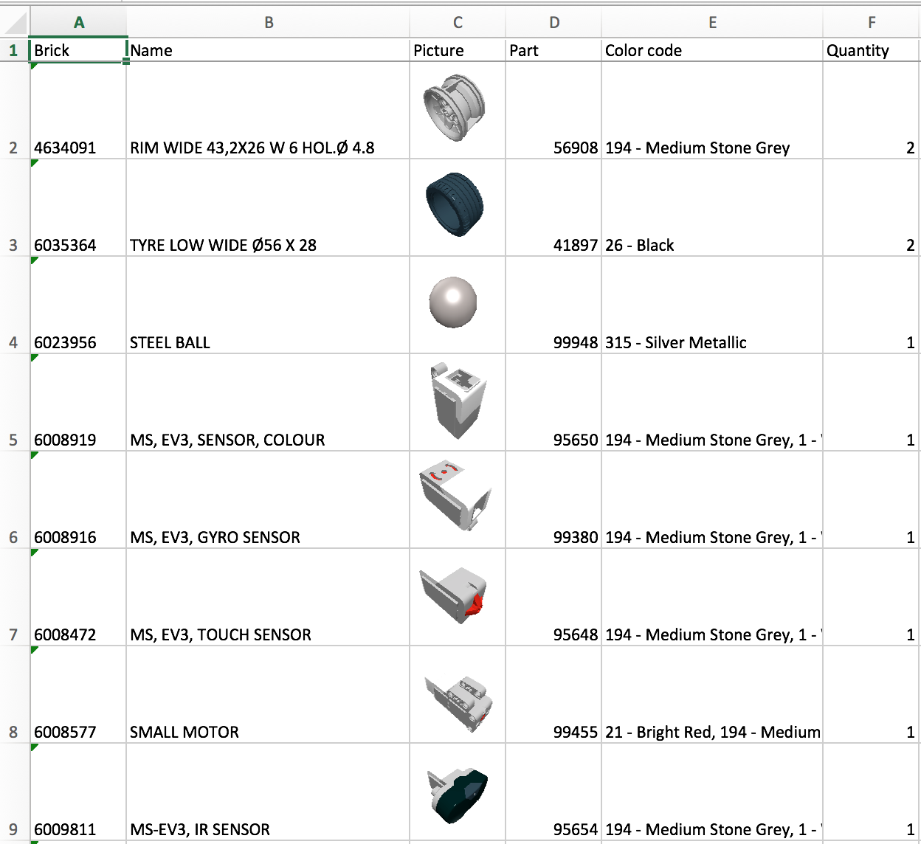
Generating a Parts List
The last page of the build instructions (HTML Building Guide mode) has a parts list
Alternatively, you can select Export BOM (Bill of Materials) from the menu

Slide 6
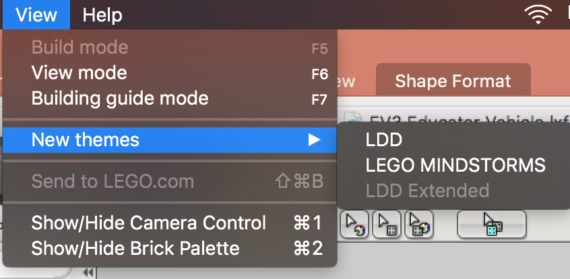
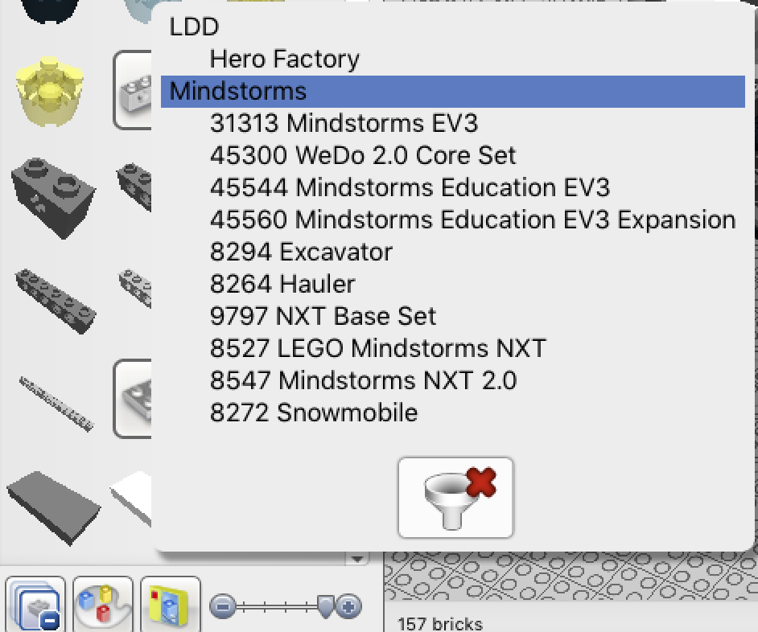
USING LDD to create mindstorms DESIGNS
TIP #1: Filtering will help you find MINDSTORMS-related parts quickly
Step 1: File —> View —> New Themes Select MINDSTORMS
Step 2: Bottom Left corner: Select “Filter Bricks by Boxes” and then select which MINDSTORMS kit you want to use.

Slide 7
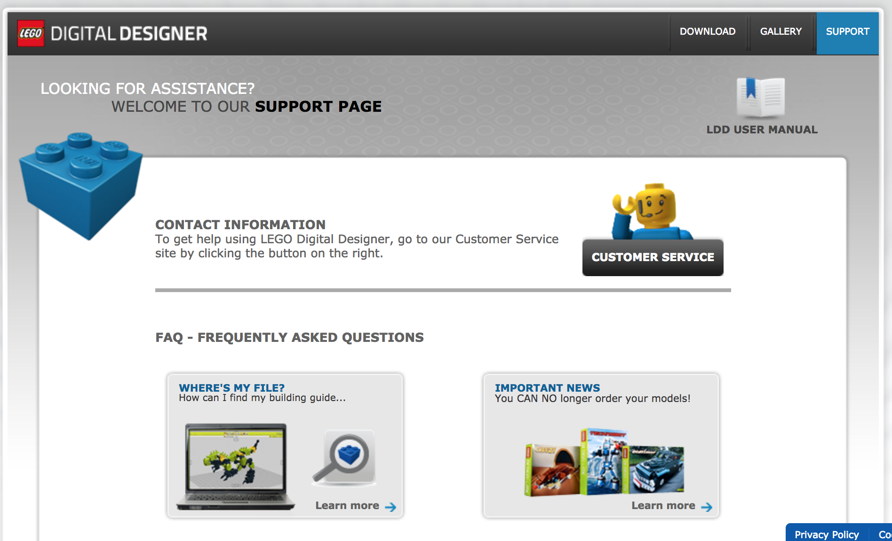
USING LDD to create mindstorms DESIGNS
TIP #2: Read the Support Manual which can be downloaded at http://ldd.lego.com/en-us/support

Slide 8
LOTS MORE TIPS & TRICKS
Virtual Robotics Toolkit Introduction to LDD Videos:
https://youtu.be/F0bunR-iBHU?list=PLH3wHnw9b170XP7HkZ6wc-FNl_7kxZOyo
https://youtu.be/-IaTwfQXmY0?list=PLH3wHnw9b170XP7HkZ6wc-FNl_7kxZOyo
Isaac Lloyd Tips & Tricks Videos:
https://youtu.be/X4c7Q0W4cDI
https://youtu.be/p-UBj76eEGA

Slide 9
Limitations with LDD
Build instructions generated by the software often seem out-of-order and do not make sense
Build instructions cannot be customized
Sometimes builds that work in the real world are not permitted in the LDD environment
Pneumatics, rubber bands and other elements often cannot be connected and placed correctly

Slide 10
Other LEGO Cad software
LDCad: http://www.melkert.net/LDCad
MLCAD: http://mlcad.lm-software.com/
LeoCAD: http://www.leocad.org/trac

Slide 11
Credits
This tutorial was created by Sanjay Seshan and Arvind Seshan
More lessons at www.ev3lessons.com
This work is licensed under a Creative Commons Attribution-NonCommercial-ShareAlike 4.0 International License.

