Slide 1

Robot DESIGN Lesson
Color Sensor Positioning and Shielding

Slide 2

WHERE SHOULD THE COLOR SENSOR BE PLACED?
According to EV3 documentation, Color Sensors work best between 4-12mm (1/2 - 1 1/2 studs) off the surface you are detecting
Note: Readings from the Color Sensor may be affected by marks, dirt, folds, bumps, and other wear and tear on the surface the robot runs on. Consider different strategies to accommodate for these situations.

Slide 3
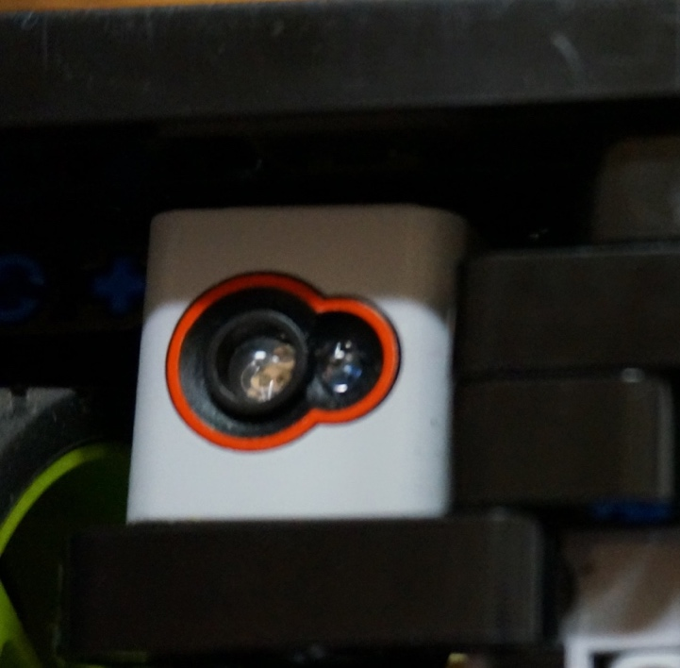
The What, Why & How of Shielding
What? Shielding refers to surrounding your Color Sensors with beams to prevent ambient light from interfering with the color sensor’s readings
Why? Shielding may improve repeatability and consistency for your robot. Shielding may be valuable if you run your robot in drastically different light settings (very sunny room, very dark room)
How? Surround the Color Sensor with beams to block external light

Slide 4
Do you really need to shield your EV3 sensors?
We conducted a test of the EV3 Color Sensor to see if shielding mattered
We connected one shielded sensor and one unshielded to the same brick
We compared the reflected light and color readings and noticed not much of a difference
We tried this experiment with a flashlight shining as well as sunlight streaming from a window.
The shielding does seem to effect the reading slightly. This is probably not much of a variation and you could do without shielding and still be reliable in most situations. However, shielding your EV3 sensor will do no harm.
We recommend that you conduct your own tests with the EV3 Color Sensor

Slide 5
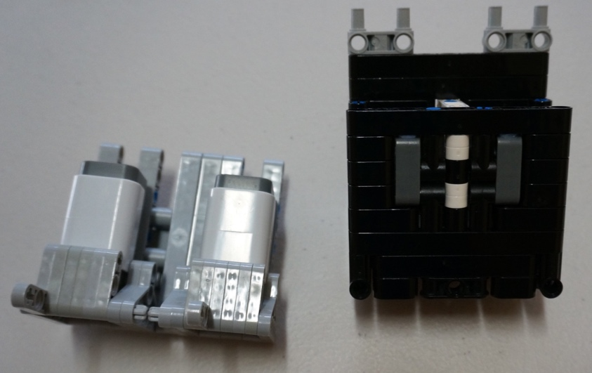
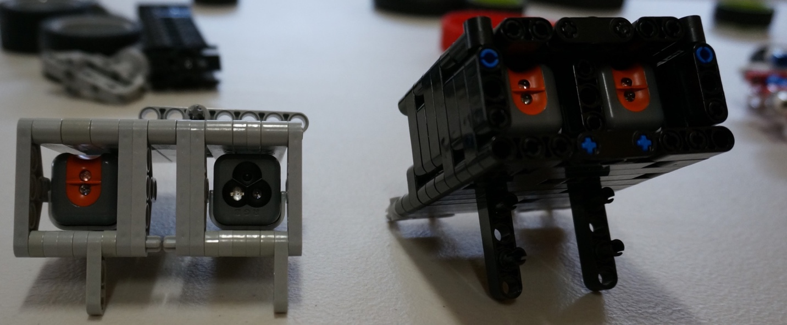
Creating Modules
You could create shielding modules around one or both of your color sensors like in the images on this page
You do not need to cover the entire sensor – only the bottom is important
Note: These images are with the NXT Color and Light Sensors

Slide 6
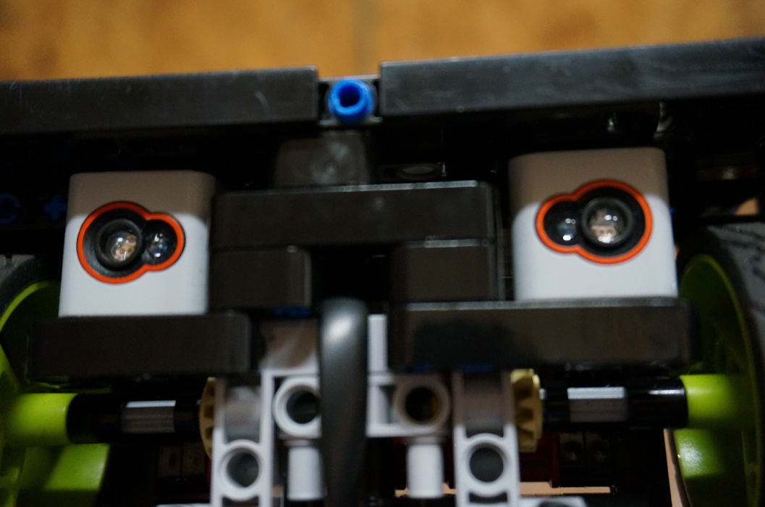
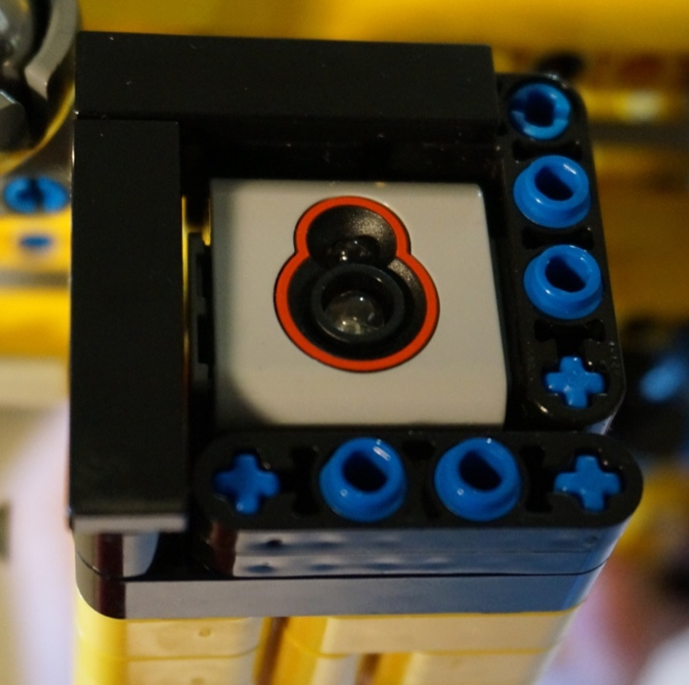
Adding smooth plates
If the shielding is low to the ground, make sure that you are not scraping the ground.

Slide 7
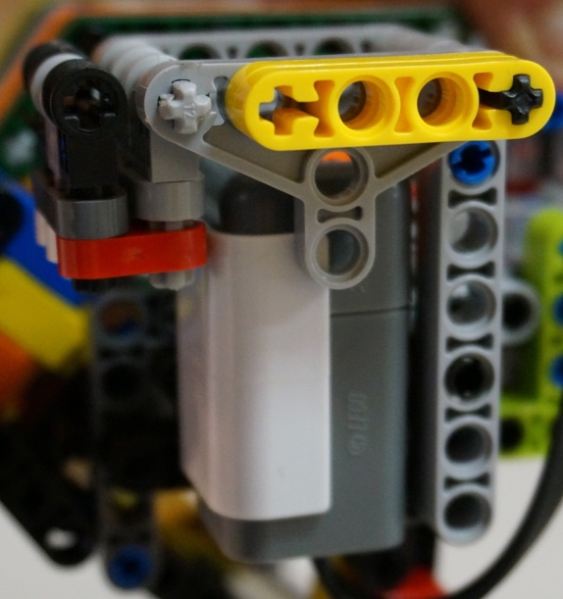
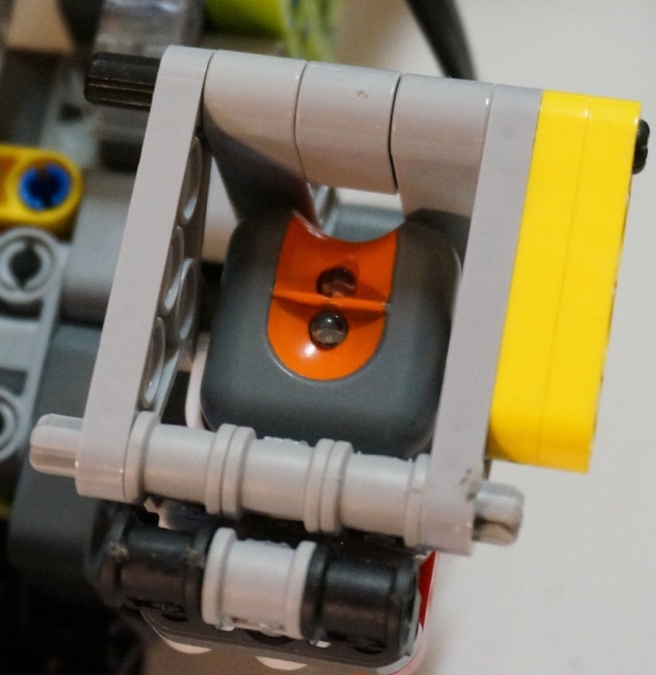
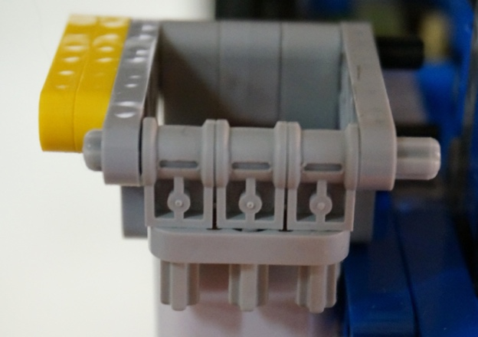
Using different parts
Experiment with different LEGO elements when you build your shield

Slide 8
Credits
This tutorial was created by Sanjay Seshan and Arvind Seshan
Images of shielded sensors provided by FTC Team 8393 The Giant Dienciphalic BrainSTEM Robotics Team
More lessons at www.ev3lessons.com
This work is licensed under a Creative Commons Attribution-NonCommercial-ShareAlike 4.0 International License.

